Slide 1
CHRISTIANITY
Beliefs

Slide 2
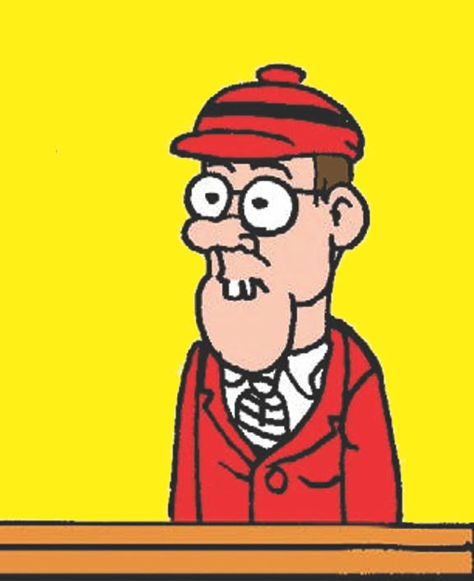
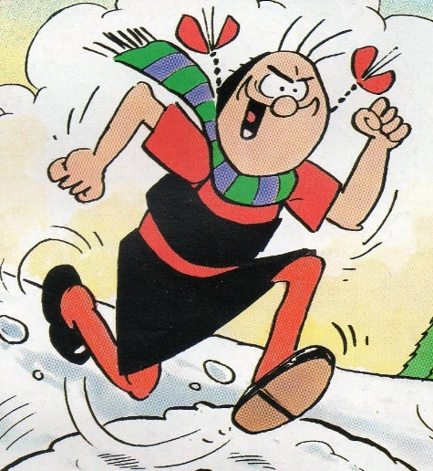
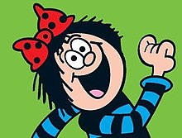
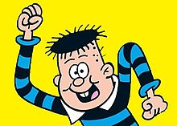
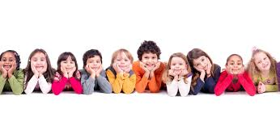
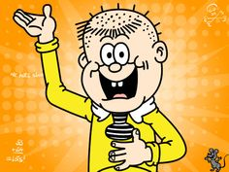
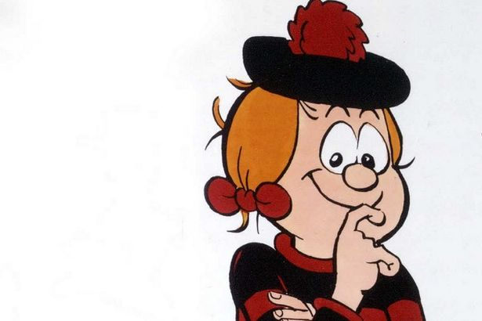
Some Basic Beliefs About
God
https://kidstalkaboutgod.org/interviews/tv-interviews/

Slide 3
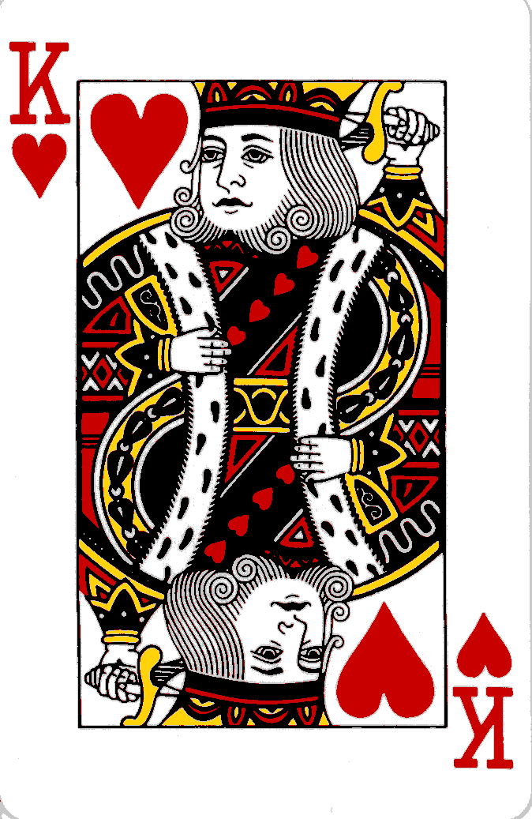
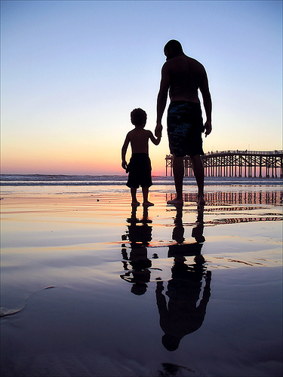
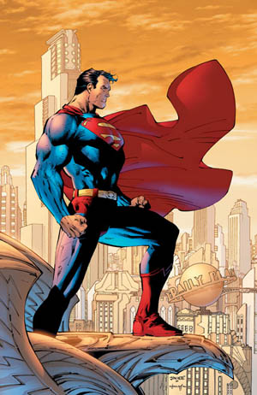
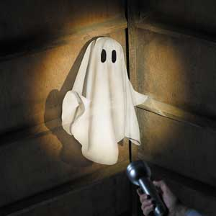
HOW DO CHRISTIANS VIEW GOD?
+
CREATOR?
WIZARD?
SAVIOUR?

Slide 4
CHRISTIANITY - KEY WORDS
CREED | INCARNATE | ATONEMENT | THE FALL
GOSPELS | MESSIAH | EVANGELISM | ASCENSION
SALVATION | GRACE | REDEMPTION | ESCHATON

Slide 5
The official definition of
God
GOD IS…
__________________ which means ____________________________
__________________ which means ____________________________
__________________ which means____________________________
__________________ which means ____________________________
__________________ which means ____________________________
?

Slide 6
The answers…

Slide 7
GOD IS…
Omnipotent which means all-powerful.
Omnisicent which means all –knowing.
Omni-benevolent which means all – loving.
Eternal which means everlasting (no beginning and no end).
Perfect which means faultless.

Slide 8
Christianity is known as a _______________ religion because it teaches that there is only _______________ God. They believe God is _______________ and exists outside _____________. The word for this is ______________. Time is part of the ____________ that God ______________. He is in control of both ____________ and ____________. God is able to see the ____________, the ______________ and the _____________. Existing outside space and time means he is ______________ and above all created things.
one
atemporal
time
time
lard
space
created
transcendent
present
world
future
eternal
past
monotheistic

Slide 9
Christianity is known as a _______________ religion because it teaches that there is only _______________ God. They believe God is _______________ and exists outside _____________. The word for this is ______________. Time is part of the ____________ that God ______________. He is in control of both ____________ and ____________. God is able to see the ____________, the ______________ and the _____________. Existing outside space and time means he is ______________ and above all created things.
one
atemporal
time
time
lard
space
created
transcendent
present
world
future
eternal
past
monotheistic

Slide 10
Christianity also teaches that God is _______________, meaning He is ____________ with the __________ and human____________. By acting in this way God shows His ______________ (love and ___________ towards __________) and His ______________. In the Bible, God is often shown to have relationships with ____________ through __________, ___________ and the presence of the ____________ ____________. So Christianity understands Him to be a ______________ God.
benevolence
people
visions
Spirit
involved
immanent
world
Holy
humans
sandwich
beings
judgement
kindness
prayers
personal

Slide 11
Christianity also teaches that God is _immanent___, meaning He is ___involved_________ with the _world_________ and human_beings___. By acting in this way God shows His _benevolence___ (love and _kindness___ towards _humans___) and His _judgement____. In the Bible, God is often shown to have relationships with _people___________ through _prayers_________, _visions__________ and the presence of the __holy___ __spirit__________. So Christianity understands Him to be a _personal_____________ God.

Slide 12
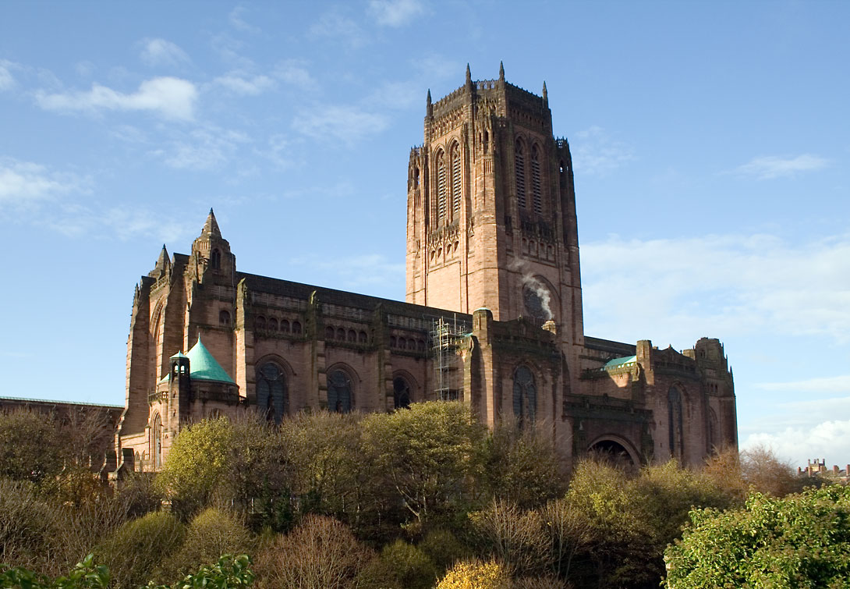
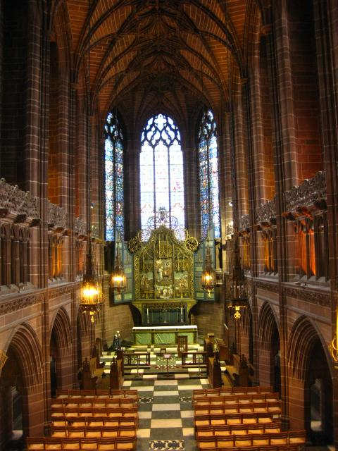

Slide 13
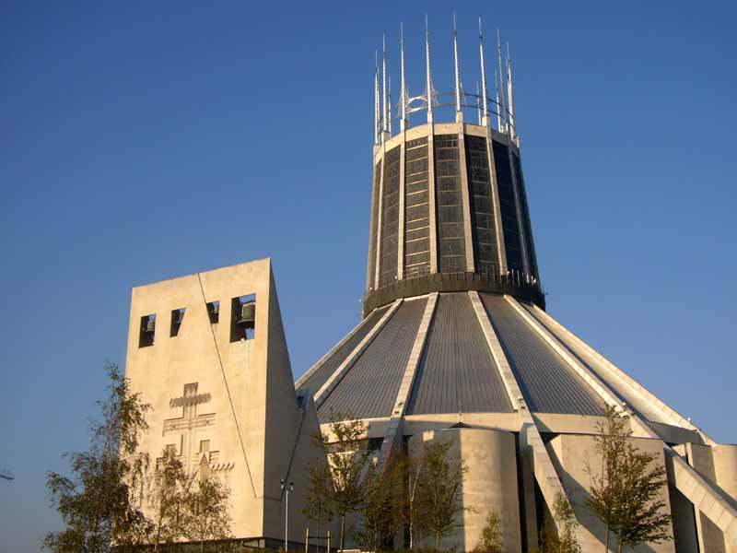
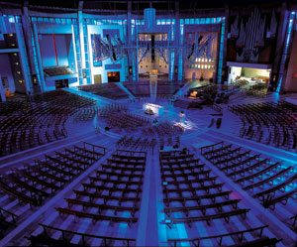

Slide 14
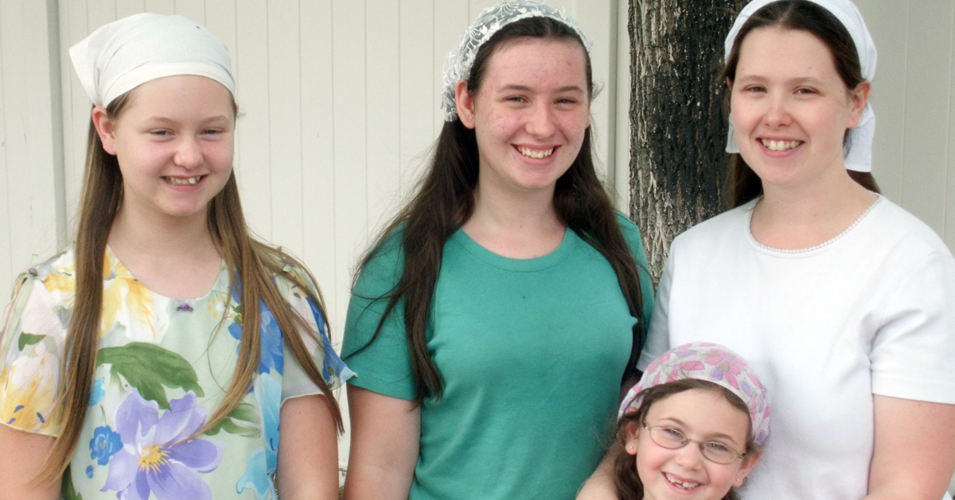
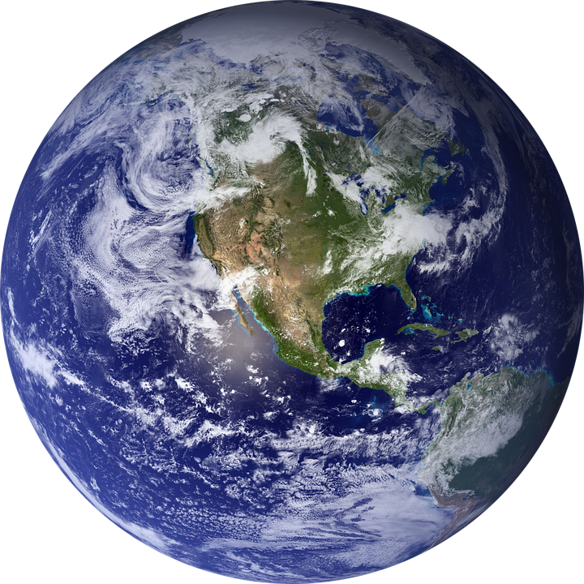
-l-m-u-h B-e-h-e-
A-i-h
What are your thoughts about these pictures?
Holy
Pure
Do not love the world or anything in the world. If anyone loves the world, love for the Father is not in them…the world and its desires pass away, but whoever does the will of God lives forever.

Slide 15
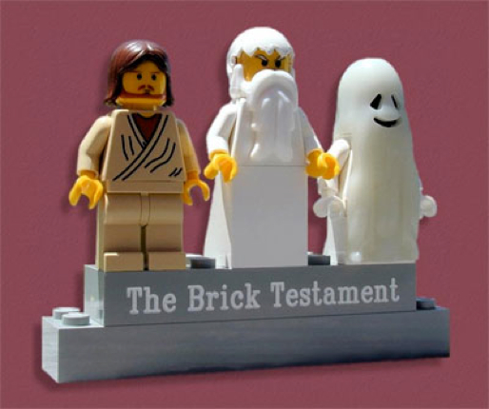
THE HOLY TRINITY
FATHER
SON
HOLY SPIRIT

Slide 16
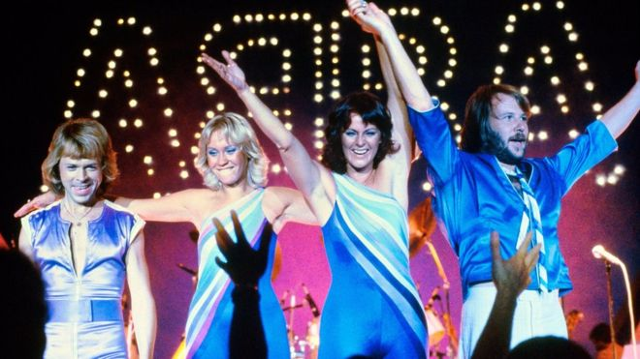
GOD THE FATHER
loving
creator - makes things
protector
discipline
("wait till your father gets home!")

Slide 17
GOD THE SON
Jesus is called the “Son Of God.” He represents God coming to earth as a man. He showed people how to behave. He took the blame for the sins of humanity and died on the cross.
understands humans
vulnerable
selfless
forgiving
tempted

Slide 18
GOD THE HOLY SPIRIT
BEYOND DEATH
PEACE
LIVING WITHIN HUMANS
SUPERNATURAL
PARACLETE.
(Not parakeet!)

Slide 21
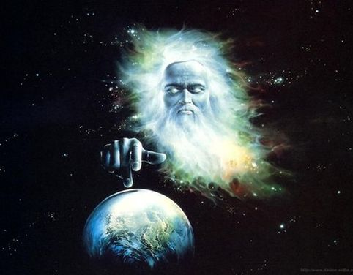
The Biblical Creation
Story
IES!

Slide 22
What do you already know about the Creation story in the bible?
Two Stories
Hebrews
Nomadic
Identity
Priests
Notes:
Discuss the background to the six day story of creation. Explain that it is (chronologically) the second creation story in the bible, even though it appears first.

Slide 23
1

Slide 24
Notes:
Students should read through the seven day creation story in the bibles. They should draw pictures of the events of each of the six days in their books, writing in what was created in the spaces below.

Slide 25
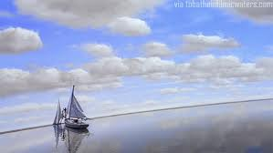
IMPORTANT POINTS
Existing beliefs about the world:
- it was flat
- the sky was a solid dome
- the land was at the centre of the world
- humans were the most important thing in the world

Slide 26
IMPORTANT POINTS
God created the world
God was in total control.
Everything was GOOD – (God cannot do bad).
God created “out of nothing”.
Humans were created last
Humans are the most important creation
The 7th day set aside for meeting and prayer.
At the time...
The Hebrews were worried about their “out of control” existence.
Scared that bad things were happening.
Felt unimportant.
Needed to be brought together regularly.

Slide 27
2

Slide 28
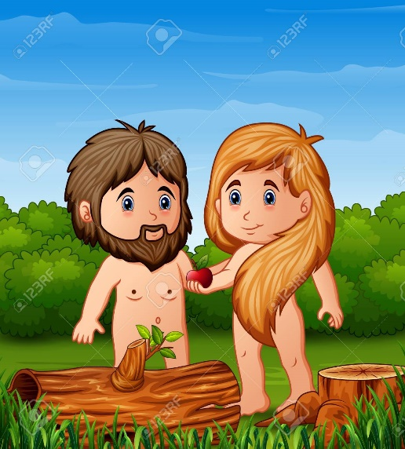
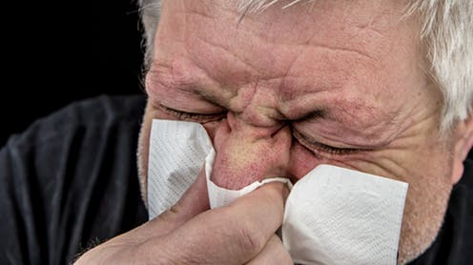
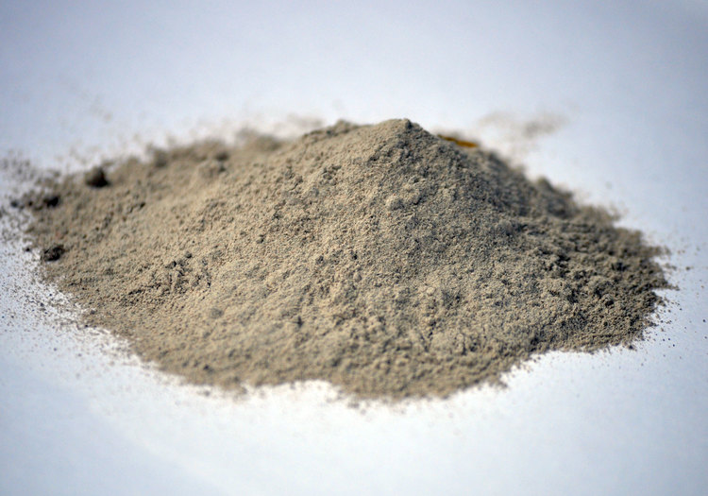
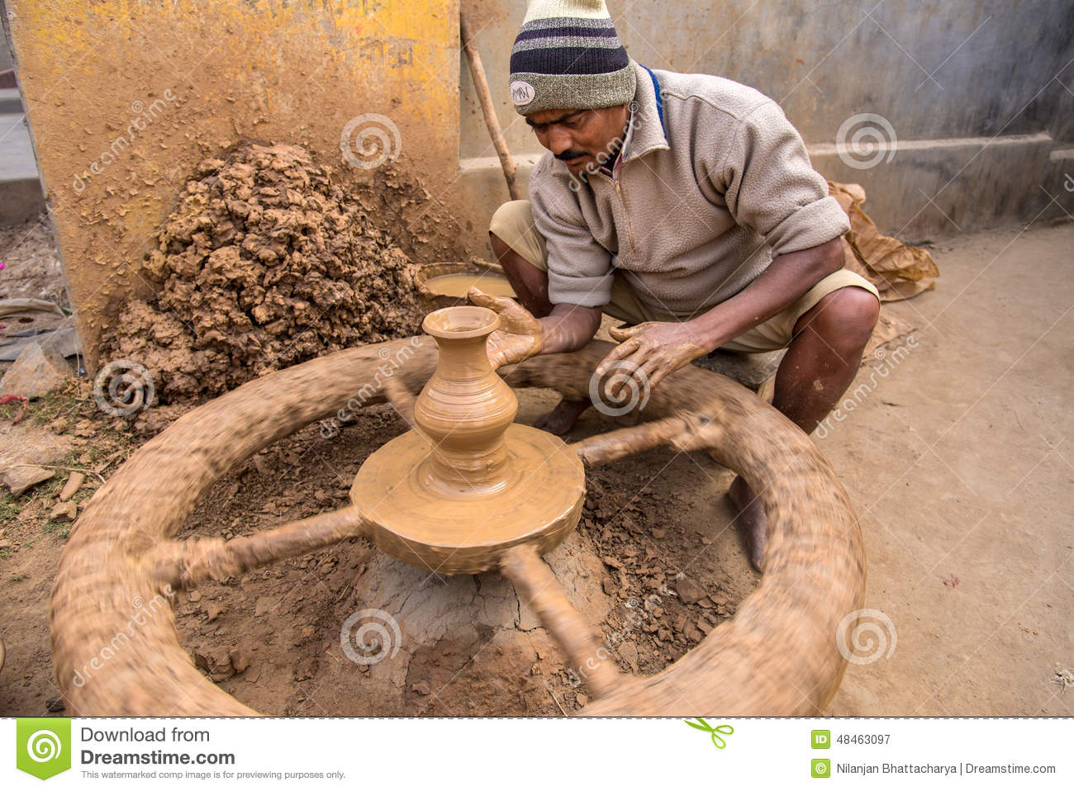
Adam = Humanity
Eve = Beginning

Slide 29
3(ish)

Slide 30
Ho
Logos
Jesus
Christ
JOHN CHAPTER 1

Slide 31
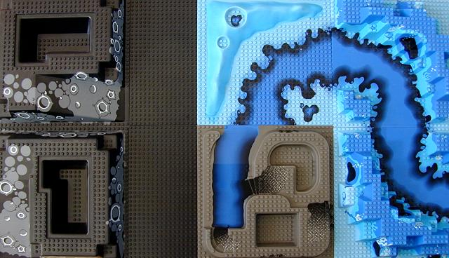
Genesis 1:1, 2:4-6 In the beginning, God created the heavens and earth. No plant or shrub had yet sprung up, for Yahweh God had not sent rain upon the earth, and there was no one to till the soil. Moisture would well up from the earth and water the surface of the ground

Slide 32
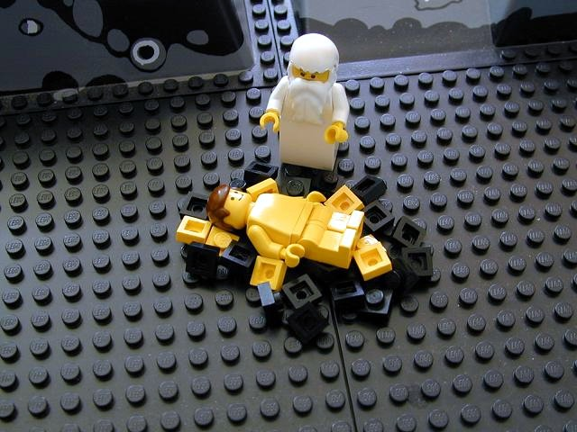
Genesis 2:7 Yahweh God formed man from the soil of the ground

Slide 33
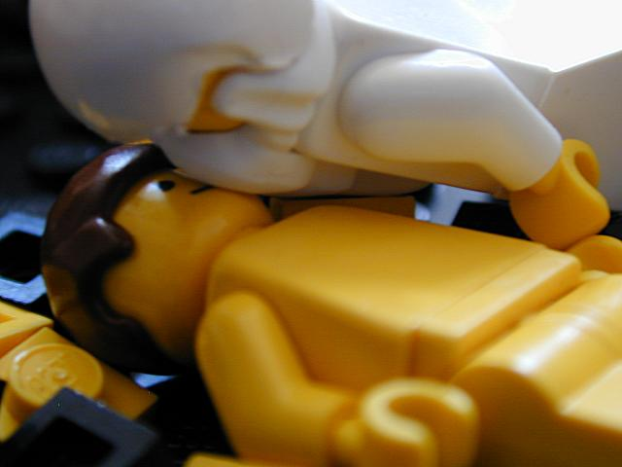
Genesis 2:7 And breathed into his nostrils the breath of life

Slide 34
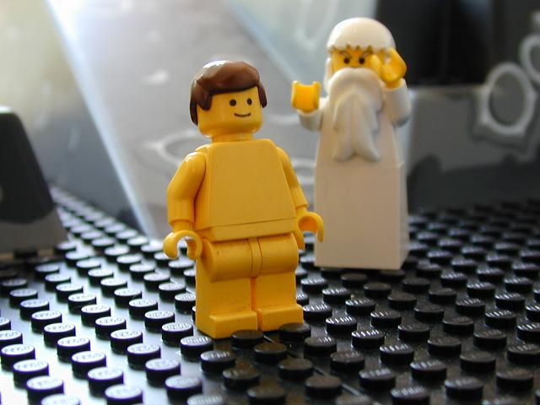
Genesis 2:7 And man became a living creature.

Slide 35
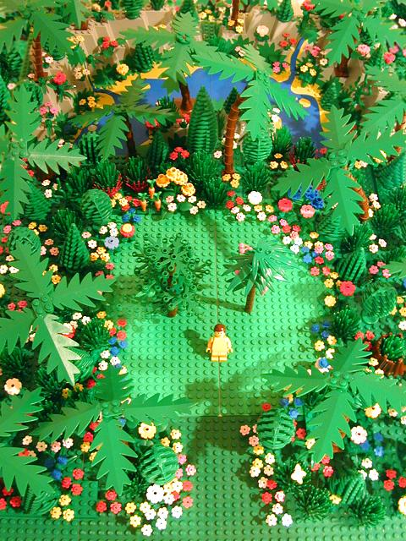
Genesis 2:8-9 Yahweh God planted a garden in Eden, and there he put the man he had formed. Yahweh God caused to sprout every tree that is pleasing to look at and good for food, with the tree of life in the middle of the garden and the tree of knowledge of good and evil

Slide 36
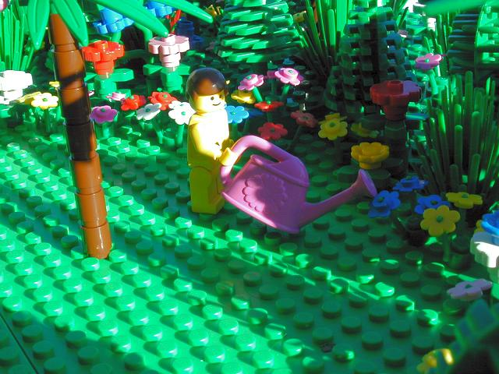
Genesis 2:15 Yahweh God took the man, and put him in the garden of Eden to look after and maintain it.
Genesis 2:15 Yahweh God took the man, and put him in the garden of Eden to look after and maintain it.

Slide 37
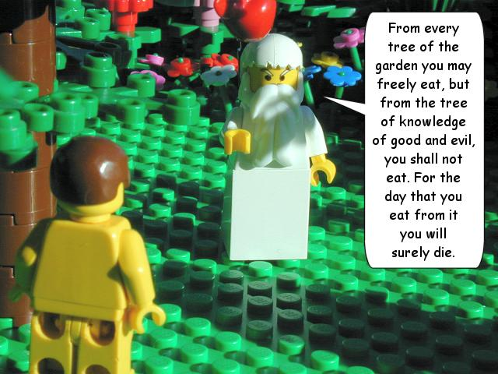
Genesis 2:16-17

Slide 38
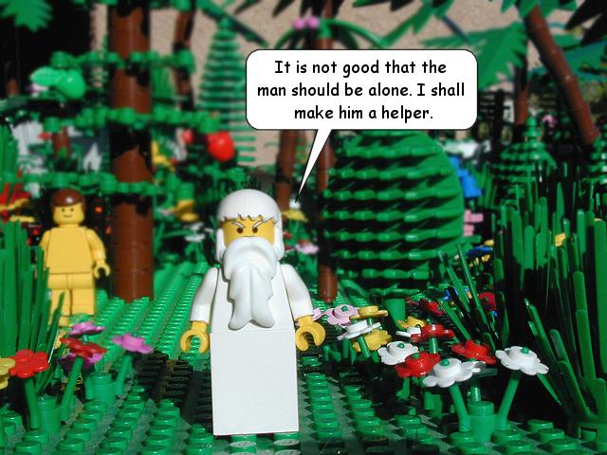
Genesis 2:18

Slide 39
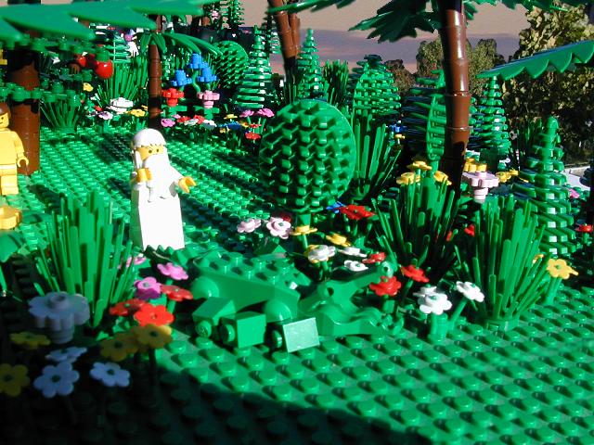
Genesis 2:19 From the ground Yahweh God formed every animal of the field and every bird of the sky.

Slide 40
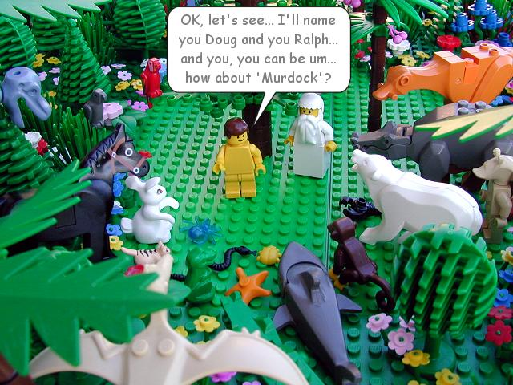
Genesis 2:19-20 He brought them to the man to see what he would call them. Whatever the man called every living creature, that was its name. The man gave names to all the cattle, every bird of the sky, and every animal of the field. But no suitable helper was found for the man

Slide 41
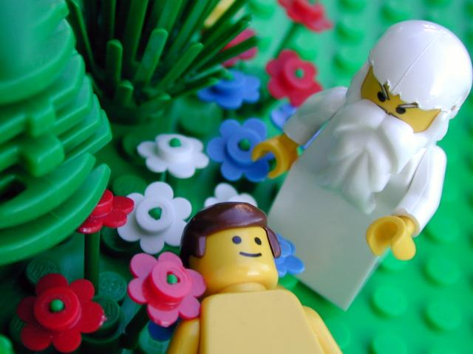
Genesis 2:21 Then Yahweh God caused a deep sleep to fall on the man

Slide 42
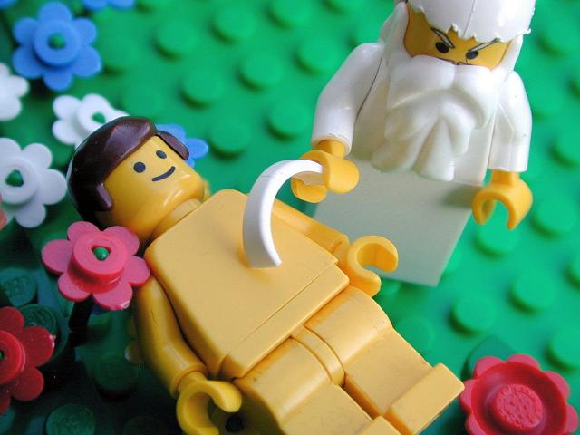
Genesis 2:21 And as he slept, Yahweh God took one of his ribs, and closed up the flesh in its place

Slide 43
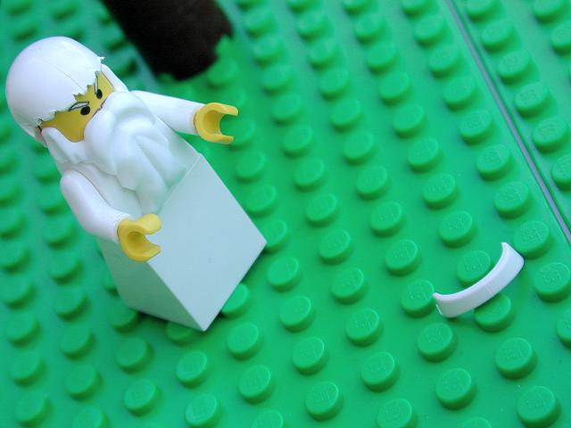
Genesis 2:22 And from the rib which Yahweh God had taken from the man…

Slide 44
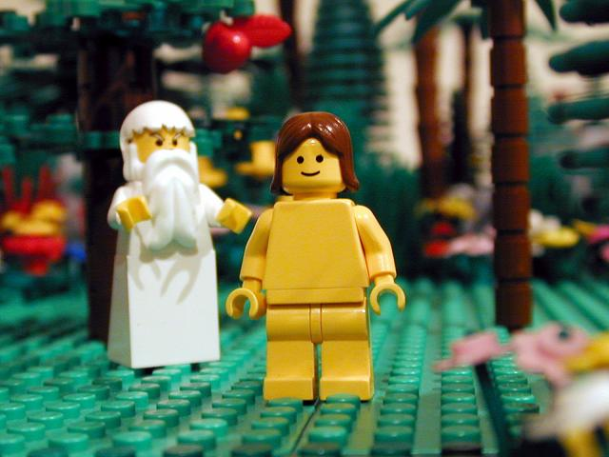
Genesis 2:22 ...he made a woman, and brought her to the man

Slide 45
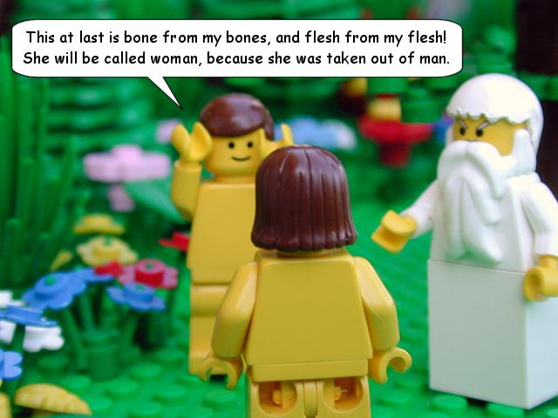
Genesis 2:23

Slide 46
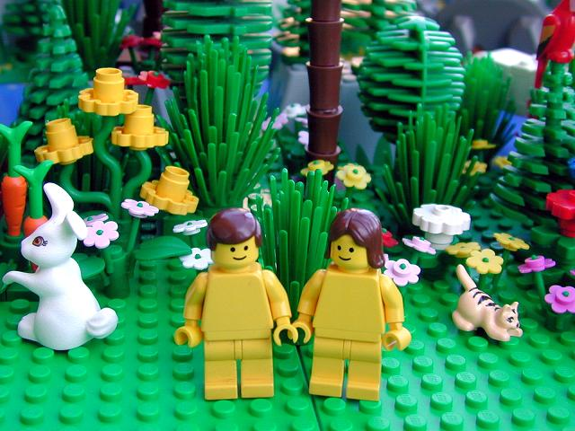
Genesis 2:25 And the man and his wife were both naked and were not ashamed
Genesis 2:25 And the man and his wife were both naked and were not ashamed

Slide 47
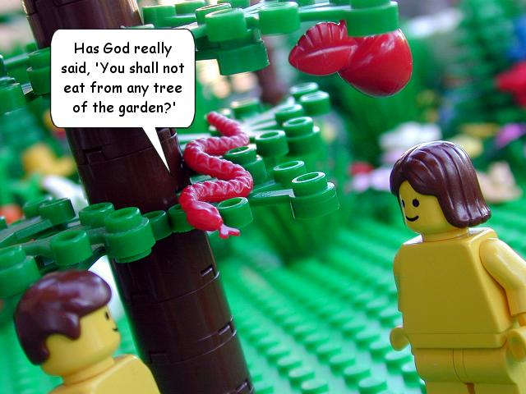
Genesis 3:1 Now the snake was the shrewdest of any animal of the field which Yahweh God had made…

Slide 48
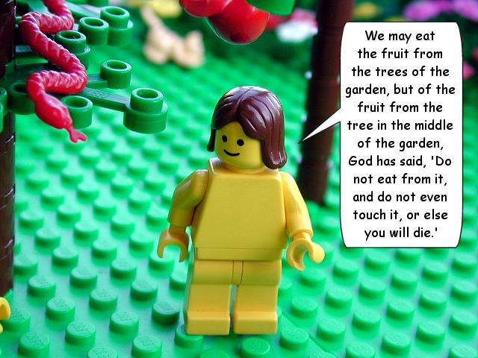
Genesis 3:2-3

Slide 49
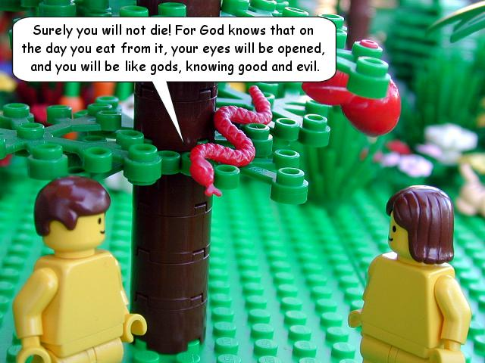
Genesis 3:4-5

Slide 50
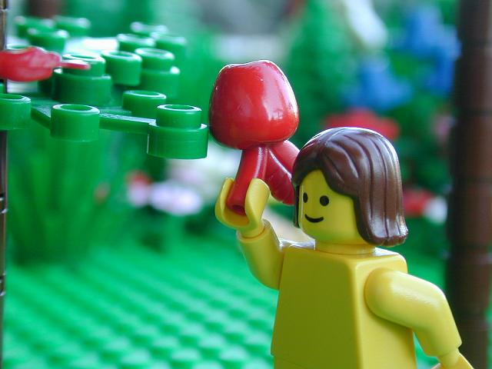
Genesis 3:6 The woman saw that the tree was good for food, pleasing to the eyes, and desirable for the knowledge it could give, and she took fruit from it…

Slide 51
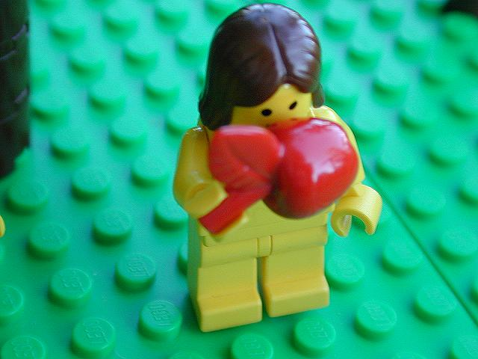
Genesis 3:6 And ate it…

Slide 52
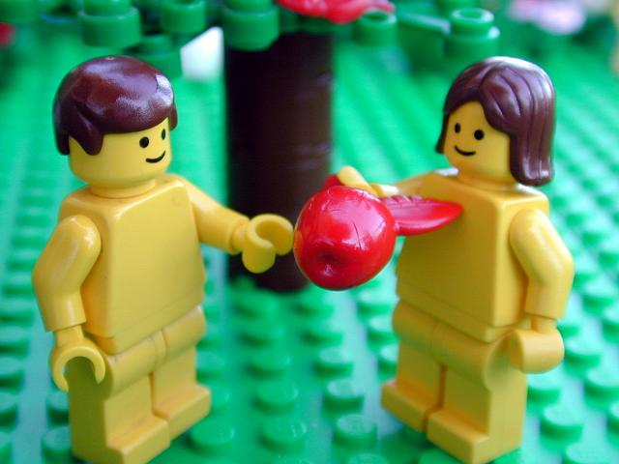
Genesis 3:6 She gave some to her husband who was with her…

Slide 53
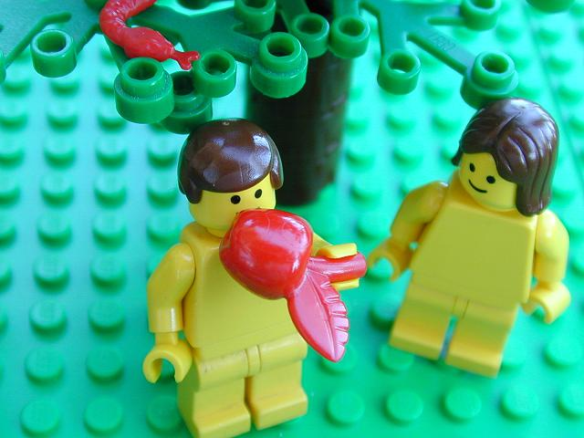
Genesis 3:6 And he ate it…

Slide 54
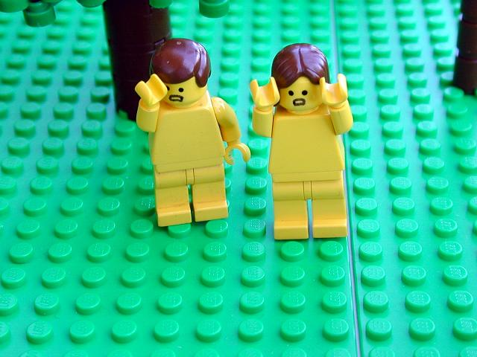
Genesis 3:7 The eyes of both them were opened, and they knew that they were naked

Slide 55
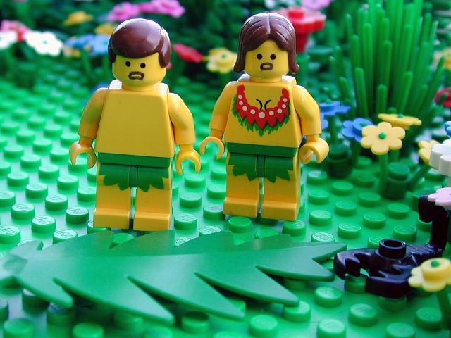
Genesis 3:7 They sewed fig leaves together, and made themselves loincloths

Slide 56
Genesis 3:8 They heard the voice of Yahweh God walking in the garden in the cool of the day, and the man and his wife hid themselves from Yahweh God among the trees of the garden…

Slide 57
Genesis 3:9

Slide 58
Genesis 3:10

Slide 59
Genesis 3:11

Slide 60
Genesis 3:12
Genesis 3:12

Slide 61
Genesis 3:13

Slide 62
Genesis 3:13

Slide 63
Genesis 3:14-15

Slide 64
Genesis 3:16

Slide 65
Genesis 3:17-19

Slide 66
Genesis 3:21 Yahweh God made leather garments for the man and his wife, and clothed them

Slide 67
Genesis 3:22-23 Yahweh God sent him away from the garden of Eden, to till the ground from which he was taken

Slide 68
Genesis 3:24 He drove the man away and stationed cherubs at the east of the garden of Eden, and a flaming sword which turned every way, to guard the way to the tree of life

Slide 69
What Sort Of World Are
We Living In?
Notes:
Pupils have a couple of minutes to answer this question. Write their responses on the board.

Slide 70
Notes:
Hurricane Harvey

Slide 71
Notes:
North Korea nuclear missile tests.

Slide 72
Notes:
Charlottesville riots

Slide 73
Notes:
Fatal M1 crash

Slide 74
Notes:
Brucie is dead.

Slide 75
Notes:
UK prisons now overcroded

Slide 76
Notes:
1 in 4 children in the UK are now living in poverty – figure is much higher globally.

Slide 77
Notes:
East Sussex beach-goers overwhelmed by noxious chemical fumes

Slide 78
GOOD THINGS THAT HAPPENED TO ME OVER THE WEEK | BAD THINGS THAT HAPPENED TO ME OVER THE WEEK
Notes:
Individual work – pupils to create lists of good and bad things that happened to them over the summer (they do not have to share if they don’t want to). Once pupils have finished this work ask them to decide whether, on balance, their summer was good or bad. They should take into account number of good v bad events and also their duration, long-term effect, how happy or sad they were made to feel etc. Once they have done this, ask those who think the summer was bad to stand on one side of the room, and those who think that the summer was good to stand on the other side. Explain that there can be no middle ground – they must choose one side or the other.

Slide 79
GROUP WORK
In small groups you must come up with a simple argument to say whether you think the world is good or bad. You must have a completed, agreed answer. You must have reasons behind your answer. You must examples from real life to back up your reasons.
Notes:
Try to create groups containing mixes of pupils from both sides of the room. Groups should be no more than four pupils and no fewer than three. Give them five to ten minutes to come up with their answers. Then listen to each group’s feedback.

Slide 80
R
E

Slide 81
?

Slide 82
So what exactly is “EVIL”?
Evil is…

Slide 83
MORAL | NATURAL

Slide 84
The Problem Of Evil & Suffering
Life is nasty!

Slide 85
Omni-benevolent
God is….
Omniscient
Eternal
Omnipotent

Slide 86
Evil exists
The Inconsistent Triad
God is
omnipotent
God is
omnibenevolent

Slide 87
This proves there cannot be a god!
I’ve obviously done something to upset god.
God must be testing me, I’d better love Him even more!
Which is the best response?

Slide 88
Who Was St Augustine
Of Hippo?
A very influential bishop from North Africa.
Lived from 13th November 354 to 28th August 430
Completely changed the course of the Christian religion and is responsible for much of the Roman Catholic dogma – eg Original Sin
Had some issues with sex.
Created a theodicy to suggest that evil and suffering is the result of god giving humans free will.

Slide 90
Theodicy Corner
A “theodicy” is a response to The Problem Of Evil And Suffering.
God made a perfect creation that had no evil in it. Evil is, in fact, the absence of goodness. It is when something good goes wrong. When Adam and Eve made a bad use of their free will by eating the forbidden fruit, evil entered God’s perfect creation.

Slide 91
Augustine’s theodicy
Augustine starts from the assumption that god is wholly, completely and utterly good. He also created a world completely free from defects. Suffering and evil where unknown.
Therefore it is not possible for god to be responsible for evil. It wasn’t Him.
Instead, evil refers to what is lacking in a thing – it is a “privation of good”. Augustine used the analogy of blindness which is not a thing in itself but an absence of sight.
goddy
If god cannot have created evil, Augustine traced its origin to those areas within the world that have free will; namely angels and humans. Not cows or geese. These fellows abused god’s gift of freedom and wilfully turned their attentions away from god.

Slide 92
He argued that the desire for power was too much for Adam and Eve, who were tempted by Satan – a fallen angel, to break god’s command and eat the forbidden fruit.
Naughty!
He went on to show that all suffering is a fully deserved consequence of human sin. Natural evil occurs as a result of the loss of order within nature following The Fall. This destroyed the delicate balance of the world. Pain and death entered the world. Thanks, Eve.
Both Natural and Moral Evil are seen as punishments for sin. ALL HUMANS must suffer because we were all seminally present in Adam’s loins, apparently.
Which makes us all Fall Fans. So it probably serves us right.

Slide 93
Don’t worry, though.
We’ve all got GOD’S GRACE to save us – God sent his son, Jesus, to die for our sins and to save us from evil. (If god was simply just he wouldn’t bother doing this. Fortunately for us, he is just AND loving AND full of grace.)
All we have to do to be saved by God is to make every effort to turn towards him and to be dutiful Christians. We don’t have to do this – its up to us, but it would probably be better if we did.
This is a soul-deciding theodicy!

Slide 94
Its good because…
Evil isn’t a substance.
It relies upon free will – a choice – so that means when we decide to be good we really are being good. This makes the existence of evil a necessary evil.
It accounts for moral and natural evil.

Slide 95
criticisms
It has been argued that Augustine’s Theodicy contains:
Logical errors
Scientific errors
Moral errors

Slide 96
LOGICAL PROBLEMS:
F.E.D. Schleiermacher (1768-1834)
Why would a perfectly created world go all wonky and evil?
Has evil created itself out of nowt? This is surely logically impossible!
Whether or not evil is a deprivation, it is still a real feature of the world. It happens.
So either the world has gone wrong, or god enabled it to go wrong.
AND ANOTHER THING…
Its all very well Augustine invoking the “FREE WILL” defence, but in a world where everything is perfect and the occupants have no knowledge of good and evil. How could they possibly be free to make decisions about good and evil? They can’t freely choose to disobey god if they don’t know that good, bad and even disobedience exist.

Slide 97
SCIENTIFIC PROBLEMS:
Just how was the world created again, Augustine?
The Biblical account of creation and the fall are scientifically controversial to say the least.
Evolutionary theory tells us that humans are getting better, not that they started perfect and then got worse. Besides, it shows that we need our selfish desires to help us survive, so they must have been present from the outset. Does this mean that god is responsible for introducing moral evil?
Also, I don’t remember being seminally present in Adams loins. I don’t even remember being seminally present in my dad’s loins. The biology here is very unsound.

Slide 98
MORAL PROBLEMS:
Did god anticipate hell?
It seems to be part of the design plan, which must mean he anticipated things getting screwed up well in advance – and accepted it!
Some people get to go to Heaven and others don’t. Even though we have this wonderful gift of free will. If we exercise it the way god wants us to, then we’re fine. But if we don’t we’re damned. Is this really free will?

Slide 99
God allows evil and suffering to exist. The world was deliberately created with both good and bad in it so that humans could choose and learn what is right and good. It is all about soul-making because giving humans responsibility allows them to develop. We learn from our suffering. That is why God gave us free will.

Slide 100
IRENAEUS’ THEODICY
God’s aim when he created the world was to make humans flawless, in His likeness.
Genuine human perfection cannot be ready-made, but must develop through free choice.
Since God had to give us free choice, He had to give us the potential to disobey Him.
There would be no such potential is there were never any possibility of evil. If humans were made ready-perfected, and if God policed His world continually, there would be no free will.
Therefore, natural order had to be designed with the possibility of causing harm, humans had to be imperfect and God had to stand back from his creation.
Humans used their freedom to disobey God, causing suffering.
God cannot compromise our freedom by removing evil.
Eventually, however, evil and suffering will be overcome and everyone will develop into God’s likeness, living in glory in Heaven. This justifies temporary evil.

Slide 101
The strengths
John Hick – goodness that has been developed by free choice is infinitely better than goodness that is readily programmed into us like robots. If we were created to be perfect and automatically love god, then our love for god would be valueless. God must keep an EPISTEMIC DISTANCE
Peter Vardy – The King and the peasant girl.
If you are free to choose, and you choose to do evil but god always intervenes and prevents harm coming from evil acts, how would you change or improve? Would you like to live in such a world? Imagine that wherever you drove in your car, the Chief of Police always sat in the car with you. Are you really free to break the speed limit?
Only a reward in Heaven can justify the magnitude of suffering that we go through in this life.

Slide 102
The weaknesses
The concept of Heaven seems unjust. Whatever happened to good old fashioned punishment for naughty people? Why go out of our way to improve if Heaven is a universal reward?
Although soul-building cannot take place in a perfect world, the amount of suffering that goes on in this world does seem unfair. Why do some have to suffer so much more than others? Whats that all about?
How can suffering be an expression of God’s perfect love? D.Z. Phillips – it is never justifiable to hurt someone in order to help them.

Slide 103
In your booklets, write out the two
theodicies WITHOUT USING THE
WORDS THAT ARE IN THE SPEECH BUBBLES!

Slide 104
Test
How are theodicies used to explain evil and suffering? (6)

Slide 106
Watch the video on the life of Jesus. Make notes on the key events.

Slide 107
What Were The Main Events In
The Life Of Jesus?

Slide 108
MAIN EVENTS IN JESUS’ LIFE
Sermon On The Mount
Arrest in Gethsemane
Lazarus
Jerusalem Entry
Water into wine
Feeding 5000
Birth
Resurrection & Ascension
Last Supper
Trial
Cleansing Temple
Crucixion
Transfiguration
Baptism

Slide 109
The Life Of Jesus
The betrayal in Gethsemane
The crucifixion
The Last supper
Choosing the twelve disciples
The birth of Jesus
The cleansing of the Temple
The Resurrection
Jesus’ trial and Peter’s denial.
The baptism of Jesus
Jesus visits the Temple as a boy
The Sermon on The Mount
The Temptation of Jesus.
PUT THEM IN THE RIGHT ORDER!

Slide 110
The Life Of Jesus
(in the correct order).
*
The birth of Jesus
Jesus visits the Temple as a boy
The baptism of Jesus
The Temptation of Jesus
Choosing the twelve disciples
The Sermon on The Mount
The cleansing of the Temple
The Last Supper
The betrayal in Gethsemane
Jesus’ trial and Peter’s denial.
The crucifixion
The Resurrection
How many did you get right?

Slide 111
_ _ _ _ _ _ _
_ _ _ _
How do we know?
_ _ _ _
_ _ _ _

Slide 112
In what ways was Jesus rebellious?

Slide 114
The Sermon On The
Mount
https://www.youtube.com/watch?v=YP2KDUiBI-E
Part One: The Beatitudes.

Slide 115
In the first three Beatitudes, Jesus shows that by being aware of their own issues and needs, it makes his followers better, truer people.
This makes them more open to God.
Then they are more able to share God’s love through their actions by caring for others who also have issues and needs.

Slide 116
Blessed are the poor in spirit,
For theirs is the Kingdom of Heaven

Slide 117
Blessed are they who mourn,
For they shall be comforted

Slide 118
Blessed are the meek,
For they shall inherit the world

Slide 119
In Beatitudes 4 - 7, the focus is on searching for God, truth and righteousness. This means trying to be “pure in heart” – focused on God in all that you do and avoiding distractions and temptations.

Slide 120
Blessed are those who thirst for righteousness,
For they shall have their fill

Slide 121
Blessed are the merciful,
For they shall be shown mercy.

Slide 122
Blessed are the pure of heart,
For they shall know God.

Slide 123
Blessed are the peacemakers,
For they will be called children of God.

Slide 124
The final Beatitudes focus on suffering as a result of doing what is right in the eyes of God.
If a Christian suffers because they are being faithful to God, they are still “happy” because they are being true to themselves.
Its not easy but they will get rewarded in Heaven.

Slide 125
Blessed are those who are persecuted…
Blessed are you when people insult you and falsely say all kinds of evil against you….
REJOICE!

Slide 126
How Beatitudiful Are You?

Slide 127
The Sermon On The
Mount
Part Two: The Law.

Slide 129
THE TEN COMMANDMENTS
1
2
3
4
5
6
7
8
9
10
Heart and Head and Deeds
You shall have no other Gods before me.
Do not make false idols.
Lust is as unacceptable as adultery.
Hate is as unacceptable as murder.
Do not misuse the name of the Lord.
Keep the Sabbath Day holy.
Honour your parents.
Don’t swear oaths, just say yes or no.
Do not kill.
Re-marrying after divorce is adultery.
Do not commit adultery.
Do not steal.
Do not tell lies.
Love your…ENEMIES!.
Do not covet your neighbour’s ass..

Slide 130
The Sermon On The
Mount
DON’T BE SHOWY!
KEEP IT PRIVATE!
Part Three: True Discipleship.

Slide 131
The Lord’s Prayer
Challenge

Slide 133
The Sermon On The
Mount
Part Four: True Righteousness.

Slide 135
+
&

Slide 137
The Sermon On The
Mount
https://www.youtube.com/watch?v=0ZFgw9J7tks
Part Five: The Narrow Gateway.

Slide 138
The Sermon On The
Mount
https://www.youtube.com/watch?v=Eu5bBDRpzPM
https://www.youtube.com/watch?v=zAjEjxX-DhA
Part Six: Building On Solid
Foundations

Slide 139
1) The Beatitudes
2) The Law
3) True Discipleship
4) True Righteousness
5) The Narrow Gateway
6) Solid Foundations

Slide 140
GOD THE SON
Jesus is called the “Son Of God.” He represents God coming to earth as a man. He showed people how to behave. He took the blame for the sins of humanity and died on the cross.
understands humans
vulnerable
selfless
forgiving
tempted
ABLE TO SUFFER

Slide 141
The Passion
https://www.youtube.com/watch?v=mFbQDhkZq3M
Make notes on the key events, themes and ideas.

Slide 143
Christians believe that because Adam and ______ sinned in The _______, the human ___________ with God had been broken. Something had to be done to ____________ the relationship.
Humans have to be saved from their __________. The Christian message is that this saving process, or ___________ was done by ______ Himself. He did it by becoming _____________ as Jesus (the ______________) and died as a _____________ in the place of humans. This is known as the _____________ (something that makes amends or pays for having done something _________).
human
God
relationship
SALVATION
Fall
INCARNATION
fish
wrong
sin
repair
ATONEMENT
Eve
sacrifice

Slide 145
Atonement –
bad news for
goats

Slide 147
COVENANT
Original Sin

Slide 150
https://www.youtube.com/watch?v=f-EsQHr2TQ8
https://www.youtube.com/watch?v=Br_RhjvZIrU

Slide 154
RESURRECTION OF THE BODY
How does resurrection of the body take place if the body has gone all mouldy, decayed or been cremated? If survival for a materialist must include both body and soul, then life after death would have to be in a form similar to to the one in this world.

Slide 155
“So it will be with the resurrection of the dead….The body that is sown is perishable, it is raised imperishable…it is sown a natural body, it is raised a spiritual body.”
1 Corinthians 15: 42, 44

Slide 156
Evidence for the existence of a soul
FLOATING
OBSERVING WHAT IS HAPPENING
HEIGHTENED AWARENESS
NO PAIN WHEN THERE SHOULD BE SOME PAIN
PASSING THROUGH WALLS
BLISS OR ECSTASTY & PEACE
A TUNNEL WITH A LIGHT
DEAD FRIENDS AND RELATIVES WAITING AT THE END
THE PRESENCE OF A DIVINE BEING
AWARENESS OF HOW YOUR ACTIONS HAVE AFFECTED OTHERS
BEING ABLE TO JUDGE YOURSELF OBJECTIVELY
THE IMPORTANCE OF LOVE
BEING TOLD ITS NOT “YOUR TIME” YET
Near Death Experiences
More people who are declared “clinically dead” are resuscitated. Their descriptions of what happened to them while dead are so similar that Dr Ray Moody reckons its more than just coincidence. Generally speaking, they include…

Slide 157
https://www.youtube.com/watch?v=txErSEZoTo8

Slide 158
PURGATORY

Slide 159
CHRISTIANITY
Practices

Slide 160
KEY WORDS
CONGREGATION | DENOMINATION | LITURGY | CONFIRMATION
EUCHARIST | BAPTISM | SACRAMENTS | SUPPLICATION
LOURDES | SERMON | ECUMENICALISM | CHURCH

Slide 161
Notes:
Explain the Christian family tree, using the work students did on their own family tree as a reference point.

Slide 162
If it helps, think of them as CRISPIANS!
(They come in different flavours, but they’re all still the same religion – like crisps come in different flavours but they’re all still crisps).
So you’ve got….

Slide 163
BAPTISTS.
METHODISTS
ROMAN CATHOLICS
SO EVEN THOUGH THEY ARE ALL DIFFERENT AND HAVE DIFFERENT THOUGHTS AND BELIEFS, THEY ARE ALL STILL CHRISTIANS!
They’re like Cheese And Onion Flavour Crispians.
They’re like Plain flavour Crispians.
Definitely Worcester Sauce flavour Crispians.
THE CHURCH OF ENGLAND
THE SALVATION ARMY
QUAKERS
Prawn Cocktail Crispians.
Porridge flavour.
Nice’n’spicy

Slide 164
Worship = feelings
& actions
To show…
Love
Adoration
Honour
Respect

Slide 165
Two-way communication

Slide 166
In ______________ there are different ways of worshipping ________. Worship is an area where there is great _____________,
even within individual _____________ groups or _____________.
The most obvious form of worship for Christians in _____________ is ___________ worship as a group in a _____________ dedicated for that ______________.
Each type of ______________ helps Christians in a different way. They may feel a benefit to worshipping in __________ groups sometimes and other times feel that worshipping ___________ allows them to __________ much better.
large Christianity denominations God
jelly focus divergence Britain alone
weekly purpose building

Slide 167
Communal Worship
Worship
Church
Sunday
Liturgical
Non-liturgical
Charismatic
Using these words and the information in your books on pg 44 write a brief paragraph about communal worship in Christianity.

Slide 168
LITURGICAL WORSHIP
Set Pattern
Formal
Set words
Call and response
Reliable –
you know what you’re going to get
Repetition
Structured

Slide 169
Liturgy is not just about what
is said and done during a service.
The Liturgical Calendar
Music, readings, prayers, rituals etc
Colour scheme
COLOUR |  | USE
 |  | Used for special celebrations, like Easter and Christmas.
 |  | (The colour of blood) used on days when Christians remember the suffering and death (the Passion) of Jesus.
 |  | Used during Ordinary Time. Represents hope.
 |  | Used in Advent to help remind Christians that it is a time of preparation for the coming of Christ. Also used during Lent.

Slide 170
There are two main types
of liturgical service –
EUCHARIST
&
The Service of The Word

Slide 171
Eucharist
The celebration or remembrance of Jesus’s suffering and death.
Clear links to the last supper.

Slide 172
Direct link to Jesus.
Church Of England – some believe Jesus is spiritually present in the bread and wine = CONSUBSTANTIATION
Roman Catholic – the bread and the wine are actually transformed into Jesus’ body and blood, even though their appearance and taste doesn’t change. Therefore Jesus has “ a real presence” during mass. = TRANSUBSTANTIATION
Reminds Christians of Jesus’ sacrifice and their salvation.
Brings them closer to other members of the Christian community.
Symbolic of their connection to all Christians.
A ritual established by Jesus.
Obeying the command of Jesus.
Sharing in something that crosses the centuries between them and the time of the Last Supper.

Slide 173
The Word
More focused on Bible readings and a much longer sermon.

Slide 175
https://www.youtube.com/watch?v=KxLir3p9z8U&list=PLdkENYvgmPdhFCT4PGQ2hkU8Bfgi4tLzb&safe=true
https://www.youtube.com/watch?v=WKqI137o_0M&safe=true
https://www.youtube.com/watch?v=bdi9CK7-gj4&safe=true
https://www.youtube.com/watch?v=D2RyakyNd30&safe=true

Slide 178
Services In Different
Denominations
1. Anglican Worship

Slide 179
Part Of The Service | What happens
The Gathering | The minister greets the people. The congregation might join in a Prayer of the Day.
The Liturgy Of The Word. | Bible readings (taken from the Revised Common Lectionary – 3 year cycle of readings) . A sermon.
 | The Nicene Creed
 | Prayers of intercession and confession. The Lord’s Prayer. Praying for concerns about their lives and the community/wider world. Ask forgiveness for sins.
 | The Peace – members of the congregation shake hands.
The Liturgy Of The Sacrament. | Preparation of the table. Bread and wine are placed on the table. A collection may be taken.
 | The Eucharistic prayer – gives thanks to God and recounts God’s love for humanity.
 | The breaking of the bread. The minister breaks the consecrated (blessed) bread up for the congregation.
 | Receiving communion. The congregation take the bread and the wine.
Sending Out Of God’s People. | The congregation leaves the service.

Slide 180
Use pages 48 & 49 in your text book to fill in the information on how the other denominations run their services.
2 | Roman Catholic
3 | Quaker
4 | Greek Orthodox
5 | Methodist

Slide 181
NON-LITURGICAL
WORSHIP
Informal
Spontaneous
Minister-led
Not stuck in
“worship rut”.
Any member of the congregation can pray in their own way.
Focus on
the Bible

Slide 182
Charismatic Worship
https://www.youtube.com/watch?v=IqG_lvZhU-A
https://www.youtube.com/watch?v=cQ4114XO-Xo

Slide 183
Individual Worship

Slide 184
THE SACRAMENTS
Sacrament = a ritual through which the grace/blessings of God can be received.
“An outward and visible sign of an inward and spiritual grace given to Christians.”
The Book Of Common Prayer.
“Holy Mysteries”

Slide 185
ROMAN CATHOLIC CHURCH – 7 SACRAMENTS
1 | MISTPAB
2 | ARCHIE STU
3 | FANTOM IRONIC
4 | CITROEN NICOLAI
5 | ARA GRIME
6 | DROOLER SHY
7 | CHOKING INFESTATION
Baptism
*
Eucharist
*
Confirmation
Reconciliation
Marriage
Holy Orders
Anointing of the sick
* Protestant & Church of England sacraments

Slide 186
Baptism
Infant Baptism Believers Baptism
Welcome to the Christian Church!

Slide 187
Why Water?

Slide 188
Infant Baptism:-
C of E
RC
Orthadox
Also known as a “Christening”. The ritual allows the baby to receive God’s blessing. The baby’s parents make promises to bring the child up as a Christian.
Practised since the first year of Christian history.
Followed by the ritual of confirmation.

Slide 189
Believer’s Baptism:-
Baptist
Pentecostal Churches
Emphasis on person making a conscious decision to be baptised. Baptised as adults. They believe the grace of God comes through their expression of faith rather than the ritual itself.
Jesus was baptised as an adult.
More information on pages 71 & 73!

Slide 190
Baptism _______ the way for a person to become a full ________ of the Christian __________. In most ___________ a person needs to be baptised before they can share in the __________ or communion.
For most Christians baptism is _______ of removal of sin and a real __________ by washing away of sin. In the __________ Catholic Church baptism is believed to wash away _______ Sin and is seen as necessary for __________.
Roman opens symbolic Original member transformation
Squirrels community denominations salvation Eucharist

Slide 191
Why
Do
Christians
Pray?

Slide 192
Prayer way is a speaking of God to.
Taught Jesus his disciples to special say a prayer.
Called it is Lord’s The Prayer.
Christians use prayers set and might also they personal their say own prayers.

Slide 193
Christianity also teaches that God is _______________, meaning He is ____________ with the __________ and human____________. By acting in this way God shows His ______________ (love and ___________ towards __________) and His ______________. In the Bible, God is often shown to have relationships with ____________ through __________, ___________ and the presence of the ____________ ____________. So Christianity understands Him to be a ______________ God.
benevolence
people
visions
Spirit
involved
immanent
world
Holy
humans
sandwich
beings
judgement
kindness
prayers
personal

Slide 194
in congregational worship
Set prayers
Prayer
Informal prayers

Slide 195
Individual Prayer & Private Worship
Silence. At peace. Listening to God. Pray for people they know.
Personal. Give thanks. Praise.
Develop an individual relationship with God.
In the Bible God answers
Prayers!

Slide 196
R
E

Slide 197
TYPES OF PRAYER
ADORATION
CONFESSION
SUPPLICATION AND INTERCESSION
THANKSGIVING

Slide 198
TYPES OF PRAYER
GRACE
PRAYING IN THE SPIRIT
MEDITATIONAL PRAYERS

Slide 199
Pilgrimage Postcards
Dear Weird Year 11 Group,
draw the cover of your post-
card based on the description
what you hear with you ears.
Then on the writing side write
about the pilgrimage
Year 11
(The Weird Group)
RSE 1

Slide 204
CHRISTMAS

Slide 205
Write down everything you
know about the birth of
Jesus.
Now watch the DVD
Now read it in the Bible.

Slide 206
Prophecy
Miraculous
conception
The Magi
The star
The
gifts
Gold = for kings
Frankincense = used in worship/holy
Myrrh = herb used in burials
(predicting death)
Angels
Incarnation

Slide 207
ADVENT
The start of the Liturgical year. Four Sundays before Christmas.
“The arrival of that which has been awaited.”
Marks the period of waiting before the celebration of Jesus’ birth AND is symbolic for the wait for the second coming.
Advent wreaths. Lighting of candles.
Light.
https://www.youtube.com/watch?v=K_RooRHSFUg
https://www.youtube.com/watch?v=bZs1m_X0600

Slide 208
TRADITION | C OF E | R.C. | ORTHADOX | OTHER | NON-RELIGIOUS
MIDNIGHT MASS
CAROLS
FASTING
LIGHTING CANDLES
LIGHTING PALM LEAVES
SHARING GIFTS
THE YULE LOG
CELEBRATING CHRISTMAS ON 25TH DECEMBER
CELEBRATING CHRISTMAS ON 7TH JANUARY
MINCE PIES
CHRISTMAS TREES
WASSAILING

Slide 209
Create a Christmas card that clearly shows all the main Christian themes/practices to do with Christmas.

Slide 210
HOLY WEEK
PALM SUNDAY | MAUNDY THURSDAY | GOOD FRIDAY | HOLY SATURDAY & EASTER SUNDAY

Slide 211
CHRISTIAN BELIEFS & THE
MARRIAGE CEREMONY

Slide 212
“Go forth and multiply!”
It is a sacrament.
A partnership of love.
The only non-sinful way
to have children

Slide 213
THE CEREMONY AND CHRISTIAN BELIEFS
In a church – before god.
Only one partner – only one god.
The importance of love.
Asking if there are any reasons it can’t go ahead – legally binding contract.
Asking if they want to marry each other – entered into freely, due to love.
Mention of having children – god’s plan.
The vows – promises before god. The marriage is SACRED.
The ring – love is eternal, like god.

Slide 214
FUNERALS
What do these banging tunes all
Have in common?
https://www.youtube.com/watch?v=9GdvFiE2R5I&safe=true
https://www.youtube.com/watch?v=k_OKd0Uo3yw&safe=true
https://www.youtube.com/watch?v=_D_PjaqU6Eo&safe=true
https://www.youtube.com/watch?v=qZnj8yifvsw&safe=true
https://www.youtube.com/watch?v=SJUhlRoBL8M&safe=true

Slide 215
What is the point of a Christian Funeral Service?
It reminds __________ of the hope of an _____________ with God. It thanks God for the dead person’s _________ on __________. It is an acknowledgement that the person is no longer part of this __________ but is ___________ in _________ care.
They can draw _____________ from other ____________.
They may feel ____________ as the dead person’s life is ____________.
It is an opportunity to express their _____________ in public.
It marks the beginning of a new life without the person who has died.
Feelings afterlife beans comfort
Christians Earth mourners toast
happiness God’s life safe world
celebrated

Slide 216
Bible
Reading
EULOGY
PRAYERS
Focus on eternal life with God after death
A talk or speech remembering the person who has died
For the friends, relatives and (esp in Catholic Church) for the dead person.
HYMNS
REQUIEM
MASS
BURIAL/
CREMATION
Focus on eternal life with God after death. Often chosen by the dead person or their relatives.
Roman Catholic & Orthodox Churches. Fullest form of memorial service. Can last up to three and half hours.
More prayers are said at burial before the final committal statement. This commits the dead person to God’s care.

Slide 217
Jesus said “I am the resurrection, and the life.
The one who believes in me will live, even though
they die.”
“Listen, I will tell you a mystery. We will not all
sleep but we will be changed – in a flash, in
the twinkling of an eye, at the last trumpet.
For the trumpet will sound, the dead will be
raised impenetrable, and we will be changed.”

Slide 218
CHRISTIAN

Slide 219
Missionaries
EVANGELISM

Slide 220
THE GREAT COMMISSION
“Go into all the world
and preach the gospel
to all creation.”
Mark 16:15

Slide 224
“A reconciled and renewed creation is the goal of the church’s mission.”
1991
No thanks
Missio Dei
CONVERSION
Continuing the work of evangelism by helping people come to a personal faith in God.
RECONCILIATION
Seeing the Christian message play a part in all aspects of worldwide society to bring about peace, communication and harmony.

Slide 225
Starting up
new churches
(church planting)
Maintaining dialogue
between churches
and between other
religions
Action for justice
Tackling poverty
Tackling climate
change
Education

Slide 226
SAVE SOULS!
GROW SAINTS!
SERVE A SUFFERING HUMANITY!

Slide 227
The Church exists for EVANGELISM and WITNESS
THE JESUS TEMPLATE
Introduce yourself to all kinds of people, whoever they are.
Take care of their immediate needs.
Call them to follow.

Slide 228
https://www.youtube.com/watch?v=H1llKcRDXCU&safe=true
https://www.youtube.com/watch?v=mGfsd03KZAQ&safe=true

Slide 229
https://www.youtube.com/channel/UC1lJfrhPKfboqReNhVJD-hg?safe=true
Alpha Course
Messy Church
https://www.youtube.com/watch?v=TSc8fo7vraI&safe=true

Slide 230
https://www.youtube.com/watch?v=ptd_h0dF7NE&safe=true
https://www.youtube.com/watch?v=tuW8TaAlBfg&safe=true

Slide 232
Corrymeela
Iona
Taize
FIND OUT SOME INFORMATION ABOUT THESE ECUMENICAL COMMUNITIES.

Slide 233
MISSION
PERSECUTION

Slide 234
WHO? | WHAT?
OPEN DOORS
THE BARNABAS FUND
CAFOD
CHRISTIAN AID
TEARFUND
OPERATION CHRISTMAS CHILD

