Slide 1


Year 7 French rotation 1:
If pupils are absent from lessons they should spend time revising and learning vocabulary. All of the vocabulary for this term is on the following slides. First of all, they should recap the vocabulary which they learned the previous week. Then they should start to learn the next section of vocabulary which they have not yet covered in class. This could be done by using the look, cover, write, check method or by making flashcards etc. It should also be copied in to their orange books. There are also a few tasks to complete. A plan for the term is on the next slide.
Pupils can also revise vocabulary on Linguascope-
Username is kingshill password is mfl123*
Any new vocabulary they learn can be written in their orange books or on paper.
If pupils wish to do extension work they can access free MFL lessons on the Oak National Academy website:
https://classroom.thenational.academy/subjects-by-key-stage

Slide 2
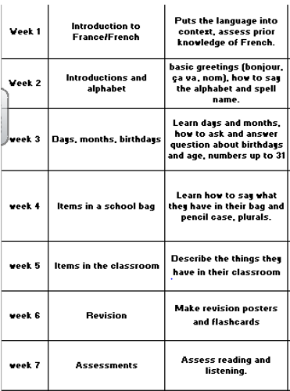

Slide 3






WEEK 1 – w/c 5th September
This term you will study French.
Make a French title page in your orange book
(or on paper). Here are some ideas for the design

Slide 4
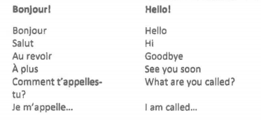
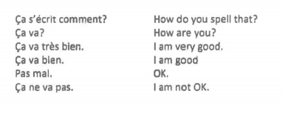
Week 2 w/c 12th September

Slide 5
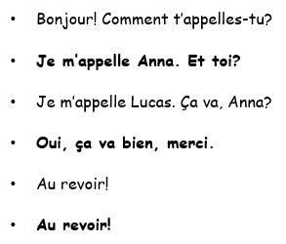

Copy and translate the dialogue, then write one of your own changing the names and the answer to the ‘how are you’ question using the vocab on the previous slide.
Then, read the speech bubbles and practice saying the sentences, noting the pronunciation point at the end.
Play some games on the elementary section of linguascope (kingshill, mfl123*) in the Bonjour section.

Slide 6

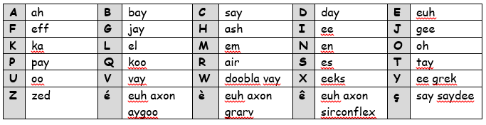
Copy the alphabet into your book.
Watch the following clip and practice singing the song:
French alphabet - L'alphabet en Français by Alain Le Lait – YouTube
Copy down the expressions in the yellow box.

Slide 7

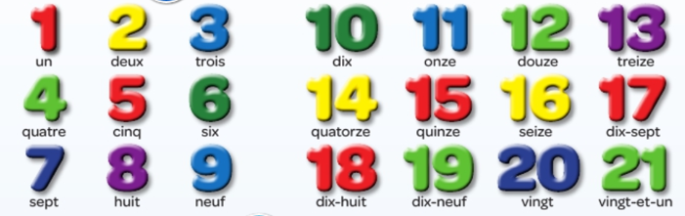
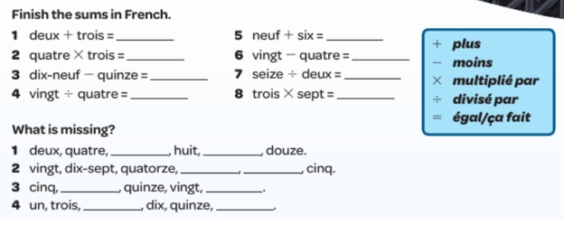
Week 3 w/c 19th September
Copy the numbers into your book then do the sums!

Slide 8
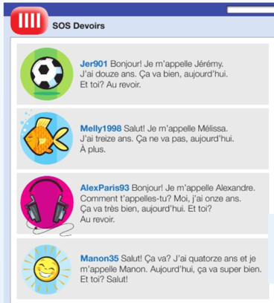
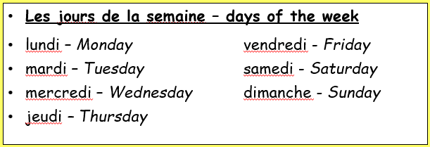
Read the texts. For each person, say what their name is, how old they are and how they are feeling. Then, copy the days of the week. What do you notice about how they are written in French?

Slide 9
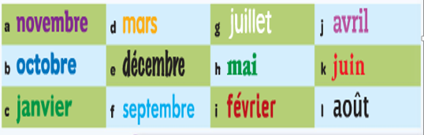
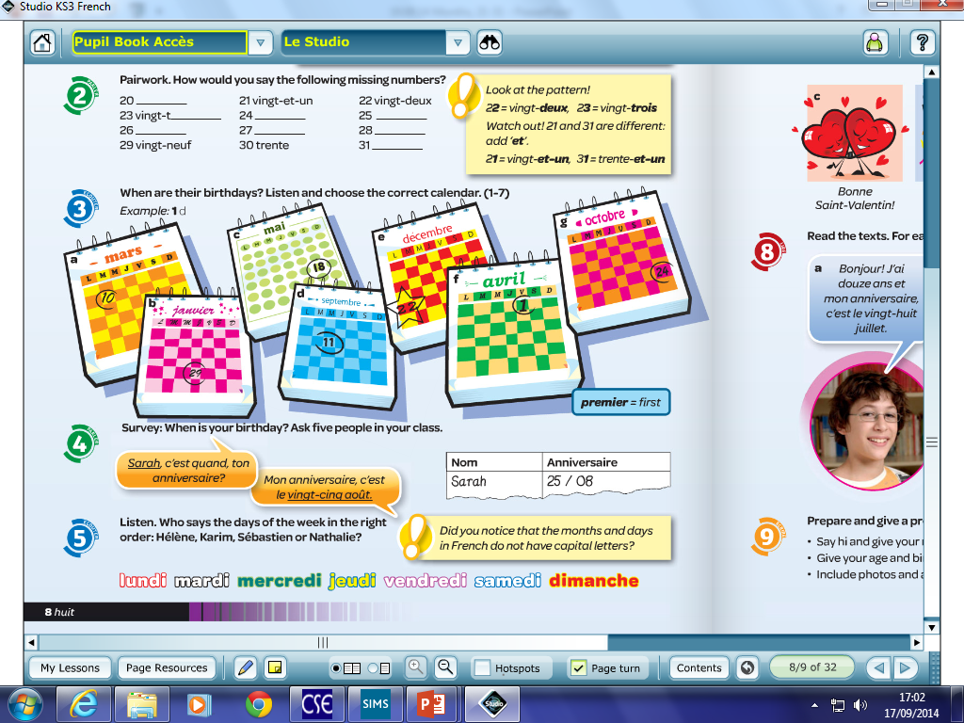

Put the months in the correct order. Then listen to the recording and match up each person with one of the calendars.

Slide 10

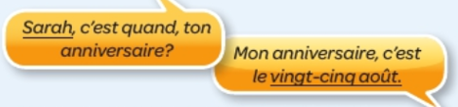

Copy down the question and write your answer (in French, you have to say the number first then the month, you cannot say it the other way around).
Next, complete the reading activity.

Slide 11
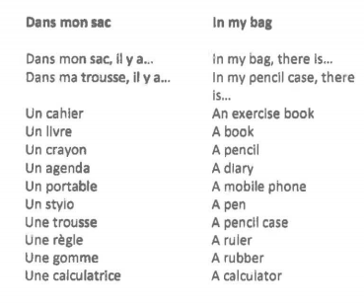

Week 4 w/c 26th September - Copy the vocab into your book and draw a picture for each item.

Slide 12

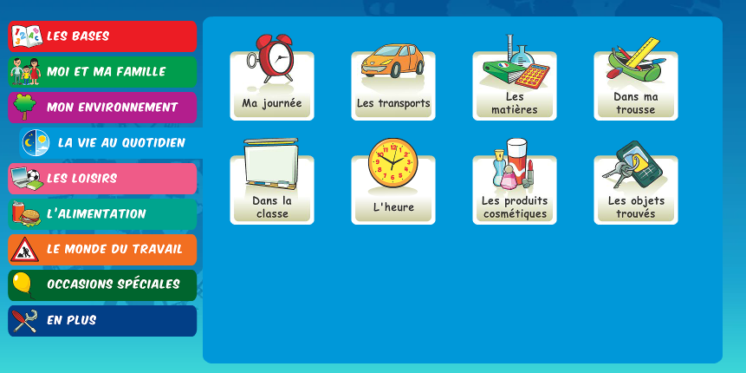
Play some games in the ‘Dans ma trousse’ section of Linguascope (beginner section) to practice vocabulary. Make a note of any new words.
Username – kingshill password – mfl123*

Slide 13
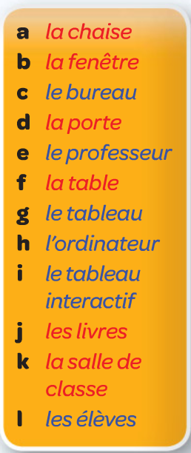
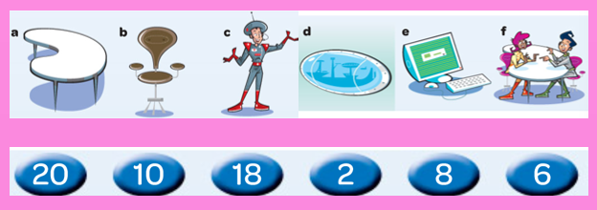
Week 5 w/c 3rd October
Copy and translate the vocab. Use www.wordreference.com to help if you need to.
Then do the listening, how many are there of each item?
(a – table, b – chair, c – teacher, d – window, e – computer, f – pupils)

Slide 14
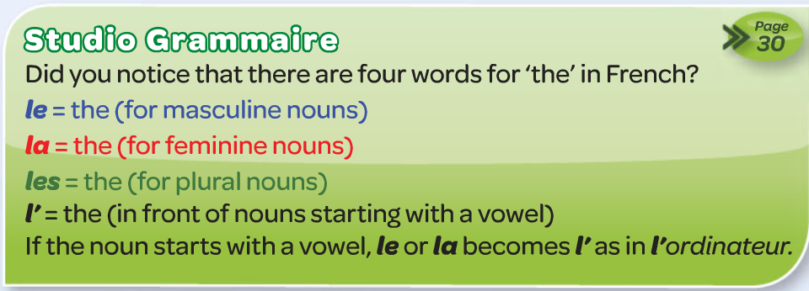
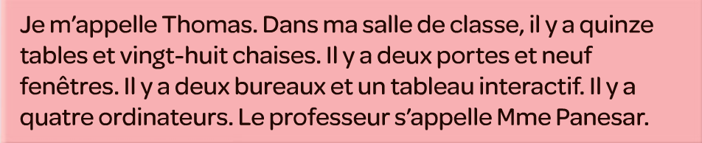
Copy the green studio grammaire box.
Watch the song, can you join in?
Translate the passage into English
Dans ma salle de classe – song https://www.youtube.com/watch?v=098Xf9d-Ntw

Slide 15

Week 6 w/c 10th October
This week is revision week. You need to revise all of the work that we have done this term, use this presentation for all of the vocab lists. You can make a revision poster or revision flashcards. You can also play some games in the following quizlet set:
French term 1 revision

Slide 16

Week 7 w/c 17th October
This week is revision and assessment week. Contact your teacher for the assessment papers. Make sure you have revised all of the words and expressions that we have learnt this term.

