Slide 1
Conflict and Tension, 1918-1945
Paper 1 – Section B (Wider World Depth Study)

Slide 2
How will this be assessed?
This section of the exam will contain 4 questions that you have to complete.
You will be expected to analyse and evaluate a mixture of sources (made during the period) and interpretations (made outside the period).

Slide 3
How will this be assessed?
The first topics covered will look at the end of WWI and the problems caused by the Versailles peace treaty.
The later section of the course focuses on the causes of the Second World War, including lessons on the international relationships between the countries in Europe.
The questions will cover 3 distinct topic areas:
Part 1 – Peacemaking
Part 2 – The League of Nations and International
Part 3 – The Origins and Outbreak of WWII
Peace

Slide 4
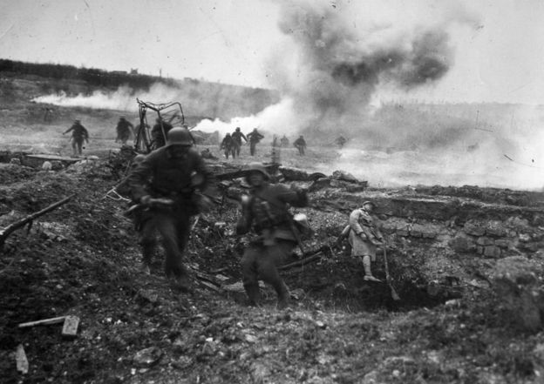
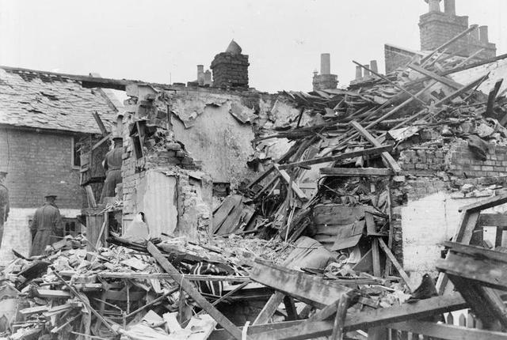
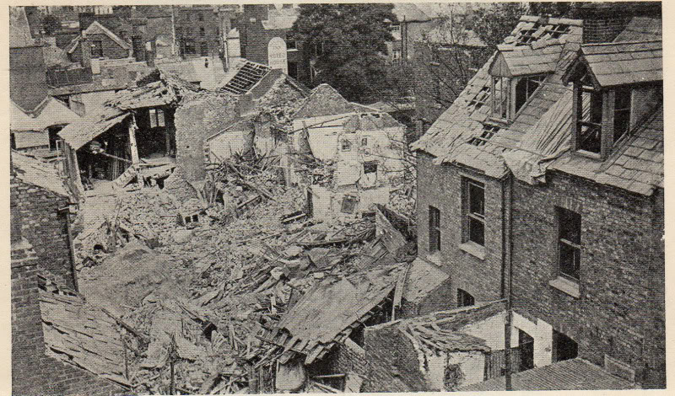
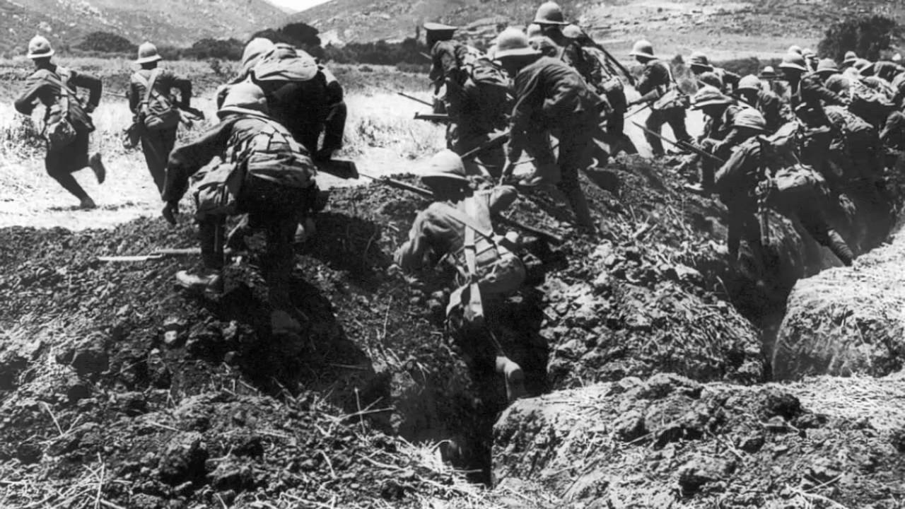
Starter – What do the images show about the impact of WWI on the countries involved? Write 3 ideas in the back of your book.

Slide 5
Peacemaking – Counting the Cost
Objectives
To compare the impact of WWI on Germany and the Allies.
To identify the terms of the 1918 November Armistice.

Slide 6
Task – On your copy of the sheet complete the following: 1) Colour in the main countries in each power block – remember the key. 2) Write a brief overview of how each country was affected by WWI in the corresponding box.
Triple Entente – Britain, France and Russia (until 1917).
Central Powers – Germany, Italy and Austria-Hungary.

Slide 7
Questions
Which country do you think suffered most as a result of the Great War? Explain your answer.
How do you think your answer for question 1 felt towards the opposition countries? Why?

Slide 8
Ceasefire!
Task – In your own words summarise what the armistice was and the terms of the agreement.
On 11th November 1918 at 11:00am the armistice (ceasefire) brought the First World War to an end.
Worldwide 8 million soldiers and 8 million civilians were killed.
The terms of the November Armistice were harsh. These included:
The German army had to surrender its equipment.
The German navy had to surrender its submarines and most of its ships.
A neutral zone was created on the banks of the Rhine.
Germany would be expected to pay reparations (money) for the damage done.
If Germany did not agree to the terms of the armistice then the allies would resume the war. Germany had no choice but to agree!
In January 1919 the main countries involved in WWI met at the Paris Peace Conference to agree the terms of peace.

