Slide 1
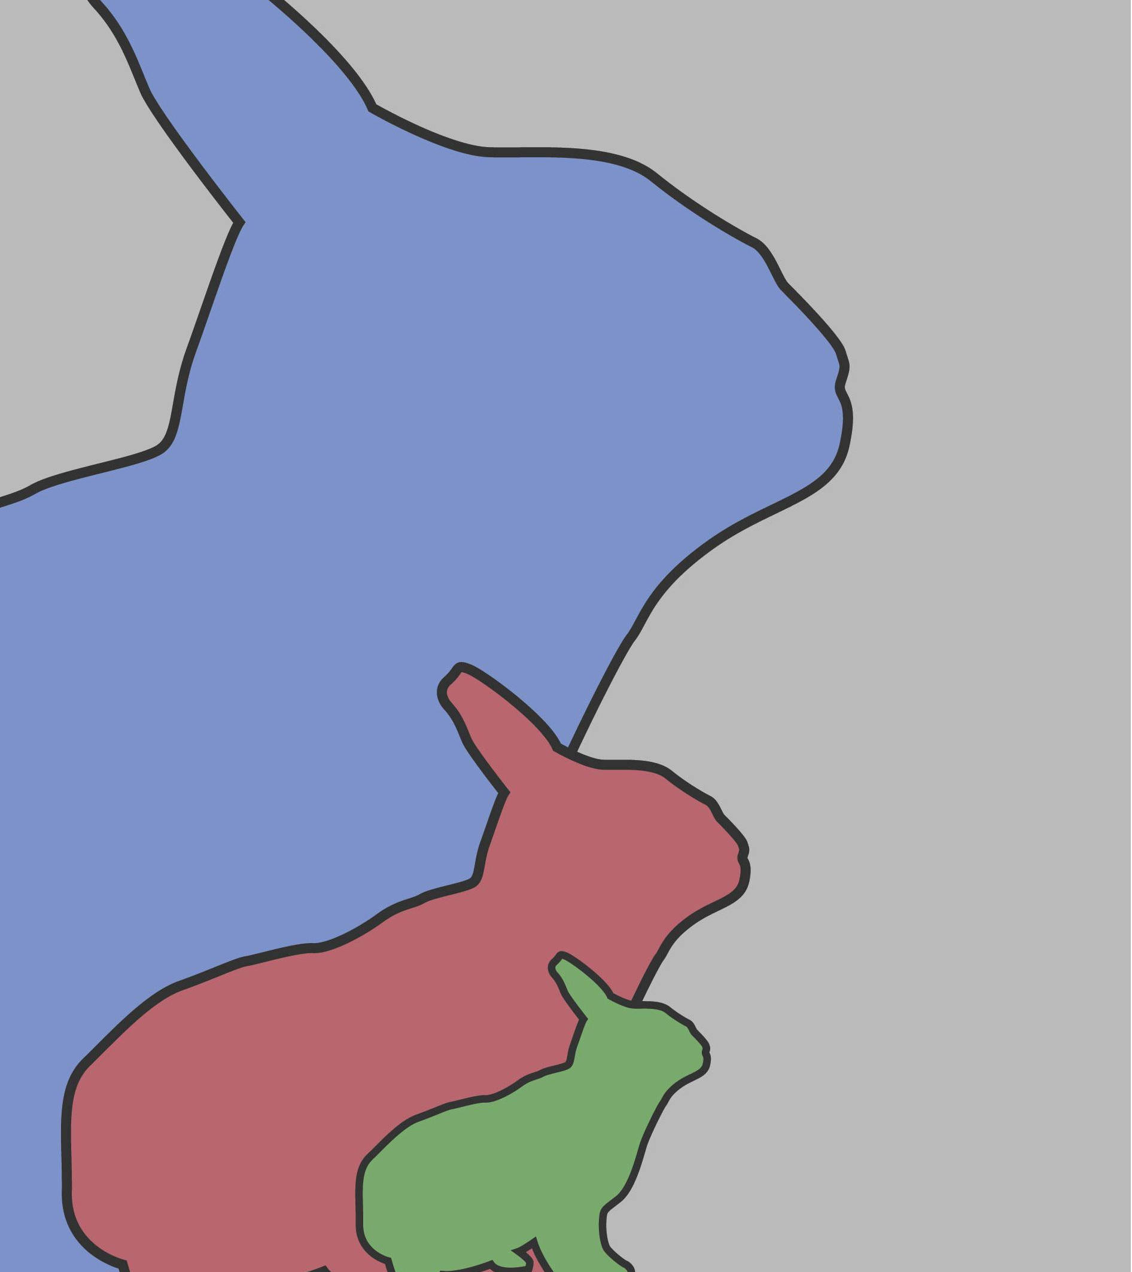
Chapters Five and Six

Slide 2
Read chapters five and six
http://giove.isti.cnr.it/demo/eread/Libri/sad/OfMiceAndMen.pdf
Please find above the link for the PDF of ‘Of Mice and Men’ above.
https://www.youtube.com/watch?v=NgzRkSWPXsY
And the link for the audio version of Chapter 5 to read along to.
https://www.youtube.com/watch?v=BPG9aLmrypk
And the find the link for the audio version of Chapter 5 to read along to.

Slide 3
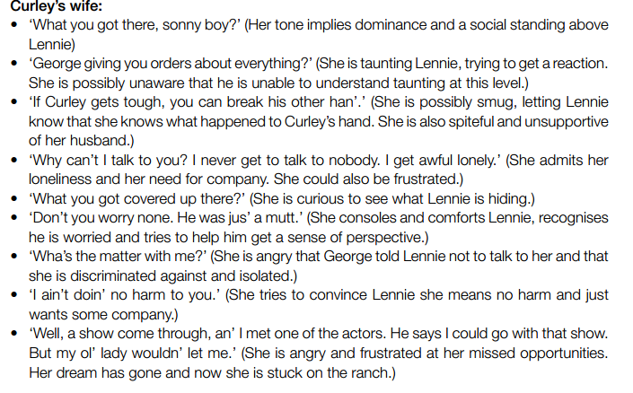
Read the box to the right to help you understand Curley’s Wife through her own words

Slide 4
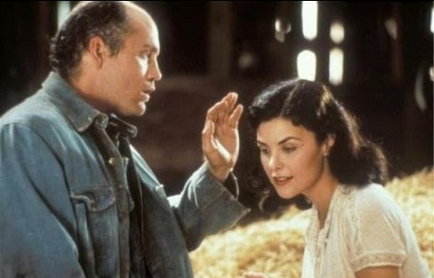
Curley’s Wife’s Demise
What do we learn about Curley’s Wife in the final moments before her death?
Does this change your opinion of her? Why?
How does it make readers feel to learn more about her just before her death?
How do you think readers are meant to feel about he death?
How do you think readers are meant to feel that it is Lennie’s fault she dies?

Slide 6
George’s Decision
Imagine you are George and you are having to give a statement for what happened
You need to clearly explain why you shot Lennie and what you think would have happened if you hadn’t done it

