Slide 1
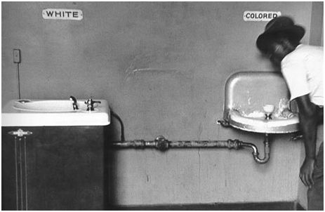
Chapter four

Slide 2
Read chapter four
http://giove.isti.cnr.it/demo/eread/Libri/sad/OfMiceAndMen.pdf
Please find then link for the PDF of ‘Of Mice and Men’ above.
https://www.youtube.com/watch?v=EXNiP3LBlsU
Please find the link for the audio version of Chapter 4 to read along to.

Slide 3
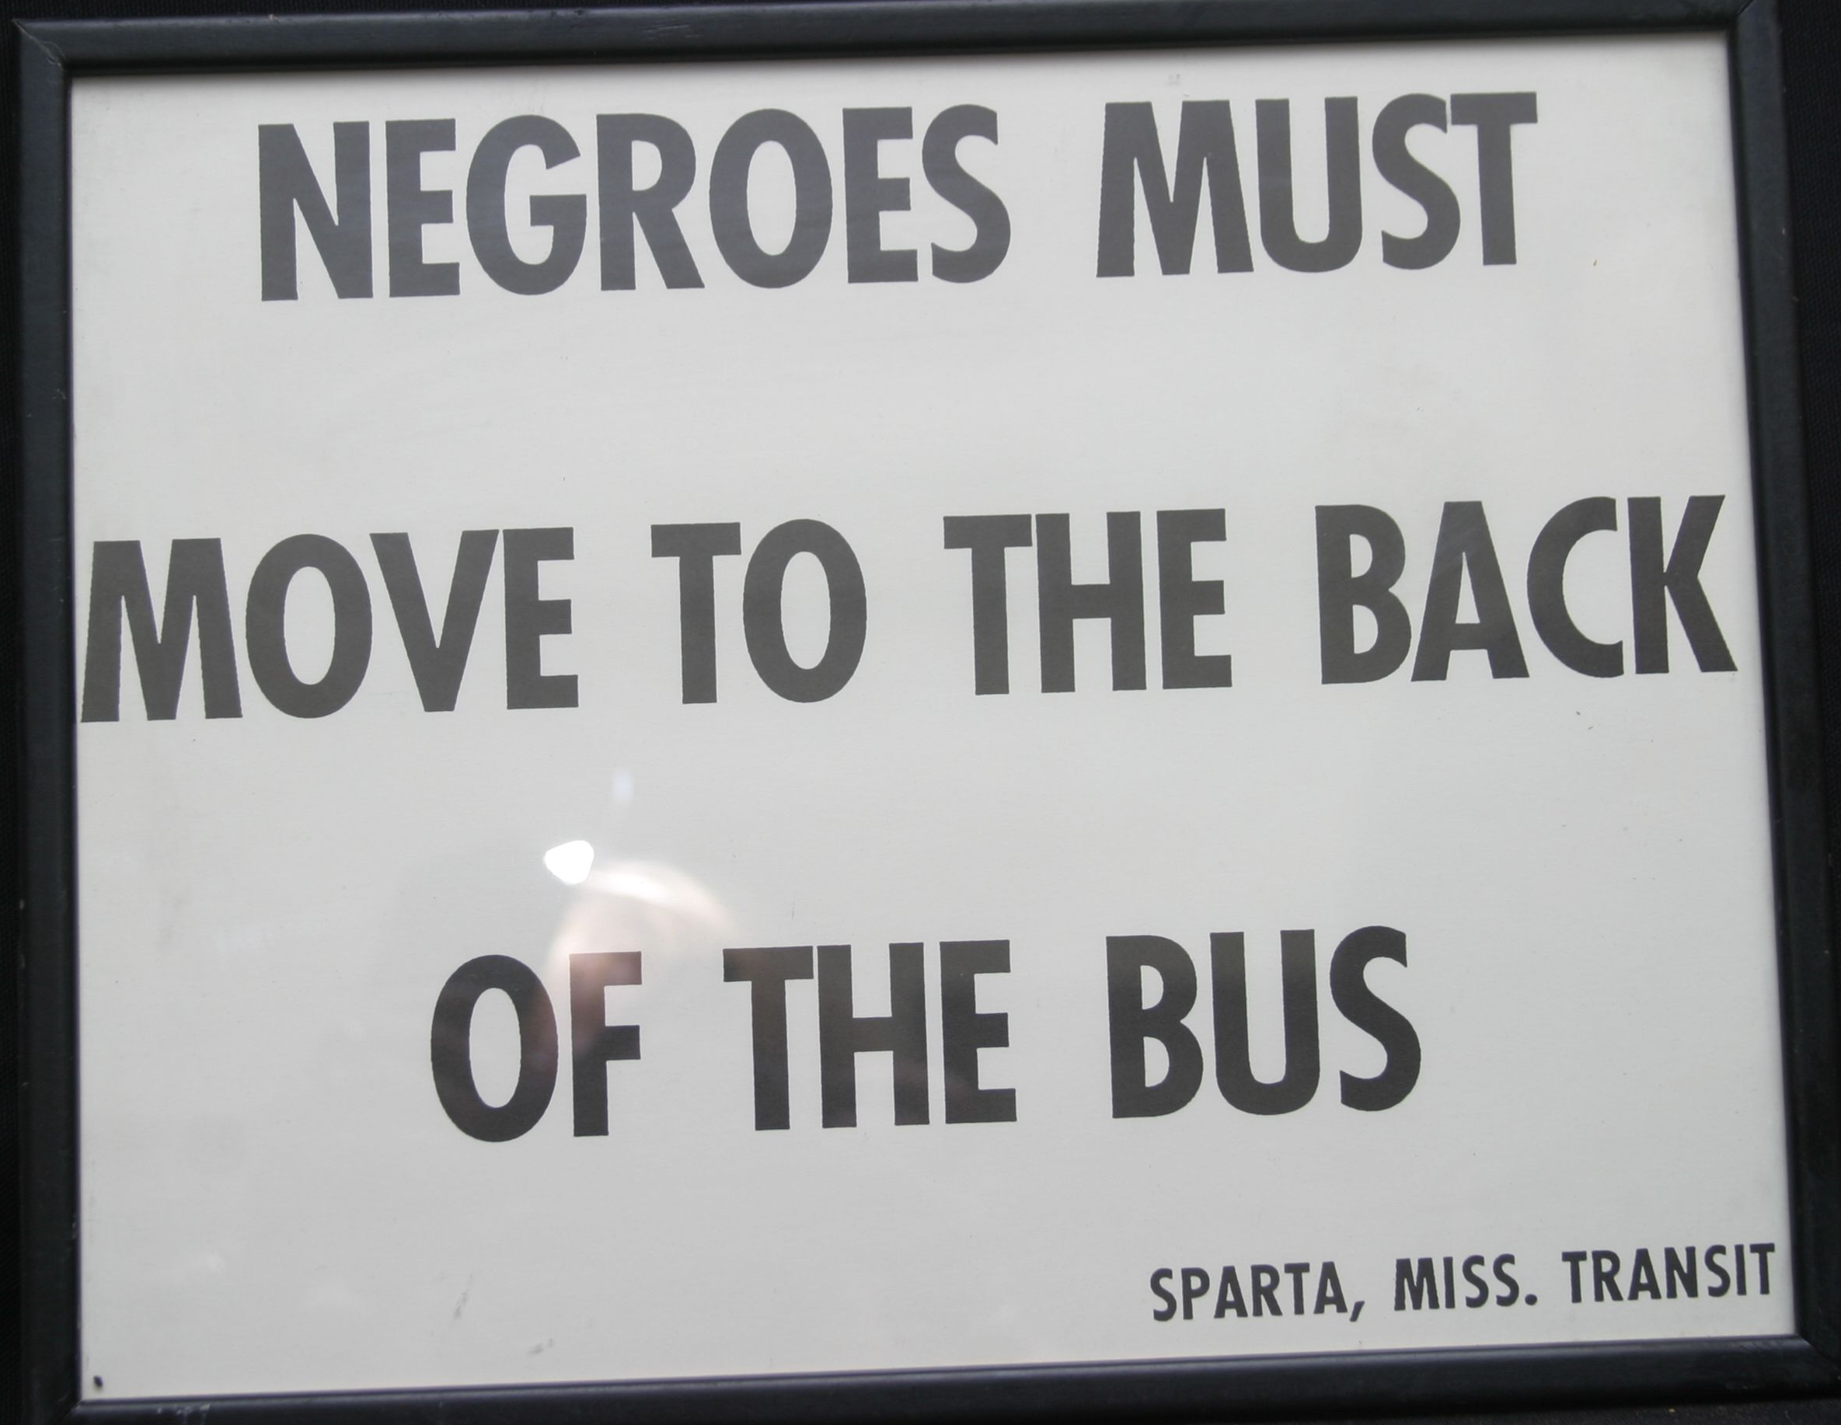
Racism in 1930s America
You need to complete research on racism during this time period and create a poster, fact file or leaflet filled with this information
You should focus on the ‘Jim Crow’ laws, the ways in which black people were segregated and what black people were and were not allowed to do

Slide 4
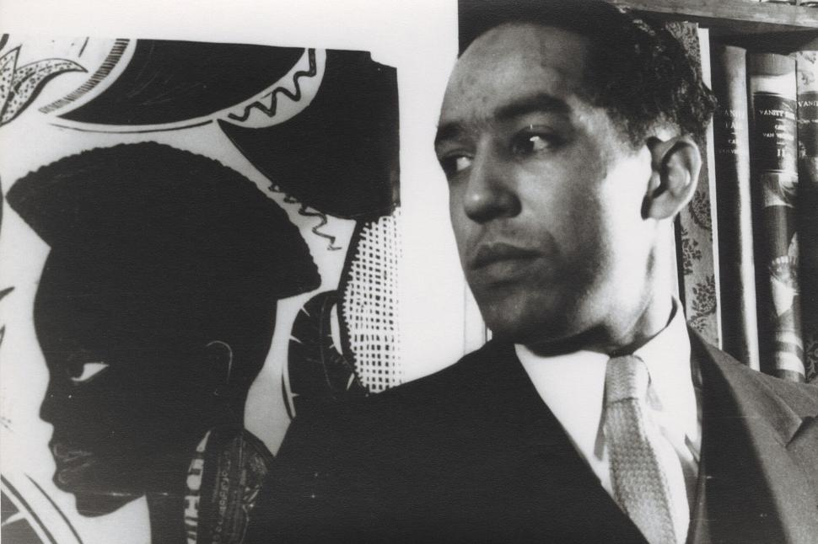
Poetry and Racism
You are going to read a poem called ‘I, Too’ published in 1925 by a black poet called Langston Hughes

Slide 5
I, too, sing America.
I am the darker brother.
They send me to eat in the kitchen
When company comes,
But I laugh,
And eat well,
And grow strong.
Tomorrow,
I’ll be at the table
When company comes.
Nobody’ll dare
Say to me,
“Eat in the kitchen,”
Then.
Besides,
They’ll see how beautiful I am
And be ashamed—
I, too, am America.
Answer the following questions to help you understand and analyse the poem.
Why do you think we are not given any specific information or hints about who the narrator is?
What do you think the effect of word ‘brother’ is here, and what could it suggest about the black community?
Who do you think ‘they’ is referring to? And why don’t you think he’s been more specific?
What do you think the stanza starting ‘Tomorrow’ is about? Is it literally what will happen the day after or does it represent something else?
What do you think the poem means by saying he is America (I, too, am America?)
What is the effect of the short lines? What could they represent?
How do you think a black person in 1925 would react to this poem?

Slide 6
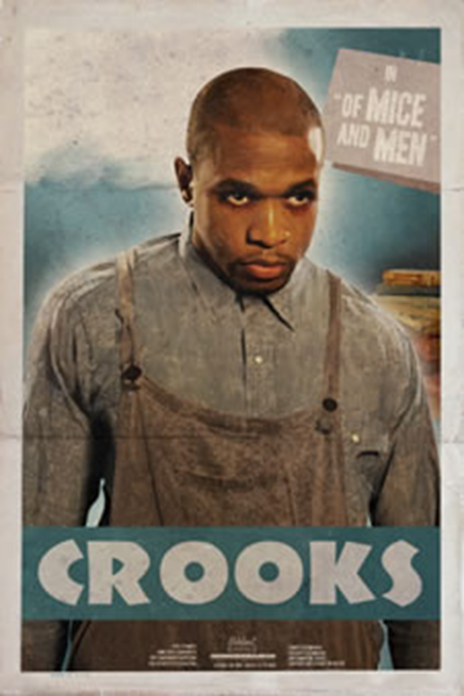
Character analysis: Crooks
Lives in a room on his own
Is referred to as ‘Stable buck’ and not his name
Or is referred to as ‘Crooks’ as a reference to an injury caused by being kicked by a horse
Is suspicious of other characters wanting to talk to him
Spends most of his time alone

Slide 7
Crooks has a copy of the California civil code from 1905 even though it’s now the 1930s, why do you think he has such an old copy? Why do you think he would have a civil code book when he is treated so badly because of these rules?
What is the effect of having every item Crooks owns listed?
What does it suggest if Crooks’ books/ magazine are ‘tattered’, ‘battered’ and ‘dirty’?
Find a word which suggests Crooks doesn’t feel ownership of his room/ suggests black people don’t feel at home in their rooms?
What does it suggest if Crooks keeps his room ‘swept and fairly neat’?
Thinking about how black people were made to feel, why do you think Crooks is ‘proud’ and ‘aloof’?
What are your connotations of the word ‘glitter’ and why might Steinbeck have used it for Crooks?

