Slide 1
Chapter three
The following slides contain enough work to fill one week of lessons.

Slide 2
Read chapter three
http://giove.isti.cnr.it/demo/eread/Libri/sad/OfMiceAndMen.pdf
Please find then link for the PDF of ‘Of Mice and Men’ above.
https://www.youtube.com/watch?v=ebjzwMO0OYc
Please find the link for the audio version of Chapter 3 to read along to.

Slide 3
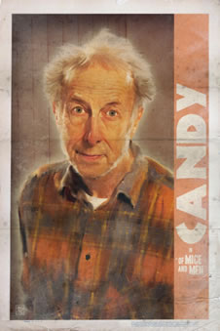
Character analysis: Candy
Candy would be considered to be at the bottom of the social hierarchy in 1920s/30s America.
This is because he has lost one hand, so would be considered to have a physical disability, he is unskilled and he is old.
He does not have much use on the ranch and is only still there due to his accident.

Slide 4
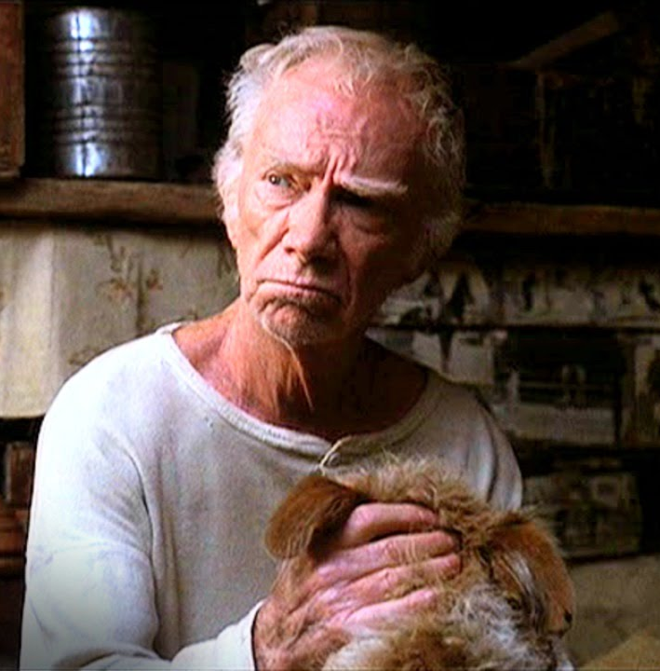
Candy’s dog and metaphor
Candy's dog could be considered to be a metaphor for Candy himself and other people like him. Why do you think this is? Create a spider diagram like the one below to note ideas down.
Similarities between Candy and his dog
Now let’s look at what happens to Candy’s dog and think about what Steinbeck could be suggesting…
Steinbeck has used Candy’s dog as a metaphor to represent…. He could have done this because…. As a reader this makes me feel…

Slide 5
The Fight: Zooming in
Challenge: | Super Challenge: | Mega Challenge:
Skim through the description of the fight. Find between 5 and 10 violent verbs, and look at the character they are written about – make a note of who in the margins. | Skim through the description of the fight. Find between 5 and 10 violent verbs, and look at the character they are written about. Why has the character with the most got the most, and why has the character with the least got the least? (_____ has the most violent words used to describe him because… _____ has the least because…) | Skim through the description of the fight. Find between 5 and 10 violent verbs, and look at the character they are written about. Who has the most? Why? What are your opinions of the characters following the fight?
What are we working towards?
PEA: How are characters presented within the fight scene?

Slide 6
The Fight! Understanding the event
You need to create a storyboard, focusing on what you think are the four most important images of the fight scene.
Think: how are certain characters made to look? What are their actions telling us?
Annotate with a minimum of one quote per image to help explain why you chose it.
Extension: Why do you think this scene so important?
Note your answer down in a mind map, a table or a paragraph.

Slide 7
For example…
Curley turning from Slim to Lennie. (I would place Slim standing up, to show his height and power. Lennie would be smiling, with a thought bubble explaining that he is thinking of his dream.) | Curley is punching Lennie. (I would have Lennie doing nothing, and George to the side telling him to fight back. I may even use Steinbeck’s ‘terrier’ reference with Curley.)
Lennie fights back. (Lennie would have Curley’s fist in his own, with George shouting at him to let go. ) | Curley is injured, Lennie is scared. (Slim would be stood over Curley, who would be lying down. Lennie would be in a corner, hunched over, looking very small.)

Slide 8
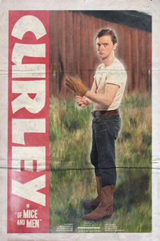
Character analysis: Curley
Curley would be considered to be relatively neutral place in society because his father owns a ranch.
He wouldn’t have the struggles many men have to do with finding work and keeping their jobs.
Whilst he wouldn’t have to ‘slum it’ working physical labour at the command of others like George etc. which would make him feel like he was better than them.
However, his business did still depend on the farming industry and how successful their crops were. Farming wouldn’t be as highly thought of as office work so he may feel he has something to prove.
Can you remember how Curley was described when we first met him in Chapter Two?

Slide 9
Character analysis: Curley
‘Curley stepped over to Lennie like a terrier’
‘Curley’s rage exploded’
‘Curley was balanced then poised’
‘Curley slashed at his eyes’
‘Curley was flopping like a fish on a line’
‘Curley was white and shrunken by now, and his struggling had become weak. He stood crying, his fist lost in Lennie’s paw’
Choose three of these quotes. Write them out and make notes around them like a spider diagram. Think about our connotations of words in the quote, any techniques and what the quotes tell us about Curley.

Slide 10
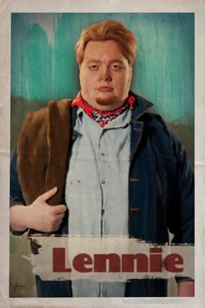
Character analysis: Lennie
Lennie, like Candy, would be at the bottom of the social hierarchy.
His mental disability would mean that he wouldn’t be able to have the same nomadic lifestyle that most ranch workers have.
It would be unusual to have a situation like George and Lennie have.

Slide 11
Character analysis: Lennie
‘Lennie looked blankly at him. “Huh?”’
‘Lennie looked helplessly at George, and then he got up and tried to retreat.’
‘Lennie gave a cry of terror’
‘Lennie’s hands remained at his sides’
‘Lennie covered his face with his huge paws and bleated with terror’
‘But Lennie watched in terror the flopping little man whom he held’
Choose three of these quotes. Write them out and make notes around them like a spider diagram. Think about our connotations of words in the quote, any techniques and what the quotes tell us about Curley.

Slide 12
Deeper thinking: Both Curley and Lennie are described using animal qualities. Why do you think this is? Can we relate this to the natural description at the beginning?

Slide 13
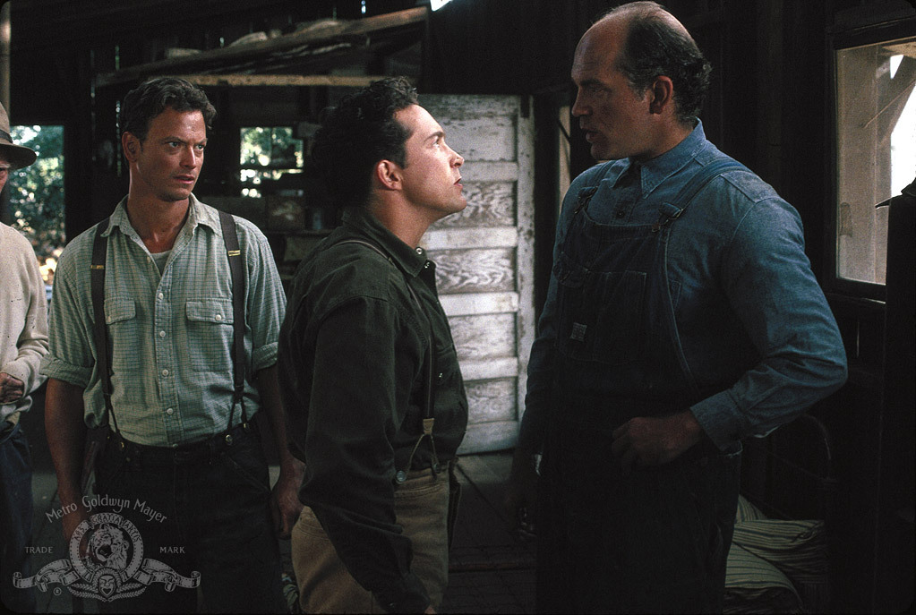
How has Steinbeck presented his characters within the fight scene?
Have a go at writing a PEA paragraph for both Lennie and Curley using the guide on the next slide.

Slide 14
How has Steinbeck presented his characters within the fight scene?
POINT: Tell me how one of the characters has been presented (aggressive? Timid? Provocative?)
Steinbeck has presented ______ as a ________ character.
EVIDENCE: Prove what you have just said with a quote from the chapter about that character.
Evidence of this can be found in the line ‘…’
ANALYSIS: Now you need to explain how that quote proves what you’ve said about the character, zooming in on key words and discussing what connotations/ associations readers would have of them.
Then try and add in why you think Steinbeck has made them like this, and how they fit into the time period.
COMPARISON CONNECTIVE and then use the same structure as above for a second character.

Slide 15
Quick self assessment
You will need to read through your PEA paragraphs and give them a WWW and a HTI.
Use the below to help you.
Have you:
Answered in full sentences
Used an appropriate quote
Linked all sentences together, preferably with a connective
Added thoughtful analysis on what the quote tells us about the character
Included information about the time period
Zoomed in on single words or phrases to look at connotations
Discussed affect on reader
Discussed writer’s intentions

