Slide 1
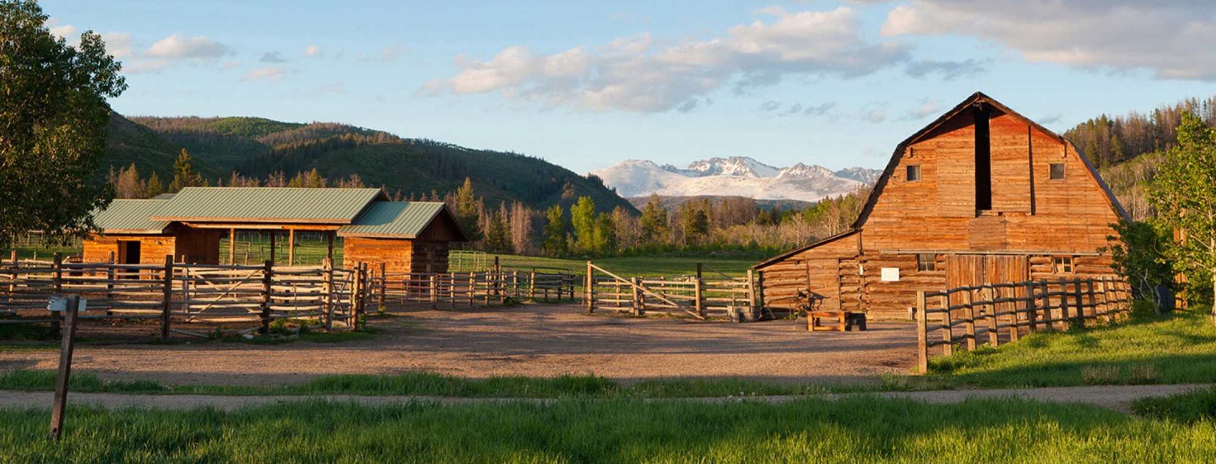
Chapter Two
Learning objective: To explore the events of chapter one and what we learn about George and Lennie

Slide 2
Read Chapter Two
http://giove.isti.cnr.it/demo/eread/Libri/sad/OfMiceAndMen.pdf
Please find a PDF copy of the novella here.
https://www.youtube.com/watch?v=KSbUa4oyoT0
And the audio version to read along to here.

Slide 3
What happened in Chapter 2?
Create a flow chart plotting what happened in Chapter 2

Slide 4
What happened in Chapter 2?
George and Lennie arrive at the ranch where they meet an old, ‘stoop-shouldered’ man with no right hand.
George and Lennie get settled into their bunks. George is a little suspicious of why the man before him left – and questions the hygiene.
Candy (the old man) says how decent the boss is. The boss is annoyed because they were meant to arrive the night before. The boss seems suspicious of Lennie and why he isn’t talking.
Curley (the boss’ son) then comes in and acts aggressively towards Lennie. George defends him.
Slim and Carlson discuss Slim’s dog’s puppies, which excites Lennie.
Curley comes in looking for his wife.
Curley’s Wife comes into the room ‘looking for Curley’. She leaves and they discuss her in a derogatory way. They meet Slim who is ‘the prince of the ranch’ and very popular and fair.
Candy tells George about Curley’s new wife and how flirtatious she is. George expresses his fears to Lennie. He reminds Lennie what to do if there’s trouble.
Predictions?

Slide 5
The characters so far…
Copy out the table below and then go back over Chapter 2 filling in the boxes for each character.
 | Candy | Boss | Curley | Curley’s Wife | Slim | Carlson
Impressions of these characters
Quotes to prove this
Stretch yourself:
Add a row for predictions about what you think could happen to them and why.

Slide 6
What does the word power mean to you?
Who do you know who has power?
Is power fair?
Is power right?

Slide 7
Curley
The Boss
Carlson
Placing the names into a triangle (most powerful on top, least on the bottom) decide how you think the ranch hierarchy sits.
Label and annotate with why you have put everyone where you have.
Consider the characters roles as workers – are they skilled?
Consider social, historical context – prejudice?
Slim
Candy
Lennie
George
Curley’s Wife

Slide 8
Ranch Hierarchy
The Boss owns the ranch and hires and fires the workers
The Boss

Slide 9
How has power been presented in Of Mice and Men?
POINT: Tell me how much power one of the characters has
EVIDENCE: Now prove that the character has that much power with a quote from Chapter 2
ANALYSIS: Now explain how that quote proves their power status. Try to zoom in on key words within the quote.
Now link this to context – is there a reason why this character does/ doesn’t have power?

Slide 10
Quick self assessment
You will need to read through your PEA paragraph and give it a WWW and a HTI, try to use a different colour if possible.
Use the below to help you.
Have they:
Answered in full sentences
Used an appropriate quote
Linked all sentences together, preferably with a connective
Added thoughtful analysis on what the quote tells us about the character
Included information about the time period
Zoomed in on single words or phrases to look at connotations
Discussed affect on reader
Discussed writer’s intentions

Slide 11
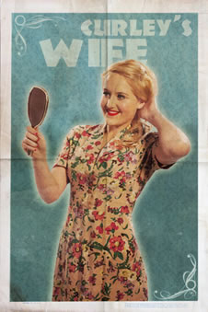
Character analysis: Curley’s Wife (and women in society)

Slide 12
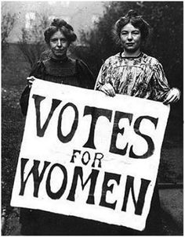
Women in 1920s America

Slide 13
Types of women
Copy out the table below and make notes using the following three slides
Poster girls of the 1920s | The fighters of the 1920s | The reality of the 1920s

Slide 14
The poster girls of the 1920s
Perfectly styled make up and professionally done hair
Confident and fun-loving
Desire to fit into the top of the social hierarchy
Focused on money and having nice things
Glamorous, over the top dresses and accessories
Priority is social engagements
Fancy surroundings – usually a party or a smart hotel/ restaurant
High heeled shoes
Daisy Buchannan

Slide 15
The fighters of the 1920s
NAWSA (National American Woman Association) existed all over the country and involved women campaigning for equal (or at least more) rights to men.
Wealthy, educated women were a great focus for the group because of the impact they could have.
Women were given the vote in 1920.
Southern states were the ones against the equality of women.
Some believed it only had so much backing to make the male politicians look better in elections.
Not everyone was able to participate in NAWSA. Although NAWSA did not exclude African American women from membership at the national level, state and local organisations could and did choose to exclude them. Conventions held in Southern cities like Atlanta (in 1895) and New Orleans (in 1903) were segregated. NAWSA also required black women to march separately during its 1913 parade in Washington, DC. Even within this socially progressive movement, racism persisted.

Slide 16
The realities of the 1920s
Woman often felt held back by their families, and couldn’t relate to their ‘old fashioned’ mothers’ views.
Men wanted women to an accessory, something to have on their arm when they were at social events – but not to have opinions or ambitions.
Despite having the vote in 1920 women still didn’t have the same opportunities as men, most would have to marry to be able to leave their family home.
Woman were expected to look after the children and do the housework – so often couldn’t work even if they wanted to.
Woman needed men to buy their clothes and possessions most of the time, so had to keep their husbands happy.
The war opened up people’s eyes a bit, but there still wasn’t a lot of work or careers for women.

Slide 17
Character analysis: Curley’s Wife
A girl was standing there looking in. She had full, rouged lips and wide-spaced eyes, heavily made up. Her fingernails were red. Her hair hung in little clusters, like sausages. She wore a cotton house dress with red mules, on the insteps of which were little bouquets of red ostrich feathers. “I’m lookin’ for Curley,’ she said. Her voice had a nasal, brittle quality.

Slide 18
Character analysis: Curley’s Wife
Find a comical image used to describe Curley’s Wifes’s hair. Write it out and label what technique it is.
Why is this a funny comparison to make?
What colour is repeatedly used in Curley’s Wife’s description?
What are your connotations/ associations of this colour? (Where might you see it? What is it often used for?
Find the two items of clothes we are told about and note them down
Why are these quite contradictory items to where?
Why do you think Curley’s Wife is so dressed up on a ranch?

Slide 19
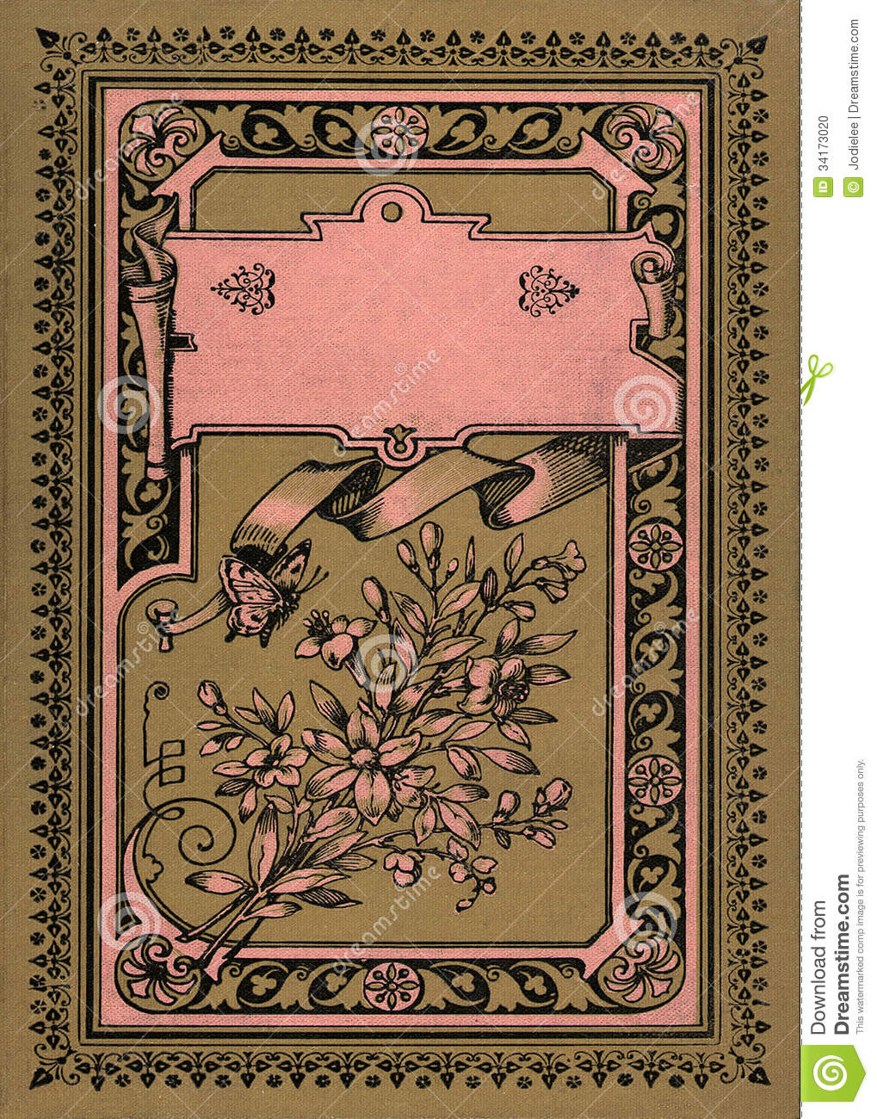
Curley’s Wife’s letter
Your challenge is to create a piece of writing in the style of a letter from Curley’s Wife to a friend she had growing up or to her mother back home.
You will need to ensure you have explored how a woman in Curley’s Wife’s position may feel.
You need to include contextual information.
You will need to make sure that the narration sounds Curley’s Wife and a woman in 1920s America.
You can use the story to help you find relevant information, such as what the characters look like, say to her and the setting in which she lives.
Mrs C

Slide 20
Curley’s Wife’s diary
Mrs C
Features of a diary

