Slide 1
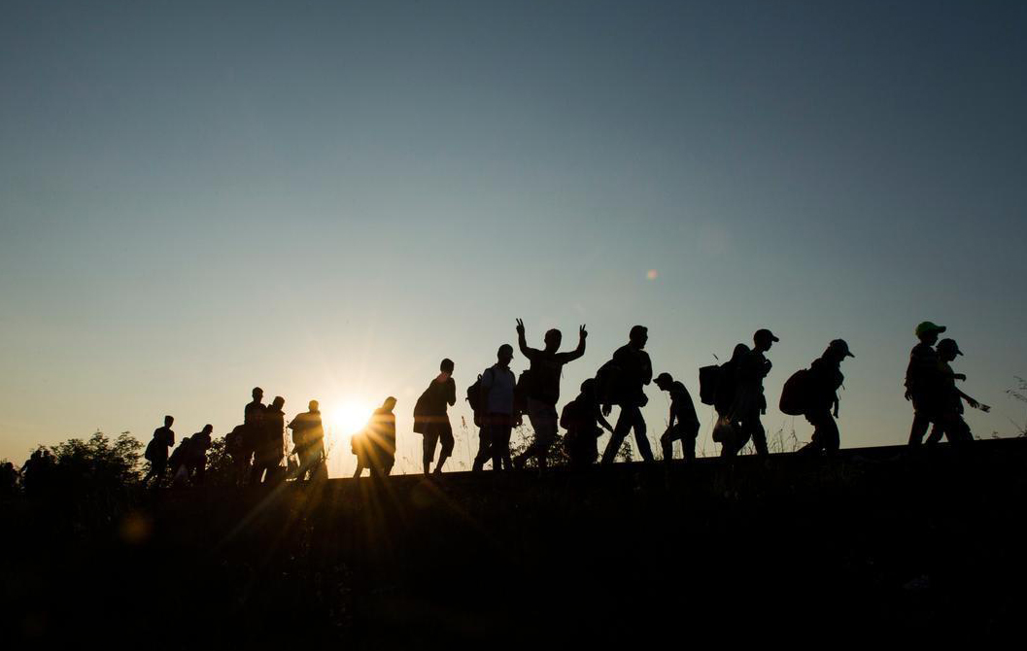
The following should be roughly enough work to cover 2 - 3 lessons, allowing for additional reading
The Migrant Crisis
Starter
What is a migrant?
What is a refugee?

Slide 2
A series of images will come up on the board.
As they do, write down any words that come to mind when you look at the image.
Stretch yourself:
Challenge: can you consider how the people in the image are feeling?
Super Challenge: can you consider why the media have used this image?

Slide 3
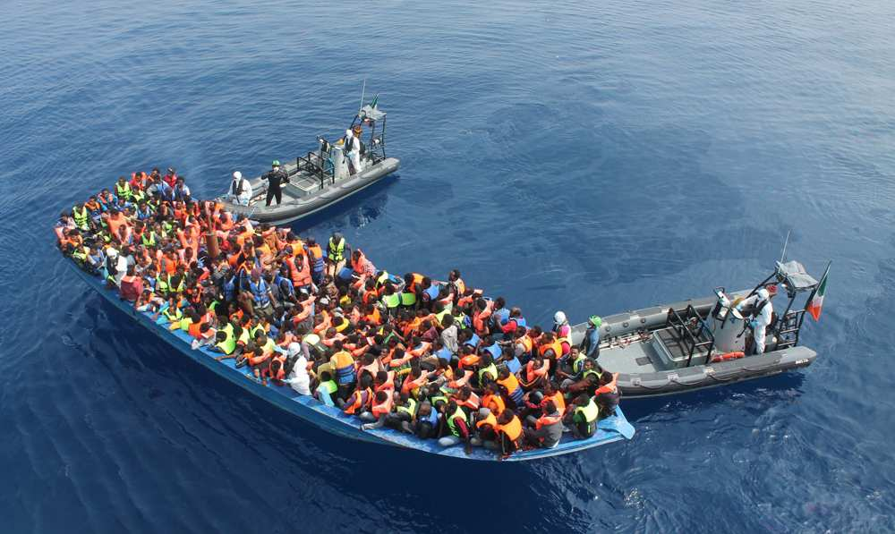

Slide 4
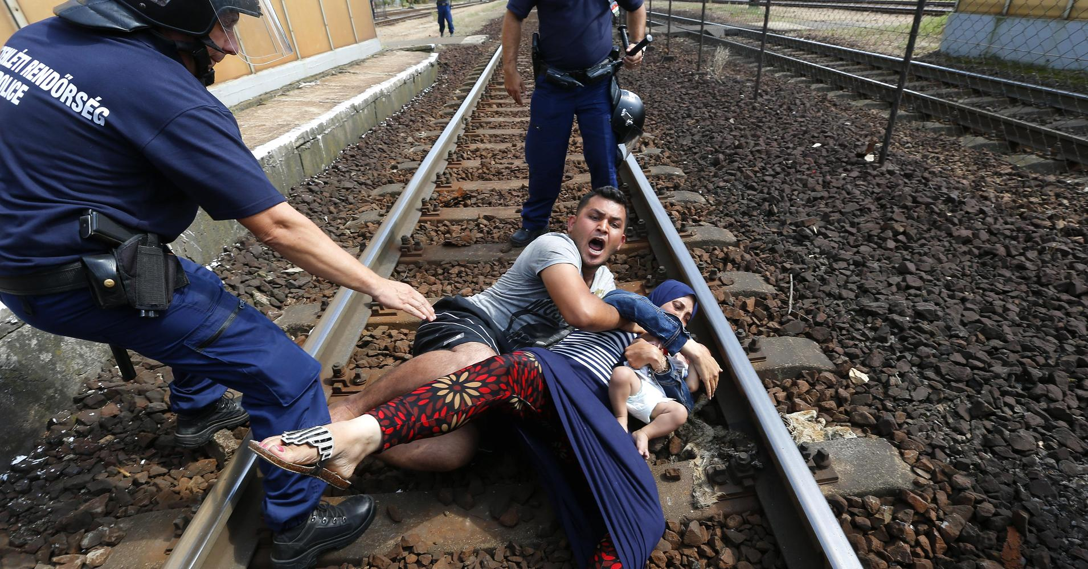

Slide 5
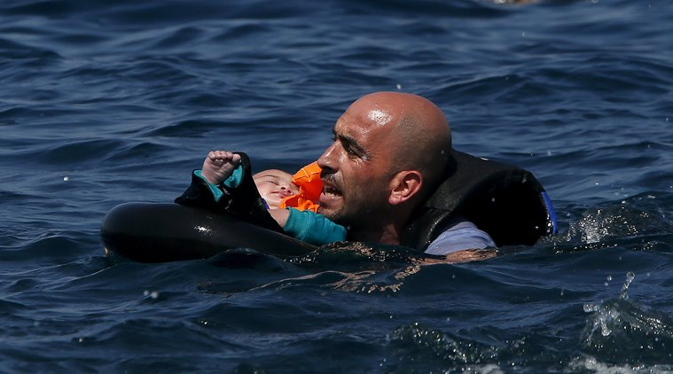

Slide 6
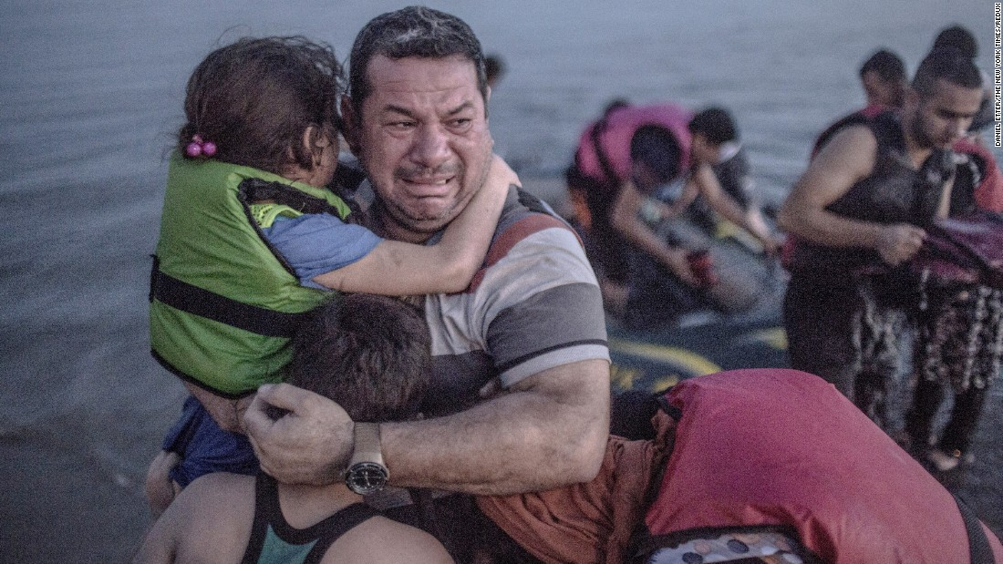

Slide 7
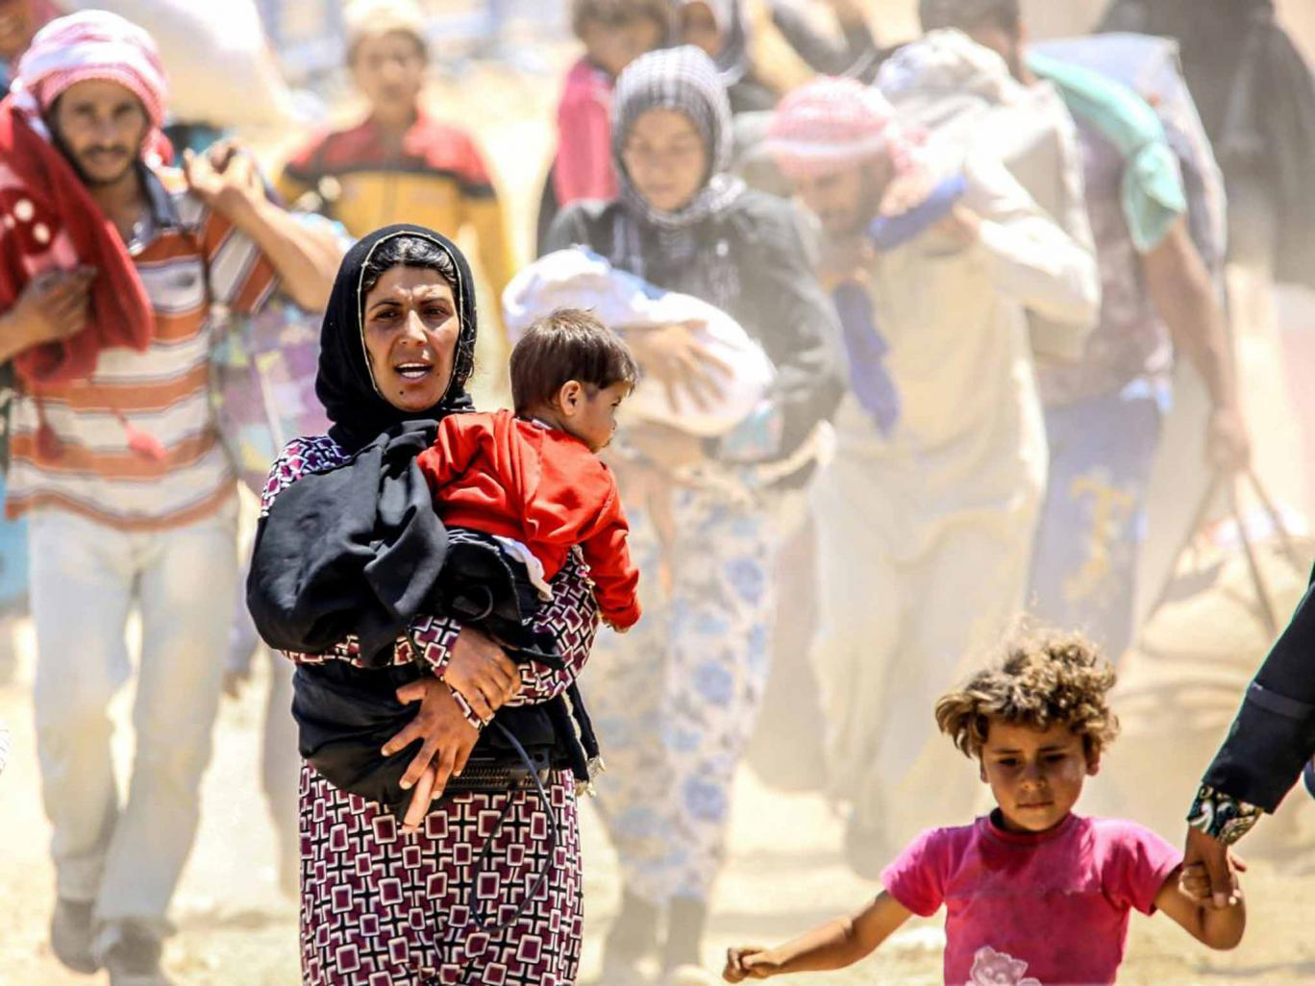

Slide 8
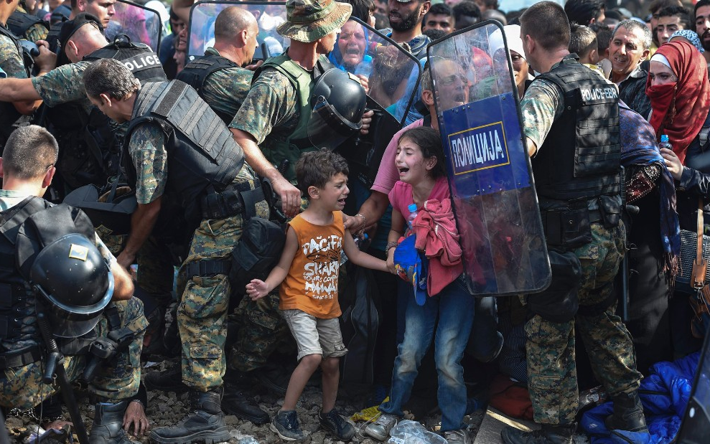
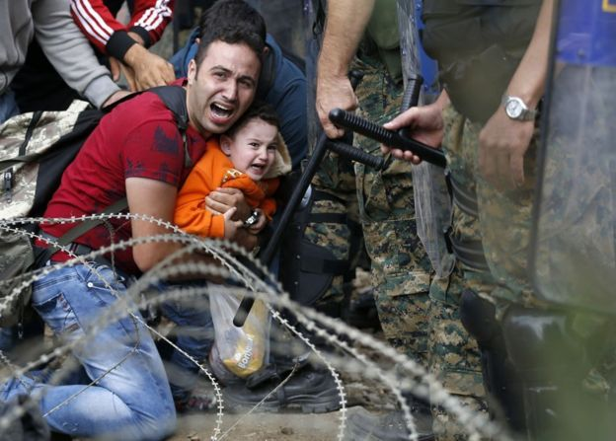

Slide 9

Migrant or Refugee?
Migrant
A person who moves from one place to another in order to find work or better living conditions.
Refugee
A person who has been forced to leave their country in order to escape war, persecution, or natural disaster.

Slide 10
Siba’s story:
Note down all the true statements:
Siba fled from Syria.
Siba’s father was shot.
Siba’s parents fled with her.
Siba’s sister is six years old.
Siba wants to go to Germany.
Siba speaks Arabic.
Siba’s dream is to be a teacher.
Siba still feels positively about her home country.
Stretch yourself:
Can you prove you are right using quotes from the text?

Slide 11
Siba’s story
Summarise Siba’s story in 5 lines
Note down what you think is most important bits of information from the text.

Slide 12
‘My parents are still there.’
Zooming in on a quote…
What does this quote tell us?
What can we infer from it?
Why do we infer that?

Slide 13

Using quotes
Your challenge is to use quotes from the extract to tell me what you learn from this extract. E.g…
I learn that life was very dangerous for Siba and her family, it says ‘a bomb went off and my father was injured’. I also learn that Siba has been separated from her family ‘My parents are still there.’ In addition, I know that…

Slide 14
Narges’ Story
List four things that you learn about Narges from the first two paragraphs:
1.
2.
3.
4.
Challenge:
Summarise what you learn abut Narges from her story. Use quotes to support your points.
Super Challenge:
How does Narges use language to describe her experience?

Slide 15
Let’s compare Siba and Narges’s stories:
Siba Narges
All the similarities between their stories go in the middle section where their circles cross over one another. Differences go in the outside sections.

Slide 16
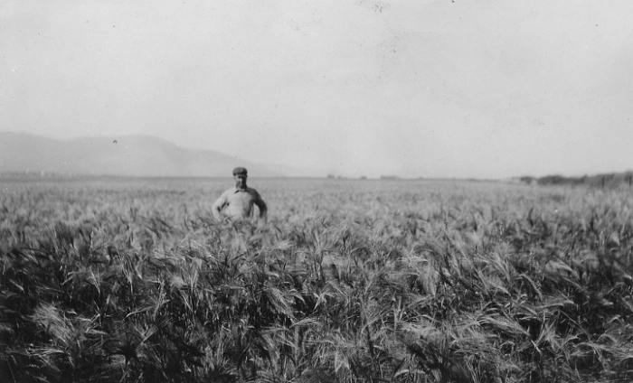
Itinerant workers
Learning objective: To use our knowledge of the Dust Bowl, The Great Depression, The American Dream along with our protagmosts George and Lennie and our thoughts on migrants refugees to create a piece of assessed writing

Slide 17
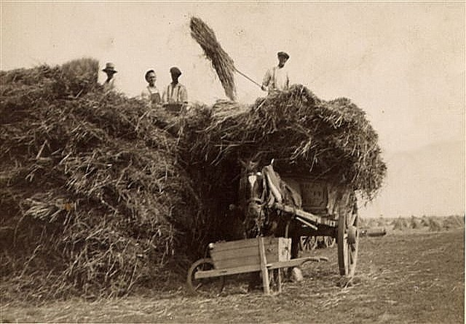
Bucking barley
To buck in this instance is to throw large bulks of barley grass onto a truck or horse drawn trap. The barley gets turned to grain which is poured into large burlap bags and passed brigade-style to another truck or trap to be sold.

Slide 18
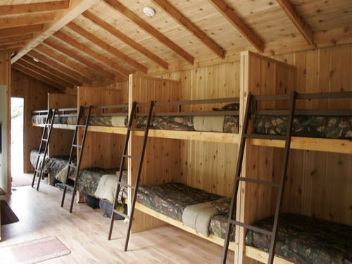

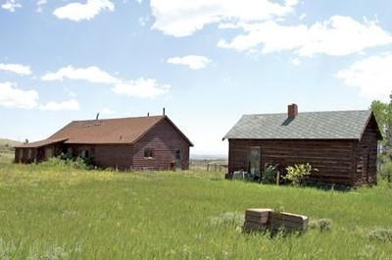
Ranch life
Ranch workers would have to live in cramped conditions with many people sharing a one-room bunkhouse filled with bunk beds. They would possibly get just one or two shelves for all their possessions.
There may be a table and chairs for social activities – like playing cards or reading magazines.
They would have a sink – usually outside – to wash and shave in, and an outhouse for a toilet.
They would have somewhere to eat their meals. These would be simple and cheap – bosses wouldn’t want to spend much money on workers because it would cut into profit, but also because workers didn’t tend to stay around too long.

Slide 19
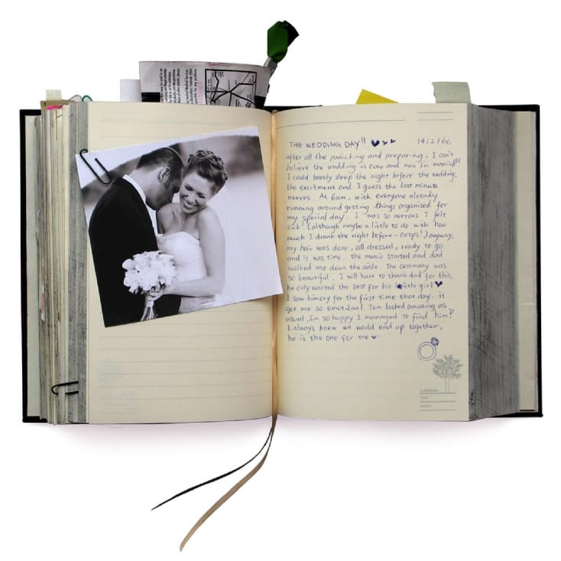
Writing a diary
What is the purpose of a diary?
What are the features of a diary?

Slide 20

Over to you…
Plan
Introduction:
Paragraph One:
Paragraph two:
Paragraph three:
Paragraph four:
Any other paragraphs:
Conclusion:
1-2 pages of writing
Varied sentence structure
Varied punctuation
Adventurous vocabulary
Clear emotion
A range of methods used (think: SOSMAPS)
Appropriate tone of voice

Slide 21

Writing your diary entry
You should start by addressing your diary in some way, and making it clear what mood your character is in
If something really dramatic has happened then you may want to describe that first – in diaries you’ll often list events based on how they make you feel, or because the dramatic events are more clear in your mind
If you are writing it chronologically don’t forget to use connectives!
You don’t want to repeat the same words – especially because you’ll be talking about emotions and feelings a lot – so use a thesaurus to help you

Slide 22

Editing your diary entry
Highlight/ circle any words you could improve and use a thesaurus to edit
E.g. ‘I went to the dining room, I was feeling so hungry’
Look at every verb you have used and see if you can in any adverbs
E.g. I slowly and dejectedly ambled along to the dining room, I was feeling so famished.
Look at your sentence types and try to vary your sentence structure
E.g. Slowly and dejectedly, I ambled along to the dining room. I felt famished.
Can you add any more contextual links?
E.g. Slowly and dejectedly, I ambled along to the dining room. I felt famished. I wasn’t expecting much though, not since the dust bowl had destroyed so many of the crops around here.
Look at your punctuation use, edit to add in a variety of punctuation
E.g. Slowly and dejectedly, I ambled along to the dining room. I felt famished! I wasn’t expecting much though, not since the dust bowl had destroyed so many of the crops around here… When will I have a decent dinner again?!
ambled
famished

