Slide 1
Of Mice and Men: An Introduction
The following should be roughly enough work to cover one week of lessons, allowing for additional reading

Slide 2
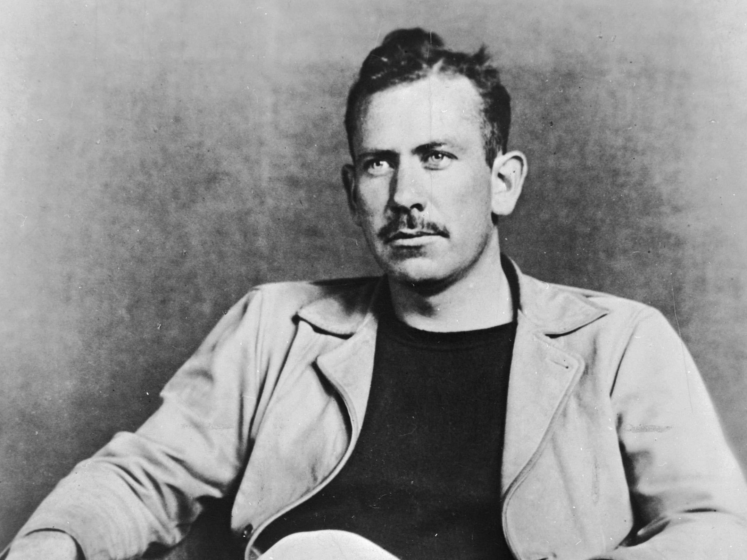
John Steinbeck fact file
Create a fact file about John Steinbeck. You should focus on when he was alive, what his work history was, what his family life was and any political views you can find.
Your findings can be written in bullet point notes.

Slide 3
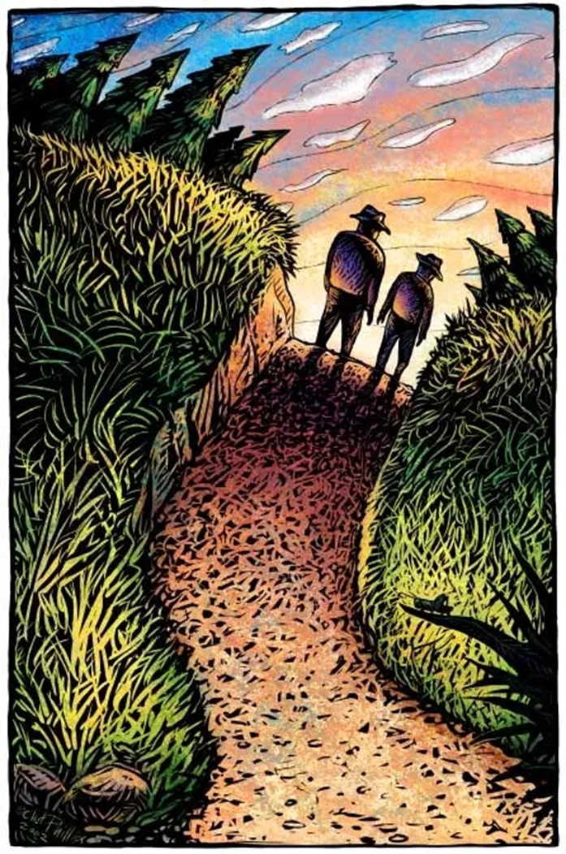
Read Chapter One
http://giove.isti.cnr.it/demo/eread/Libri/sad/OfMiceAndMen.pdf
Please find a PDF copy of the novella here.
https://www.youtube.com/watch?v=XIU5PH4_Yno
And a link for a YouTube audio version to read along to.

Slide 4
Chapter One analysis
Learning objective: To explore the events of chapter one and what we learn about George and Lennie

Slide 5
What happens and how does it link to context?
Create a flow chart to plot what happens in Chapter One. Throughout the stages see if you can link what’s going on to our knowledge of what life was like in those times
John Steinbeck describes the landscape for the setting of Chapter One. It is very calm, tranquil and full of nature, for example: ‘…’

Slide 6
Inference
It’s a bit like reading between the lines….
Or seeing a piece of text as full of clues and hints which you need to work out.
Writers don’t want to have tell us every bit of detail in an obvious way, so they hint at things.

Slide 7
What can you gather about this man from this piece of text? That’s inferring!
The man opened his front door and went into his house. It was dark, and cold, from remaining empty all day. He wondered through to kitchen, flipped the light and sat at the table opposite nothing but a blank wall. It was a table for four, but only he ever sat there. “Looks like dinner for one. Again.” He muttered to himself, something he did a lot just to fill the void and break the deafening silence.
He put the kettle on to boil and took his mug off of the draining rack. He did have others, stacked up and attracting cobwebs on one of the cupboards that lined his tiny kitchen. After making his tea he opened up the fridge, scanning for leftovers. He liked to cook, but there was always so much left over that he ended up having to eat the same meal for days.

Slide 8
The protagonists: George and Lennie
Wanted!
Reward: $500
Name: George Milton/
Lennie Small
Description:
What do they look like?
Personality:
How do they act? How do they treat each other?
Things to look out for:
Is there anything to know about them that might make it easier or harder to catch them?
Backstory:
Why are they on the run?
Your challenge is going to be to create two wanted posters – one for George and one for Lennie. You will be skimming and scanning and using your inference skills of Chapter One to fill your posters with as much information as possible

Slide 9
Language analysis – zooming in
Lennie:
‘…dragging his feet a little, the way a bear drags his paws
What are your connotations of a bear?
What about of a teddy bear?
How could these represent Lennie?

Slide 10
What are your first impressions of George and Lennie in Chapter One in Of Mice and Men?
Learning objective: To explore how we can use our knowledge of these two characters to answer this question.
We will have a go at doing together and then you will complete the second.

Slide 11
Make a point that answers the question.
One of my first impressions is...
Use a quotation to back up your point.
Steinbeck creates this impression by using the word/phrase…
What does the quotation suggest?
This suggests/creates/ highlights/emphasises….
What words in the quotation are particularly effective?
The words…. are particularly effective because they have connotations of…
What effect/impact do these words have on the reader?
They make the reader think/feel…
Can you draw any conclusions from this or are there any other interpretations?
Another interpretation could be…

