Slide 1
Hope and Despair
Learning objective: To explore the words ‘hope’ and ‘despair’ and what a topic of this theme could involve.
To begin looking at a period of time filled with hope and despair

Slide 2
Warm up task
Title: ‘Hope and Despair’: An Introduction
Write a definition for both ‘hope’ and ‘despair’
Write as many synonyms as you can for each of these words

Slide 3
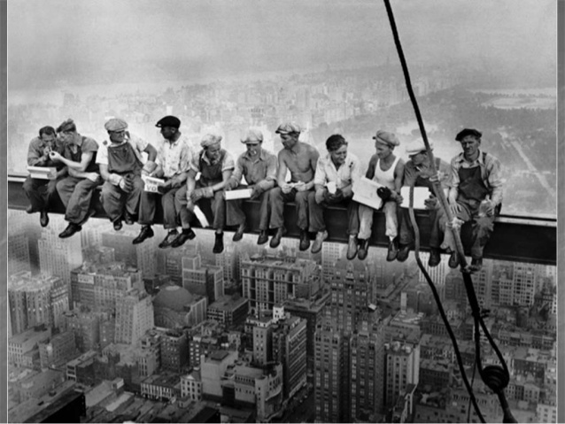
Context: The Roaring Twenties in America

Slide 4
Quick task: Connotations of ‘roar’

Slide 5
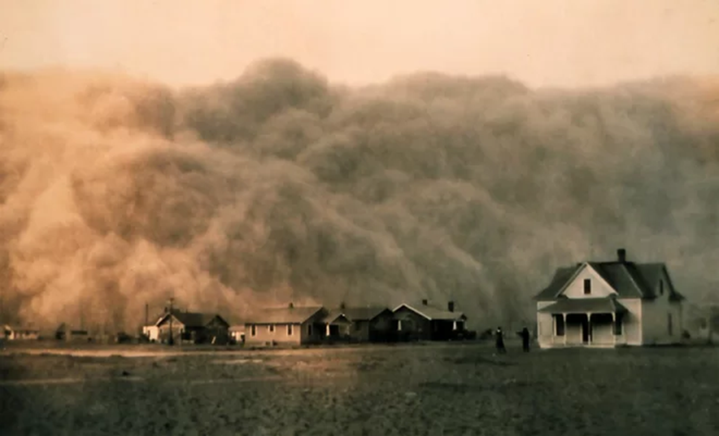
The Dustbowl
You’re going to look at one example of something that was going on during America in the twenties which contributed to the feeling of despair among many living in rural, less affluent areas.

Slide 6
Draw a table like the one below. Each box is linked to a picture on a following slide. You need to fill in the box with… What do you think is going on in the following images?
What words/ phrases come to mind?
Picture 1: | Picture 2:
Picture 3: | Picture 4:
Stretch yourself: Can you also add to your table sophisticated descriptive words for each picture

Slide 8
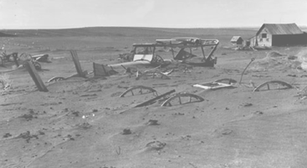

Slide 9
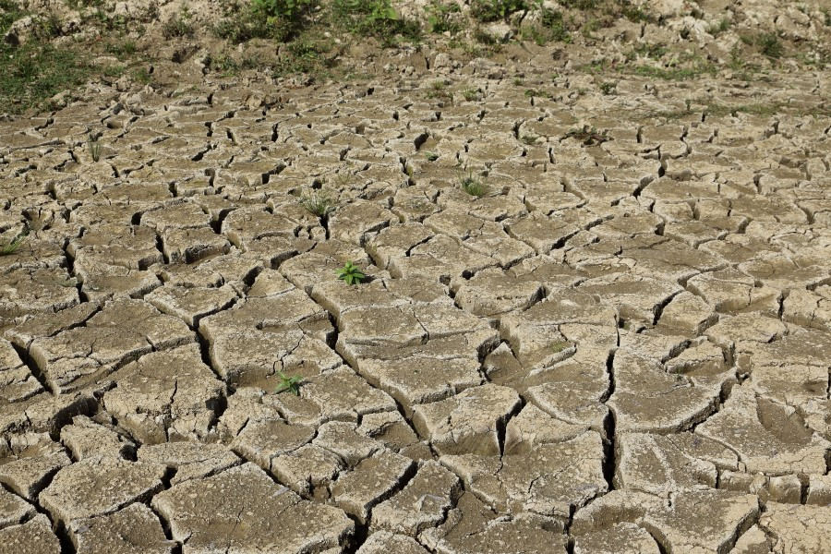

Slide 10
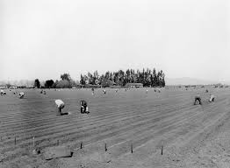

Slide 11
Summarise the information below in one paragraph or no more than 5 bullet points
The Dust Bowl, also known as the Dirty Thirties, was a period of severe dust storms that greatly damaged the ecology and agriculture of the American prairies during the 1930s; severe drought and a failure to apply dryland farming methods to prevent wind erosion caused the problem. The drought came in three waves, 1934, 1936, and 1939–1940, but some areas experienced drought conditions for as many as eight years
During the drought of the 1930s, the dry soil turned to dust, which winds blew away in huge clouds that sometimes blackened the sky. These choking billows of dust – named "black blizzards" or "black rollers" – travelled cross country. On the plains, they often reduced visibility to 3 feet (1 m) or less.
The Dust Bowl forced tens of thousands of poor families to abandon their farms, unable to pay mortgages or grow crops. Many of these families migrated to California and other states to find that the Great Depression had left economic conditions there little better than those they had left.

Slide 12
Your teacher has asked you to enter a writing competition. Using this picture as inspiration either:
Write a description that is inspired by this image
Write a narrative titled ‘The day the dust hit’

Slide 13
Peer assess and Purple Pen (the 3 p’s!)
Have you used basic punctuation such as capital letters and full stops?
Have you used punctuation such as commas, question and exclamation marks?
Have you used more challenging punctuation such as colons, semi colons and ellipsis?
Have you used sentence structure for effect?
Have you used paragraphs?
Have you varied your paragraph length throughout?
Have you written in the same tense throughout?
Have you circled spellings you are unsure of and checked them in the dictionary?
Have you used ambitious vocabulary?
Have you circled words that you could make more ambitious and used a thesaurus to change them?
Now give yourself a wish for the future by using the success criteria above:
In the future I will…

Slide 14
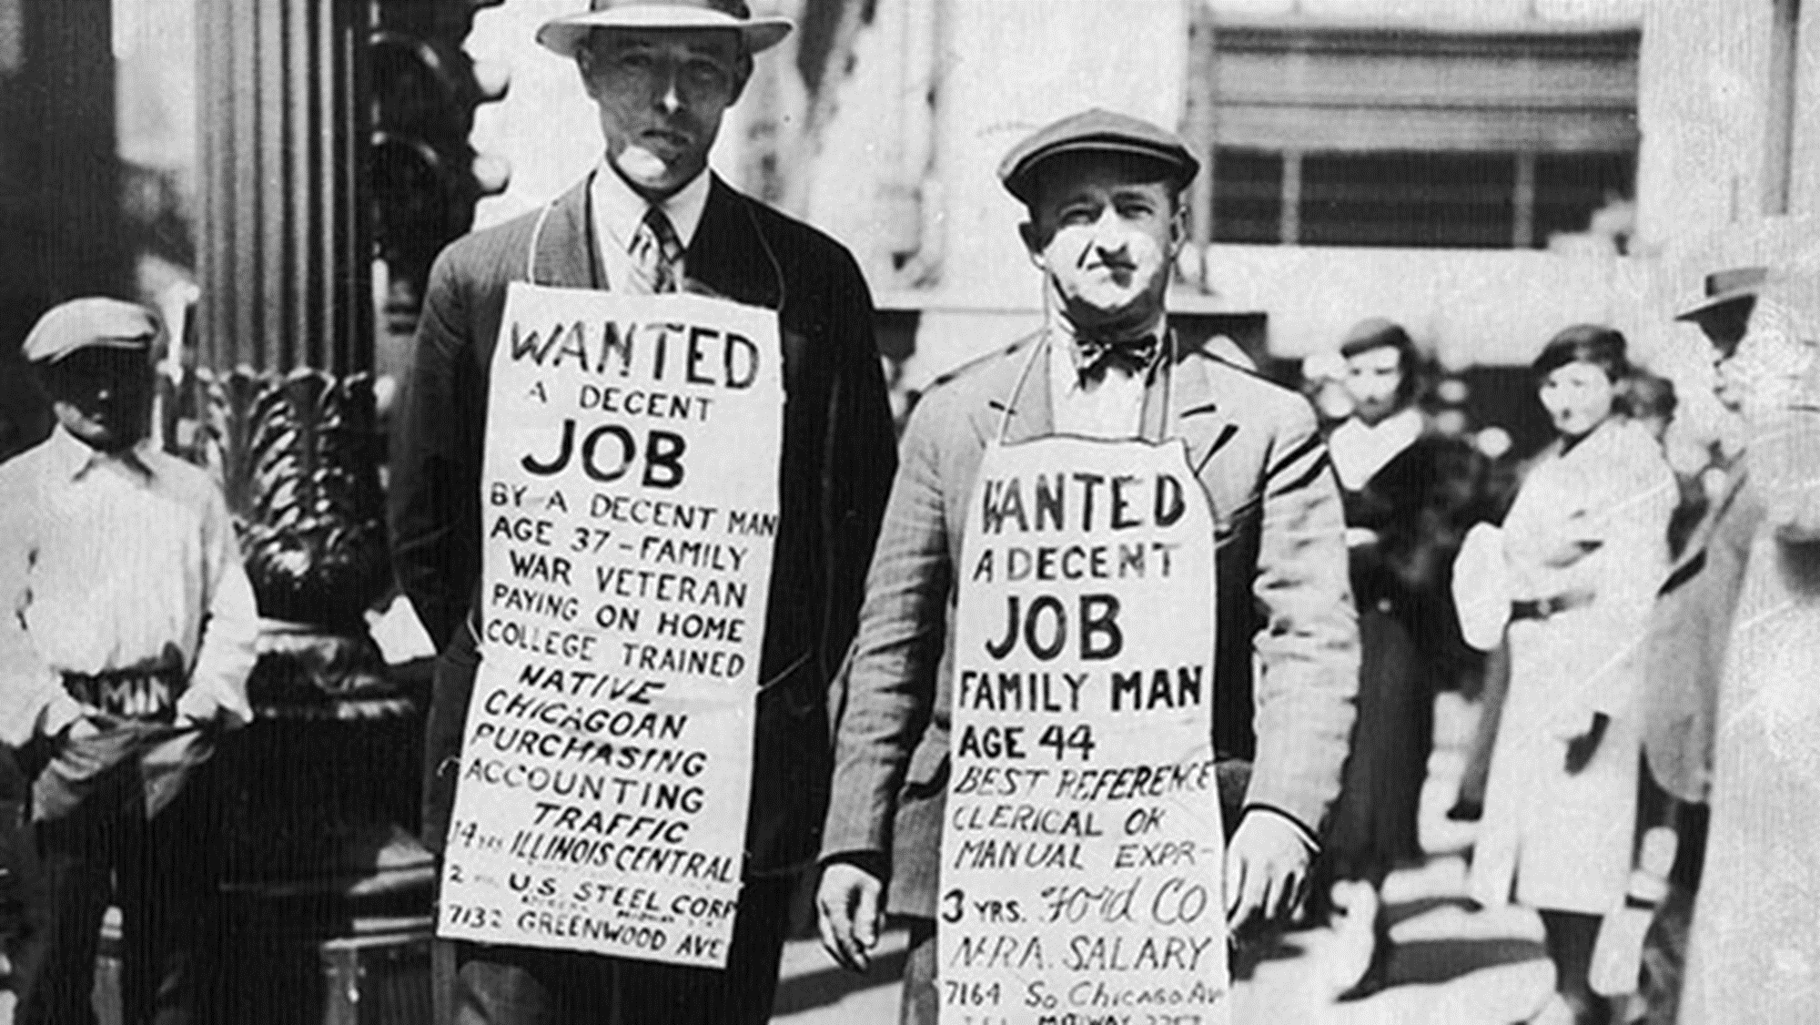
Meanwhile in the city…
The Great Depression

Slide 15
The Great Depression
The Great Depression was the worst economic downturn in the history of the industrialised world, lasting from 1929 to 1939. It began after the stock market crash of October 1929, which sent Wall Street into a panic and wiped out millions of investors. Over the next several years, consumer spending and investment dropped, causing steep declines in industrial output and employment as failing companies laid off workers. By 1933, when the Great Depression reached its lowest point, some 15 million Americans were unemployed and nearly half the country’s banks had failed.
Write out information about The Great Depression in your own words.

Slide 16
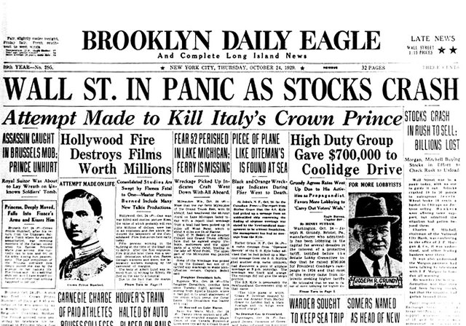
Create three newspaper headings reporting the Wall Street Crash from the 1930s.
Extension: Create three contrasting news heading which you may find in the news today if the same thing happened.
How would they differ? Why?

Slide 17
So where was the hope…?

Slide 19
What are dreams? Is it good or bad to have dreams? Is there anything that we as a society all dream of?
Create a spider diagram as a way of noting down all your thoughts about these questions – you may be able to see different points of view

Slide 20
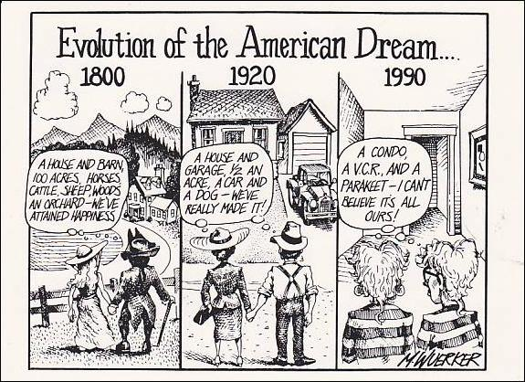
How has what's important to us changed over the years?

Slide 21
What was the American Dream?
The American Dream is a national ethos of the United States, the set of ideals (democracy, rights, liberty, opportunity and equality) in which freedom includes the opportunity for prosperity and success, as well as the ability to move up in society for the family and children, achieved through hard work. In 1931 a definition of the American Dream said: "life should be better and richer and fuller for everyone, with opportunity for each according to ability or achievement" regardless of social class or circumstances of birth.
The American Dream is rooted in the Declaration of Independence, which proclaims that "all men are created equal" with the right to "life, liberty and the pursuit of happiness."
New vocab!
Ethos: set of beliefs, morals, ideas
Ideals: a standard to aim for
Prosperity: wealth and success
Think, discuss, write:
What do you think the American Dream is (in your own words)?
Do you think there is still evidence of this today? Where?

