Slide 1
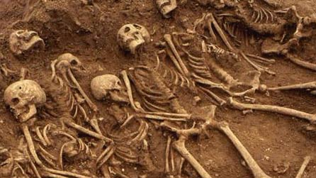
‘Remains’ by Simon Armitage
Please note:
You do not need to print off this PowerPoint.
It is designed to take you through the work step by step and some slides will just be to give you information.
Each block is roughly enough work for one week of lessons.

Slide 2
What does the word ‘remains’ mean to you? What are the connotations?
AO1

Slide 3
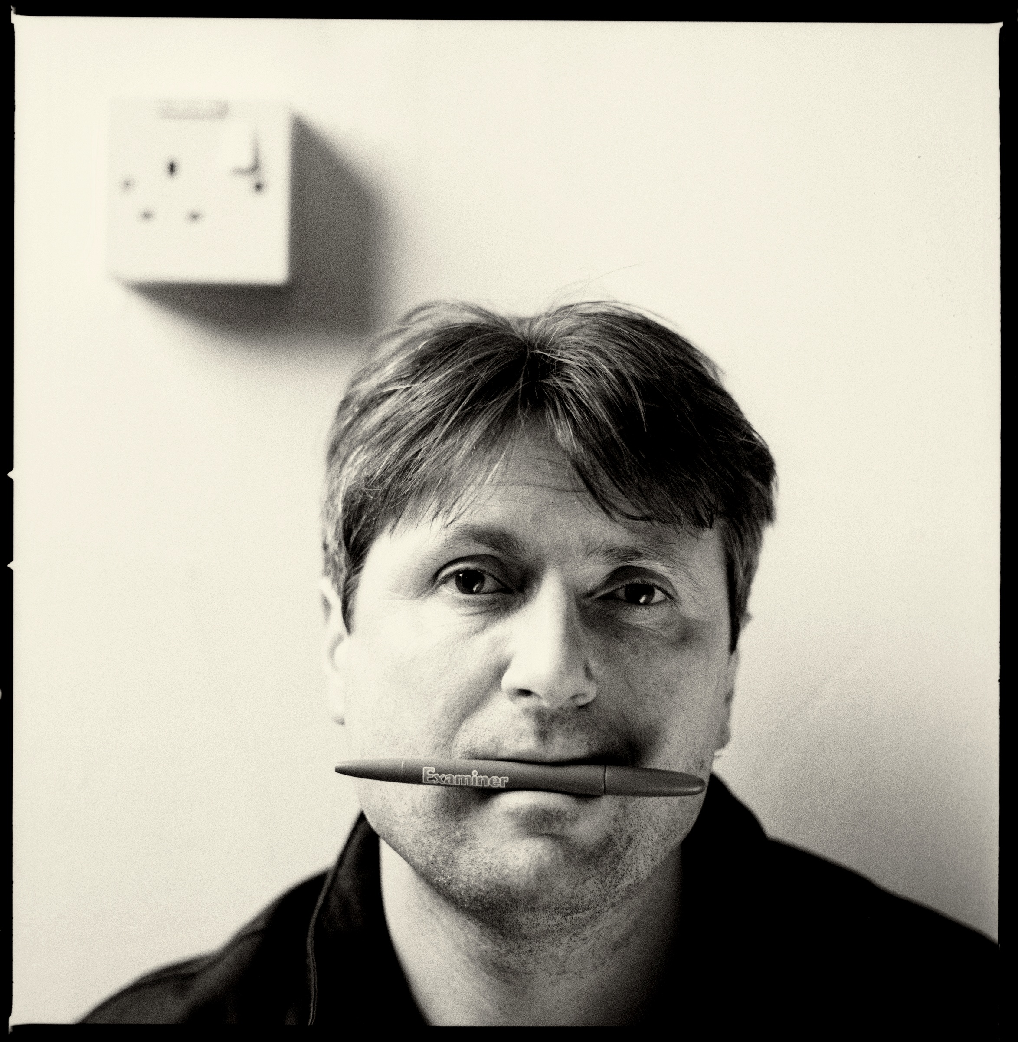
The poem:
AO1
https://www.bbc.com/education/guides/zcsjmnb/revision/1
(read by Simon Armitage)
First impressions?

Slide 4
Understanding Context
Create a project with research on PTSD (Post Traumatic Stress Disorder) and specifically how it links to war
This could be in the form of a poster, a leaflet or a PowerPoint presentation
Try to find out current statistics, help provided by the forces and when PTSD became recognized
Also research the specific inspiration for this poem

Slide 5
Imagining ‘Remains’
On the following slides, and the accompanying resource, there is a set of images. Your challenge is to try and link each of these images to one quote from the poem

Slide 6
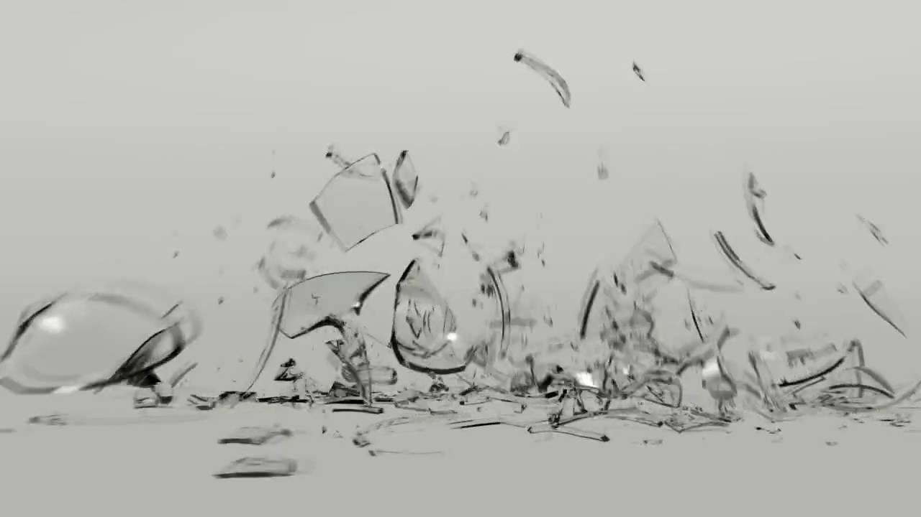
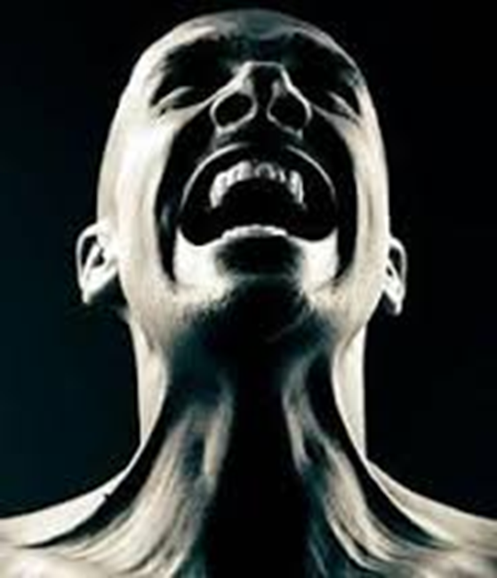
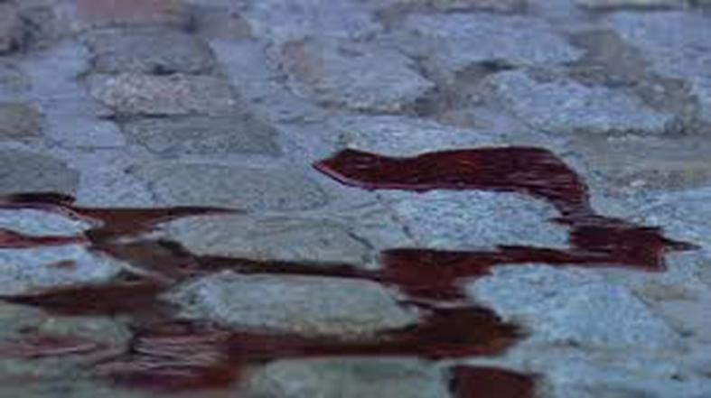
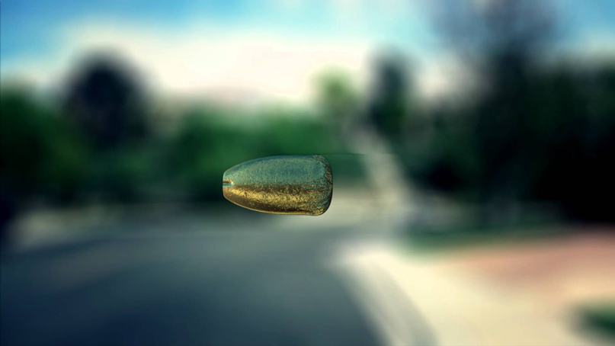
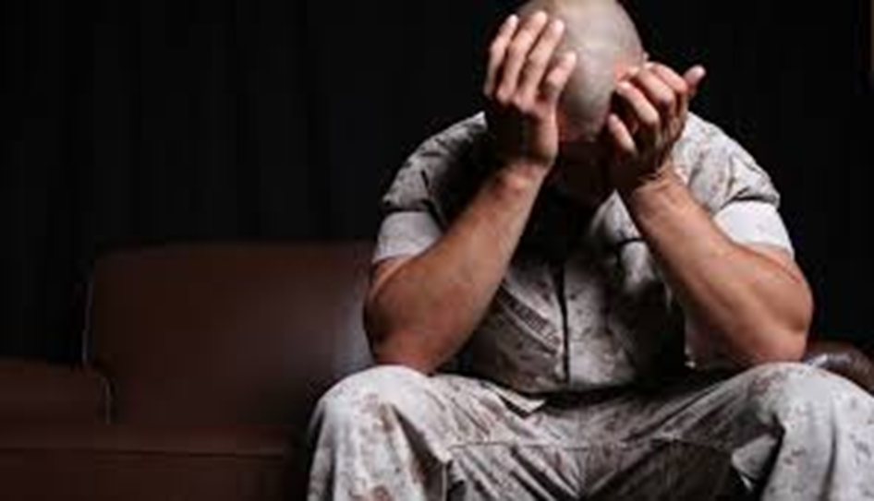

Slide 7
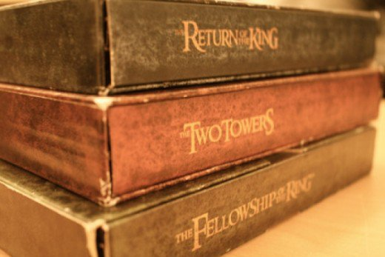
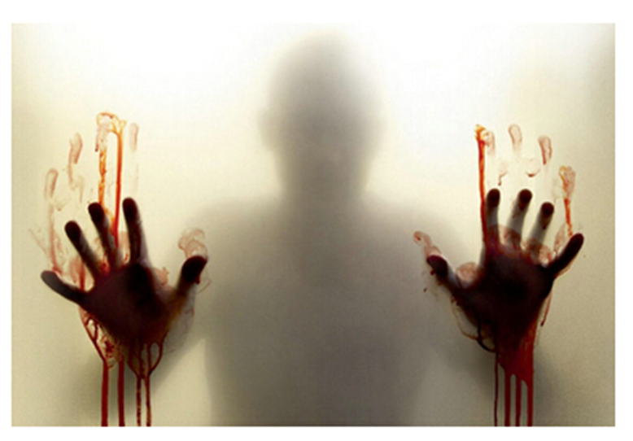
Book One
Book Two
Book Three

Slide 8
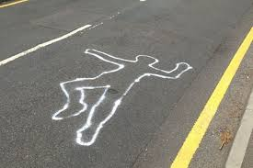
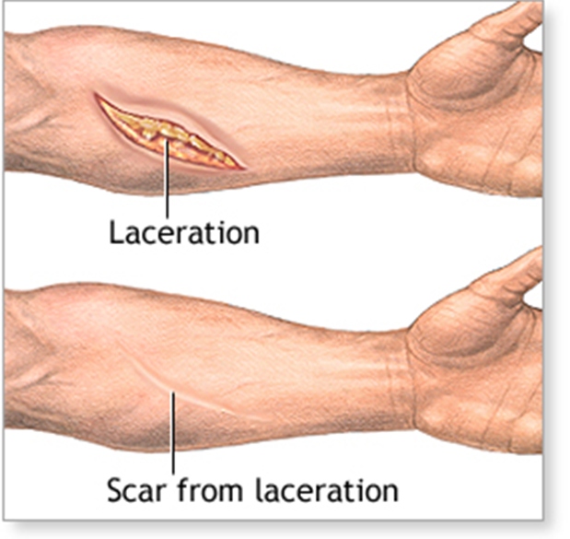
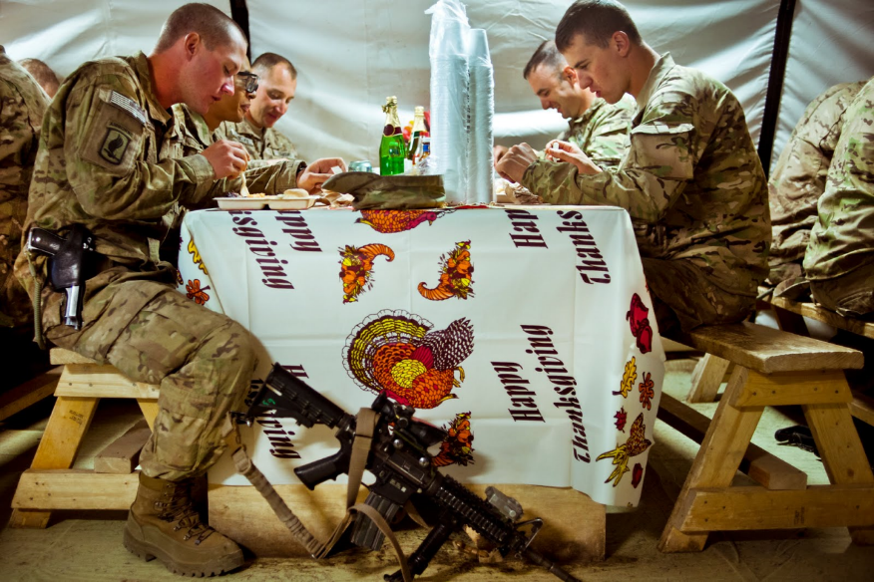

Slide 9
AO1
Note down the following information in your own words
The poem is told anecdotally and begins with ‘On another occasion’, implying that this account is not the only unpleasant account the soldier has in his memory. He tells how he and ‘somebody else and somebody else’ opened fire on a looter who may or may not have been armed. They shot him dead and one of them put the man’s ‘guts back into his body’ before he’s carted away.
Later the soldier thinks about the shooting every time he walks down the street. Then later again, when he returns home he is still haunted by the thought of what he has done. He tries drink and drugs to drown out the memory, but they do not work. The line ‘he’s here in my head when I close my eyes’ indicates this.
The final lines show that the memory was not left behind in the place of war in a distant land, but is with the speaker all the time. He feels as though he will always have blood on his hands.

Slide 10
Write a summary, in your own words, for what the poem is about
AO1

Slide 11
Use the following slides to annotate the poem. If you don’t have access to your anthology/ a printer you can copy the poem into a word document and make notes using text boxes.

Slide 12
This makes it sound like we have come in mid conversation, as If the narrator has just been talking about another story just like this
Informal– chatty and conversational. He is comfortable talking about this.
On another occasion, we get sent out
to tackle looters raiding a bank.
And one of them legs it up the road,
probably armed, possibly not.
Well myself and somebody else and somebody else
are all of the same mind,
so all three of us open fire.
Three of a kind all letting fly, and I swear
Assonance of monotonous ‘o’ sound. Also line is split in half with four syllables on each. Rhythmic, rehearsed as if he has to say it a lot or almost as if he chants it to himself - PTSD
List-like – because there’s so many people. Says ‘somebody else’ instead of naming them. Can’t remember? So he doesn’t get others involved? Or because their identity doesn’t matter?
From the phrase ‘two of a kind’ to describe two people who are really similar. They are no longer individuals, also takes away blame again.

Slide 13
Use of the senses – focus on ‘sight’. Links to PTSD and the idea that they still see what they went through at war.
Could this be the soldier trying to see the light, or see the bright side of what he’s doing.
I see every round as it rips through his life –
I see broad daylight on the other side.
So we’ve hit this looter a dozen times
and he’s there on the ground, sort of inside out,
pain itself, the image of agony.
One of my mates goes by
and tosses his guts back into his body.
Then he’s carted off in the back of a lorry.
No one person or shot is to blame.
Excessive amounts for one looter.
Graphic images – reality of war. No longer phased by gore.
He sees the people he is with as close comrades. There’s no blame, or hard feelings.
Makes him sound like an object to be ‘carted’ around – like rubbish thrown in the back of a lorry

Slide 14
Contradiction. He thought it was the end but it wasn’t – just like we think war ends when the soldiers leave but for them it doesn’t actually
Metaphoric – shadows reflect us and are attached/ follow is around. Blood/ people killed will attach themselves to you too
End of story, except not really.
His blood-shadow stays on the street, and out on patrol
I walk right over it week after week.
Then I’m home on leave. But I blink
and he bursts again through the doors of the bank.
Sleep, and he’s probably armed, possibly not.
Dream, and he’s torn apart by a dozen rounds.
And the drink and the drugs won’t flush him out –
Repetitive life. Also shows that ‘life’ goes on.
Repeated quote. Shows it must be an important one. Reflects how events repeat themselves in PTSD sufferer’s minds
Same as above – the events happen in his dreams. He has no control over this. ‘Dreams’ should have positive connotations
There is a reason why soldiers turn to these habits, it’s to try and ‘cure’ themselves, or just numb the pain. Yet society judges.

Slide 15
Metaphoric – he is ‘enemy lines’ and the memory is ‘dug in’ into his mind, so buried there. The event is stuck in his head, and the fact he sees himself as the ‘enemy’ suggests guilt.
he’s here in my head when I close my eyes,
dug in behind enemy lines,
not left for dead in some distant, sun-stunned, sand-smothered land
or six-feet-under in desert sand,
but near to the knuckle, here and now,
his bloody life in my bloody hands.
Sibilance – ‘s’ sounds. Could replicate the spitting/ hissing sound people make when saying things angrily.
Or possibly could be because it is a soft sound, and these images are places we associate with holidays and relaxing – which is the opposite of the truth - irony
Repetition of ‘bloody’ – shows what is in his mind. Also metaphor for guilt.

Slide 16
Write out between 3 and 5 key quotes, then complete the below for each of them:
What is going on in the poem at the point where this quote can be found?
What is so interesting about this quote?
Are there any interesting words or techniques in this quote?
What is the effect of this quote on the reader/ how would it make a reader feel?
What themes could you use this quote to help you discuss?
What is the poet’s intentions with writing this into their poem?

Slide 17
How has Simon Armitage presented the feelings of the soldier in ‘Remains’?
Ideas for your answer:
No longer bothered by the gore and brutality of war – use of informal language
He feels like he will never be able to forget what happens in the war
He feels like you lose your identity when you’re a soldier
He feels like he shouldn’t have shot the looter
He feels like this man is haunting him
Now find a quote that proves he is feeling this way
Tell me one feeling/ attitude/ view of the soldier’s
The soldier’s feelings

Slide 18
How has Simon Armitage presented the feelings of the soldier in ‘Remains’?
POINT: Tell me on way in which the soldier is feeling from your plan
Simon Armitage has presented the soldier as feeling….
EVIDENCE: Now you need to prove to me that he is feeling this way with a quote taken directly from the poem
Evidence of this is ‘…’
ANALYSIS: Now you need to explain how this quote proves what you have said.
Try to zoom in on techniques and word choices and discuss their connotations and how they make the reader feel.
This can then help you think about why the poet wants to write a poem about a soldier seeing/ experiencing/ feeling this

Slide 19
How has Simon Armitage presented the feelings of the soldier in ‘Remains’?
Simon Armitage has presented the soldier as being immune to the brutalities of war.
Evidence of this would be the informal and colloquial language choices the soldier uses to tell the story of what happened, such as ‘Mates’, ‘tosses’, ‘sort of’ and ‘leg it’.
Readers would associate these with casual conversations about everyday events – not the killing of a civilian in war torn country. The verb ‘tosses’ would have connotations of throwing balls, or invaluable objects, and not the ‘guts’ of human body you’d just killed. Readers would also think that the noun ‘mates’ is one they’d use when discussing socialising casually with close friends, not being sent out to kill people.
The informal language suggests the soldier is quite happy to discuss the events, and isn’t bothered by the brutal event he is discussing. Armitage may have done this because he wants to shock the readers. He wants people with no comprehension of war to understand how what may disgust us has become the everyday lives of soldiers. This immunity to the horrors they experience is a way of trying to get society to understand how hard it will be for a soldier to come back to our lifestyle, to help us empathise with people post war, because Armitage may believe that the army isn’t doing enough to help soldiers.

Slide 20
Poetry Inspired Writing Task
In your language exam you will have to produce a piece of creative writing ‘inspired by’ an image or a word/ phrase
Your challenge now is to take one quote from ‘Remains’ and turn it into a piece of writing
This could a short story, an opening to a story, a poem, a letter or a diary
This piece of writing does not need to be about war or PTSD, the only thing it needs to link to is the single quote
You need to fill at least one A4 page, can be any narrative (1st person etc.)
Try to include ambitious word choices, varied punctuation and sentences and methods (e.g. simile, metaphor, alliteration…)
Think about the structure of the piece – how will you start it? Will the end link to the start? Etc.

Slide 21
Further watching and reading
The Not Dead – created by the poet and inspiration for this poem
The Invisible Wounded with Ross Kemp – PTSD sufferers
Both of these can be accessed on ClickView using your usual school log in (please be aware they do contain swearing!)

