Slide 1
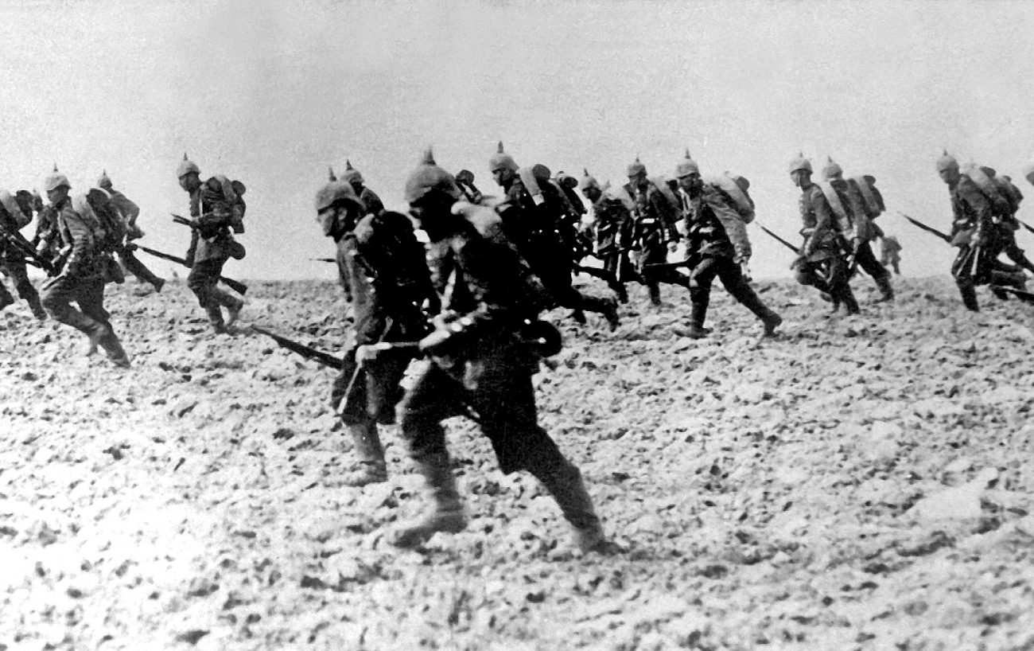
Bayonet Charge, by Ted Hughes

Slide 2
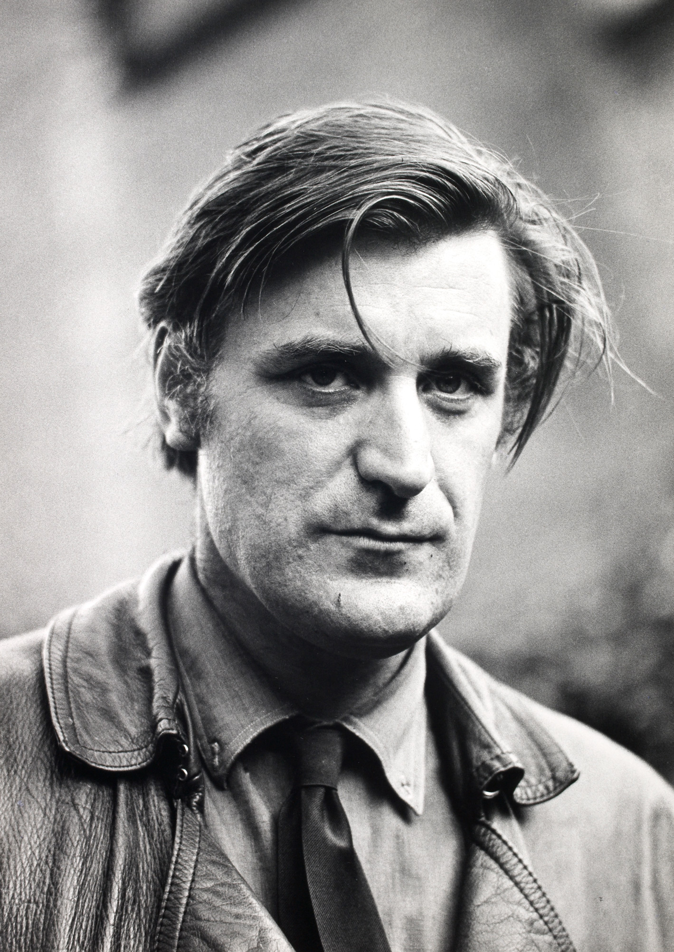
Ted Hughes
Read through this slide and the next to get some context about the poet behind ‘Bayonet Charge’
1930-1998
was an English poet, translator, and children's writer.
Critics frequently rank him as one of the best poets of his generation, and one of the twentieth century's greatest writers. In 2008 The Times ranked Hughes fourth on their list of "The 50 greatest British writers since 1945"
He served as Poet Laureate from 1984 until his death.
He had a sister two years older and a brother ten years older
Hughes loved hunting and fishing, swimming and picnicking with his family. He grew up surrounded by the harsh realities of working farms in the valleys and on the moors

Slide 3
Hughes won an open exhibition in English at Pembroke College, Cambridge, but chose to do his National Service first. His two years of National Service (1949–51) passed comparatively easily. Hughes was stationed as a ground wireless mechanic in the RAF on an isolated three-man station in east Yorkshire, a time during which he had nothing to do but "read and reread Shakespeare and watch the grass grow“
He initially studied English at university, which went well but he attended few lectures and wrote no more poetry at this time, feeling stifled by literary academia and the "terrible, suffocating, maternal octopus" of literary tradition
After university, living in London and Cambridge, Hughes went on to have many varied jobs including working as a rose gardener, a nightwatchman, a reader for the British film company and at London Zoo as a washer-upper
He met his future wife at a party, she was American and an already published poet. They helped and supported each other’s writing, had two children but separated when he met another women. She committed suicide

Slide 4
Hughes’ Inspiration
Read through the accompanying resource about Ted Hughes and his links to the war and the answer the questions below:
Which of Hughes’ relatives went to war?
Hughes completed National Service – what does this mean?
What is it referred to when men from the same towns and villages went to war together?
What did Hughes refer to men who came back from war as?
What does this reference (and metaphor) suggest?
Did Hughes discuss his fathers’ time at war with him? Provide evidence.

Slide 5
What is the tone of the poem?
Positive word choices | Negative word choices
Copy out this table and read through to find positive and negative phrases
The poet has used a large amount of ________ words, this gives the reader a first impression that he _______ with war.

Slide 6
The voice of the poem
Find and label the pronoun which tells us the narrative form of the poem
Create a flow chart for what happens in the poem
The soldier wakes up ‘suddenly’ and is ‘running’ and ‘stumbling across a field whilst being shot at.

Slide 7
Annotating Bayonet Charge
Highlight/ underline all the verbs in the poem
Highlight/ underline and label any examples of sibilance, assonance, plosives, alliteration and onomatopoeia
Highlight/ underline and label all the similes
Highlight/ underline all the graphic and grim imagery
Then look at the next slide to see (and note down) the effect of these

Slide 8
Analysing Bayonet Charge
The excessive use of verbs, such as ‘running’, ‘jumped’, ‘crawled’, ‘plunged’ creates a fast paced, action packed poem – replicating the fast paced, action packed nature of the battle the soldier is experiencing
The sibilance, plosive and onomatopoeia replicate the sounds of war and fighting. Bullets whizzing past, explosions, gun shot etc.
The large amount of similes used shows the poet is having to compare what is happening in the poem to other things readers may understand. Perhaps this also suggests he finds it hard to talk about – reflecting Hughes’ own reaction to his family’s time in the war
There are some very graphic/ grim images: ‘smashed arm’, ‘threw up a hare’, ‘bullets smacking’. These suggest the poet wants to present the realities of war and go against the propaganda that glamorised wars and fighting. He wants to shock.

Slide 9
Use the next few slides to annotate and look at the methods Hughes has used…
If you don’t have access to a printer you can copy the poem into a word document and make notes on that using a text box.

Slide 10
This is a technique called media res, which is where a piece of writing starts in the middle of action. Here, the soldier has been ‘suddenly’ woken up so we can assume something dramatic and action packed is happening and he is straight away involved in it. How does this compare to TCotLB?
Suddenly he awoke and was running – raw
In raw-seamed hot khaki, his sweat heavy,
Stumbling across a field of clods towards a green hedge
That dazzled with rifle fire, hearing
Bullets smacking the belly out of the air –
He lugged a rifle numb as a smashed arm;
The patriotic tear that had brimmed in his eye
Sweating like molten iron from the centre of his chest, –
This is a technique called oxymoron, which is where two opposite words are put together to form a phrase which shouldn’t make sense, e.g. ‘bitter sweet’. Sweat isn’t actually heavy, the weight of it is miniscule. This could be suggesting it’s the things making him sweat that are weighing him down. How does this compare to TCotLB?
Personification – tears can’t be patriotic. He is crying for his country – this could have a double meaning. A soldier may cry because they are so loyal to their country, but he could also be crying because of how much he doesn’t want to do what he is doing for his country. How does this compare to TCotLB?
This simile again suggests the sweat is heavy, but it’s also something being melted, and that something is coming from the ‘centre of his chest’ where our heart is. His heart could be melting and sweating, he is experiencing heart break for what he’s doing? His country? Death? How does this compare to TCotLB?

Slide 11
This suggests hesitation, and the verb ‘stopped’ contrasts to all the quick action verbs used so far. How does this compare to TCotLB?
Rhetorical question suggests confusion and that he’s questioning what he’s doing, this links in to the fact he ‘almost stopped’. How does this compare to TCotLB?
In bewilderment then he almost stopped –
In what cold clockwork of the stars and the nations
Was he the hand pointing that second? He was running
Like a man who has jumped up in the dark and runs Listening between his footfalls for the reason
Of his still running, and his foot hung like
Statuary in mid-stride. Then the shot-slashed furrows
This simile makes the reader think of someone who has awoken suddenly and dpesn’t know why they are running – links in to both the previous points. How does this compare to TCotLB?
We are now being told he is trying to find the reason for him being there, he doesn’t think the fighting and war is necessary or good – he is no longer patriotic? Or he at least doesn’t agree with what his country is doing. How does this compare to TCotLB?
Sibilance and onomatopoeia replicate shots ‘slashing’ into the ground – he no longer has time to think. How does this compare to TCotLB?

Slide 12
Personification – the ground is ‘vomiting’ up the hare. The earth and nature is getting caught up in all the manmade fighting, it has lost power. How does this compare to TCotLB?
Similie – it keeps going, like flames last for ages. Also quite a graceful/ elegant movement which juxtaposes the fighting which is not elegant or graceful. Nature is the only thing remaining dignified. How does this compare to TCotLB?
Threw up a yellow hare that rolled like a flame
And crawled in a threshing circle, its mouth wide
Open silent, its eyes standing out.
He plunged past with his bayonet toward the green hedge, King, honour, human dignity, etcetera
Dropped like luxuries in a yelling alarm
To get out of that blue crackling air
His terror’s touchy dynamite.
Connotation of ‘green’: fresh, healthy, full of life, evergreen. Again, images of nature, surviving all this manmade destruction but now he is plunging towards it with his weapon, he is bringing death and danger to nature – loss of power again. How does this compare to TCotLB?
Is this a metaphor? What is the ‘dynamite’? Could it be his terror – about to become too much and explode?. How does this compare to TCotLB?
Simile – he is suggesting that ‘honour’ and ‘human dignity’ and the ‘King’ were all luxuries now being dropped, just like a soldier may drop actual luxuries like food, jewellery etc. He no longer has these things. How does this compare to TCotLB?

Slide 13
Comparing ‘Bayonet Charge’ and ‘The Charge of the Light Brigade’
Learning objective: To explore how we compare poems using ‘Bayonet Charge’ and ‘The Charge of the Light Brigade’

Slide 14
The Charge of the Light Brigade
Similarities
Bayonet Charge
Methods/ ideas/ attitudes etc. that TCotLB has but BC doesn’t
Methods/ ideas/ attitudes etc. that BC has, but TCotLB doesn’t
Copy out this Venn diagram and make notes on the similarities and differences between the poems

Slide 15
How have both Tennyson and Hughes presented attitudes to war and soldiers?
POINT: Tell me one way in which ‘The Charge of the Light Brigade’ has shown us how war is viewed/ treated…
EVIDENCE: Provide a quote which proves what you have said
ANALYSIS: Zoom in on key words within the quote to explain how it is proof, how audiences would respond and what the poet’s intentions are
COMPARISION CONNECTIVE
Now discuss ‘Bayonet Charge’
Now have a go at writing a PEA about ‘TCotLB’ and then comparing it to ‘BC’

Slide 16
How have both Tennyson and Hughes portrayed attitudes to war and soldiers?
Alfred, Lord Tennyson has presented war as being simple and straightforward in ‘The Charge of the Light Brigade’.
Evidence of this is the triplet ‘Theirs not to make reply, Theirs not to reason why, Theirs but to do and die.’
This suggests that the soldiers only need to follow the instructions handed to them, they don’t do anything other than the physical actions required. Whilst this could be taken as a view that the soldiers don’t do much, it is most likely that his perspective is that soldiers shouldn’t be blamed for what they do because they can’t ‘reason why’ and that it’s actually a bad thing because all they can do is follow the order, even if it’s to ‘die’. This would evoke feelings of empathy in readers, because to have no choice in their actions may be straightforward, but that doesn’t make it easy to do.
Similarly, in ‘Bayonet Charge’ Ted Hughes has implied that soldiers don’t always find it easy to complete orders and to serve their country.
This can be seen in the line ‘In bewilderment then he almost stopped’.
The verb ‘stopped’ shows that what he wants is to not fight anymore, that he wants it to end, but ‘almost’ tells readers that despite this he carries on. ‘Bewilderment’…

