Slide 1
Year 10 Home Learning Catch Up

Slide 2
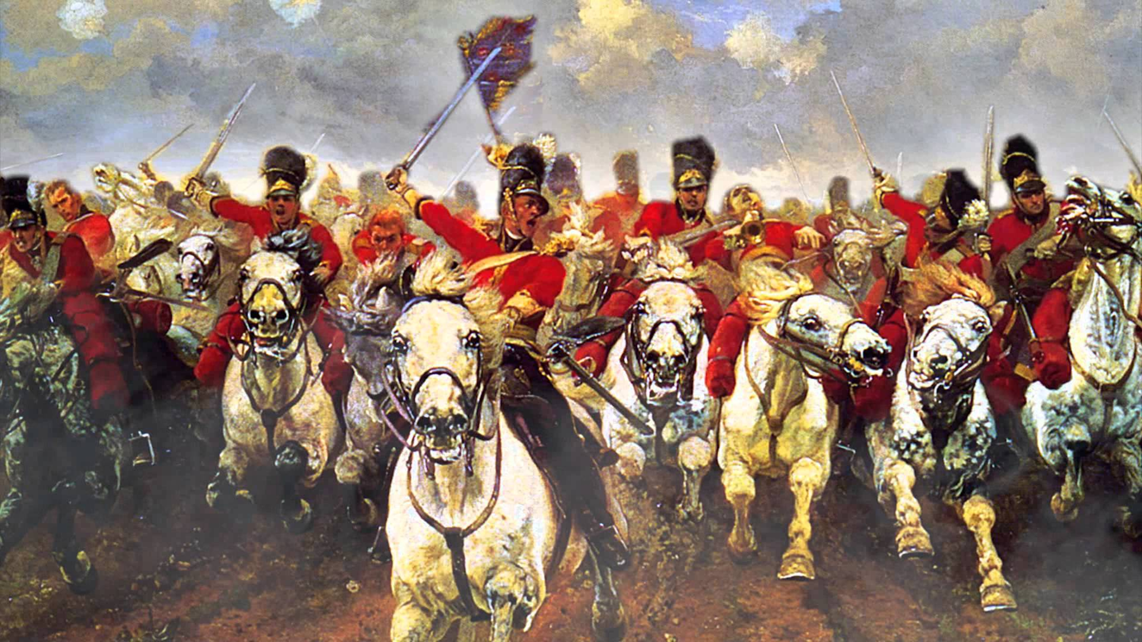
‘The Charge of the Light Brigade’
By Alfred, Lord Tennyson

Slide 3
Key words:
Copy out the key words table, filling in the blanks
Word: | Definition:
Brigade | a subdivision of an army, typically consisting of a small number of infantry battalions and/or other units
Light cavalry | Made up of lightly armed/ armoured troops mounted on horses, as opposed to heavy cavalry, where the riders (and sometimes the horses) are heavily armoured. The missions of the light cavalry were primarily reconnaissance, guarding, raiding, and most importantly, communications.
Patriotic/ patriotism
Honour
Heroism
Duty
Stretch yourself: Now have a go at writing sentences using these words, or variations of them!

Slide 4
What words or phrases come to mind when you see this image? Why?
Stretch yourself: What would these soldiers be feeling? Why? Think about more than just ‘fear for their lives’

Slide 5
AO3: What was ‘The Charge of the Light Brigade’?
http://www.bbc.co.uk/education/clips/z88nvcw
An eyewitness account
http://www.bbc.co.uk/education/clips/zhh9wmn
Read through the first article (What actually happened?) and answer the following comprehension questions:
Who was in charge of the light cavalry?
Which men hated each other?
Who sent the order for the cavalry to charge?
Which opposing country surrounded them?
What was the war called in which this event happened?
How many men are thought to have died and been wounded?
What year did this take place?

Slide 6
Let’s look at Tennyson’s inspiration…
AO1
Read through and underline any words you don’t understand. Use a dictionary to get the definitions and annotate in your own words on your sheet on your sheet.
Highlight/ circle any word choices you think stand out as being different to the types of words we would use in a newspaper article today.

Slide 7
They swept proudly past, glittering in the morning sun in all the pride and splendour of war
AO2 AO3
Let’s zoom in…
Write this quote out, leaving plenty of space around it.
Choose what you think are the key words in this quote. Circle/ underline them, draw an arrow and note down all your connotations/ associations.
How does this quote make the soldiers sound? How would people reading this back home in England feel?

Slide 8
The tone of the poem
AO1
Positive language for the brigade | Negative language for the event

Slide 9
The voice and structure of the poem
AO1
Find a pronoun that tells us what the narrative is in the poem and label
Create a stanza by stanza flow chart of what is happening so that we can understand the structure of the poem
Stanza 1:
The soldiers are half a league away from the valley. They ride into it with the instruction ‘Forward, the Light Brigade! Charge for the guns!’.
Extension:
Write a summary of the poem in either: exactly four lines or exactly 140 characters
Stanza 2:

Slide 10
Reader response
AO1
Find and label imperatives that tells the reader what they need to do in response to the poem
Find and label a word in the second stanza which suggests to the reader that the event was not their fault
Find and label a technique in the third stanza which emphasises to the reader how dangerous and hopeless this event was for the brigade
Find and label an adverb in the third stanza which implies to the reader they were brave, and good soldiers
Find and label a phrase in the fourth stanza which suggests the soldiers had a lot of support
Find and label the technique in the sixth stanza which makes the reader question the event, and feel guilt

Slide 11
Poet’s methods
AO1
AO2
Copy these definitions into your books and find an example of each in the poem:
Plosives: Sounds starting with t,k,p,d,g,b. They make a hard, explosive sound. Sibilance: Makes a hissing sound, starting with s or sh. Assonance: Repeated vowel sounds Alliteration: Repetition of the first letter Onomatopoeia: Words which resemble to sound made

Slide 12
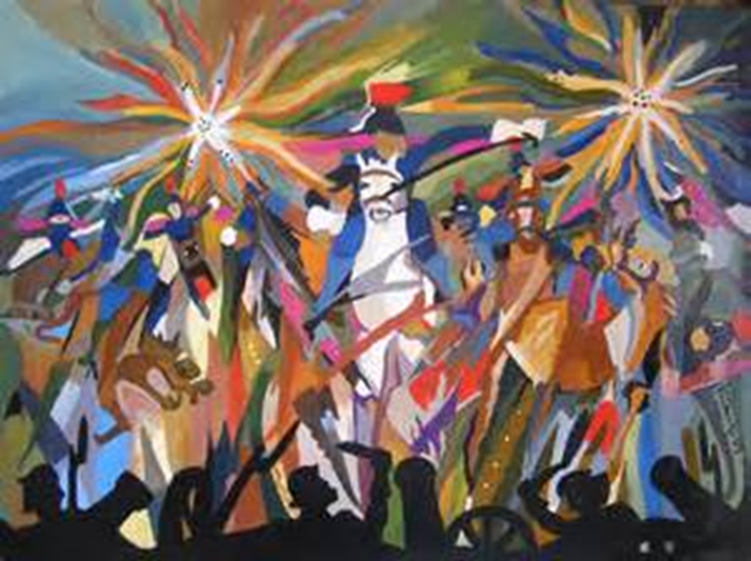
Finally, annotate your copy of the poem with the following notes…

Slide 13
Repetition – can suggest the charge (1 ½ miles) seems ever ending and also rhythmic, to help represent the rhythm of hooves
Death has a capital letter, making it sound like a personal pronoun which personifies it. It makes it sound like Death is a being
Rhetorical question – they often show confusion or uncertainty. Of course men were in dismay, but perhaps he thinks that doesn’t matter - patriotism
Biblical reference
2.
“Forward, the Light Brigade!”
Was there a man dismayed?
Not though the soldier knew
Someone had blundered.
Theirs not to make reply,
Theirs not to reason why,
Theirs but to do and die.
Into the valley of Death Rode the six hundred.
1.
Half a league, half a league,
Half a league onward,
All in the valley of Death
Rode the six hundred.
“Forward, the Light Brigade!
Charge for the guns!” he said.
Into the valley of Death
Rode the six hundred.
Blunder = mistake
Repetition, same amount of syllables per line and rhyming lines. This makes it sound like a chant, or a song which could be mockery. It also highlights these three lines
Repetition – emphasises the number of men and the fear of death which would be going through their minds
‘he’ = ambiguous? Who is ‘he’? Or is it assumed readers will know?
Metaphor – suggests it felt like certain death

Slide 14
Repetition here suggests repetitive/ never ending cannon fire. It represents a sense of overwhelming attack
Acknowledges that the world is thinking about the soldiers – supportive, but also all they can do is wonder. ‘world’ shows how famous the battle is and how many are on our side. Alliteration
4.
Flashed all their sabres bare,
Flashed as they turned in air
Sabring the gunners there,
Charging an army, while
All the world wondered.
Plunged in the battery-smoke
Right through the line they broke;
Cossack and Russian
Reeled from the sabre stroke
Shattered and sundered.
Then they rode back, but not
Not the six hundred.
3.
Cannon to right of them,
Cannon to left of them,
Cannon in front of them
Volleyed and thundered;
Stormed at with shot and shell,
Boldly they rode and well,
Into the jaws of Death,
Into the mouth of hell
Rode the six hundred.
Metaphor, makes death sound like a monster. Makes soldiers who died seem heroic and brave
Storms = violent, dangerous, scaring and out of our control
Powerful adverb. Suggests the men were brave, confident and stood out. Do we believe this is true?
Metaphor. Biblical ref. Makes hell also sound like a monster – fits into the idea of acting like good Christians
Verb – suggests force and strength, but also an ease with their action

Slide 15
Powerful noun. Likens them to something out of fiction. This makes them unrelatable and puts them in higher esteem
Rhetorical question – asking the readers perhaps. Trying to suggest we shouldn’t just forget about their ‘glory’
5.
Cannon to right of them,
Cannon to left of them,
Cannon behind them
Volleyed and thundered;
Stormed at with shot and shell,
While horse and hero fell.
They that had fought so well
Came through the jaws of Death,
Back from the mouth of hell,
All that was left of them,
Left of six hundred.
6.
When can their glory fade?
O the wild charge they made!
All the world wondered.
Honour the charge they made!
Honour the Light Brigade,
Noble six hundred!
Connotations of ‘wild’ – loud, aggressive, untamed, uncontrollable – it’s their natural instincts
Final message – imperatives. Commanding those at home to honour them
A change in the repetition – there’s no longer 600. Suggests death without directly saying – avoiding admitting some died or a euphemism or the readers?

