Slide 1
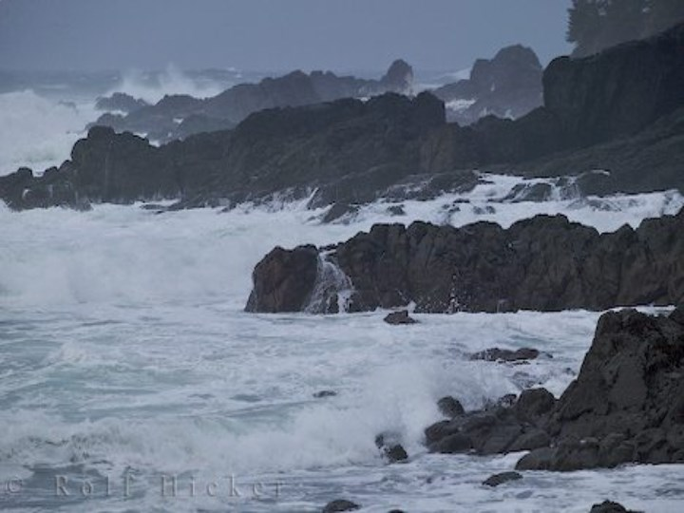
Storm on the Island, by Seamus Heaney

Slide 2
Storms
Create two spider diagrams to answer the two questions below.
What weather elements could make up a storm?
What could you use these weather elements as a metaphor for?

Slide 3
Ambiguous title
Note down this definition then think about the question below
How could the title ‘Storm on the Island’ be ambiguous?

Slide 4
Structure
The poem is a monologue (a long speech by one person). Can you find a word/ line that suggests it is a narrator talking to someone?
The poem also uses enjambment, when lines do end with punctuation, showing that the contents just keeps on going. How could this link in to the theme of a storm?
The poem is not split into stanzas, it also doesn’t rhyme. This is called free verse. Linking to the first point, what could this lack of formal structure represent about the poem and narrator?
Can we make any links to other poems based just on this?

Slide 5
Sound
Read through and highlight/ circle all the harsh sounds/ plosive in one colour
Now go through and highlight/ circle all the soft sounds (including sibilance) in another colour – don’t forget to create a key
Now go through and circle/ underline all the examples of alliteration and assonance
What do you notice about the way sound techniques have been used in the poem?
What could they replicate?

Slide 6
Verbs
Verbs used for human actions | Verbs used for nature’s actions
Seamus Heaney presents _________ as having the most power in the poem. This is evident by his use of verbs. ________ has more verbs used, therefore has more actions, but also those verbs include ______, _______, ________ and ______ which would make a reader….

Slide 7
The following slides have notes for you to annotate in your anthology, or copy the poem into a Word document and make notes using text boxes

Slide 8
Very definite - confidence
Personification of earth – saying it is wise and so therefore has a mind and knowledge.
Wise = old, clever, experienced
Also personification. The earth has never caused them problems – which suggests it could if it wanted to. A fragile relationship?
We are prepared: we build our houses squat,
Sink walls in rock and roof them with good slate.
This wizened earth has never troubled us
With hay, so, as you see, there are no stacks
Or stooks that can be lost. Nor are there trees
Which might prove company when it blows full
Blast: you know what I mean - leaves and branches
Can raise a tragic chorus in a gale
So that you listen to the thing you fear
Forgetting that it pummels your house too.
‘you’ = direct address, ‘so, as you see’ makes it sound like someone is talking to another – a conversation or monologue.
Personification of trees – they could be company. Suggests the narrator/ people are lonely and the trees – nature – is not.
The trees are musical, chorus means all together, like a chant – war-like. Tragic suggests tragedy, negative things to come.
People listen for things they’re scared of – people are fearful and weak – they don’t confront them. ‘Forgetting’ suggests people are also naïve, ignorant and stupid
‘pummels’ = violent, powerful, aggressive, deliberate, wanting to cause harm
‘your’ = possessive pronoun. Nature doesn’t care about or respect your possessions.

Slide 9
Nature has the power to help them – but can’t/ won’t.
Oxymoron – exploding should never be comfortable. Suggests nature/ the sea is evil and destructive if it like explosions.
But there are no trees, no natural shelter.
You might think that the sea is company,
Exploding comfortably down on the cliffs
But no: when it begins, the flung spray hits
The very windows, spits like a tame cat
Turned savage. We just sit tight while wind dives
And strafes invisibly. Space is a salvo,
We are bombarded with the empty air.
Strange, it is a huge nothing that we fear.
Simile – ‘spits’ = provocative, immature. ‘tame cat turned savage’ suggests it once was calm and good but it is now angered, has had enough. ‘savage’ = wild, uncontrollable, aggressive, relentless
This shouldn’t make sense. How can you fear nothing? Highlights stupidity and weakness of people.

Slide 10
How has the power of nature been presented in ‘Storm on the Island’ by Seamus Heaney?
Have a go at answering the question above using the sentence starters below…
Seamus Heaney has presented the power of nature by…
Evidence of this is ‘…’
This suggests the weather is … because the word ‘...’ would have connotations of... which would make readers feel…
Heaney may have done this to…

