Slide 1
The Last Wish in the World
Lesson 7

Slide 2
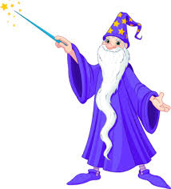
The ending…
Discuss…
What did you think of the ending?
Did you expect it to end that way?
What would you wish for if you had the last wish in the world? Has your answer changed from the first lesson?

Slide 3
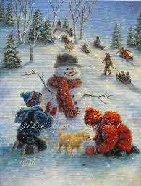
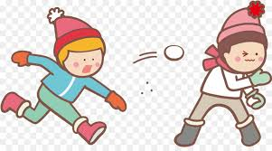
Task 1
Working individually, prepare three freeze frames of the little boy/girl;
Just as she is taking the box carefully from the snowman’s arms
As she reads the babel
As she throws the box down and makes the wish
Note to audience – choose one person to watch so you are able to give them feedback.

Slide 4
Task 2
In groups of 5/6 bring your scene to life with dialogue and movement. Include:
The wizard and Little girl
Everyone else represents the wishes!
Create a ‘magic’ atmosphere by using sound and movement

