Slide 1
The Last Wish in the World
Lesson 3

Slide 2
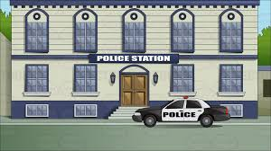
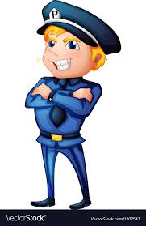
Task 1
Think about the police officer who is “looking the wizard up and down with weary, seen it all eyes”
Look at the person next to you with your ‘seen it all eyes’.
Task 2
With your pair, discuss what you think it must be like to be a police officer in Sky Scraper city.

Slide 3
Task 3
Write about a day in the life of a police officer, this could be done as a diary entry or day planner.
8AM – Wake up and put on uniform – look important and dashing
9AM – Stop at bakery for coffee and donuts
10AM – Catch a criminal
11AM - …
Dear diary,
Today I really showed them robbers…
or
*Make sure you mention your encounter with the wizard!!

Slide 4
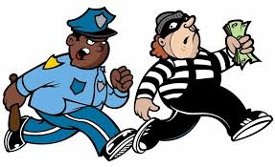
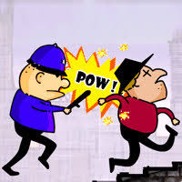
Task 4
Draw a storyboard showing the police person’s dreams that night. They keep dreaming of all the things that have happened that day. Including their strange meeting with the wizard.

