Slide 1
The Last Wish in the World
Lesson 1

Slide 2
Task 1 - Create a character who is one of the passers by
Name
Age
Picture
Where are they going?
Why are they in a hurry?
What is their job?
Do they like being in Skyscraper City?
Do they like their job?
What do they wish for?

Slide 3
Task 3 – Hotseat!
Hotseat another character, what else can you find out about them?
2. Add information about your character

Slide 4
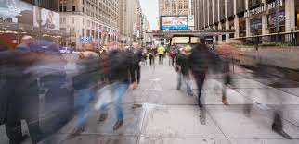
Task 3
Draw a picture of the street with speech bubbles coming from the wizard and passers by.
Moooooove out the way!

