Slide 1
ISLAM

Slide 2




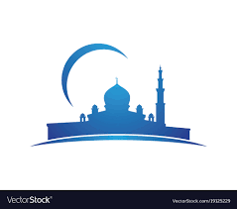


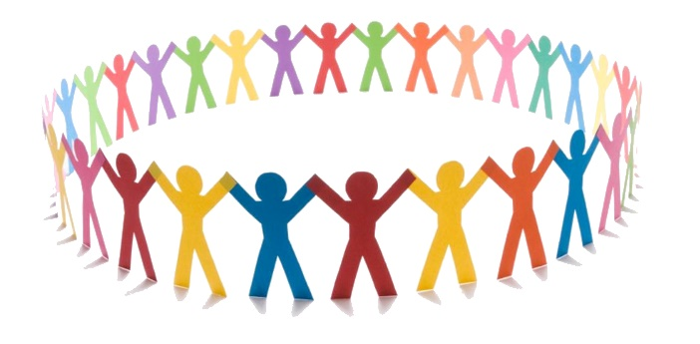
Key Concepts…
Tawhid
Prophethood
Halal
The Oneness of God.
Or “risalah” – the messengers of God from Adam to the Prophet Muhammad.
Permitted/Allowed
Mosque
Jihad
Or “masjid” – place of prostration/ communal worship
Shari’ah
“To Strive” – inner spiritual struggle is Greater Jihad, holy war is Lesser Jihad.
Straight path – a way of life set out by God.
Haram
Ummah
Forbidden/Not allowed
The worldwide community of Muslims

Slide 3
Islam Worldwide
500
There are…
…Muslims in the
world today
500 billion
1.6 billion
1st
Islam is the world’s
2nd
largest religion.
3rd
The Middle East &
North Africa
The highest concentration of the
world’s Muslims is in…
Central Europe
Cirencester
However, nearly…
One
2/3
1/350
of the world’s Muslims
live in the AsiaPacific region

Slide 4

In Britain today there are nearly ______________ Muslims, making up __________ % of the population.
Up until the __________ twentieth century there were very ____________ Muslims in the __________. From the ___________ onwards significant numbers of __________ came from the former __________, taking up the offer of __________ in post Second _______________ Britain.
The 2011 ___________ shows that Britain is home to one of the most __________ Muslim communities in the ___________. The majority of British Muslims are __________ (95%) with remaining 5% coming from the __________ tradition.
How much can you work out without the missing words?
World War few Shi’a mid 3 million
crumpets 4.5 UK colonies diverse 1950s
world Sunnis people work

Slide 5
ISLAM - KEY WORDS
ISLAM | SHAHADAH | ZAKAT | WUDU
HAJJ | MUSLIM | SALAT | MOSQUE
RAMADAN | KAABA | MAKKAH | ALLAH

Slide 6
The Life of MUHammad
KEY POINTS FROM THE VIDEO

Slide 7
Why is Muhammad important?
The ____________ brought by Muhammad is the same message as had been preached by all the ____________ back to __________ :- the need to ____________ the one true God - __________, who will be the _____________ of all.
But due to the teachings of these prophets becoming corrupt, a new prophet was needed.
Muslims believe that the greatest of revelations was given to Muhammad during “Laylat-ul-Qadr” – The Night of ____________ - in the Cave of Hira.
On this night, the Angel _________ appeared before Muhammad and ordered him to recite the words of the __________.
Muslims also believe Muhammad to be last and _________ prophet – the “Seal Of The Prophets”, highlighting his importance.
Muhammad is also a role ___________ because of the moral and prayerful way he lived. God chose Muhammad to be a prophet because he was a humble, honest man.
Jibril Allah message final Power
prophets worship Qur’an model Adam
judge

Slide 8
P
H
B
U
Can you create an acronym to help you remember?
…Pink and Blue Umbrella Handle…

Slide 9
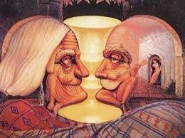

Slide 10
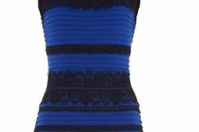
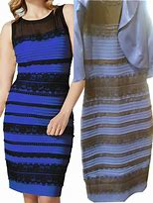
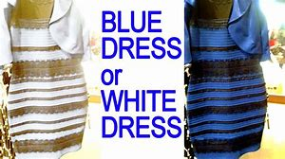

Slide 11
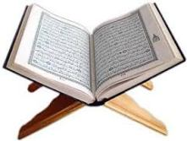
SOURCES OF
AUTHORITY
Divine Law – sent by Allah, guides humans in the right way to live. Mostly it comes from the Qur’an, but there are other sources…..
The Qur’an
This is the word of God. It is the most important source of authority in Islam. The complete book of guidance for all and was revealed by Allah to the Prophet Muhammad (through the Angel Jibril) over a period of 23 years. It was written down in Arabic by his followers and compiled into one book shortly after the Prophet’s death.
“This is the book about which there is no doubt, a guidance for those conscious of God.”

Slide 12
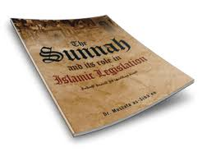
SOURCES OF
AUTHORITY
Divine Law – sent by Allah, guides humans in the right way to live. Mostly it comes from the Qur’an, but there are other sources…..
The Sunnah – The way of the Prophet.
The Prophet Muhammad is an inspiration to all Muslims, so they try to imitate the way that he lived. The Sunnah is the second most important source of authority for Muslims and describes the customs, practices and traditions of Muhammad. It teaches the perfect path or model of how Muslims should live.

Slide 13
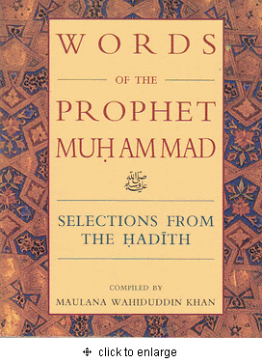
SOURCES OF
AUTHORITY
Divine Law – sent by Allah, guides humans in the right way to live. Mostly it comes from the Qur’an, but there are other sources…..
The Hadith – the sayings of the Prophet
Muslims love and respect the words of Muhammad, because he was such an outstanding character. He had deep devotion to God, with enormous wisdom, kindness and compassion. The Hadith is a book which contains his sayings, as recorded by his family and companions. There are three different collections of these sayings, each accepted by different Muslim groups.

Slide 14
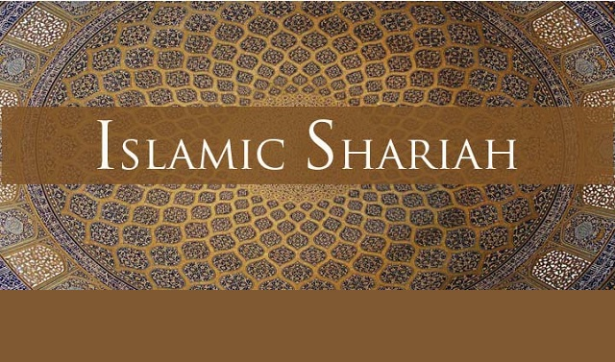
SOURCES OF
AUTHORITY
Divine Law – sent by Allah, guides humans in the right way to live. Mostly it comes from the Qur’an, but there are other sources…..
Shari’ah law – moral and religious rules that Muslims must follow.
The Shari’ah Law sets out the moral and religious rules that Muslims must follow. It puts into practice the principles set out by the Qur’an, the Sunnah and the Hadith, so by following Shari’ah law Muslims know they are obeying the will of Allah. Shari’ah lays down laws about what is halal and haram. It deals with everyday topics like food, clothes, crime, money, sex and relationships

Slide 15
In the Hadith it states
that Muhammad said…
“I have left among you that which if you hold fast to, then you would never go astray, clear things, the book of God and the Sunnah of his prophet.”

Slide 16
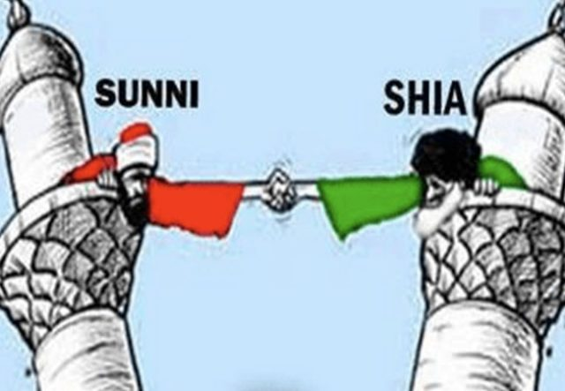

Slide 17
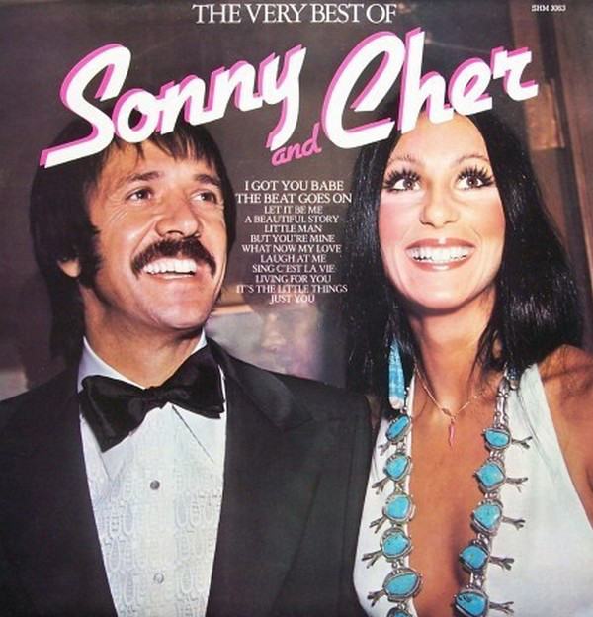
Not to be confused with…

Slide 18
https://www.youtube.com/watch?v=Kt3yFGiElrs

Slide 19
The World Muslim Population
Sunnis and Shi’as have coexisted for centuries, living peaceably side by side, often worshipping together in the same mosques, sometimes inter-marrying.
87% of Muslims are Sunni.
13% are Shi’a

Slide 20
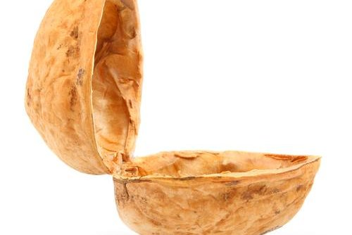
After Muhammad’s death an argument started about who should lead the Muslim Community.
A large group of believers chose Abu Bakr to be the new Khalifah (leader) as he had been a close friend of Muhammad.
After Abu Bakr’s death Umar became the leader, then Uthman and then Ali.
These four leaders have come to be known as the Rightly Guided Khalifahs.
Sunni Muslims accept that they were God’s appointed leaders.
Sunni

Slide 21
There was a smaller group of Muslims who, after Muhammad’s death, believed that Ali – Muhammad’s cousin and son-in-law – should have become the first Khalifah. They believed this was what Muhammad wanted. They rejected Abu Bakr, Umar and Uthman. They were angry that Ali had been overlooked.
Ali eventually became Khalifah but was murdered.
The group then began to separate themselves.
They believe that Prophet Muhammad appointed 12 Imams (successors) from his own descendants.
Shi’a

Slide 22
“If I were to take a friend
other than my
Lord, I would take
Abu Bakr as a friend.”
Muhammad quotes
(Hadith)
“You [Ali] are my brother in this world and the next.”

Slide 23
Key difference – in Sunni Islam
an imam is the leader in a local
mosque. In Shi’a Islam there
were only 12 Imams. They are
holy figures who were all
diviniely appointed descendants.

Slide 24
Sunni And Shi’a
What Can You Remember?

Slide 25
THE BIG QUIZ!
Preparation.
In your teams you will
Split your text books/sheets between you.
Each team member must write down ten questions.
Five should be simple/basic questions.
Three should be “describe” questions.
Two should be “explain” questions.
EVERYBODY SHOULD HAVE DIFFERENT QUESTIONS!
WRITE THE ANSWERS DOWN BENEATH THE QUESTIONS.

Slide 26
Stage One
Silent reading.
Read through your text book/sheet. Do not write anything down. – 5 minutes.
Stage Two
Notes.
Make your own brief, bullet-point notes on the most important things you have read. – 5 minutes.
Stage Three
Feedback.
Each member of the group should feedback their findings to the others.

Slide 27
Stage Four
Write your questions.
All questions must have clear answers. Write the questions out in full. Write the answers beneath them.
Use only the information you have found in your text books or on your sheets.
Each individual team member must have….
5 short answer, basic questions
3 “describe” questions – asking people to describe a belief/event/action.
2 “explain” questions – asking WHY Muslims believe this/have an event/do that.
Make sure members of your group are not asking the same questions.

Slide 28
The Quiz

Slide 29







Choose your first “answerers”.
Then choose your first “questioners.”

Slide 30
Answer
Wrong
Answer
Answer
Question
Question
Question
Bad, wrong or repeated question.

Slide 31
The winning team is the one
left on at the end.

Slide 32
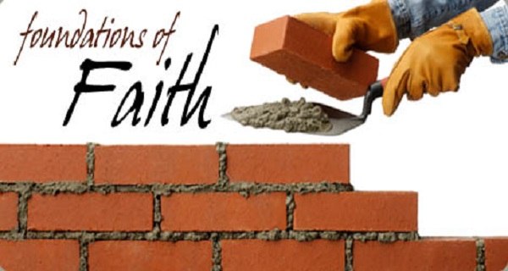
6 Articles Of Faith
SUNNI
Holy
Books
Allah
Malaikah
Risalah
Akhirah
Al-Qadr

Slide 33
“You must believe in
Allah, his angels, his holy
Books, his messengers, in the
Last Day and in fate.”
Muhammad – The Hadith

Slide 34
5 Roots Of Religion
SHI’A
Tawhid
Adalah
Nubuwwah
Imamate
Qayamat

Slide 35
Oneness
Justice
Prophethood
Leadership
Resurrection

Slide 36
What’s in
the bag?

Slide 37
WHAT IS ALLAH LIKE?
MONOTHEISM
UNITY
TAWHID
UNIVERSAL GOD
OF ALL HUMANITY
THE SHAHADAH
“THERE IS NO GOD BUT ALLAH”

Slide 38

R
E

Slide 39
QUALITY | DEFINITION
Immanent
Transcendent
Omniscient
Omnipotent
Omnibenevolent
Merciful
Judge
Creator
The al-Fatihah: The first chapter of the Qur’an
Allah is… merciful
The Lord of the Worlds
Beneficient
The one who guides us on the straight path.

Slide 40
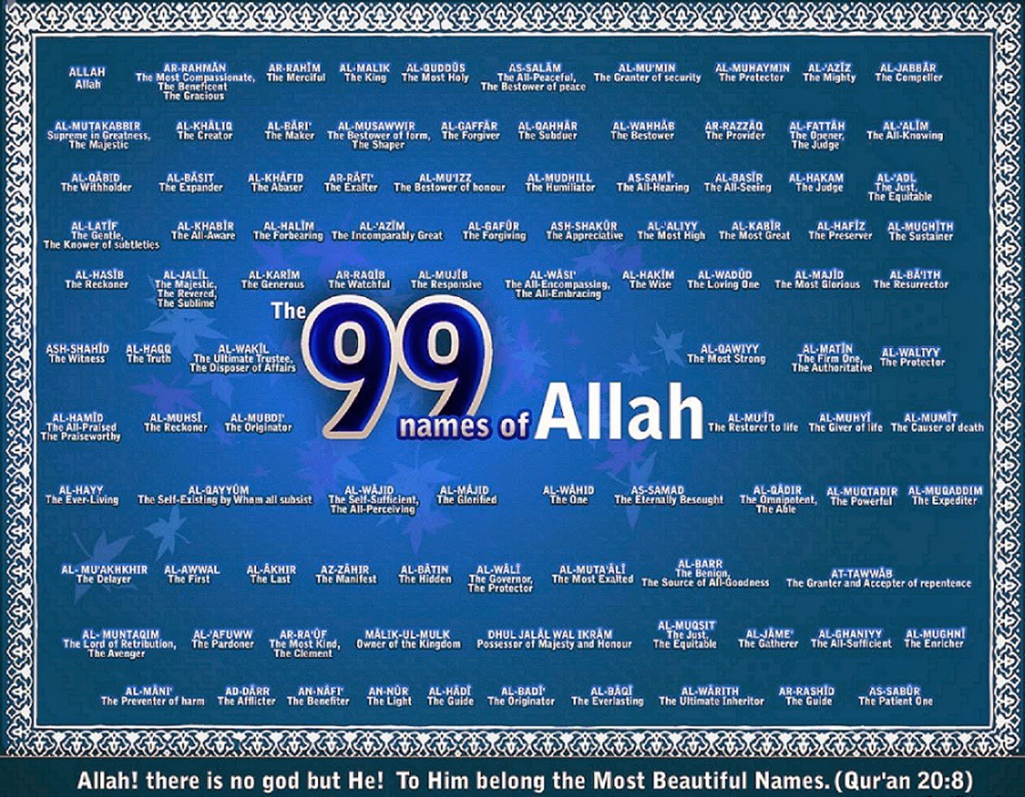

Slide 41
SHIRK

Slide 42
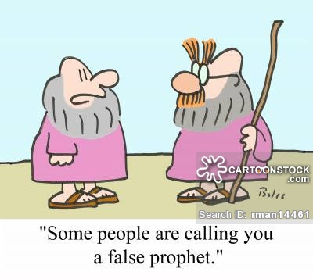
Why are prophets important?
Hints….
Guidance Messengers Warnings

Slide 43
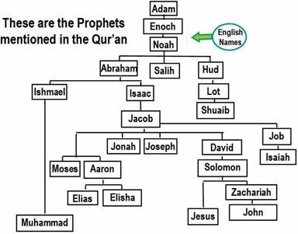

Slide 44
“People, no prophet or messenger will
come after me, and no new faith
will emerge.”
“I leave behind me two things, the
Qur’an and the example of my life
(the Sunnah). If you follow these
you will not fail.”
Muhammad’s last sermon, Hadith

Slide 45
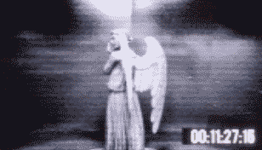

Slide 46
Heavenly
Immortal
Messengers
God’s first creation
Made out of light.
No free will
Invisible
Without sin
All around us
No Knowledge
No physical bodies
Male
They’ve got wings

Slide 47
“Glory to thee, of
Knowledge we have
None, save what
Thou hast taught.”
The Qu’ran

Slide 48
Jibril (Gabriel)
Angel Of Revelation.
Responsible for revealing the Qur’an to Muhammad
Israfil (Raphael)
The archangel responsible for blowing
the trumpet on the Day of Judgement to
announce the resurrection.

Slide 49
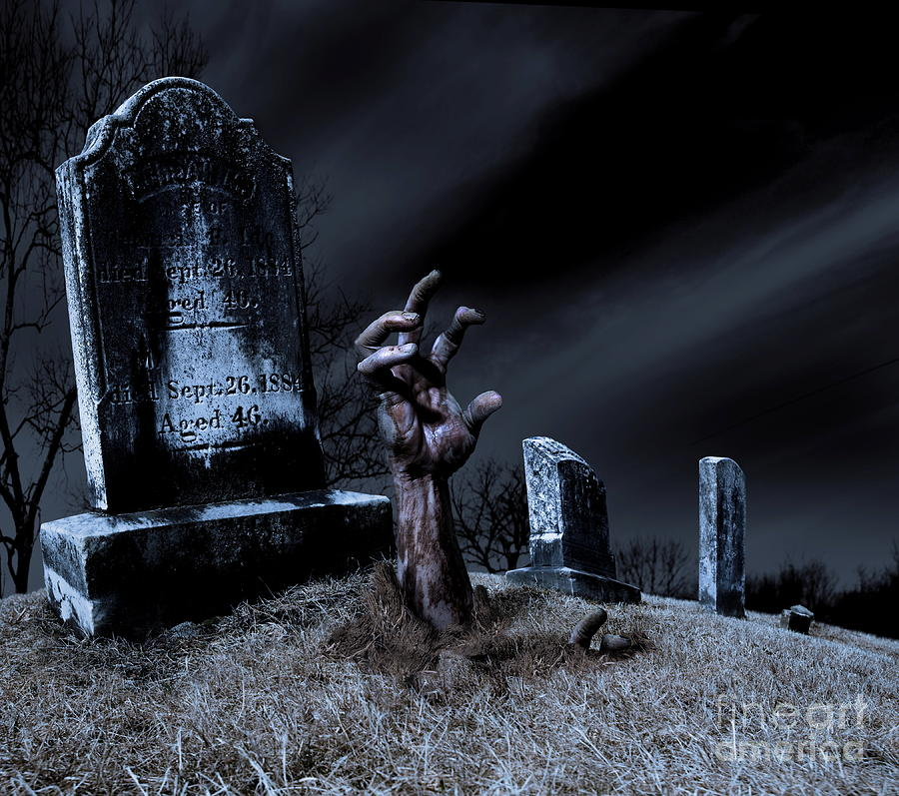
AKHIRAH
The Afterlife

Slide 50

Earthly life is just a preparation for the eternal life to come.
It is also a test.
We will be judged according to how we have lived.
We have been given free will so we can make choices,
BUT WE WILL BE HELD RESPONSIBLE!
Repent,
The end is
Nigh!

Slide 51
You know the end is
coming when…
The Mahdi (a saviour mentioned in the Hadith) will return.
So will Jesus
A false messiah will attempt to deceive the people.
The Mahdi and Jesus will team up to defeat the false messiah.
Also, there will be a lot of earthquakes, murder, rejection of Islam, dishonesty, drunkenness, obscenity, nakedness, fornication, corruption and general naughtiness.

Slide 52
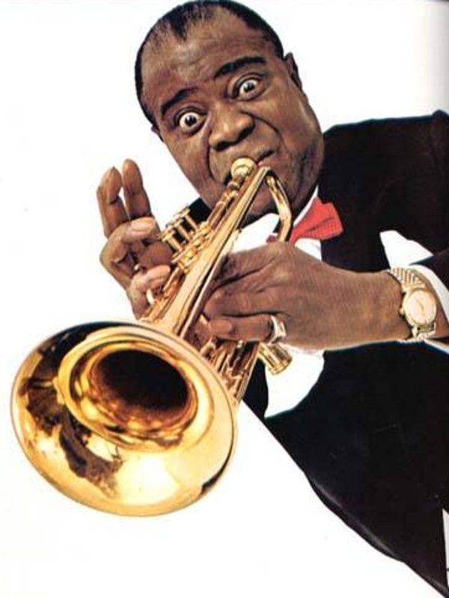
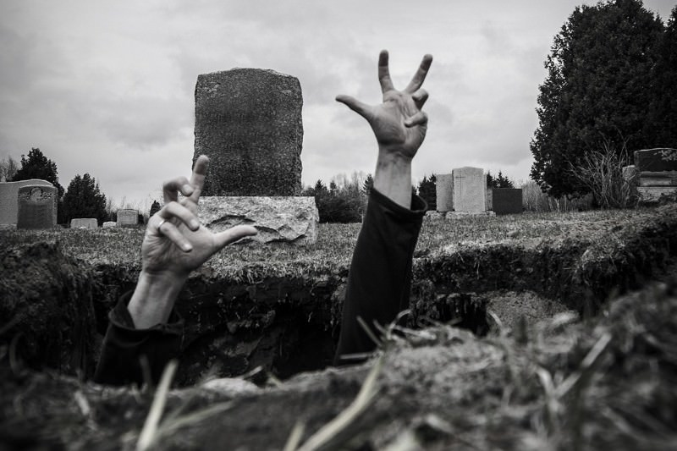
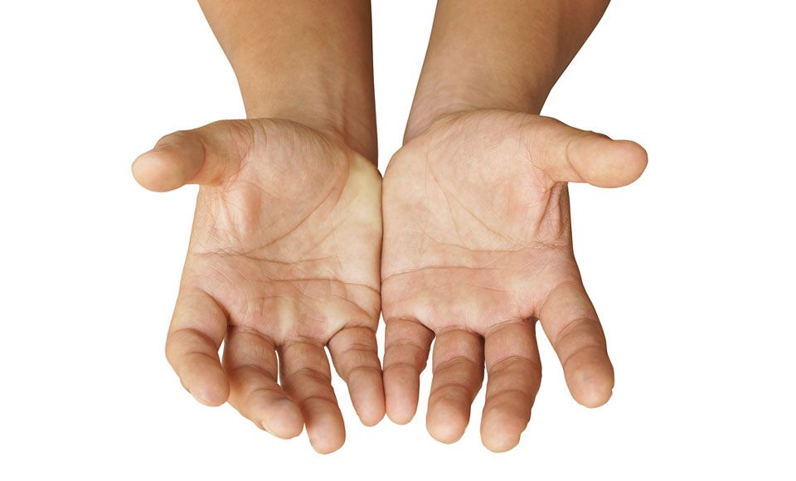
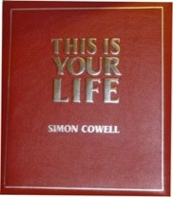

Slide 53
God judges each person’s actions but ___________ (niyyah) are taken into _____________. The two terrifying judging angels __________ and ____________ will question each person, testing their faith.
In order to give the correct ___________ to their questions, it is not enough just to learn to recite the Shahadah. If the person has not truly lived a life of ___________ to God, following the ________ __________, they will be incapable of giving the right response on the day.
Muslims believe that, for those who _______ before that day, the angel of death, __________, will come to take their souls to await the day.
They will be kept in a state of barzakh (________) until the sound of the final _________.
Azrail submission Five consideration trumpet
die answer Munkar intentions Pillars
Nakir waiting turnips

Slide 54
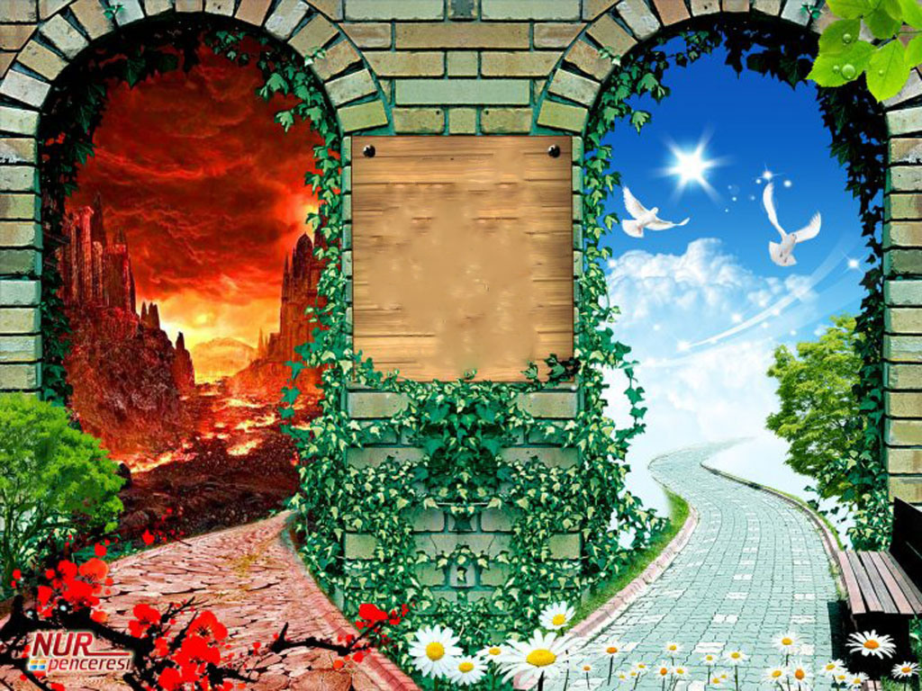

Slide 55
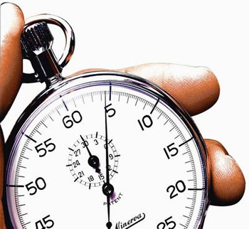

Slide 56
https://www.youtube.com/watch?v=V5YILtFgylc
https://www.youtube.com/watch?v=KWOLzYY_ZtY

Slide 57
And now...
b&p -The e.a.t.s.!
One word answers/ lists = fine!
(THE EXAMINATION ANSWER TECHNIQUE SONG).
A and B and C
Just want simple facts, you see!
But when you get to D, there is more complexity
(HERE WE GO!)
D!
Multiple points made, develop them – try!
Don’t just describe stuff – try telling me why!
And add juicy evi-dence!
E!
Do just what it says on the tin…
Put more than one viewpoint in!
Argue like mad! But the examiner gets sad…
If you leave the religion out!
Explain, beliefs attitudes or teachings
Juicy evidence = technical terms, quotes etc.
Follow the instructions. Discuss!
Use more juicy evidence.

Slide 58
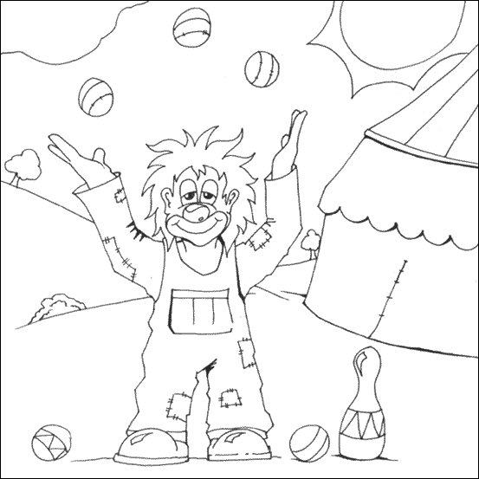
EVALUATION QUESTION
(A)
This means.
(B)
On the one hand some Christians think…
….because….
(D)
On the other hand some Christians think….
….because….
(E)
There are holes in this argument because…
SOURCES OF WISDOM!…
(G)
So my conclusion is…
…because…
(C)
There are holes
in the argument because…

Slide 59
AO1 | AO2
A good demonstration of knowledge and understanding in response to the question: * appropriate selection of religious knowledge Selection of appropriate sources of wisdom and authority with detail and/or developed explanation Good knowledge and understanding of different viewpoints within Islam Good knowledge and understanding of the influence on individuals, communities and societies. | A good attempt to respond to the stimulus, demonstrating some or all of the following: A variety of viewpoints explored with good use of reasoned argument and discussion Good analysis and evaluation of the significance and/or influence of the issue on different Muslim groups Evidence of critical evaluation including comment on, and comparison of, arguments from different Islam groups Evidence of judgement on the issue in the stimulus and a balanced conclusion to the discussion

Slide 60
PRACTICES

Slide 61
https://www.youtube.com/watch?v=BkL1uDuta2U
Watch the clip.
DON’T MAKE NOTES!
But try to remember what you
Can.
Notes:
https://www.truetube.co.uk/film/five-pillars-islam

Slide 62
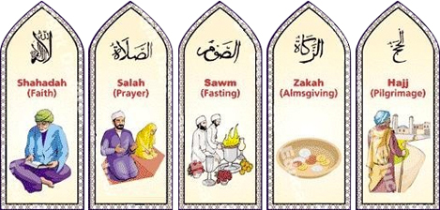
Actions speak louder than
words.

Slide 63
Every action is a form of worship – known as IBADAH.
Worship is a complete way of life – this is shown in the obligation to follow the five pillars of Islam.
1
2
Shahadah. Declaration of faith:-
“There is no God but Allah and the prophet Muhammad is his messenger.”
This declares a Muslim’s belief in Tawhid and Risalah.
Shi’a do not have it as an obligatory act, but still recite it with the addition of “and I bear witness that Ali was the friend of God.
Salah. Prayer is the second pillar. It is the most important way of worshipping God. It happens five times a day – just after dawn, just after midday, just after sunset and after dark.
Rakah (actions) and Wudu (washing) are part of prayer and are performed to show submission and respect.
Prayer brings the ummah together, especially during Jumu’ah (congregational prayers). It can also help Muslims in non-Muslim countries to feel connected to the wider ummah as they pray in the same direction, at the same time etc.
It allows Muslims to build a personal relationship with God, particularly through Du’a – an extra personal prayer to God.
Many Shi’a’s pray three times a day.

Slide 64

How Do You Do
Wudu?

Slide 65
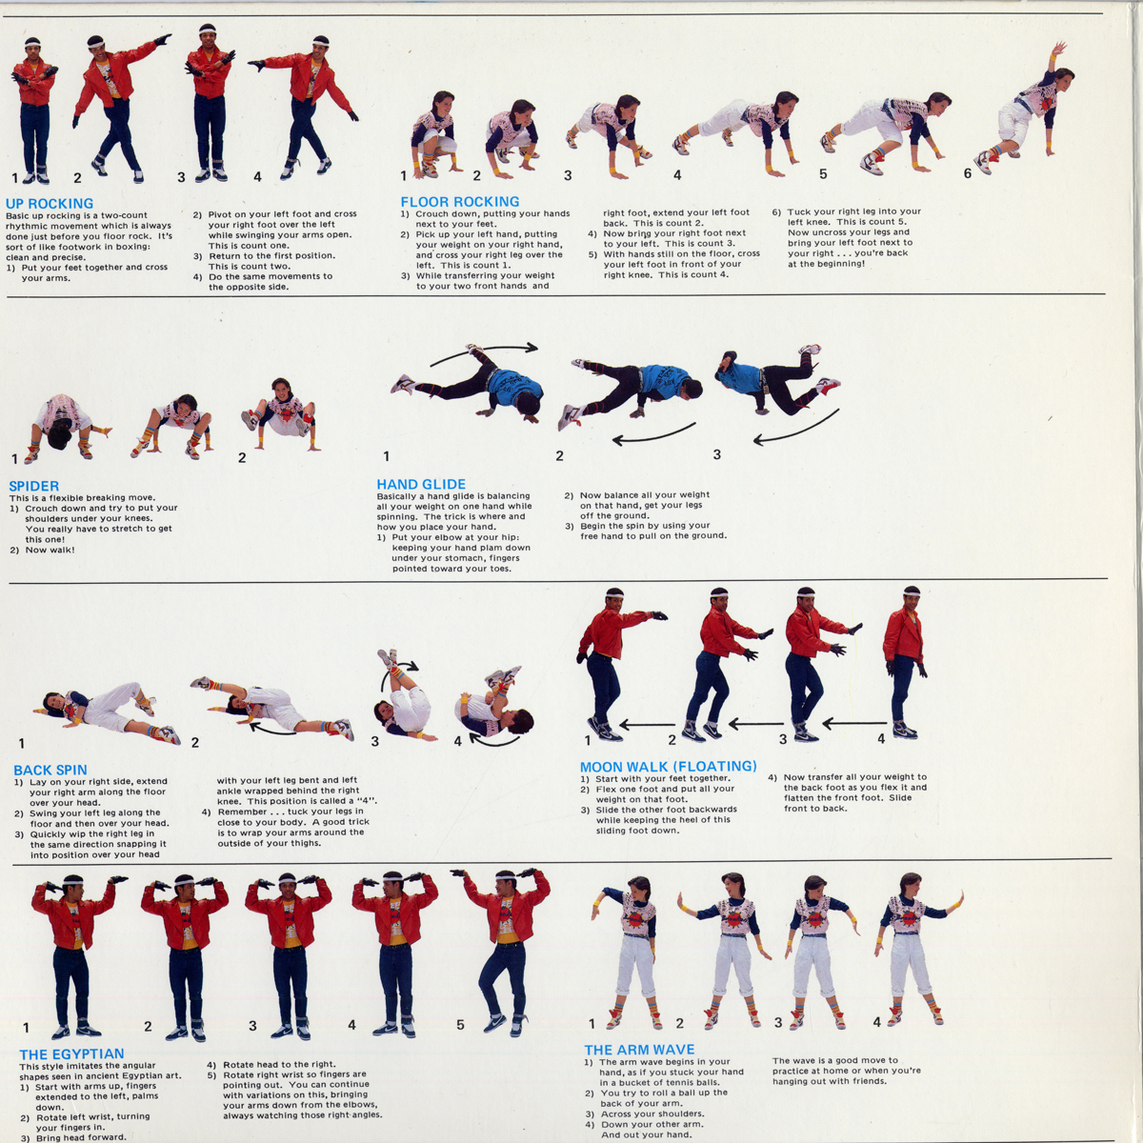

Slide 66
3
4
Zakah – 3rd Pillar, giving to charity. Muslims give 2.5% of their wealth every year as they believe that it is a duty to be charitable and that God will reward them for their acts of giving.
Sadaqah are extra payments often in the form of charitable actions or deeds.
Muslims are commanded in the Qur’an to give to those in need, widows, orphans and travellers. It is also a sign of purity as money is believed to corrupt. Wealth does not belong to them but is a gift from Allah so it should be shared.
Sunnis often pay Zakah to the government whereas Shi’a’s pay theirs to the religious leaders as well as an additional Khum tax.
Sawm – 4th Pillar, fasting during the month of Ramadan.
It is the ninth month of the Islamic year (the time when Muhammad is believed to have received the first revelation of the Qur’an). Muslims are expected not to eat food, drink, smoke or have sex during the hours of daylight. They should also avoid evil thoughts and unkind speech.
It develops spiritual discipline and self-control. They focus on the word of God rather than bodily desires.
It also builds the ummah as families share food together at suhur (meal just before dawn) and iftar (meal that breaks the fast after sundown).
It also helps Muslims to identify with the poor.
Shi’a’s fast in the same way but also spend three days during Ramadan mourning the death of Ali.

Slide 67
http://khumsbank.com/php/index.php

Slide 68
5
Hajj – 5th pillar – the pilgrimage to Makkah.
The Qur’an only commands that it is a duty for those who
Have enough money to leave their homes for a lengthy period
Are mentally and physically fit enough to carry out this demanding ritual.
Those who complete it often count it as the greatest achievement of their lives. Hajji (male) or Hajjah (female) is the special title given to someone who has successfully completed the Hajj. It is a great honour.
Makkah is the holiest city. Muslims believe that it was here that Prophet Ibrahim was commanded by God to sacrifice his son, Isma’il. Ibrahim threw stones at the devil here, driving him away. Muhammad received his first revelations from God here, and returned to the city before his death to reclaim it for God.
Hajj brings the Muslim ummah together from all over the world and emphasises the equality between all Muslims through the wearing of Ihram (white garments). Muslims focus on the teaching of tawhid by circling the Kaaba.
Muslims celebrate together all over the world by performing the festival of Eid Ul Adha at the end of Hajj. An animal is sacrificed and its meat is distributed to the poor.
Shi’a Muslims also perform Hajj, but may also perform pilgrimages to other Shi’a shrines at different times of the year, such as to the grave of Ali.

Slide 69


Postcards from the Hajj
Dear Weird Year 10 Group,
draw the cover of your post-
card based on the description
what you hear with you ears.
Then on the writing side write
about what you think is probably
going on.
Year 10
(The Weird Group)
RSE 1

Slide 70
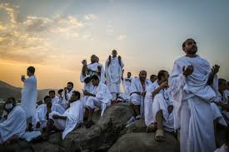

Slide 71
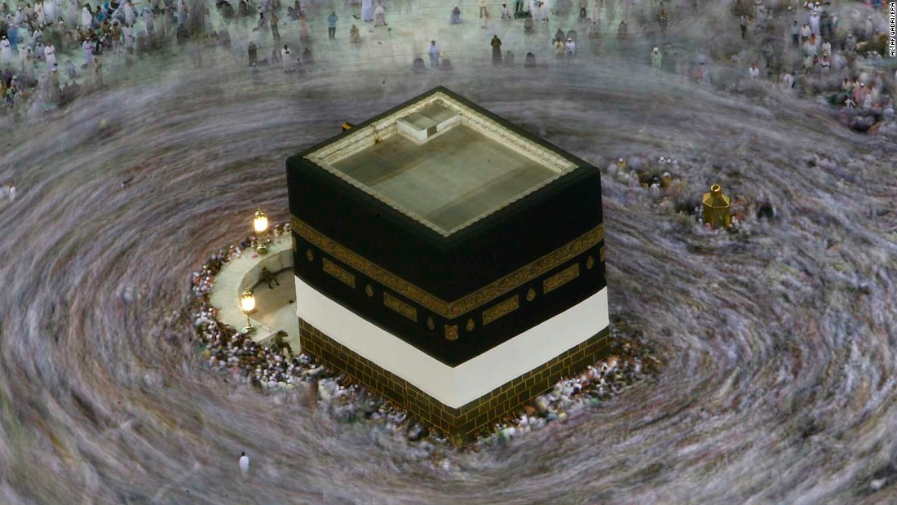

Slide 72
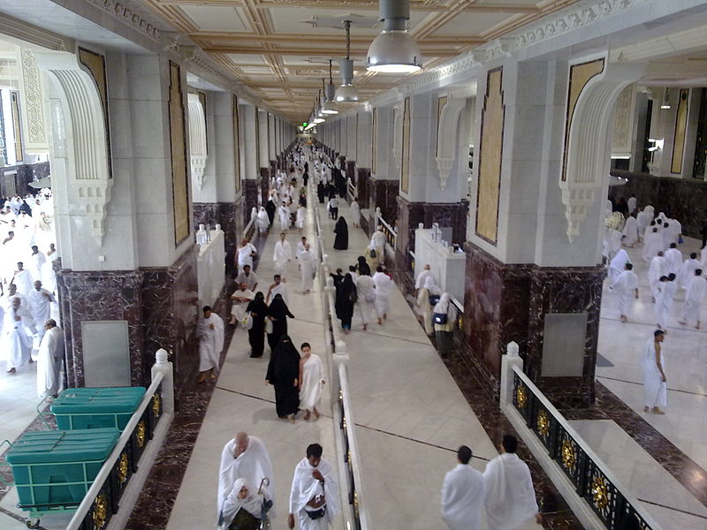

Slide 73
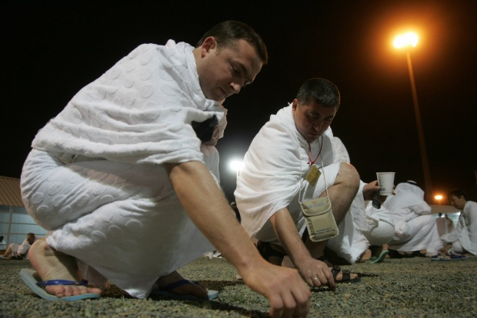

Slide 74
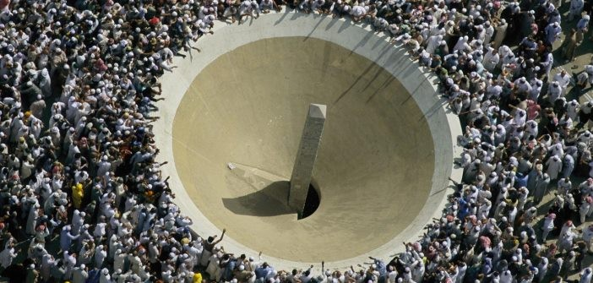

Slide 75
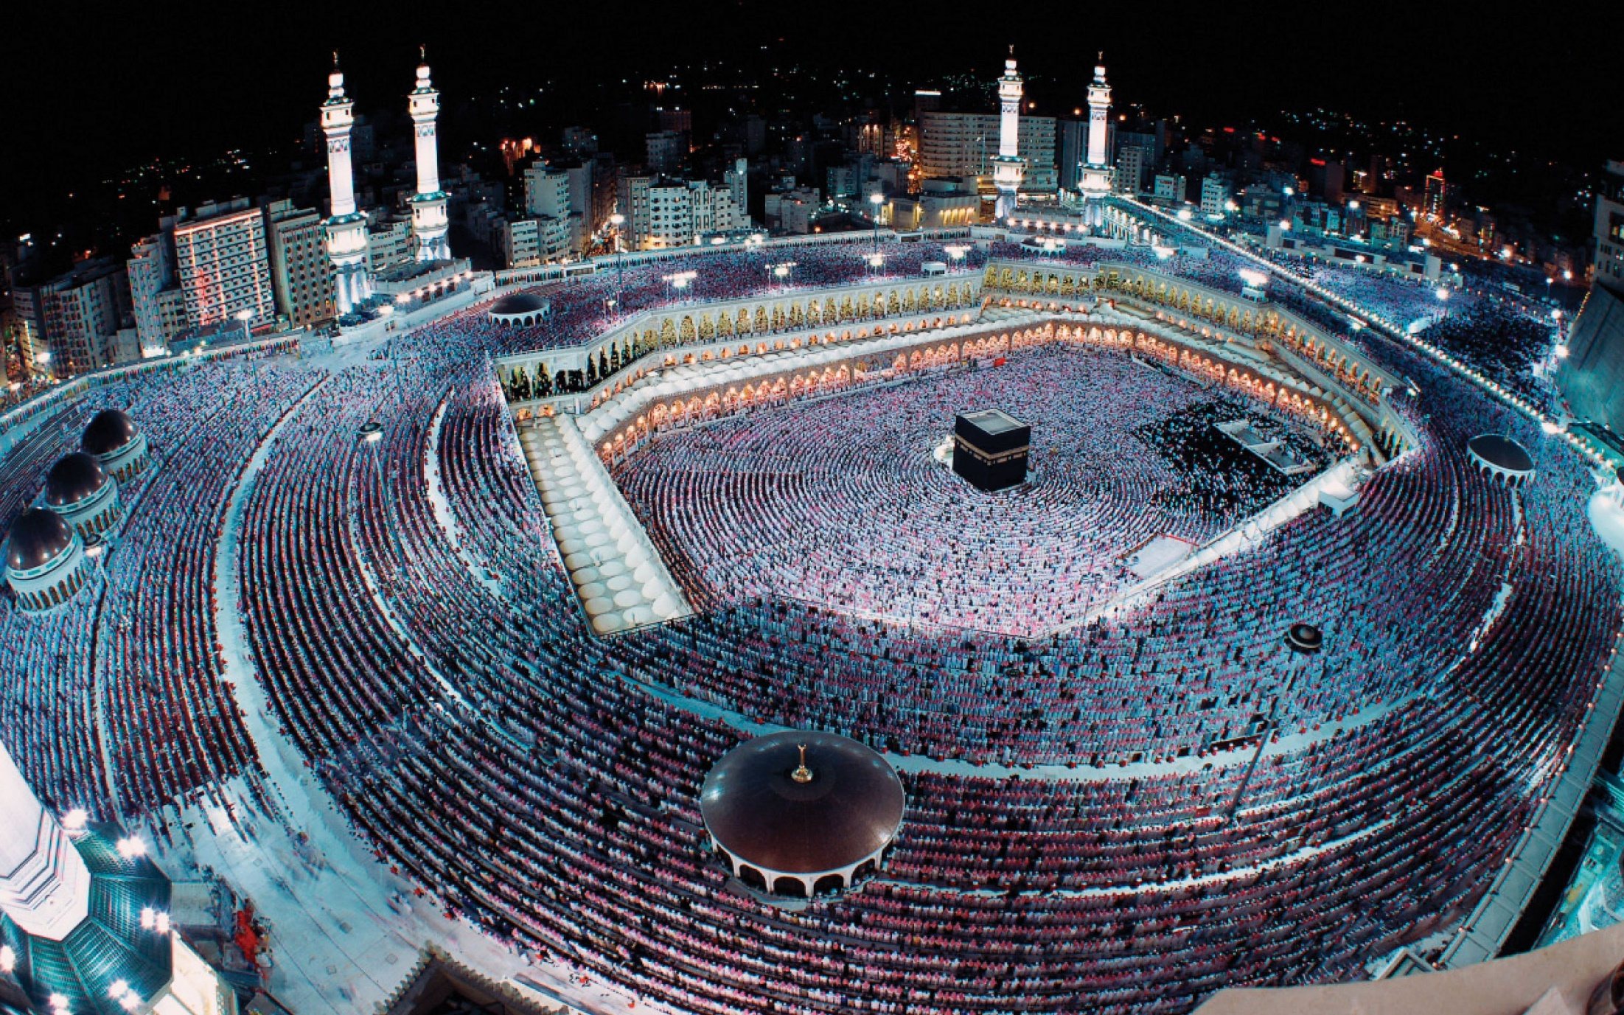

Slide 76
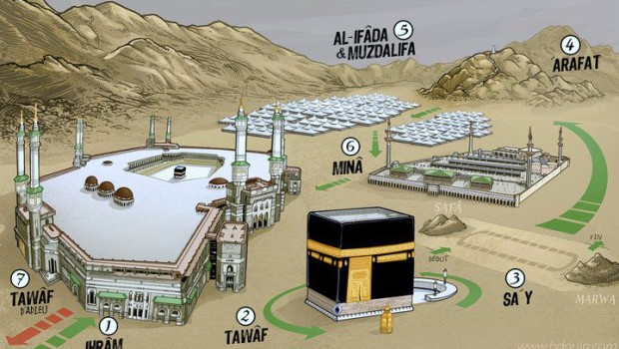

Slide 77
What is your favourite type
of festival?
Why?
Why do we have festivals?

Slide 78
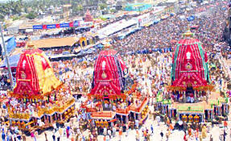
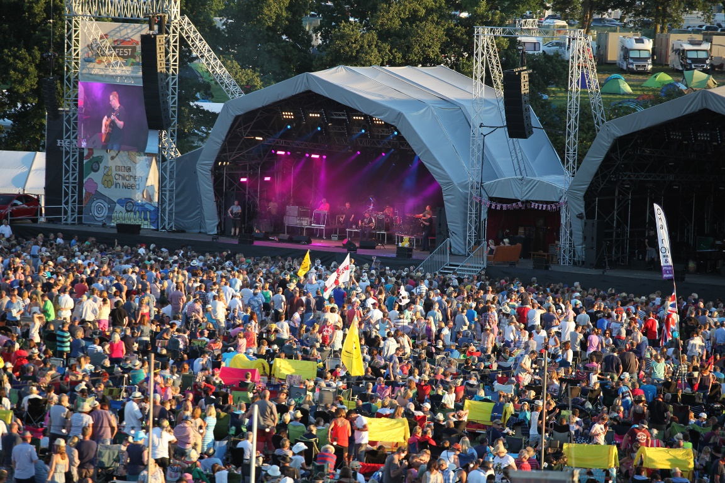
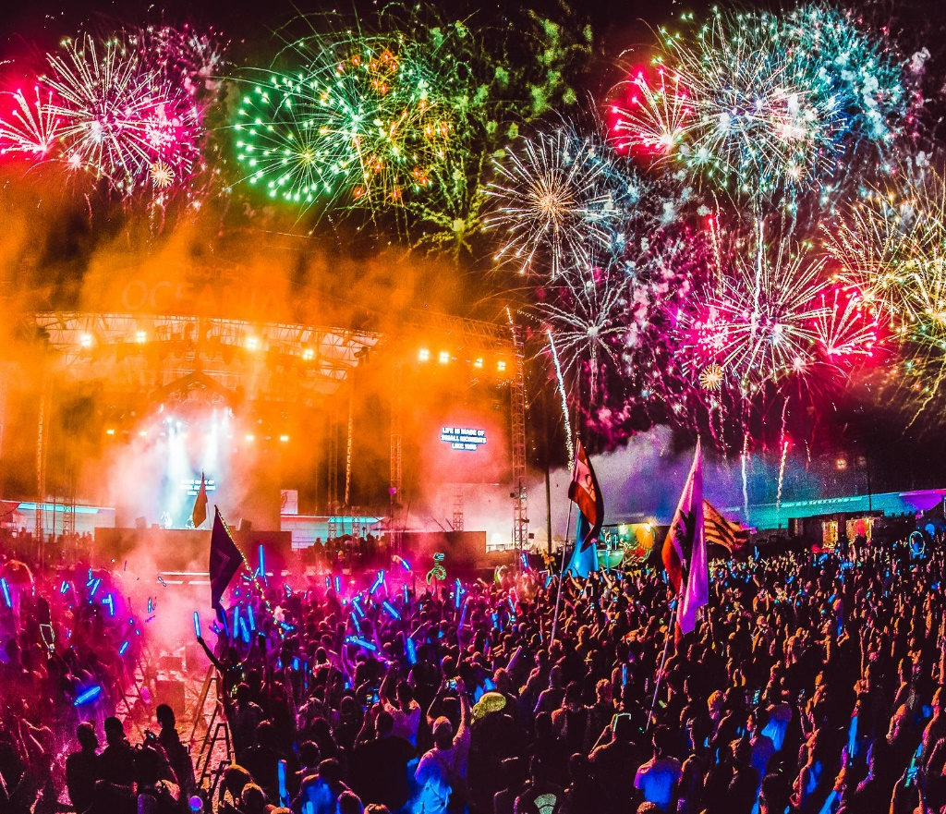
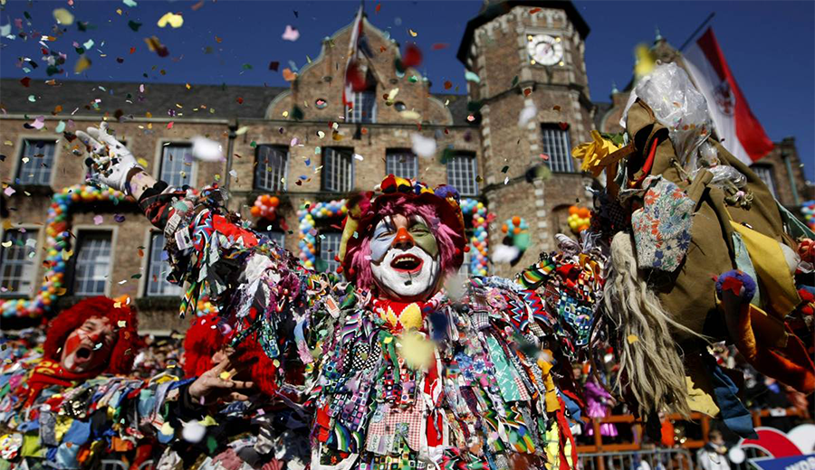

Slide 79
Islam believes in practicing moderation and so religious festivals are not about excess and partying but instead they are about….
Community
Thanksgiving
Remembrance
Celebration

Slide 80
Minor Festivals
Mawlid an-Nabi
The birth of the Prophet
A public holiday in many countries with joyful processions through the streets and chanting of stories in praise of Muhammad’s life.
Laylut ul Qadr
The night of power
Remembering the night in which Muhammad first received the Qur’an. Muslims stay up all night reciting the Qur’an, praying and remembering God’s mercy and forgiveness.

Slide 81
Minor Festivals
Laylut ul Miraj
The Night Journey
Remembers when Muhammad ascended to Jerusalem to meet with Allah and the prophets.
Events at the mosque, special prayers and telling the story to children.

Slide 82
Major Festivals
Eid-Ul-Adha | Eid-Ul-Fitr | Ashura
Festival of sacrifice and most important event in the Muslim calendar. It marks the end of Hajj. All Muslims across the world celebrate together. In many countries it is a public holiday. They remember the stories of Ibrahim’s obedience to God and his encounter with the Devil. A sheep or a goat is killed and the meat is shared and some is given to the poor. This is to remember the sacrifice that Ibrahim was prepared to make and that Muslims must sacrifice themselves to God. | A Joyful three day celebration at the end of Ramadan where Muslims enjoy breaking their fast. It is a reward for the completion of a month of fasting and for showing self control during this time. It begins with the sight of the new moon. Muslims decorate their homes, dress in their finest clothes, meet early in the mosque, exchange gifts etc. During this time Muslims also pay Zakat-ul-Fitr – an extra tax to help those who are poor enjoy the festival. | This is a Muslim day of sorrow and is most significant in Shi’a Islam, although important for all Muslims. SUNNI – a day of fasting established by Muhammad and an occasion to thank God for saving the Israelites from Pharoah. They remember the fast Moses made in gratitude to God for parting the Red Sea. SHI’A – a day of mourning the death of Husayn, Muhammad’s grandson, in battle. This triggered the Sunni/Shi’a split. Shi’a believe that Husayn was next in line to be leader behind Ali and Hasan, but was betrayed and murdered. Shi’a Muslims dress in black, march through the streets and chant and slap their chests.

Slide 83
JIHAD

Slide 84
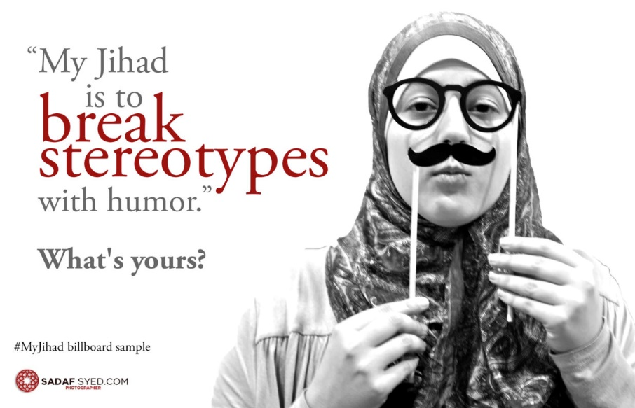
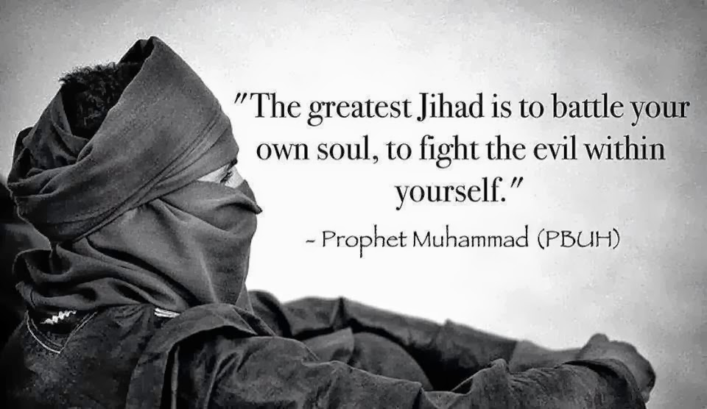

Slide 85
Jihad is an Arabic word that means ___________. It is important for all __________ and one of the Ten _____________ Acts of Shia tradition of Islam. The striving takes two forms in Islam. Greater Jihad and _________ Jihad.
Lesser Muslims Striving Obligatory

Slide 86
Greater Jihad
Inner struggle
Control bad desires
Ongoing, continuous process
Following “the straight path”
Learning to be obedient to Allah
Leading a disciplined life
Overcoming negative qualities like greed and anger
Following the call to holiness
Follow the teachings of the Qur’an
Conquer their hearts and minds with the Qur’an, not through violence
Seeking to do what is good

Slide 87
Lesser Jihad
Outward jihad
Creating a good and fair Muslim society
Sometimes believed to include war
Any war should be defensive or against an unjust regime
Liberate people who are oppressed

Slide 88
ISLAMIC GUIDELINES
FOR GOING TO WAR
The opponent must always have started the fighting.
It must not be fought to gain land.
It must be started by a religious leader.
It must be fought to bring about good.
It must be the last resort.
Innocent people should not be killed or harmed.
Enemies must be treated with justice.
Wounded enemy soldiers must be treated in exactly the same way as one’s own soldiers.
The war must stop as soon as the enemy asks for peace.
Property must not be damaged.
Chemical or biological warfare is banned.

