Slide 1
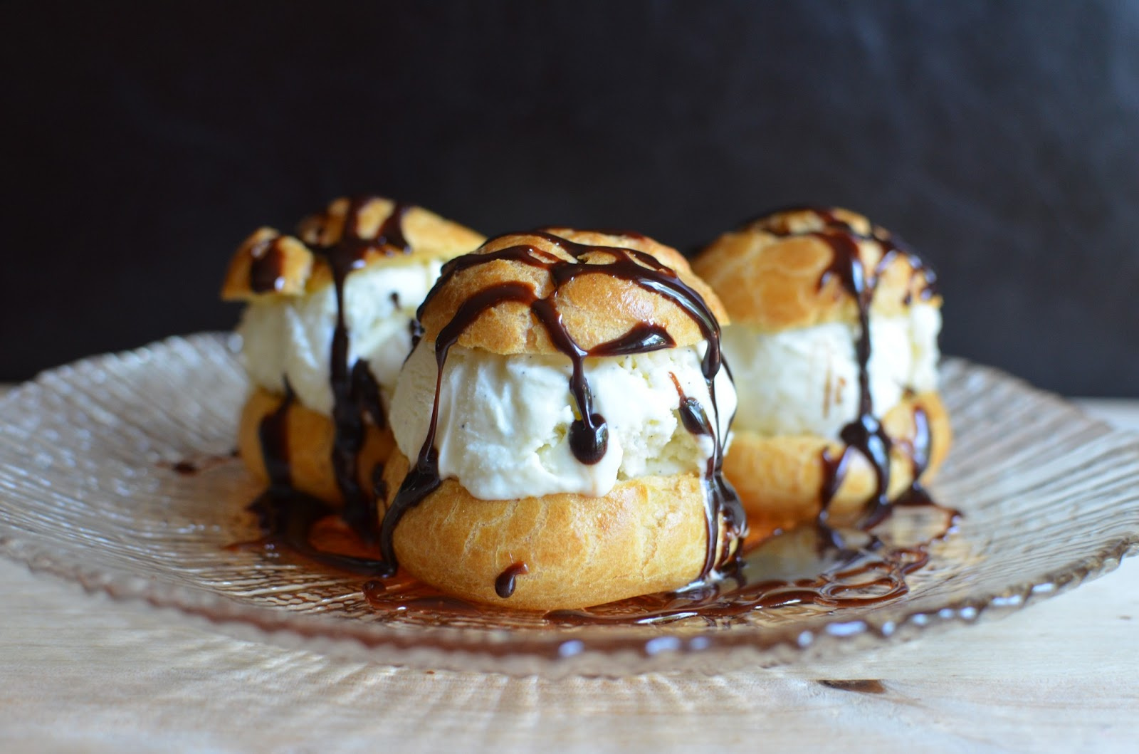
Food Preparation & Nutrition - Cereals
Practical Profiteroles – light choux buns filled with sweetened cream and covered with chocolate sauce.
Minutes | Activity | Health & safety points
10.00 | Mis-en-place – you will need to get the following equipment – Medium saucepan Wooden spoon Baking tray Piping bag (if using) Small bowl for eggs Fork Jug Large bowl Ensure you have all of your ingredients weighed out and ready by the cooker. | Ensure your work area is clean before you start. Cream to be kept in fridge until needed
5.00 | Put 150ml water, the butter and a pinch of salt into a medium pan and gently heat until the butter melts. Turn up the heat and bring to the boil. As soon as it’s boiling, tip in the flour in one go. Beat quickly to combine. | It’s important to tip the flour in as soon as the water boils, because losing too much liquid by evaporation will affect your pastry.
5.00 | The starch in the flour needs to be cooked out now. Beat well, over the heat, until the mix turns smooth and glossy and starts to come away from the edge of the pan. Tip the mix into a bowl and allow to cool a little.
5.00 | Give the mixture a quick beat, then start adding the eggs a little at a time, using a whisk, wooden spoon or electric beaters. You may not need to add all the egg – stop once the pastry is smooth and elastic and drops easily off a spoon
20.00 | Rinse the baking tray in cold water – this helps to buns to rise. Using 2 teaspoons, place blobs of the dough onto the baking tray leaving room for them to expand, then place in the oven and cook for about 15-20 mins until well risen and brown. Remove the profiteroles from the oven and cut a small slit in the base of each one so they don’t collapse. Cool on a wire rack.
10.00 | To make the sauce – Sift the cocoa powder into a bowl. Put the sugar in a pan with 100ml water and warm over a low heat until the sugar has dissolved. Bring to the boil, cook for 1 min, then pour over the cocoa and stir until smooth. Return to the pan, cook for 1 min then set aside for 15 mins before drizzling over the profiteroles.
10.00 | When they’re cold, whip the cream lightly until just holding its shape. Sweeten to taste with remaining sugar and a few drops of vanilla extract. Cut the profiteroles in half, fill them with the sweetened cream and pile them up on a plate.

Slide 2
Food Preparation & Nutrition - Cereals
Once you have finished cooking and I have checked your utensils, please get out text books and answer the following questions (you must write the questions out first):
Give 5 examples of the secondary processing of rice.
What is maize more commonly known as in the UK?
Give 3 examples of food products commonly made from maize or corn.
Give the name of the deficiency disease caused by lack of niacin (vitamin B3) where maize/corn is the staple food.
How do they avoid this disease in Mexico, Central and South America?
Name a popular breakfast cereal made from oats.
Explain the difference between soluble and insoluble fibre.
Why are most oatmeal brands unsafe to eat for those on a gluten-free diet?
What are the most likely contaminants that can affect the quality of cereal crops?

