Slide 1
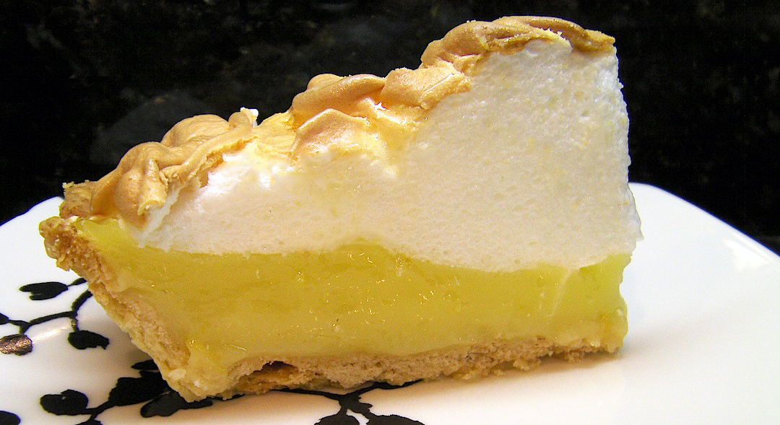
Food Preparation & Nutrition – Butter, Oil, Sugar & Syrup – lesson 7
LO’s
To make a lemon Meringue Pie
Success criteria –
A short pastry (crisp), a rich, a sharp and beautifully set filling and a fluffy meringue topping
Skills & Techniques used-
1,2,5,6,7,8,9,12,13,17,18,19,20
Making pastry, zesting citrus fruit, blind baking, setting a filling, making a meringue & testing for readiness
Science involved-
Coagulation of eggs to set the filling, yolk adds colour to the filling, aeration of whisked whites to create structure to meringue.
Notes:
10X – 19/6/18 10W – 25/6/18

Slide 2
Food Preparation & Nutrition – Butter, Oil, Sugar & Syrup
Ensure your skills chart is up-to-date along with your dish evaluations.
If finished, ensure your work area is immaculate, then check to see if you have completed your homework.
Ext. task 1 – read w/s BOM 4 and stick into your book.
Ext. tasks 2 – complete w/s BOM 5 and stick into your book.
A reminder – catch-up club will be in here on Wednesday 3.00 – 4.15.

