Slide 1
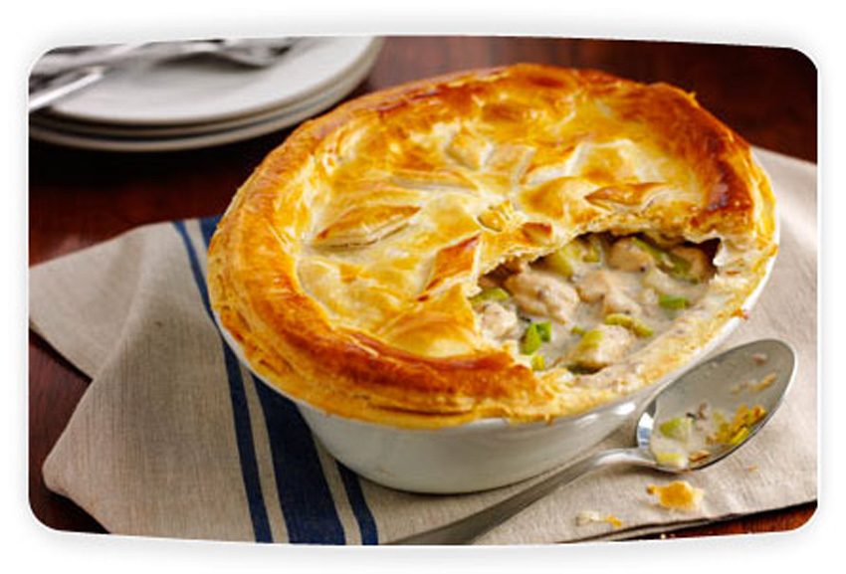
Practical chicken, bacon and leek pie with shortcrust pastry
Time (in mins) | Activity | Health & safety points
10.00 | Mis-en-place – you will need to get the following equipment – Oven proof pie dish medium saucepan White and red boards Sharp knife Jug Small bowl and pastry brush for egg glaze Flour shaker Rolling pin | Ensure your work area is clean before you start. Bacon and chicken to be kept in fridge until needed
10.00 | Make pastry. Rub fat into flour until it resembles breadcrumbs. Add a little water and mix to a dough. Place in fridge while you make filling.
2.00 | Boil kettle for stock. Add to stock cube (in jug) and stir until dissolved
10.00 | Add a little oil into the saucepan and gently fry the onion, leek and bacon (if not pre-cooked) until the onion is translucent. Add the garlic and continue to cook for another minute. | Be careful of fat spitting.
10 – 20.00 | Add butter to cooked vegetables. Once melted add the flour and cook for a minute. Add the stock and milk and gradually bring to the boil until gelatinisation has taken place. Add the diced, cooked chicken and the cream.
10.00 | Roll out the pastry and use to line your pie dish. Keep some back for the top.
5.00 | Trim the edges of the pie and glaze with egg. Cook in a preheated oven for 20-30 minutes until golden brown.
Notes:
Demonstrate pie on Wednesday. Students to take notes and write a time plan.

Slide 2
Food Preparation & Nutrition - Cereals
Once you have finished cooking and I have checked your utensils, please get out text books and answer the following questions (you must write the questions out first):
What is the name of the field that rice is grown in?
Rice is a staple food in which countries?
Describe the primary processing of rice using the following terms, threshing, screening, drying, cleaning and grading.
What is removed from brown rice to make it white rice?
List 3 varieties of rice.
What is the name of rice most often used to make risotto?
Give 5 examples of products obtained from the secondary processing of rice.
What is Beri beri?

