Slide 1
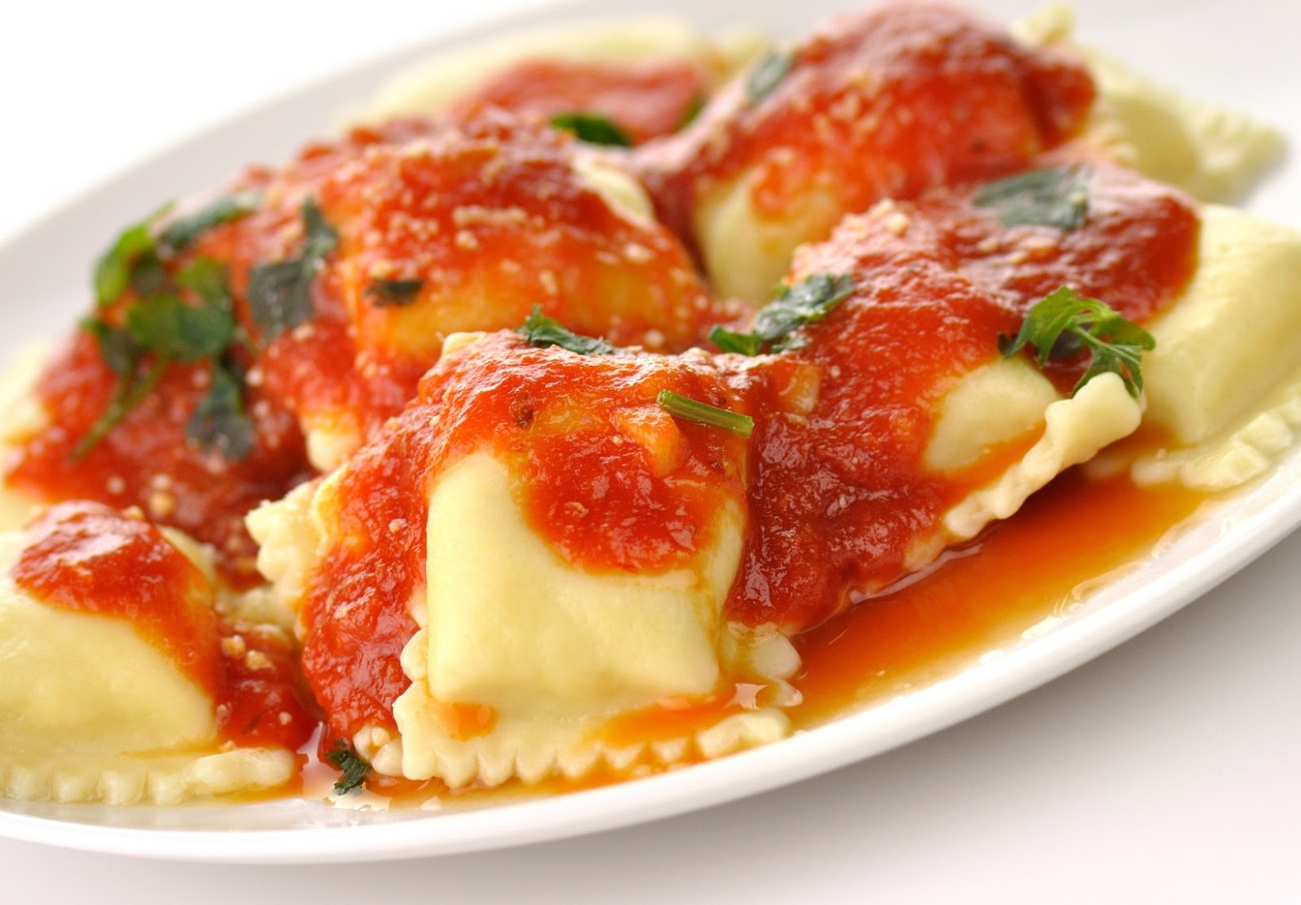
Practical Ravioli – fresh pasta
Time (in mins) | Activity | Health & safety points
10.00 | Mis-en-place – you will need to get the following equipment – Glass bowl Pasta roller Flour shaker Rolling pin White Board Sharp knife | Ensure your work area is clean before you start.
10.00 | For the pasta, pour the flour into a large bowl. Make a well in the centre and break in the eggs. With a fork or with your hands, gradually mix the flour with the eggs to form a soft dough. Knead the dough for 5 minutes, or until smooth. Shape the dough into a ball, wrap in cling film and leave to chill in the fridge for at least 30 minutes. | High-risk food to be kept in fridge until needed.
15.00 | Divide the pasta into 4 equal pieces. Starting at the lowest (thickest) setting, feed one piece of the dough through the machine, turning the handle with one hand and holding the dough as it comes through the machine with the other. Change the setting on the pasta machine to the next-thickest setting, flour the pasta to stop it sticking and feed the pasta sheet through the machine again, as before.
10.00 | Repeat this process 3-4 more times, flouring the pasta and changing the setting down each time. The pasta should be quite thin, but still easy to handle without tearing. Don't be tempted to skip settings or the dough may tear. Repeat with the other pieces of dough. Once the pasta sheets have reached the ideal thickness, dust with flour and set aside.

Slide 2
Food Preparation & Nutrition - Cereals
Once you have finished cooking and I have checked your utensils, please get out text books and answer the following questions (you must write the questions out first):
Draw a wheat grain and label the parts.
What are cereals – give examples of three cereals grown and processed in the UK.
What is a staple food? Explain the importance of a staple off in a developing country.
List the key nutrients found in cereals.
Name two diseases that eating whole grains may help to reduce.

