Slide 1
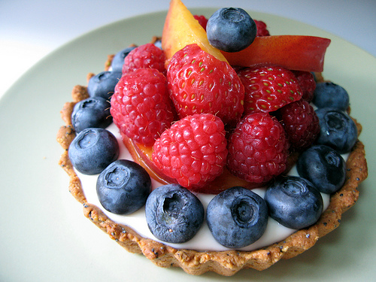
Food Preparation & Nutrition – Butter, Oil, Sugar & Syrup – lesson 9
LO’s
To make Fresh Fruit Tarts with Crème Patissière
Success criteria –
A short pastry (crisp), a light and creamy Crème Patissèrie, beautifully prepared fruit.
Skills & Techniques used-
1,2,5,6,7,8,9,12,13,14,17,18,19,20
Making pastry, preparing fruit, simmering, baking, making a custard, testing for readiness
Science involved-
Coagulation of eggs to set the filling, yolk adds colour to the filling, gelatinisation of flour to help set the filling
Notes:
10X – 19/6/18 10W – 25/6/18

Slide 2
Food Preparation & Nutrition – Butter, Oil, Sugar & Syrup
Ensure your skills chart is up-to-date along with your dish evaluations.
If finished, ensure your work area is immaculate, then check to see if you have completed your homework.
Ext. task 1 – Start reading the chapter on p.335

