Slide 1
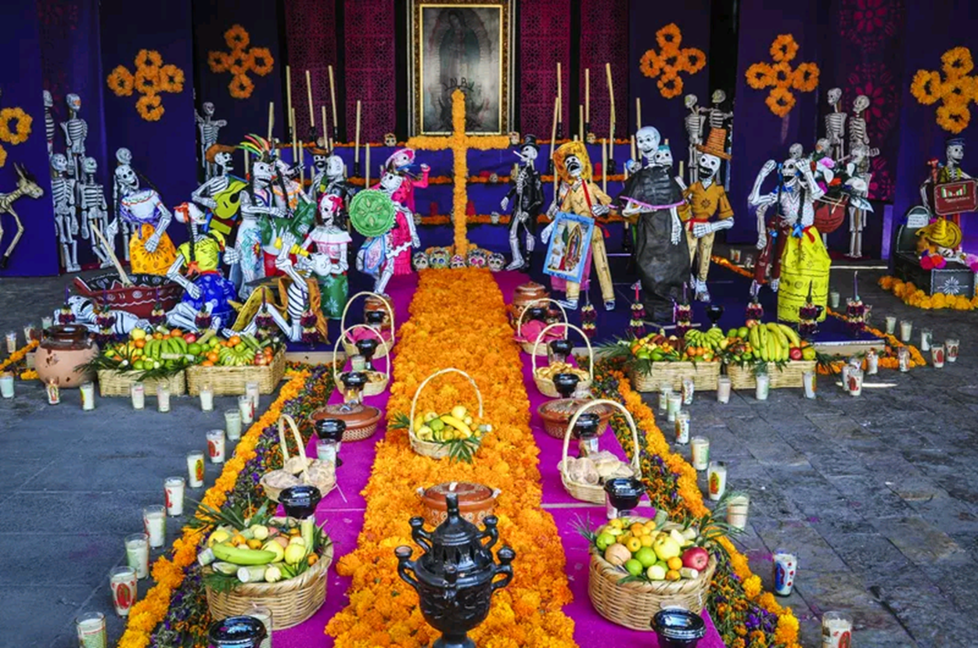
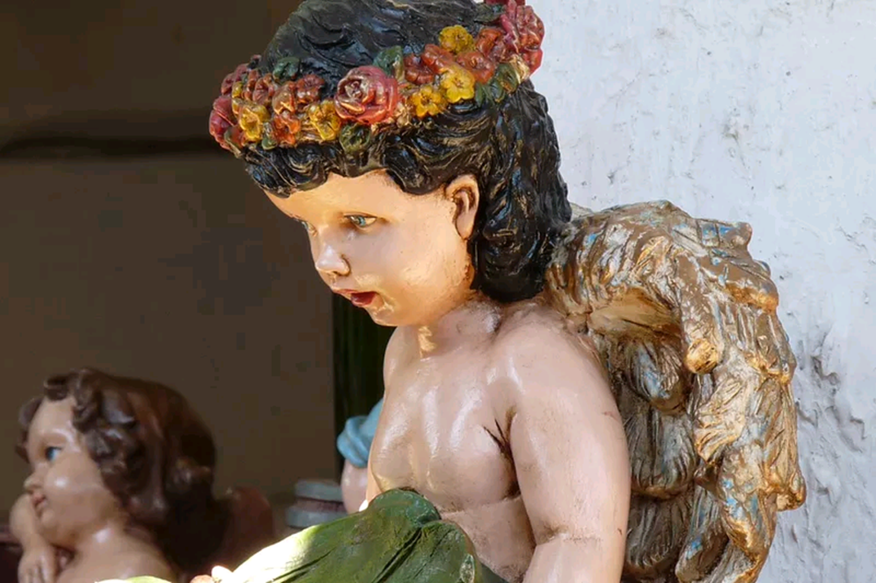
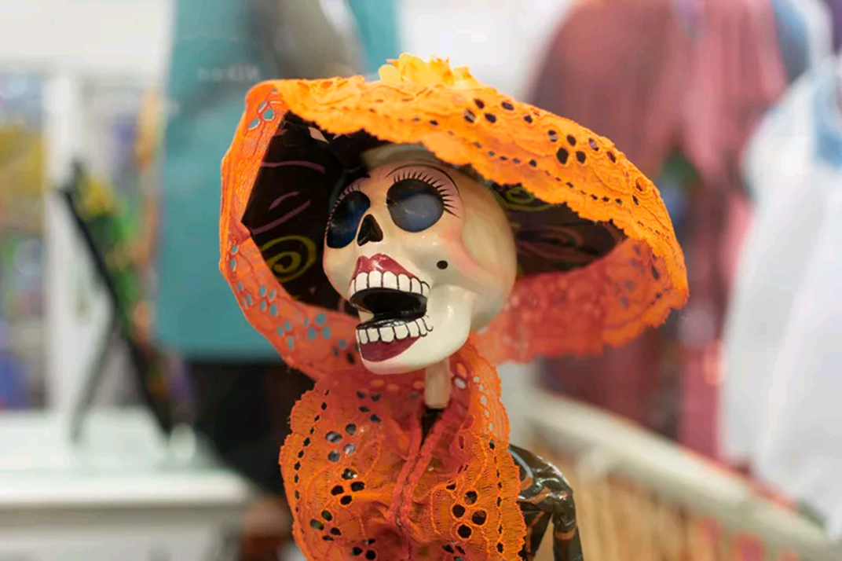
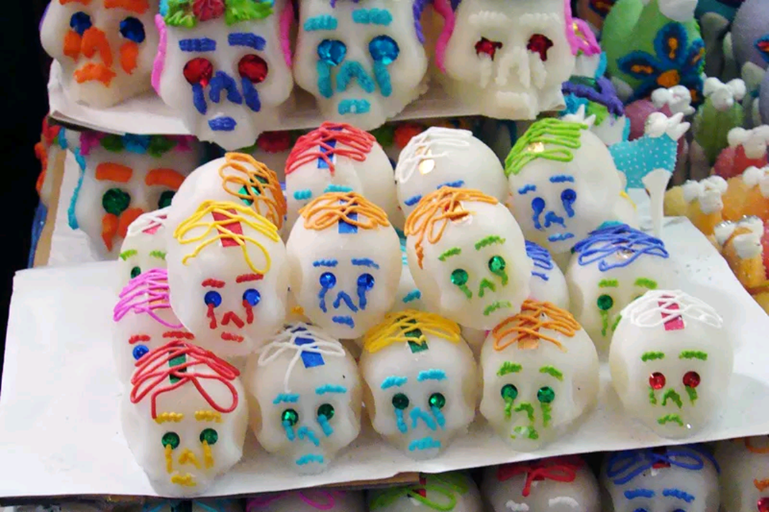
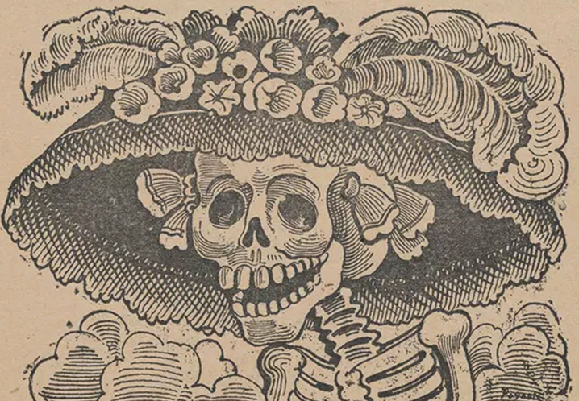
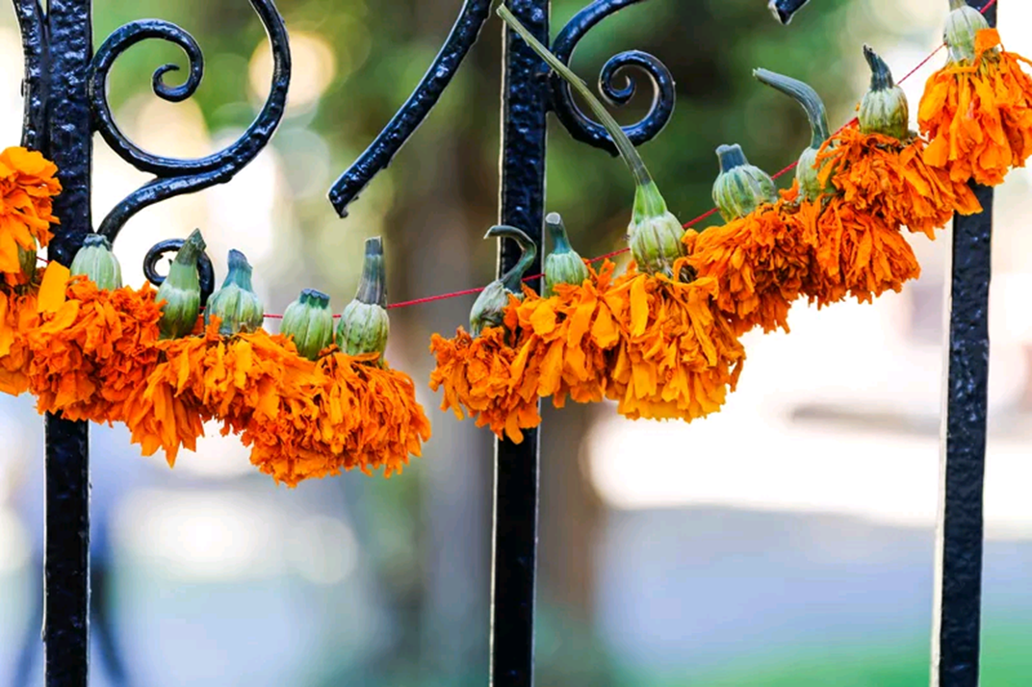
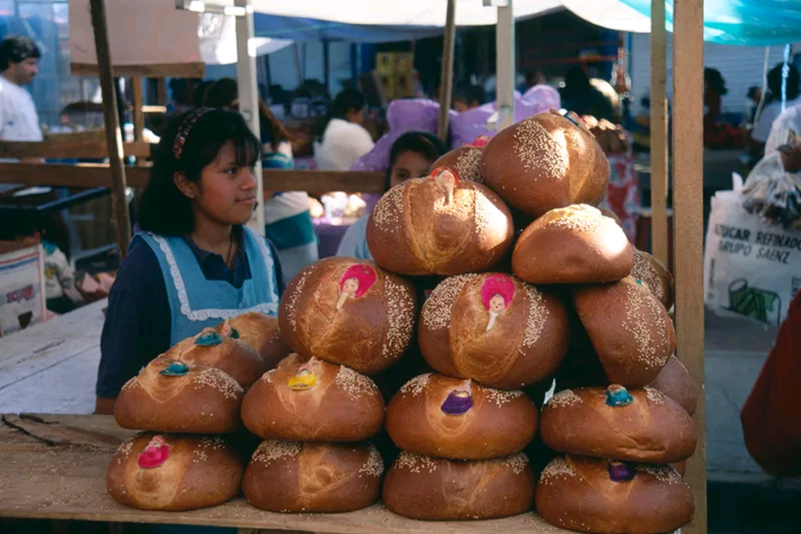
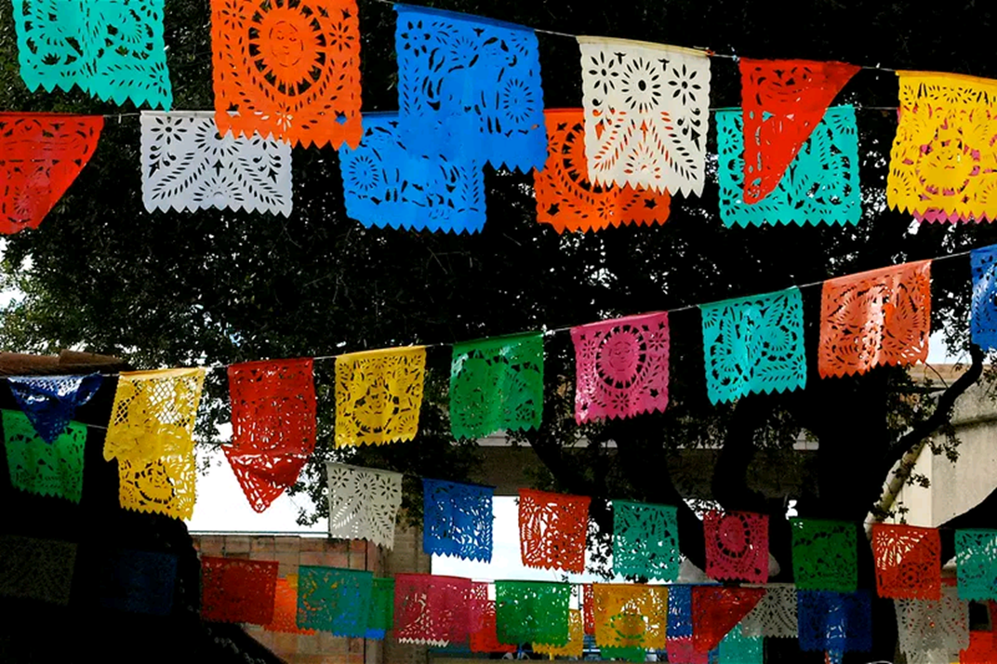
Mexican day of the dead vocabulary
Find out what the following words and phrases mean. Write a paragraph about each one.

Slide 2

What is an OFRENDA?

Slide 3

Who are LOS ANGELITOS?

Slide 4

What does CALACA mean?

Slide 5

What is a CALAVERA?

Slide 6

Who is LA CATRINA?

Slide 7

What is a FLOR DE MUERTO?

Slide 8

What is PAN DE MUERTO?

Slide 9
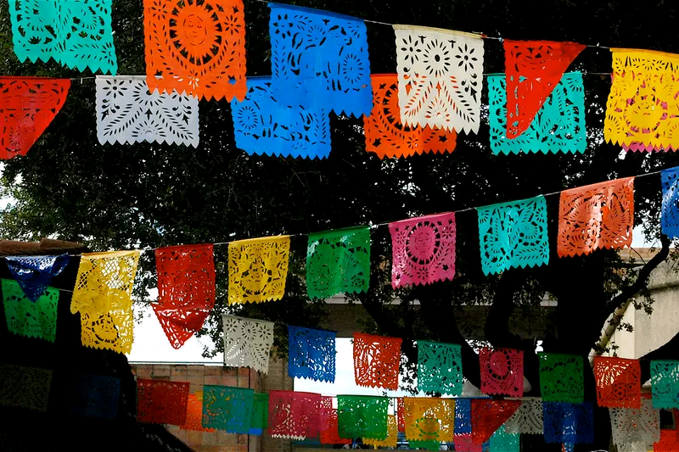
What is a PAPEL PICADO?

