Slide 1
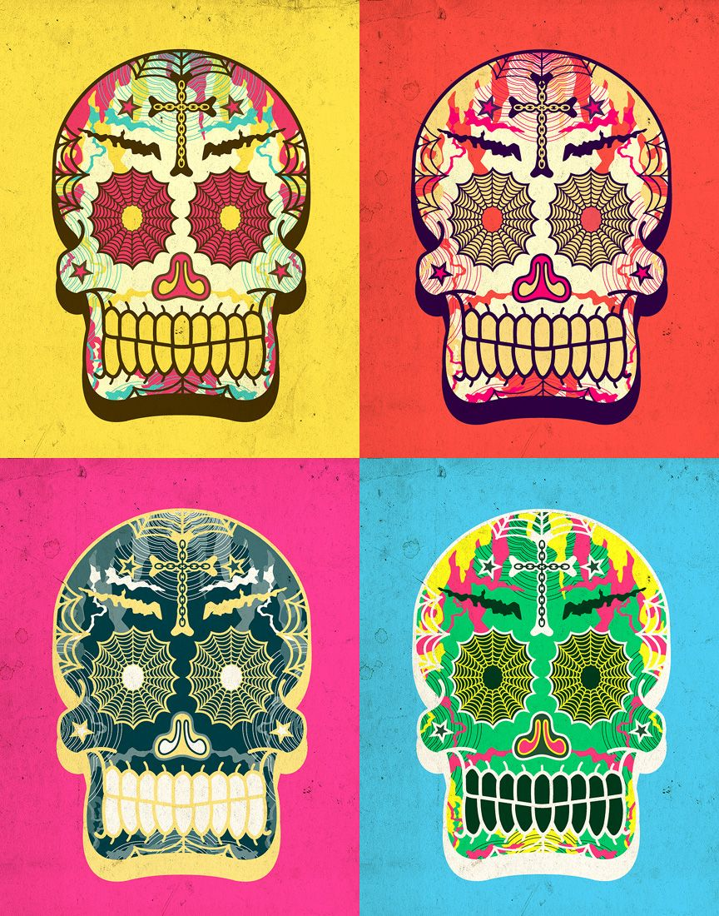
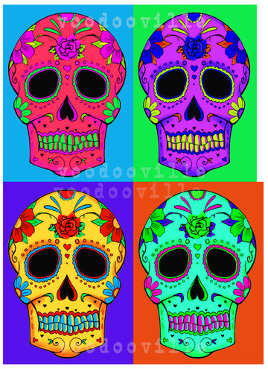
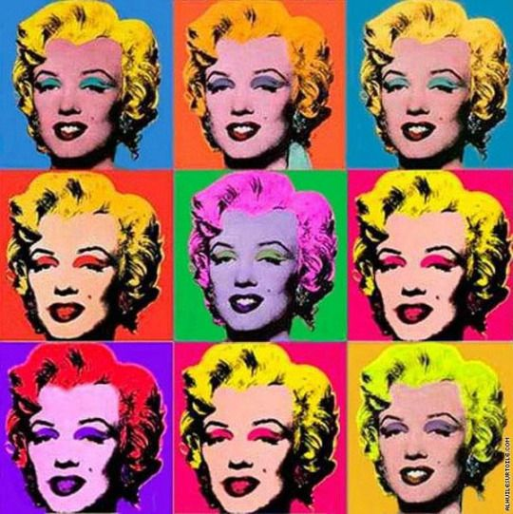
Mexican Day of the dead:Lesson 3
https://www.youtube.com/watch?v=_sSawpU81cI
Watch this clip all about Mexican day of the dead.
Trace one of the designs onto an A4 page in your sketchbook, colour carefully using contrasting/complementary colours. If you prefer you can draw your own design and trace it 3 times to repeat the image.
Andy Warhol “Marilyn Monroe”

Slide 2
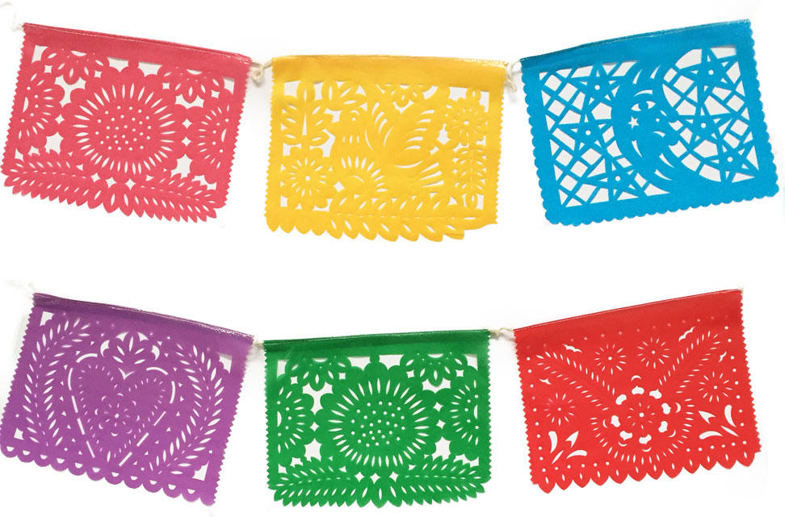
Lesson 4
Watch you tube clip about Papel Picados
https://www.youtube.com/watch?v=sT6-5YFpujg
Extension task for those who have finished Pop art colouring task.
Create 3 Papel picados try to create different designs by folding your paper in a variety of ways.
Use a template if you really struggle.

Slide 3
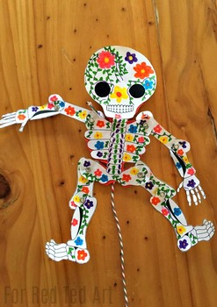
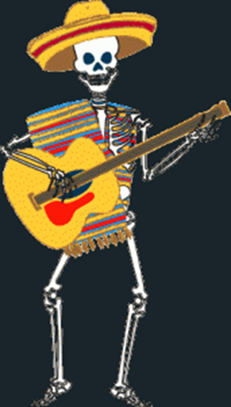
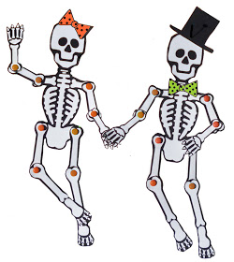
Lesson 5 & 6
Skeleton puppet
Trace your choice of Skeleton onto white cartridge paper make sure that you trace all the bones!
Decorate the bones with day of the dead patterns or dress you skeleton in clothes…what kind of character will it be???
Give it accessories and clothing.
Use colour.

Slide 4
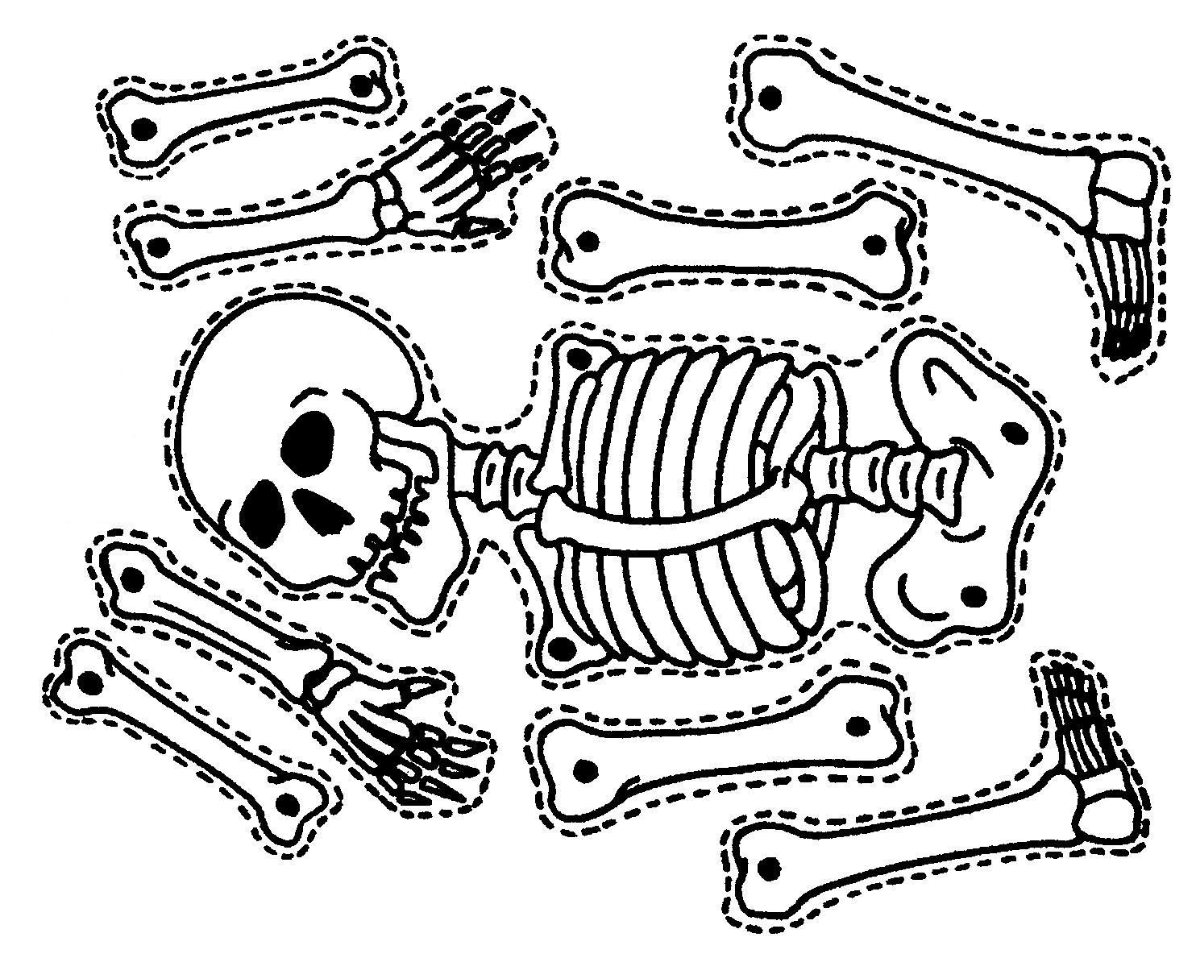

Slide 5
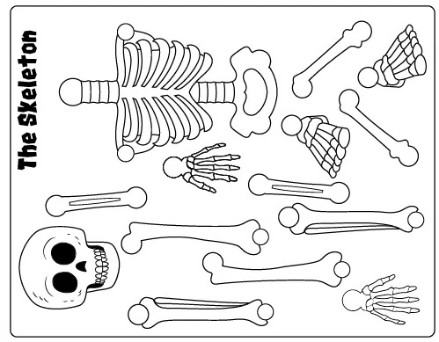

Slide 6
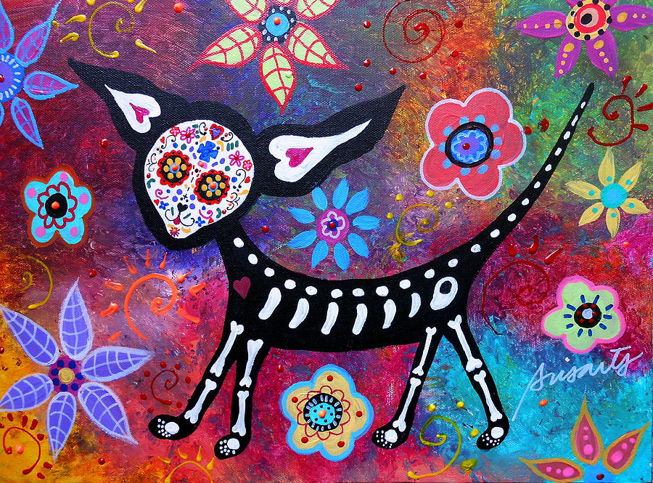
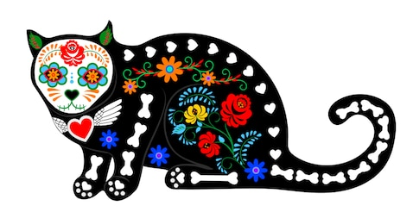
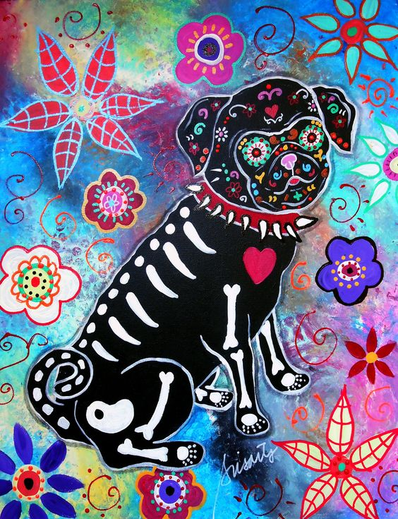
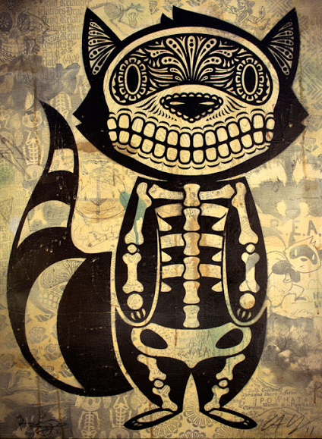
Extension task:
Create a Day of the dead style animal skeleton of your choice. Research different ideas. Try to include colour patterns.

