Slide 1
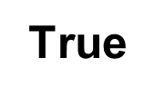
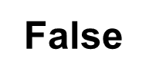
True or False?
1. All Rastafarians smoke Cannabis
2. Rastafarians are hippies
3. Rastafarians eat only beef
4. Rastafarians believe in three gods
5. Rastafarians called God ‘Jah’
6. The 4 main colours used to symbolise Rastafari are Red, Yellow, Green and Blue
7. They believe that Jah came to Earth in the form of man called Hallie Selassie
8. Rastafarians do not wash their hair and have dreadlocks so they are in harmony with nature
9. Hallie Selassie is worshiped as the saviour of Rasta people and is very often called the Lion of Judah
10. Rastafarians believe it is only right to fight to defend your family

Slide 2
Reggae and Reasoning
Objectives
Understand the significance of reggae for Rastas
Describe the meaning of the lyrics in some reggae music
Understand and relate the use of cannabis to reasoning

Slide 3
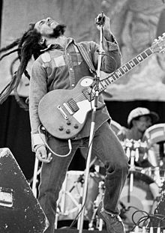
Bob Marley
One of the most famous followers of the Rastafari religion was Bob Marley.
Bob Marley sang songs about his religion and what they believed
Bob Marley was an activist for peace

Slide 4
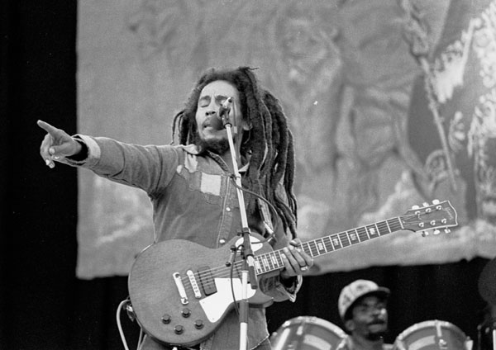
Your task
Buffalo soldier
1) Listen to this song and follow the lyrics
2) When the song has finished write a few lines explaining what you think the song could be about.

Slide 5
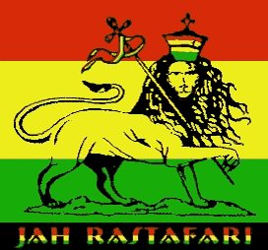
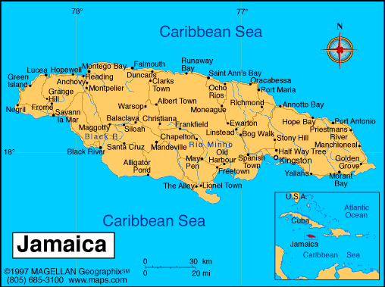
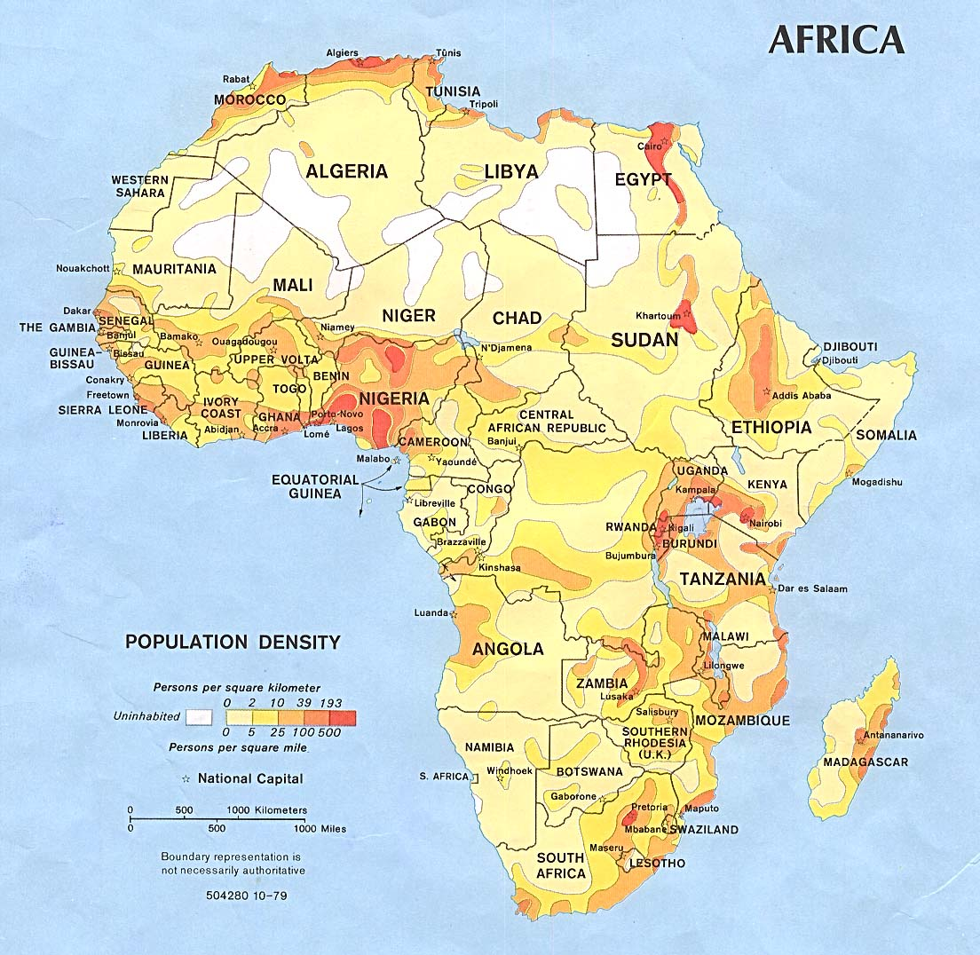
Feedback
What do you think the song was about?
Write your answer: explain

Slide 6
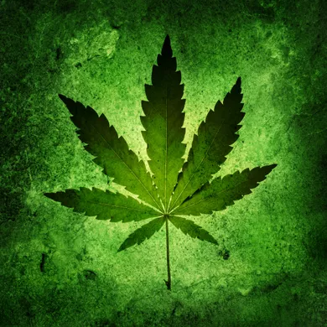
illegal Drugs
Drugs are illegal in nearly every single country.
Rastafarians are peaceful people who do not break laws.
Suggesting that Rasta’s smoke drugs is very offensive and would upset most Rastafarians.
Cannabis is not seen as a drug to Rasta’s. It is a sacred herb used for meditation

Slide 7
Rastas are not allowed to smoke or chew tobacco. Rastas are allowed to smoke Ganga (herb) which is the leaves of a plant. They are supervised by a Rastafarian priest, and only use it to have direct experience of God. They are not allowed to use it for recreational purposes.
This is very controversial to other cultures in countries like Britain where it is against the law. Nonetheless it is a real aspect of Rasta culture which has to be made reference to.
Rastas argue that the smoking of this plant is permitted because of Bible passages showing how it was used by people like King Solomon. It is therefore seen as a way of reaching out to Jah.
The use of this herb is very extensive in Rasta culture for medicinal purposes also. Psalms 104:14 “He causeth the grass for the cattle and herb for the service of man.”

Slide 8
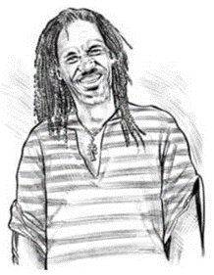
Your Task
fill in the boxes using the information from the ‘Ganja in the news’ resource and your own ideas.
UK Chronicle
Judge rejects Rastafarian plea to be allowed to smoke ganja
The Court of Appeal has upheld the decision that the English law on cannabis does not go against the right to freedom of religion given under the European Convention of Human Rights. Robert Rodney had argued that, as a Rasta, the use of ganja was a spiritual act linked to his faith and should therefore be allowed. Addressing the Court, Mr Rodney argued that the use of cannabis (ganja) is justified in the Bible and quoted three verses to justify this: You shall eat the herb of the field (Genesis 3:18); He causes the grass to grow for the cattle and the herb for the service of man (Psalms 104:14) and Better is a dinner of herbs where love is than a stalled ox and hatred therewith (Proverbs 15:17). The Court ruled that no Rasta had a religious right to smoke ganja as that was directly against the law in England. | Leaving Court, Mr Rodney said that when he smoked ganja it was linked to his reading of the Bible and he considered it a sacrament that made his body and mind clean as well as bringing him closer to Jah. He went on to express his disappointment at the ruling saying, ‘It opens minds to the truth and many people do not want that to happen.’

Slide 9
Read the resource sheet entitled ‘Ganja in the news’. Consider the consequences of that ruling as well as looking at the consequences if the Court had agreed with Mr Rodney. Fill in the boxes with your answers.
Consequences for Mr Rodney because of ruling against him. | Consequences for all Rastas in the UK because of ruling against him. | Consequences for non-Rastas in the UK because of ruling against him.
Consequences for Mr Rodney if the Court had agreed with him. | Consequences for all Rastas in the UK if the Court had agreed with him. | Consequences for non-Rastas in the UK if the Court had agreed with him.

Slide 10
Summarise your own thoughts about this case in a few sentences.

