Slide 1
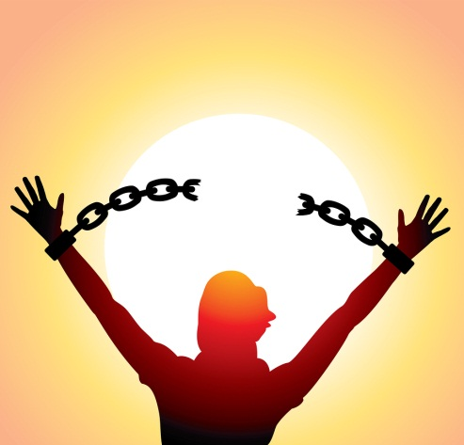

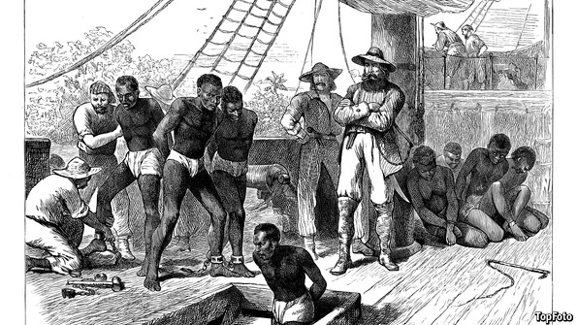
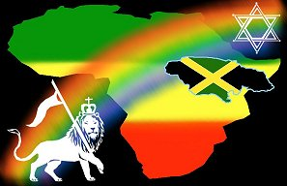
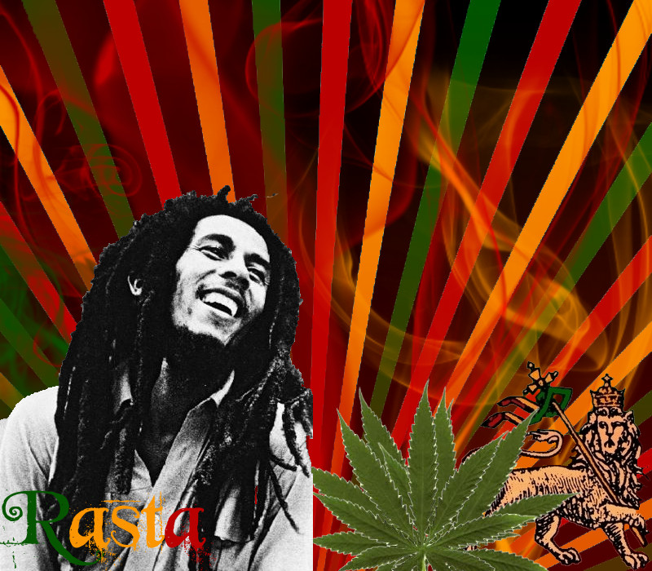
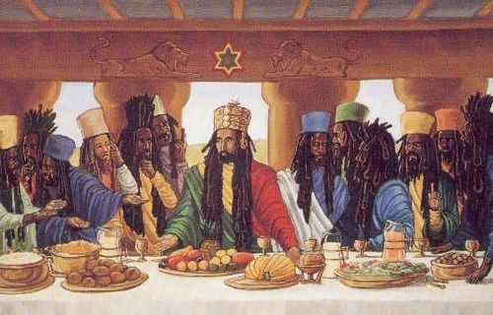
Stimulus
What questions come to mind?
Notes:
Pupils should write down

Slide 2
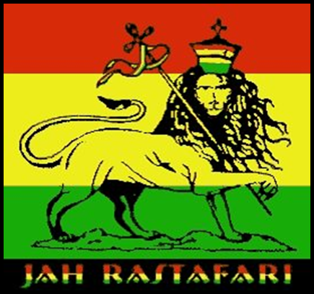
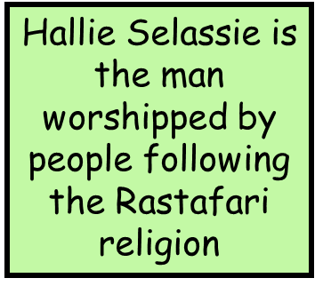
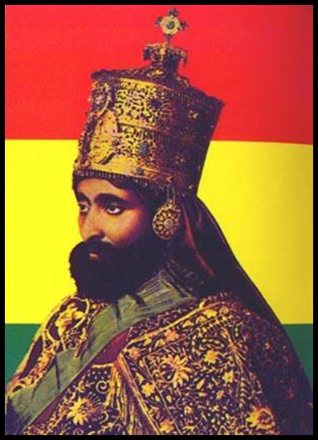


Rastafarianism Lesson 1
Understand some of the beliefs of the Rastafari religion
Describe symbolism
Red, Gold and green are the colours of Rastafarianism

Slide 3
A brief history
The Rastafarian movement originated in Jamaica in the 1920s. It is heavily influenced by the work, the writings and the teachings of Marcus Garvey. He was a very influential black spokesman born in Jamaica in 1887. He spent his life fighting for the improvement of black people in white society cultures. He founded the United Negro Improvement Association and predicted that his people would be saved by a future African King.
One of the key beliefs of Rastafarians is that every individual must discover truth for him or herself. God is within every individual. All religious opinions are respected and although they often spend much time discussing the Bible, Rastafarians believe that there is no one meaning.

Slide 4
Rasta beliefs about God
Rasta’s believe God is called ………… They believe that ………..came to Earth in the form of man called ………….
………… was the Emperor of a large African country called ……….. Hallie Selassie is worshiped as the ………. of Rasta people and is very often called the ………. of Judha
Jah Lion
Hallie Selassie Saviour
Ethiopia Hallie Selassie
Jah

Slide 5
Rasta beliefs about God
Rasta’s believe God is called Jah. They believe that Jah came to Earth in the form of man called Hallie Selassie. Hallie Selassie was the Emperor of a large African country called Ethiopia. Hallie Selassie is worshiped as the saviour of Rasta people and is very often called the Lion of Judha

Slide 6
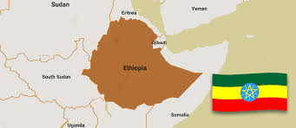
Rasta beliefs about Africa
Rasta’s believe that when black slaves were taken to Jamaica and other parts of the Caribbean they were taken away from their home in Africa. They also believe that because Africa is the cradle of civilisation (where all humans came from) it is a very important continent for all humans. Africa is also the continent where Hallie Selassie came from so is very important

Slide 7
Symbology
Rastas see Ethiopia as the Promised Land and use symbols of the Cross and the Star of David (to show the Jewish-Christian foundation of Rastafarian principles), also especially the crowned Lion of Judah carrying the cross over its shoulder from which flies the flag of Ethiopia in red, green and gold. So their religion is the blending of the purest forms of Judaism and Christianity and they believe themselves to be the descendants of the early Israelites who went into exile.
The 4 main colours used to symbolise Rastafari are Red, Yellow, Green and Black
Red – Represents the blood that was bled by the black slaves
Yellow – Represents the sun and warmth of Africa
Green – Represents nature
Black – Represents the dark skin of people from Africa
Task
Using a full page, create a flag to represent yourself, it must have;
Three colours
At least one symbol
Draw your flag and explain what each part means
Be ready to share!

Slide 8
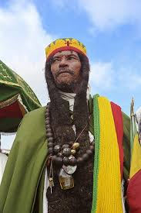
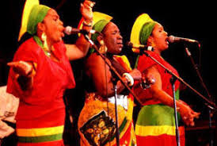
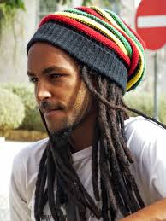
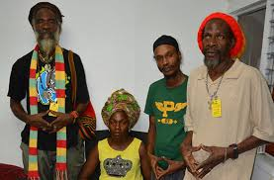
Dress and Dreads
Rastas will often wear the symbolic colours red, yellow, green and black. Or the colours of the Ethiopian Flag.
Rasta’s believe that it is very important to live in Harmony with nature. Some Rasta’s believe that they should not touch their hair and let it grow naturally. If hair is not combed for a long time it begins to dreadlock.

Slide 9
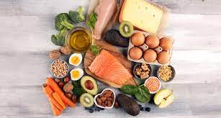
Diet
The true Rasta follows very strict rules about food, eating what is called I-tal Food.
Milk, rum, other alcohol, flavoured soft drinks and coffee are forbidden, and only fruit juice or herbal tea is drunk.
All food is prepared very carefully and cooked in containers which are usually reserved for I-tal food. It must not be in cans or contain chemicals and additives.
Natural food is served in the rawest form possible, without salt, preservatives or other condiments.
All food is carefully, almost ceremonially, prepared and Rastas are mainly vegetarian.
They do not eat pork, shellfish or any fish over 18cm
Task
Create a menu for your Rasta friend, you really want to impress them! It must include a starter, a main course and dessert. They will also need a drink!

Slide 10
Stimulus
Which images are you to now able understand?
Notes:
Pupils should write down

Slide 11
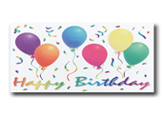
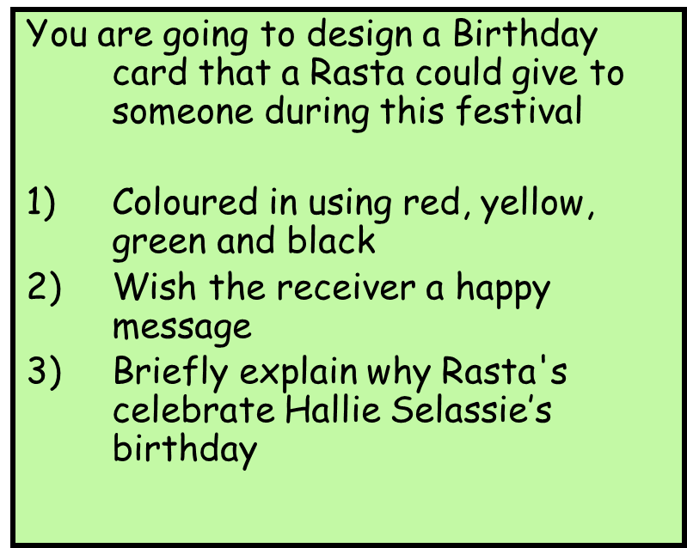
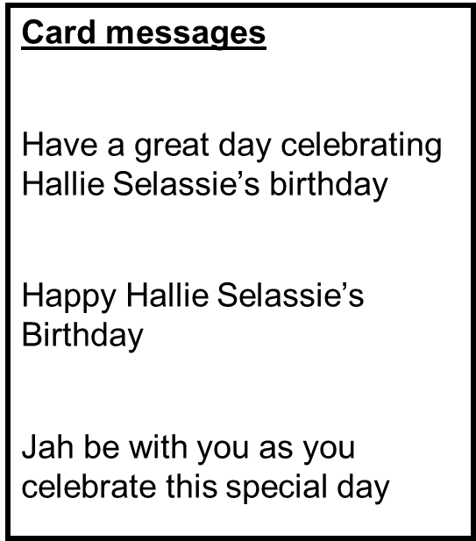
Homework
Hallie Selassie’s birthday Like Christians celebrate Christmas (day Jesus was born) Rastafarians celebrate the birthday of Hallie Selassie. They will throw parties, play music with lots of dancing, and eat party food give cards and presents. Hallie Selassie’s birthday s one of the biggest festivals in the Rastafarian calendar.

