Slide 1
Food Collage
Year 8 Textiles

Slide 2
Collage
Collage is a form of art where an image or a design is made by sticking different materials or images together onto a backing. The collage could be made from recycled paper, images cut from magazines or photographs or bits of fabric.
Appliqué and quilting which are both textiles techniques where fabrics are stitched onto a background to make an image are quite similar to collage.

Slide 3
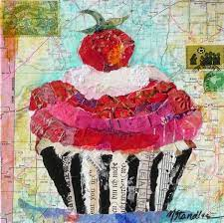
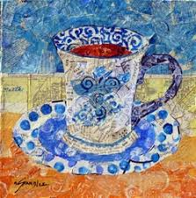
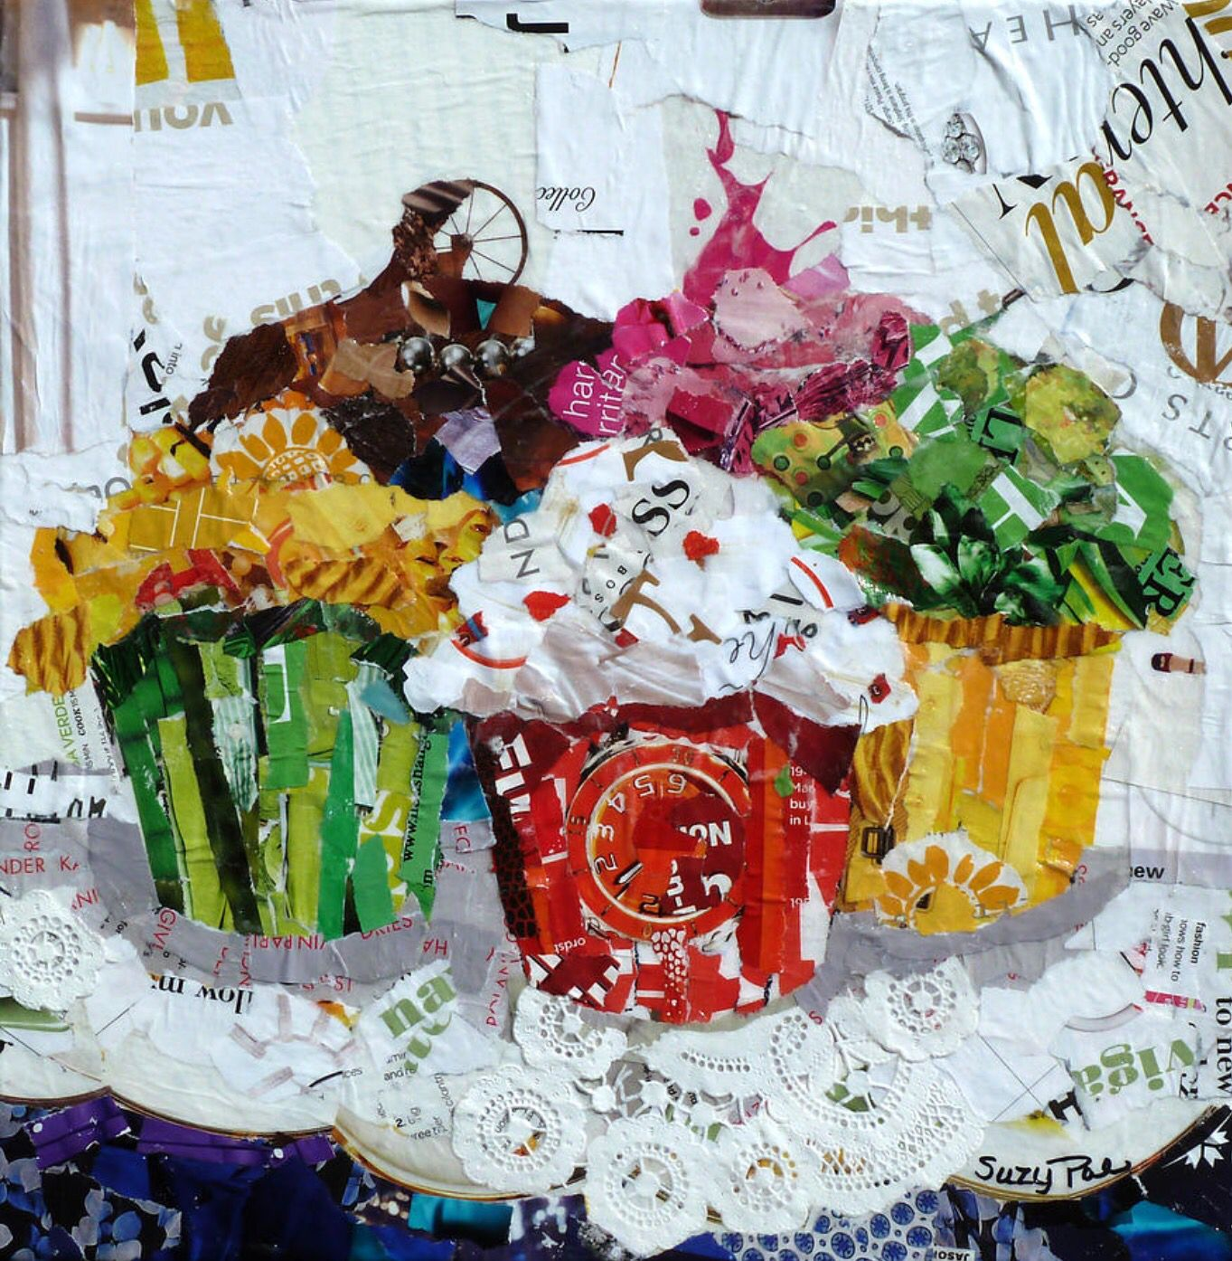
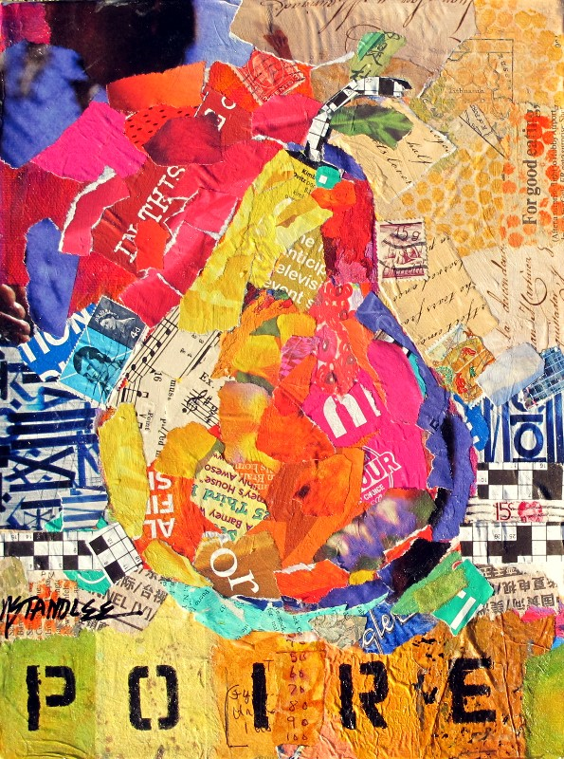
Nancy Standlee

Slide 4
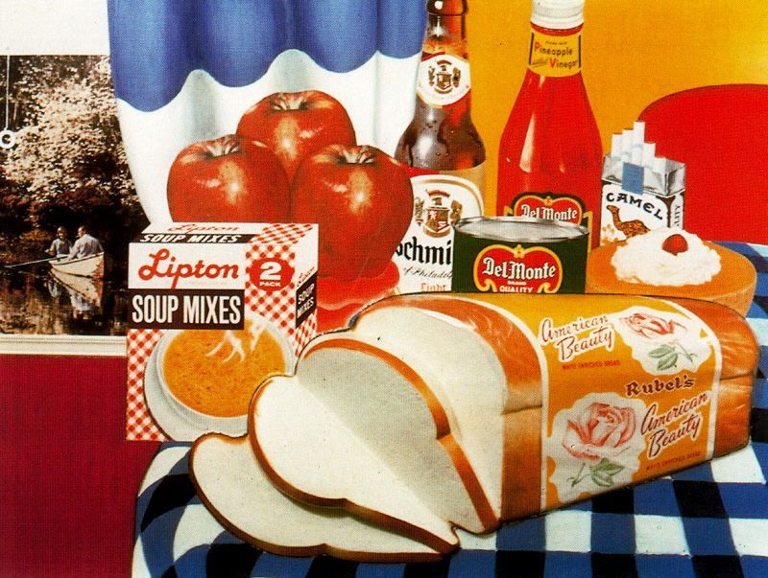
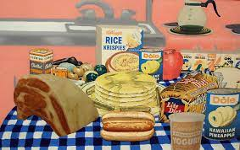
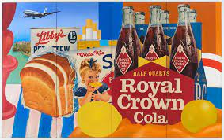
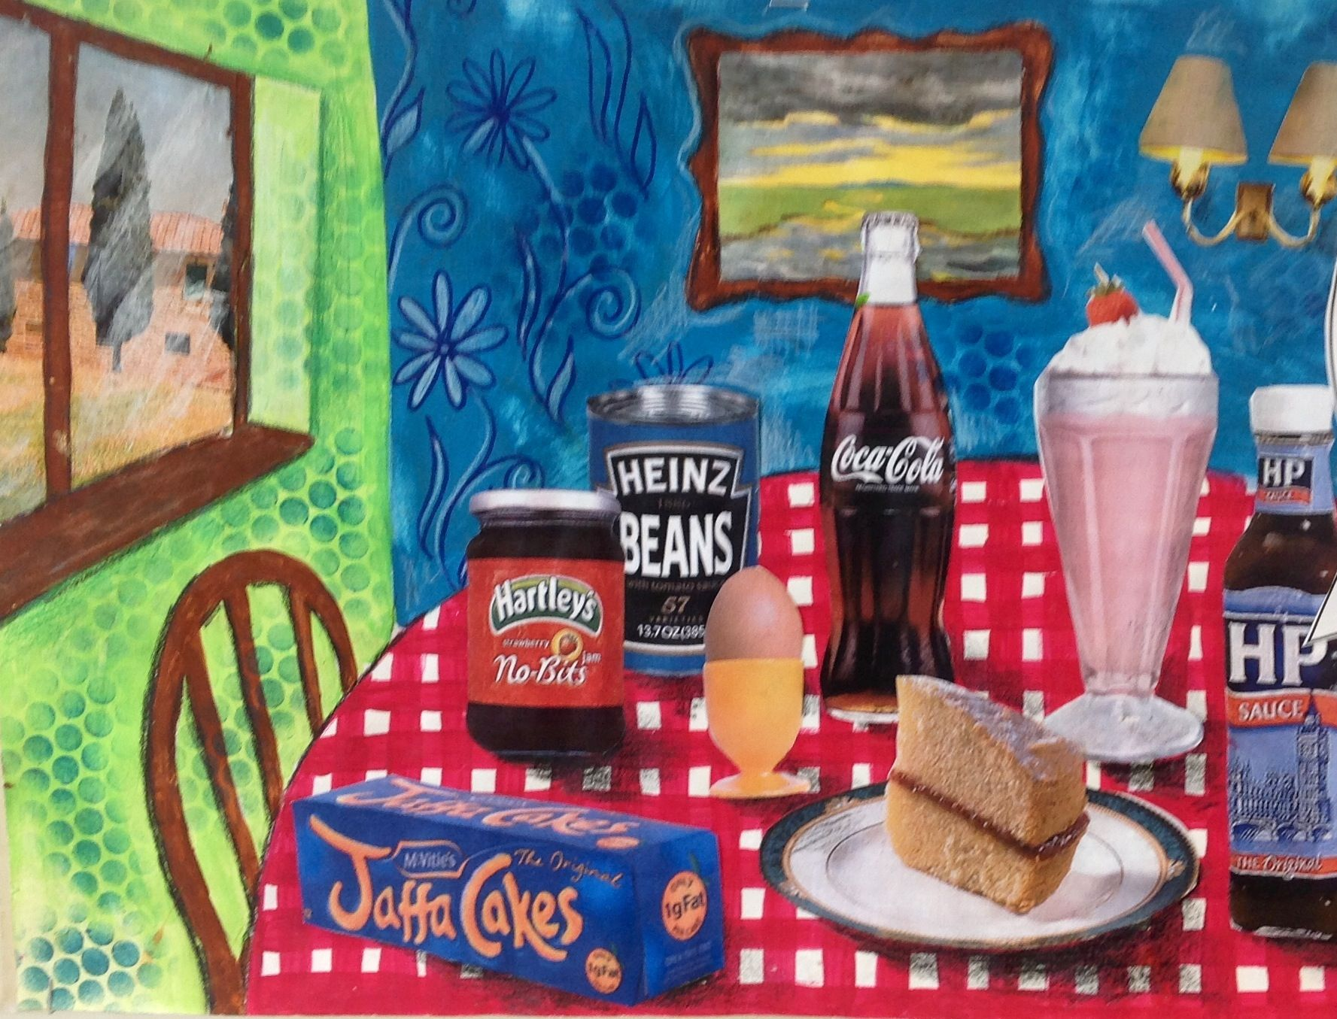
Tom Wesselmann

Slide 5
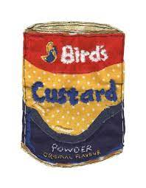
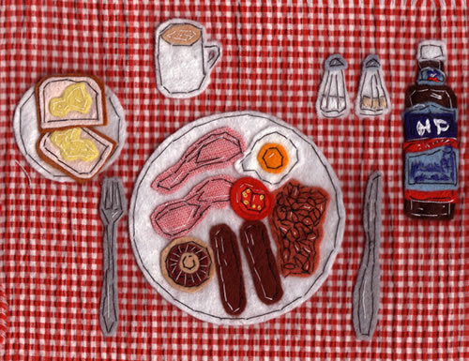
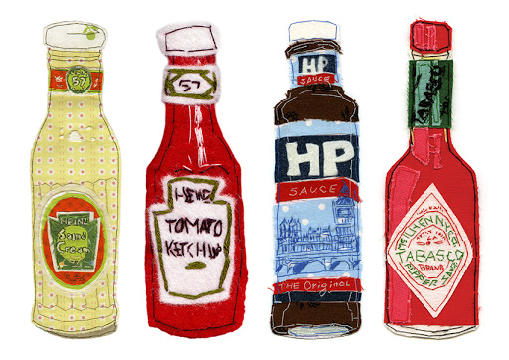
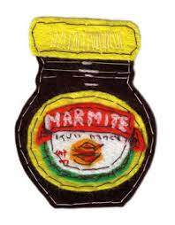
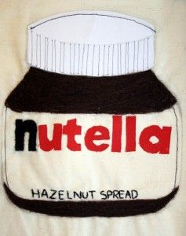
Kate Talbot

Slide 6
Task For Today: Food Collage
Make your own collage of a food item or items using whatever materials you have available. You could …
Tear up pieces of paper and collage them together to make an image in the style of Nancy Standlee
Draw or paint a background eg: a dining table and fill it with pictures of food which you have cut out of a magazine or printed from the computer
Use fabrics and stitch to create a fabric collage using the appliqué technique in the style of Kate Talbot
OR
Create your own design and idea the great thing about collage is that anything goes!!

Slide 7
If You Can’t Make a Collage
If for whatever reason you are not able to make a collage then please complete the following:
Create a research page explaining what collage is. Find out how the technique began
Produce a research page about an artist who uses collage include the following in your research page: Background information about the artist, a description of their work (what materials do they use), find pictures of their work and label to describe them, give your opinion of their work what do you like/ not like about it?

