Slide 1
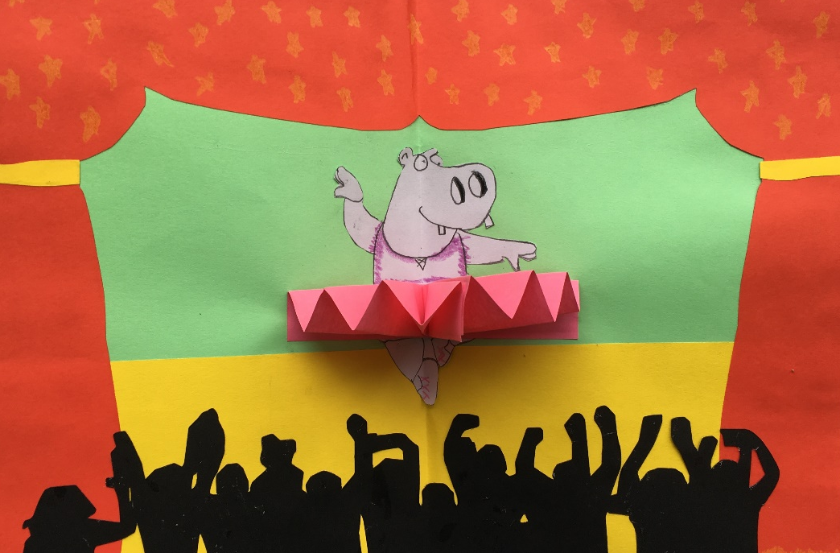
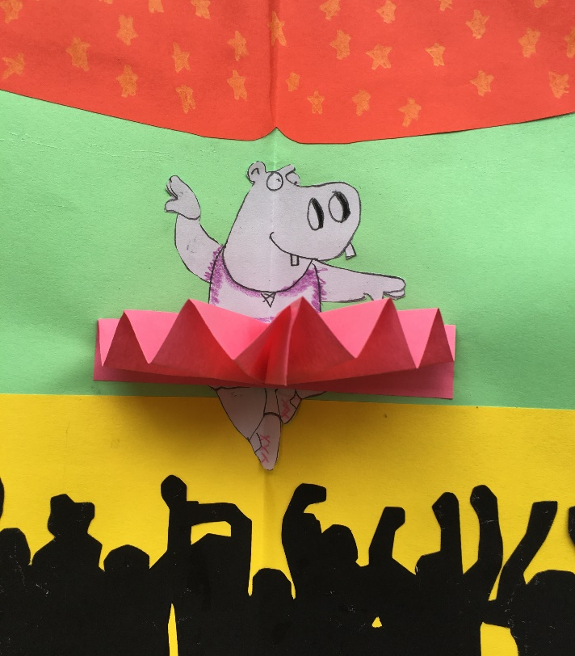
Fan Mechanism

Slide 2
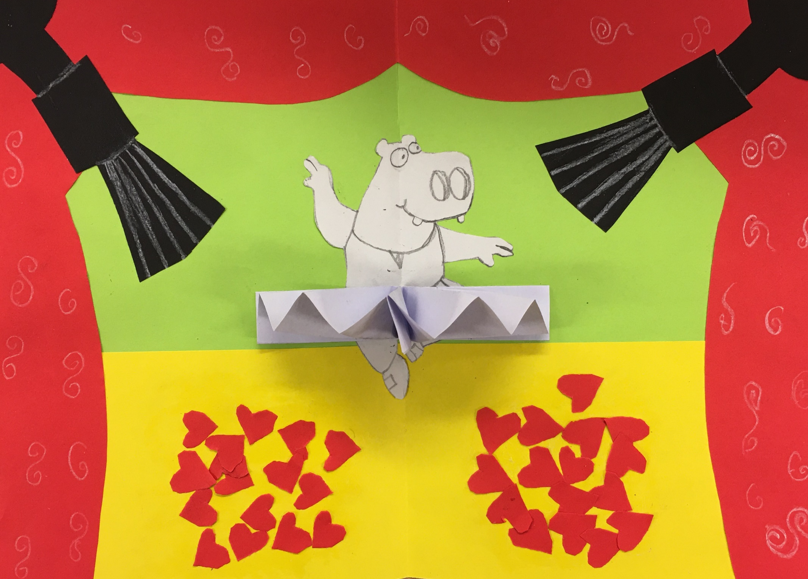

Slide 3
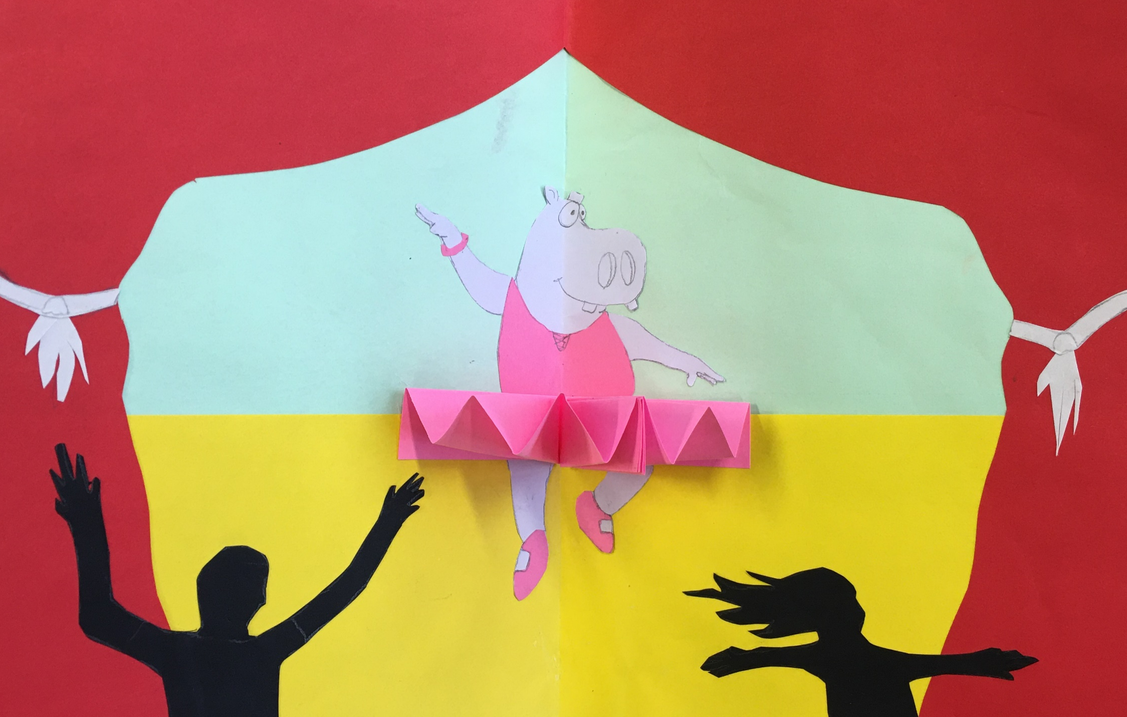

Slide 4
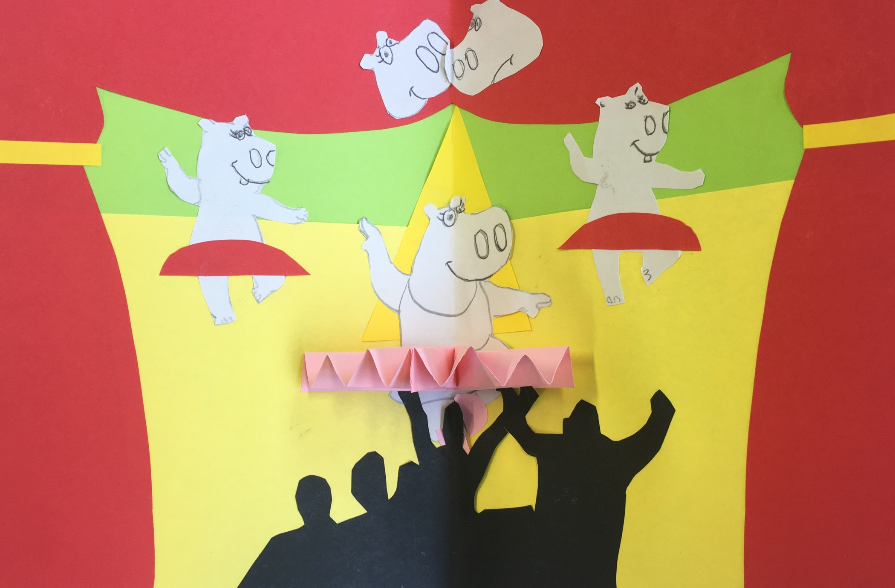

Slide 5
Fan Mechanism
Create a background by folding A4 Coloured paper in half. (Green)
Add the stage – about 1/3 the depth of your page (yellow)
Create the curtains by folding A4 Red paper in half, draw the shape you want and then cut out.
Glue curtains to the stage background.
Draw a hippo, cut out and glue to middle of stage
Create a fan by folding a pink piece of paper into a concertina. Fold in half and glue to the hippo.

Slide 6
Hippo Background Research Design Ideas

Slide 7
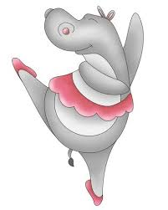
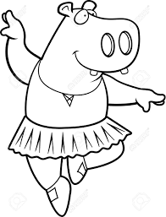
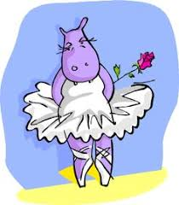
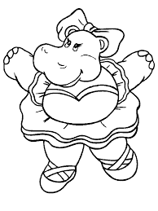
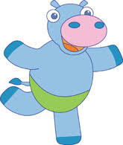

Slide 11
Fan mechanism- Final Outcome

