Slide 1
Yr 9 Art
Drawing tutorials

Slide 2
Turtle – this can be used as the base for a coffee or felt pen & bleach technique.
https://www.youtube.com/watch?v=MIXePJ0j-G0&safe=true

Slide 3
Octopus
https://www.youtube.com/watch?v=WOzd5AL6syw&safe=true

Slide 4
Advanced drawing - Tutorials
The following slides give links to drawing tutorials for more advanced outcomes
(Thinking of GCSE Art? Try one of these!)

Slide 5
Jellyfish
https://www.youtube.com/watch?v=XA0hPFgWH94&safe=true

Slide 6
Great White Shark
https://www.youtube.com/watch?v=Dsd61_vXZr4&safe=true

Slide 7
Humpback Whale
https://www.youtube.com/watch?v=HOspZK3YkUs&safe=true

Slide 8
Jellyfish in Watercolour
https://www.youtube.com/watch?v=Ag0z-LuVWiw&safe=true

Slide 9
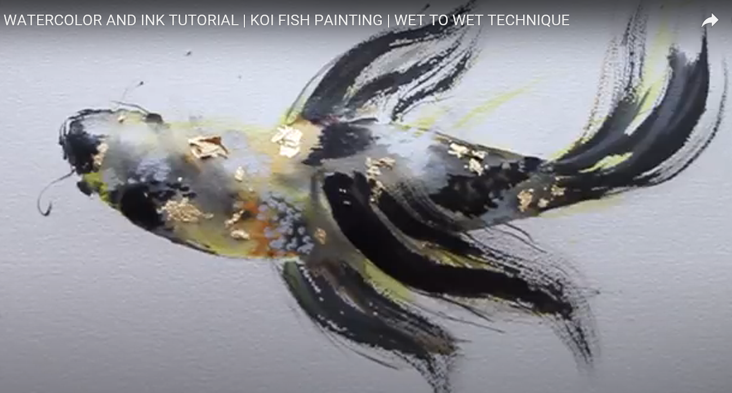
WATERCOLOR AND INK TUTORIAL | KOI FISH PAINTING
https://www.youtube.com/watch?v=axRzbqI9vZU&safe=true

