Slide 1
Yr 9 Art
Drawing tutorials

Slide 2
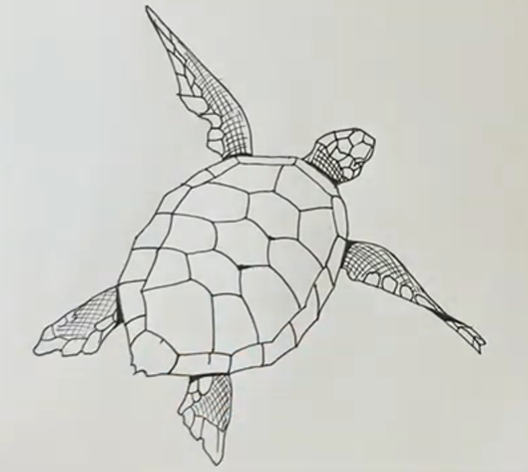
Turtle – this can be used as the base for a coffee or felt pen & bleach technique.
https://www.youtube.com/watch?v=MIXePJ0j-G0&safe=true

Slide 3
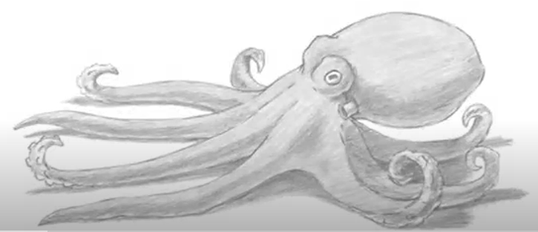
Octopus
https://www.youtube.com/watch?v=WOzd5AL6syw&safe=true

Slide 4
Advanced drawing - Tutorials
The following slides give links to drawing tutorials for more advanced outcomes. If you are unable to come to school we would like you to attempt some of these during your Art lesson time.
(Thinking of GCSE Art? Try one of these!)

Slide 5
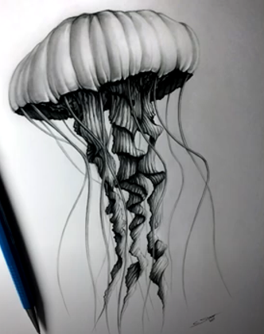
Jellyfish
https://www.youtube.com/watch?v=XA0hPFgWH94&safe=true

Slide 6
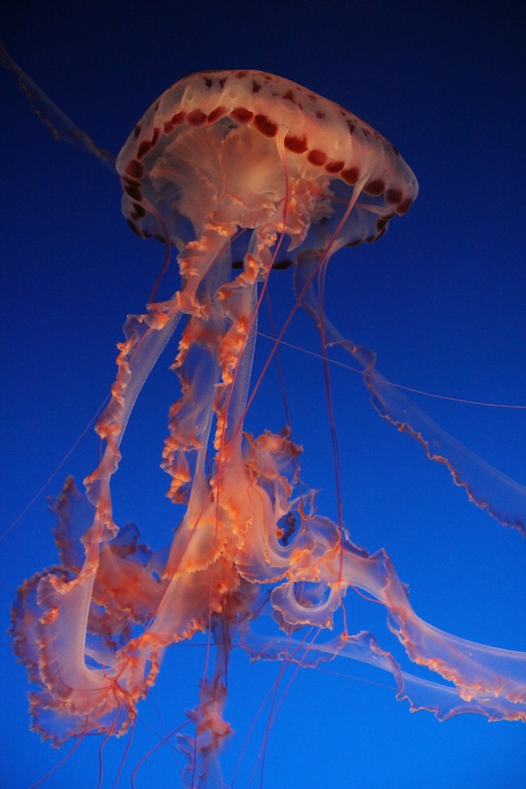
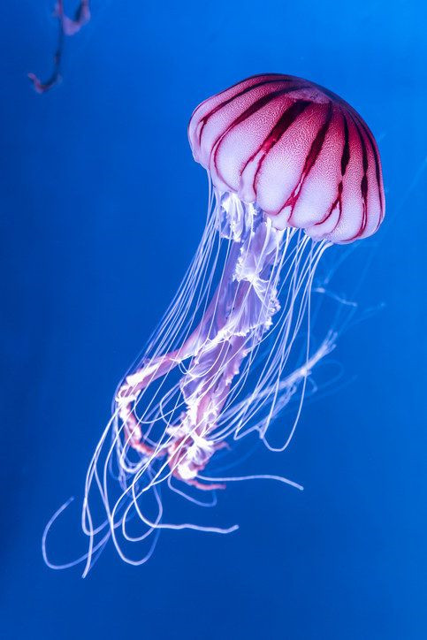

Slide 7
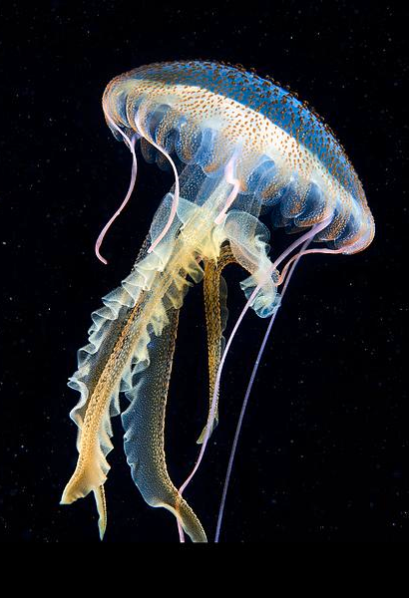
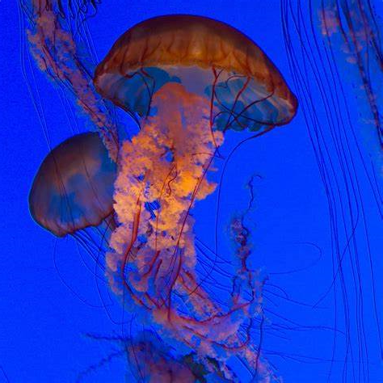

Slide 8
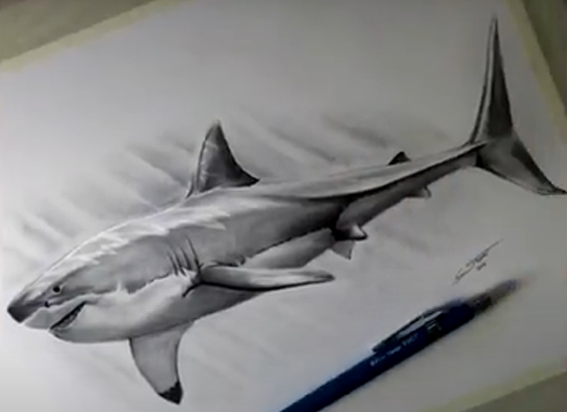
Great White Shark
https://www.youtube.com/watch?v=Dsd61_vXZr4&safe=true

Slide 9
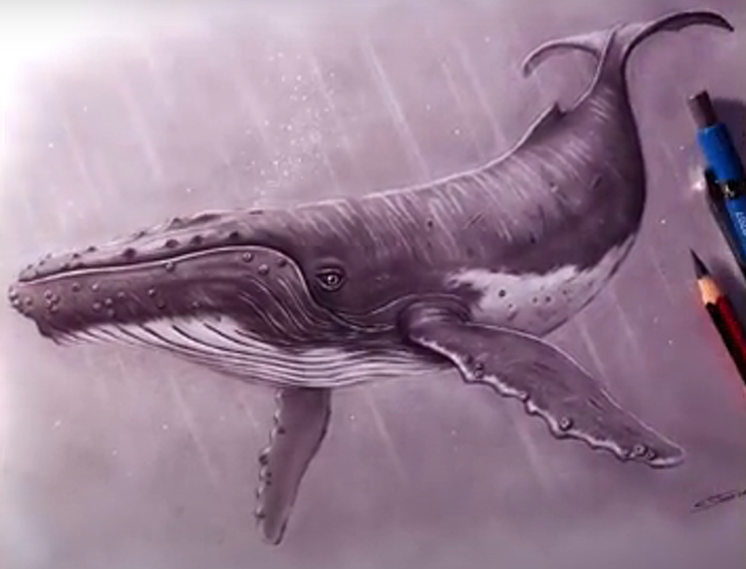
Humpback Whale
https://www.youtube.com/watch?v=HOspZK3YkUs&safe=true

Slide 10
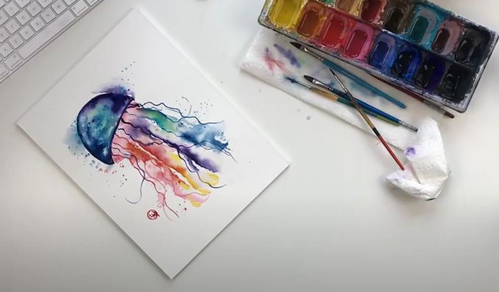
Jellyfish in Watercolour
https://www.youtube.com/watch?v=Ag0z-LuVWiw&safe=true

Slide 11
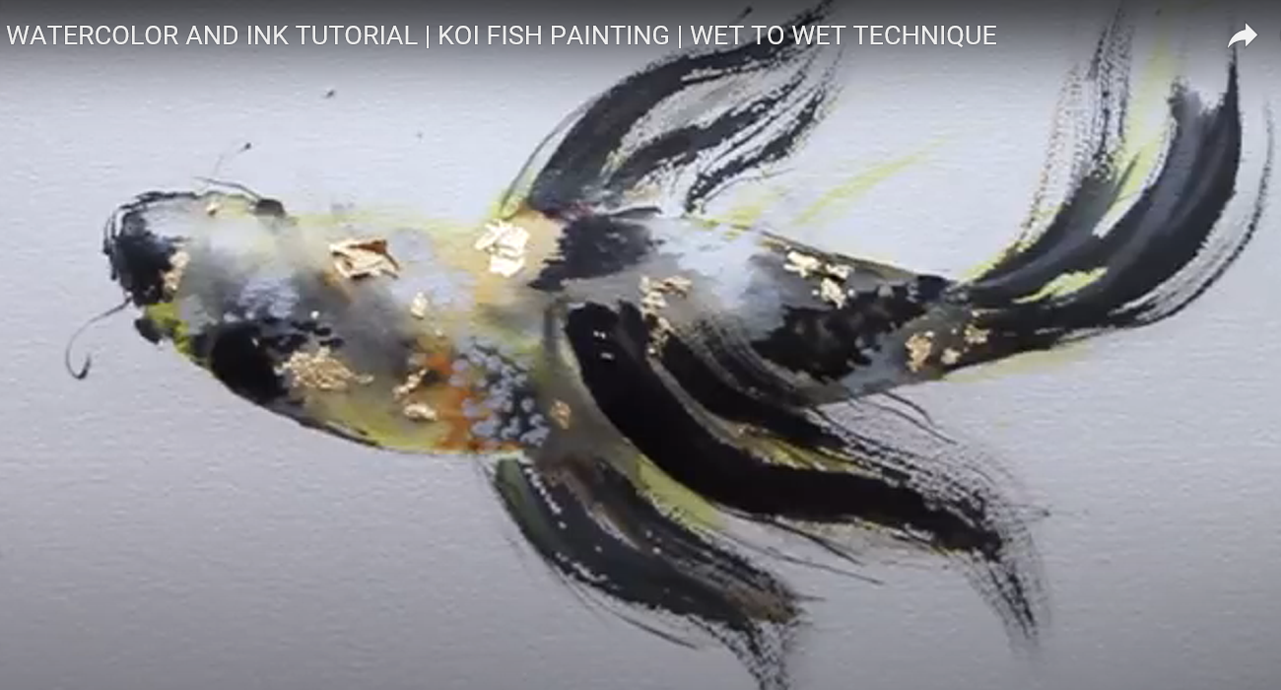
WATERCOLOR AND INK TUTORIAL | KOI FISH PAINTING
https://www.youtube.com/watch?v=axRzbqI9vZU&safe=true

