Slide 1
Welcome
Year 11 Study Skills
Session Outcome: to take away practical strategies to improve your revision at home and to better understand how we will be supporting you at school

Slide 2
A slide coming to make us smile...

Slide 3


Slide 4
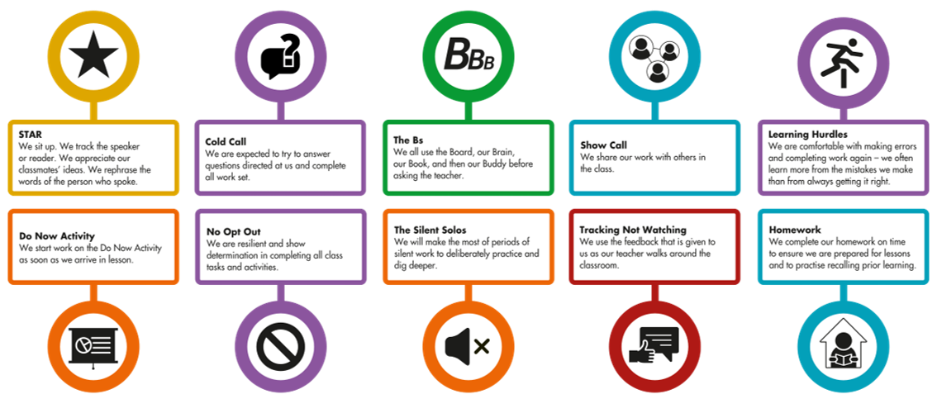










Slide 5
The Legacy of Cohort 2024
+0.2

Slide 6


Slide 7
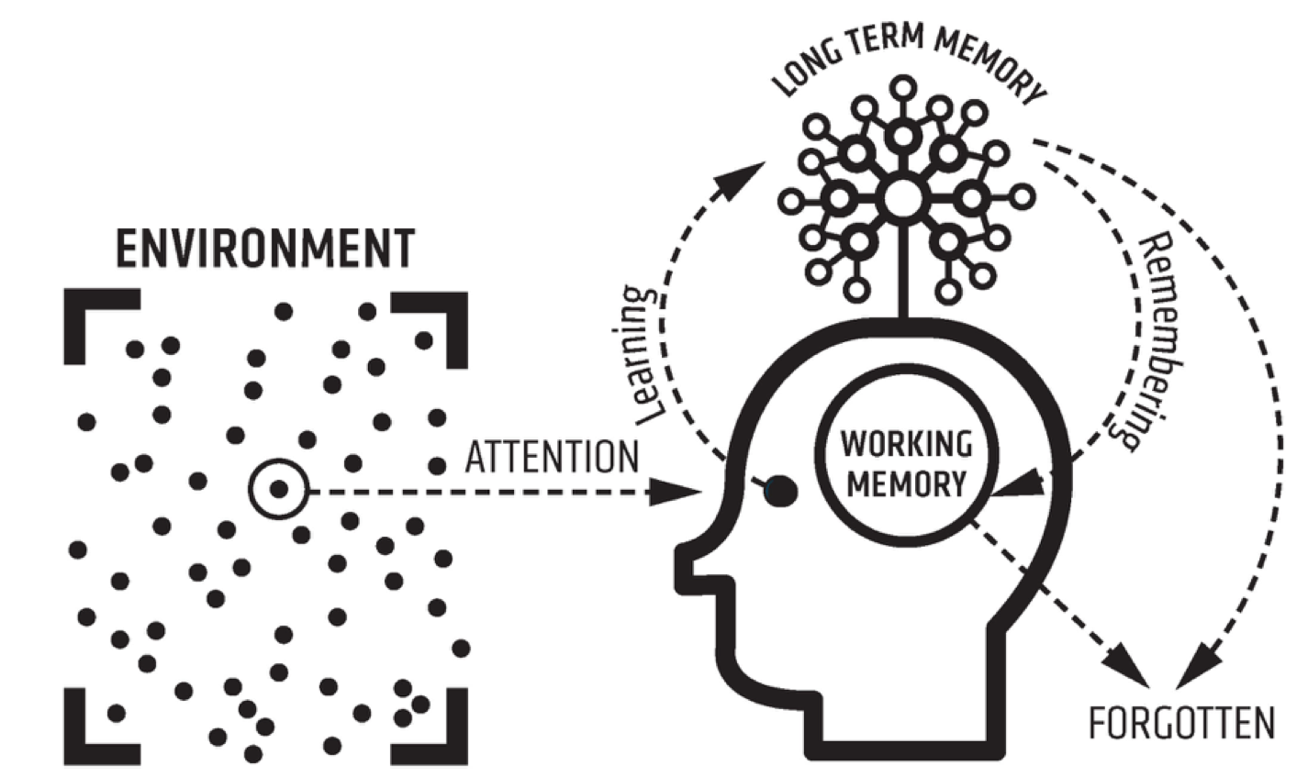

Slide 8
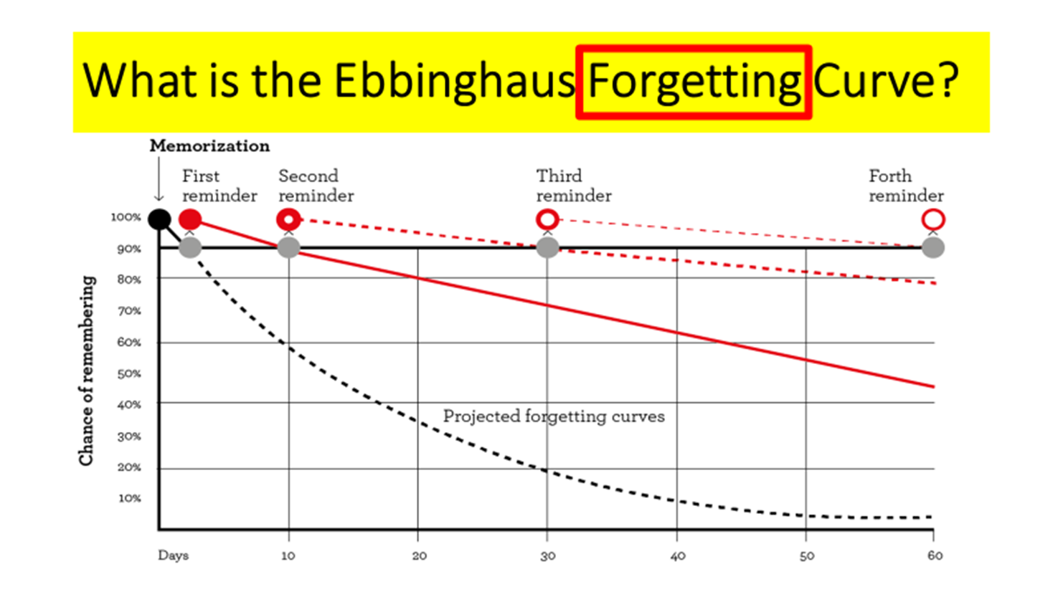
Forgetting Curve

Slide 9

The biggest revision fail ….

Slide 10
Why highlighting and rereading your notes/books is ineffective

Slide 11
They are popular study techniques but amongst the least effective
Lee/Dunlosky et al., 2013

Slide 12
You become familiar with the material and your confidence increases
But this creates a false sense of mastery and can discourage critical thinking
Adescope et al., 2017; Dunslosky et al., 2013, Trev

Slide 13
So … what works better?
Don't cram - review at spaced intervals
2) Explain the material to yourself and others
3) Take frequent, low stakes tests practice tests

Slide 14
Term Time revision: (each block = 35-45 minutes)
Include Task – (precise details!) And testing/checking
Mon | Tues | Wed | Thurs | Fri | Sat | Sun
School!
Aim for 2 specific revision sessions most evenings and around 4 over a weekend (these could be linked to HW). Think about the best times for you!

Slide 15
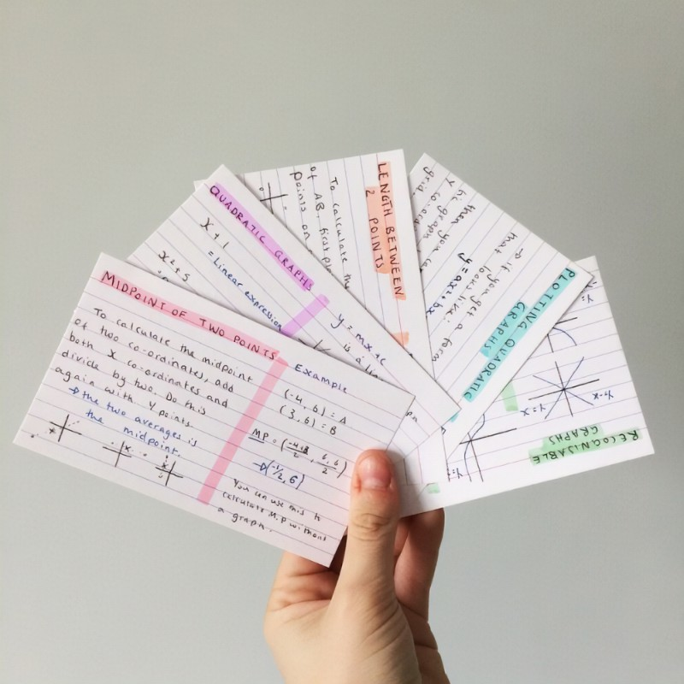
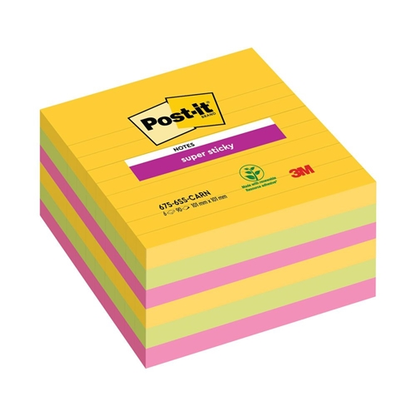

Explain the material to yourself and others

Slide 16




Take frequent, low stakes tests practice tests

Slide 17
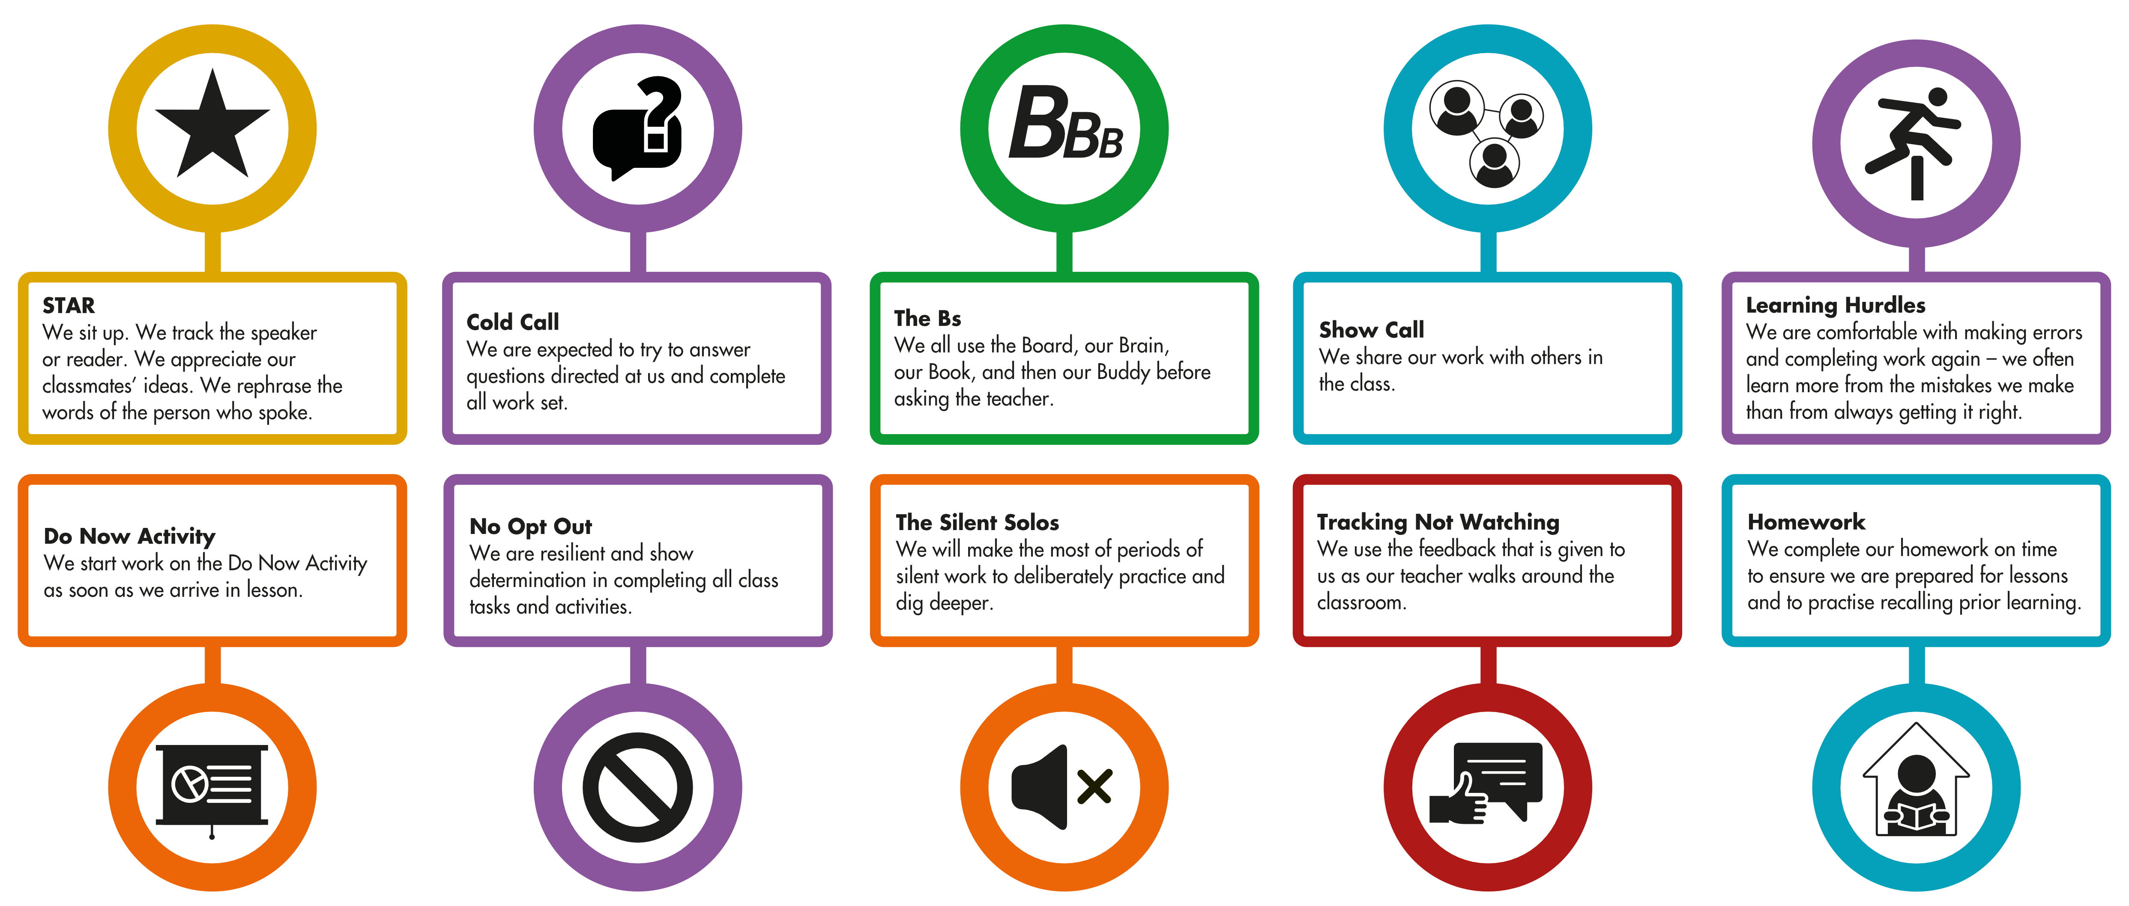
ACTIVE MINDS – Helping you in school

Slide 18
How do you know it's working?
Mock Exams – December & March
UP Strategy

Slide 19

Our UP Strategy
Mr Darren Stillman
CIRENCSTER
KINGSHILL
SCHOOL
UP
Unlocking Potential

Slide 20




Our Performance Colours
Platinum
Blue
Green
Amber
Red

Slide 21
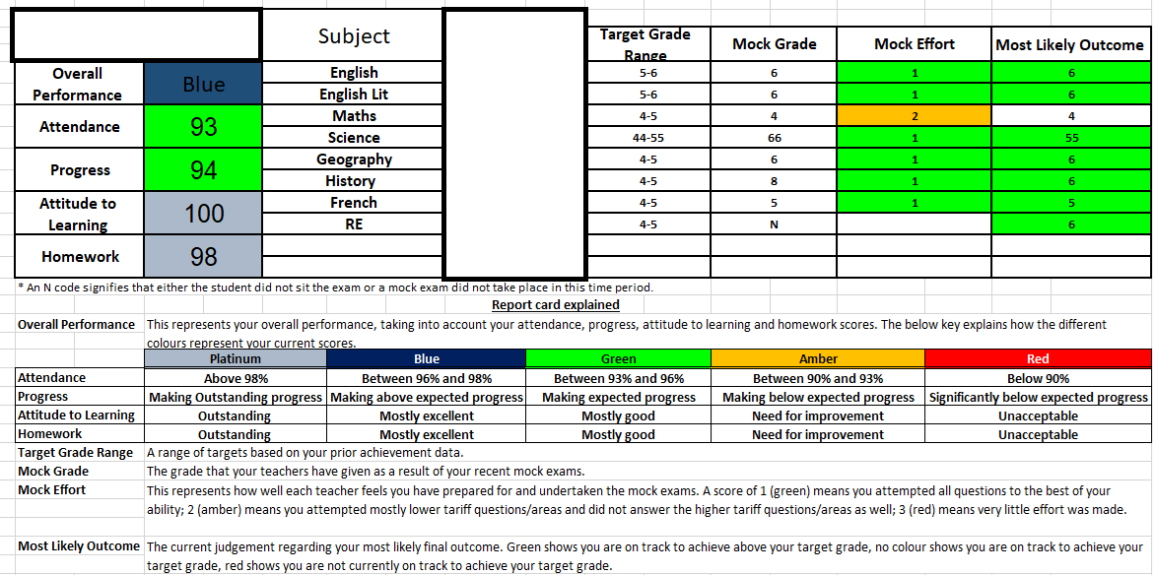

Slide 22
Ambition
My progress is over half a grade above where
it is predicted to be
My progress is above
where it is predicted
to be
I am on track with
my progress
My progress
is significantly below
where it is predicted
to be
My progress is below
where it is predicted
to be

Slide 23
Resillience
My attendance
is above 98%
My attendance
is between 96%
and 98%
My attendance
is between 93%
and 96%
My attendance
is between 90%
and 93%
My attendance is
below 90%

Slide 24
Cohort 2024 (Y11 Leavers)
P8 by Attendance
Below 90% | -1.361
90-93% | -0.93
93-96% | -0.07
96%+ | 0.72

Slide 25

Edulink
What is it and how do I use it?

Slide 26



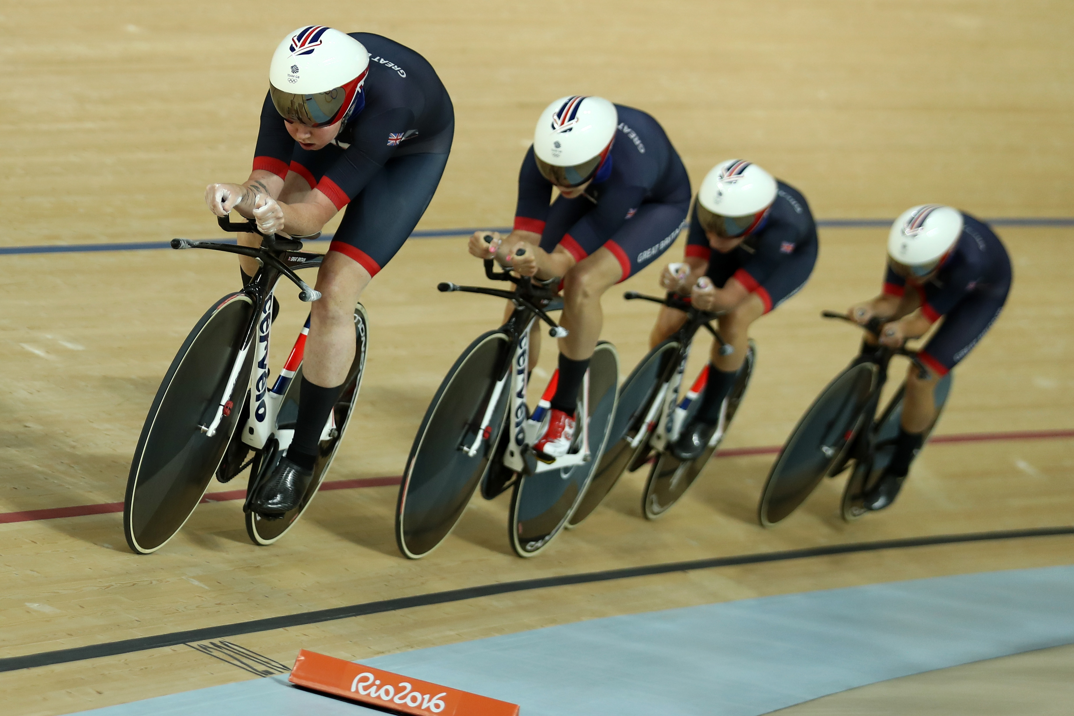
What have they got in common?

Slide 27

The power of data

Slide 28

Edulink
Attendance
Behavior totals
Homework
Timetable
Reports

Slide 29
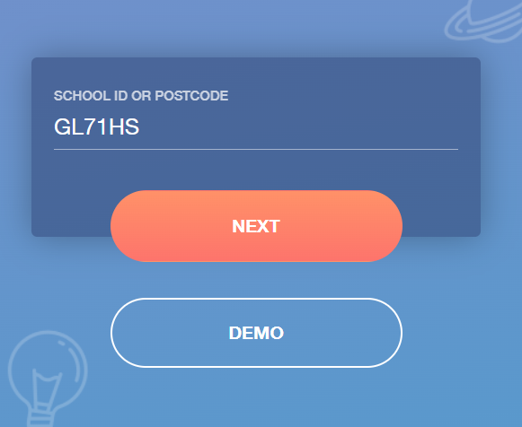
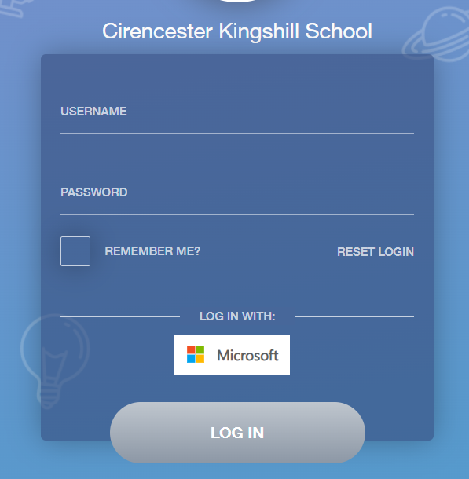
How to log in ...

Slide 30
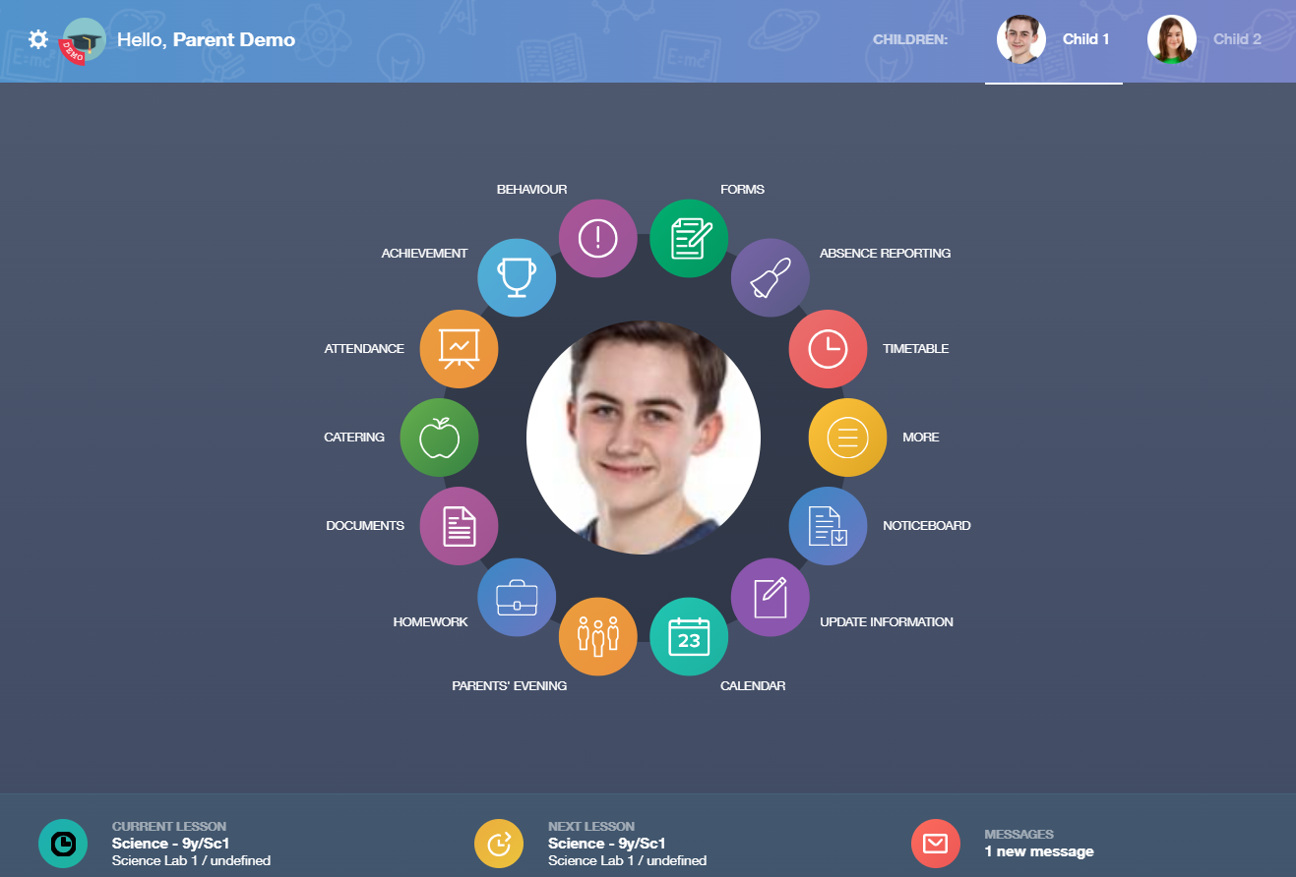
Multiple children, one log in
Your child's attendance
Multiple children, one log in
Your child's homework
In App messaging

Slide 31
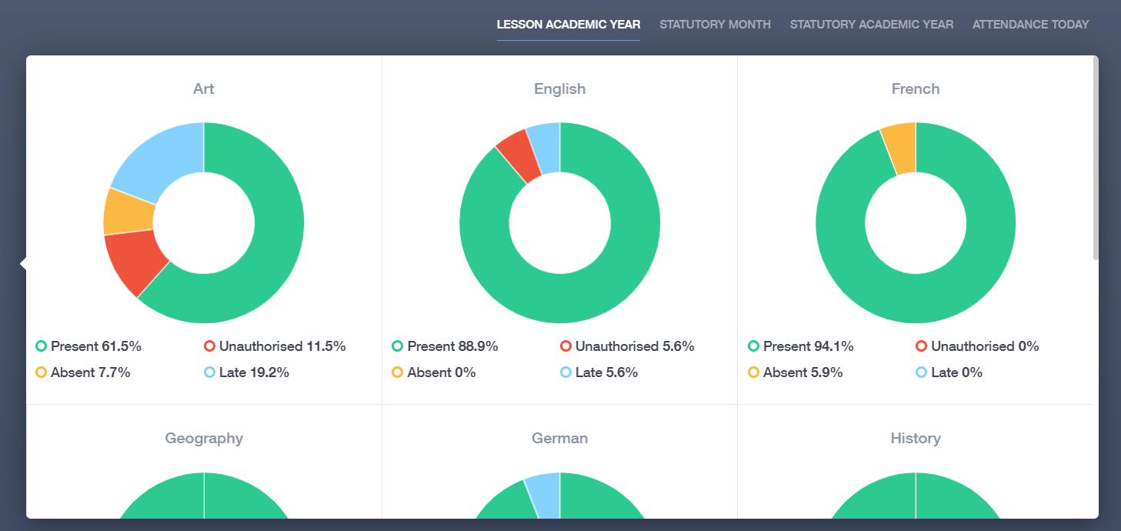
Attendance

Slide 32
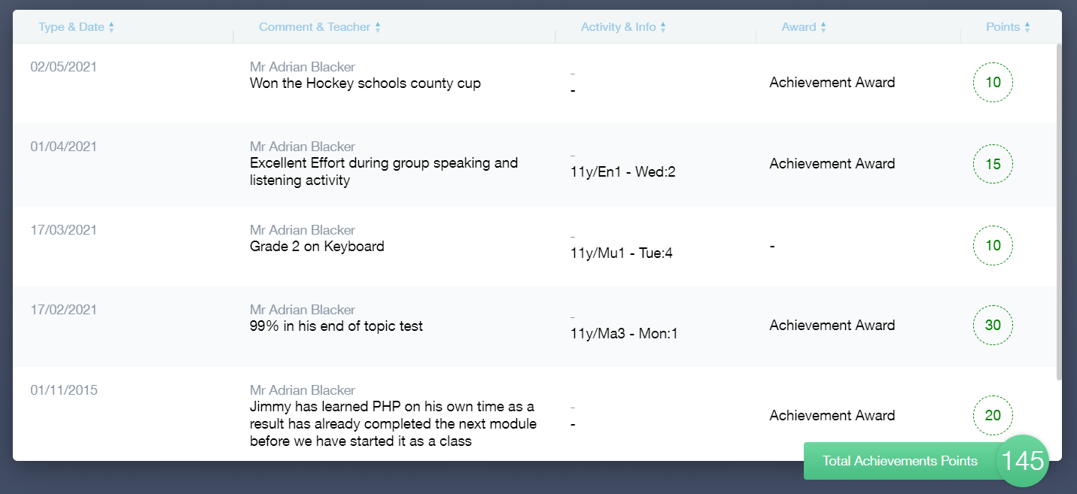
Achievement

Slide 33
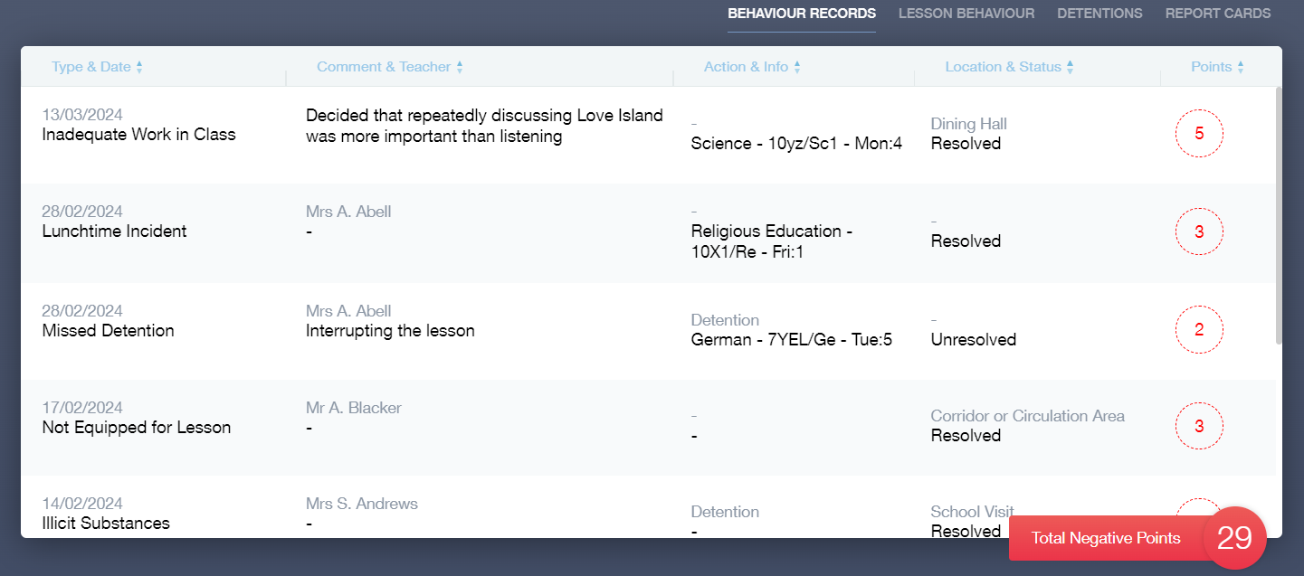
Behaviour

Slide 34
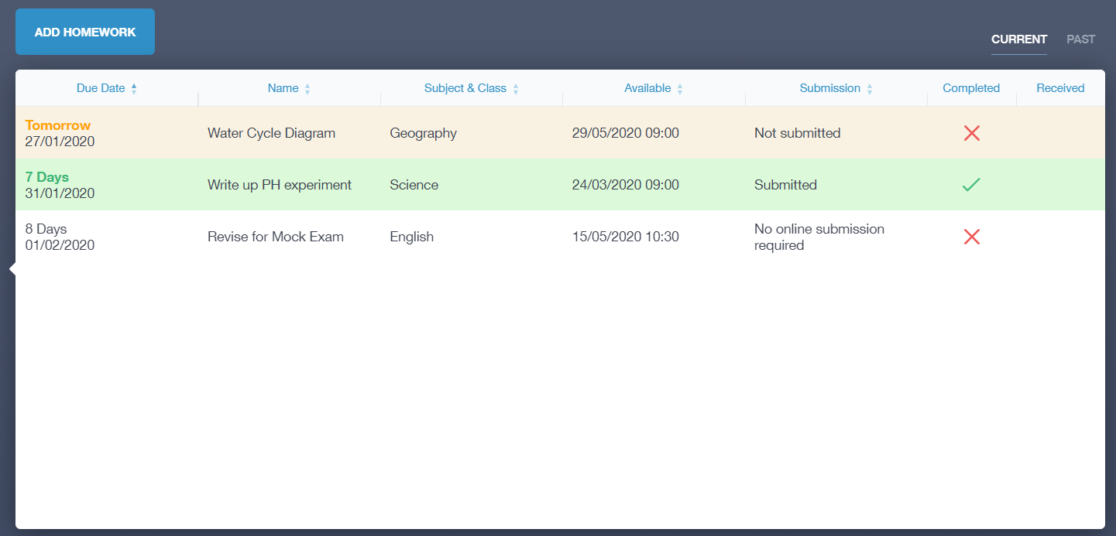
Homework

Slide 35
Supporting your child…
Balance: challenge and support
Nagging = retreat!
Encourage routine
Minimise distractions
Show an interest: let them teach you and quiz them!
Build in rewards: short and long term

Slide 36
Post 16 Information Evening
Thursday 26th September
Please save the date – Mr Morland and Mrs Hicks will be giving valuable information around your choices post-16.

