Slide 1
Study skills
Thursday 2nd February 2023
A Starter…, start completing the exercise on the green sheet on your table: a light-hearted look at some at some of your general characteristics and personality traits.

Slide 2
Aims of this session:
To encourage you to think about how you revise;
To remind you of effective revision techniques;
To advise you on planning your revision.

Slide 3
STUDY
The act of checking… Instagram and Snapchat, watching television, eating and drinking, with a textbook open somewhere nearby.

Slide 4
Week Beginning | What we are studying | Why…?! Other Things…
Monday 6th Feb | An Inspector Calls: re-read, revise, context, themes and characters | Literature Paper 2, 34 marks
Monday 13th Feb | An Inspector Calls: re-read, revise, context, themes and characters | Literature Paper 2, 34 marks
Half Term
Monday 27th Feb | A Christmas Carol re-read, revise, context, themes and characters | Literature Paper 2, 34 marks
Monday 6th March | English Language, Paper 2, reading non-fiction | Mocks Prep
Tuesday 13th March | English Language, Paper 2, writing non-fiction | Mocks, Eng Language Paper 2, Non-Fiction
Monday 20th March | A Christmas Carol re-read, revise, context, themes and characters | Literature Paper 2, 34 marks Friday 24th March – Interviews and Photos Reports - home
Monday 27th March | Poetry - Anthology | Literature Paper 2, 34 marks
EASTER BREAK

Slide 5
Week Beginning | What we are studying | Why…?! Other Things…
Monday 17th April | English Language, Paper 1, reading fiction | English Language, Paper 1
Monday 24th April | English Language, Paper 1, writing fiction | English Language, Paper 1
Monday 1st May | Unseen Poetry | English Literature Paper 2, 32 marks
Monday 8th May | Romeo and Juliet/Christmas Carol | English Literature Paper 1, 34 marks
Monday 15th May | Inspector Calls/Poetry | Wed 17th May: Eng. Lit, Paper 1, (R+J/Christmas Carol)
Monday 22nd May | Inspector Calls/Poetry | Wed 24th May: Eng. Lit, Paper 2 (Insp Calls/Poetry)
Half Term
Monday 5th June |  | Mon 5th June; Eng.Lang, Paper 1. Reading and Creating Fiction texts
Monday 12th June |  | Mon 12th June; Eng.Lang, Paper 2. Reading and Creating Non-Fiction texts

Slide 6
I’m pleased
Gutted
I didn’t get what the question meant
I missed loads of questions
I’ve done ok
I screwed up
I’m way below target
I didn’t revise enough
…but I learnt…

Slide 7
Attitude Process
You’ve got to do it
It takes time!
Boring
Hard to
fix the information
Frustrating
How do you know
when you’re done?!
If you think you can or think you can’t…
…you’re right

Slide 8
What does revision feel like…?

Slide 9
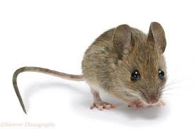
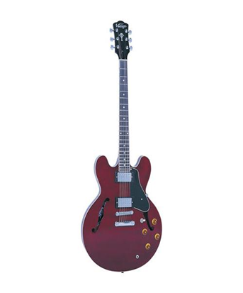
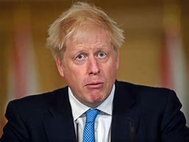

Slide 10
How many can you recall?
What strategies did you use to help you remember?

Slide 11
How many did you get?
Alarm clock
Keys
Train
i-phone
Chocolate
Guitar
X-box
Books
Candle
Chair
Mouse
Boris Johnson

Slide 12
Memory techniques:
Ongoing repetition
Mnemonics (e.g. ‘because’, Never Eat Shredded Wheat);
Making a story to link ideas, sequence associations
Visualisation
Word association
Rhymes (e.g. ‘In fourteen hundred and ninety-two, Colombus sailed the ocean blue’);

Slide 13
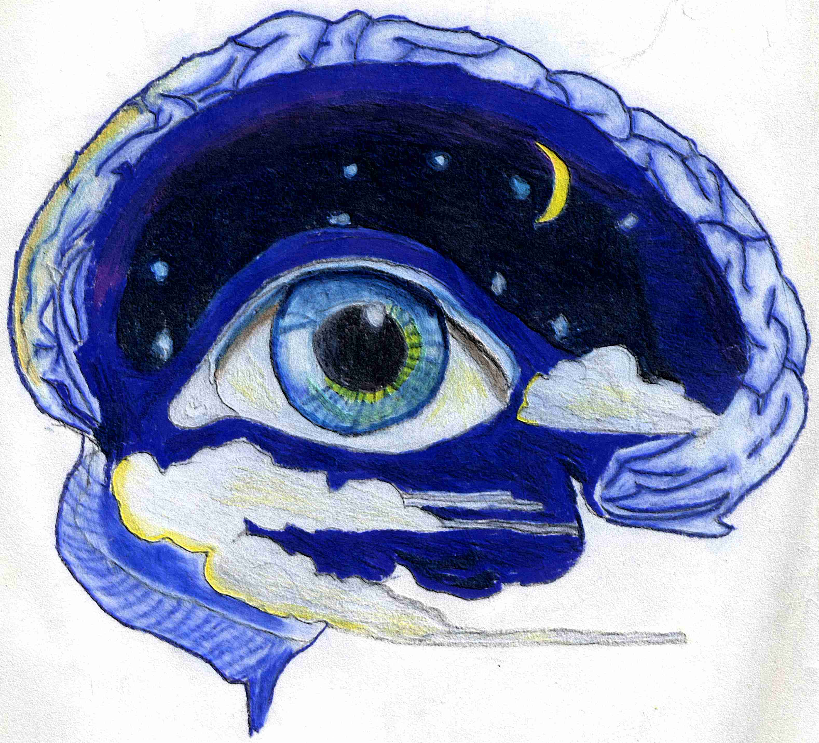
Understand it
Condense it
Memorise it
Click
Review it

Slide 14
But revision is about more than just remembering…
It’s also about understanding and showing you can apply this understanding.

Slide 15
Brain Gym - colours
yellow red blue
green orange purple
black brown grey
pink turquoise lilac
beige white orange
blue yellow blue
Pink green black

Slide 16
Brain Gym: (feels Daft But worth a go..!)
Cross Crawl
Put right hand across body to left knee as you raise it.
Now do the same for the left hand on the right knee.
Now continue (as if you are marching!)
Do this for 2 minutes to stimulate & co-ordinate both sides of the brain.
Active 8’s
With your finger, trace a figure 8 in the air.
Now use your whole arm.
Now the other one.
Now your left elbow.
Now your right elbow.
Now your left foot.
Now your right foot.

Slide 17
Left & Right brain functions:
Sequence
Language
Logical
Words of a song
Linear
Writing
Numbers
Spelling
Detail
Reading
Intuition
Ideas
Playing music
Patterns
Rhythm
Imagination
The tune
The big picture
Daydreaming and visioning
Colour sport

Slide 18
Left brainers - tips
You may need to be open to new approaches
Don’t get bogged down in detail
Practise working well with others
Vary own learning styles and habits to keep your creative brain working

Slide 19
Right brainers - tips
Don’t forget detail – one step at a time
Make yourself plan and prioritise in advance
Avoid putting things off until the last minute
Avoid distraction and distracting others
Don’t rush in without thinking
Read instructions and check work when finished

Slide 20
Understanding how your brain works will give you a starting point when selecting the most appropriate revision techniques. Of course, you will also need to vary the technique depending on what you are revising.

Slide 21
Suggested aid for learning modalities
VISUAL | AUDITORY | KINAESTHETIC
Colour codes Study cards Film-strips Charts, graphs Drawings Mind maps Watch lips move in front of mirror | Tapes Speak/listen to others Rhymes/ poems Read aloud Talk to yourself Mnemonics Words in syllables | Pace as you study Breathe slowly Role play Write on surfaces with fingers Repeatedly write lists Exercise

Slide 22
Visual Summaries
Brainstorm
Spider Diagrams
Mind Maps
Flow diagrams

Slide 23
Mind maps!
Page should be landscape
Have a central image
Broad arrows coming from this image, with the ordering ideas (could be chapters or themes within a topic)
Use wavy lines
Use images, symbols, codes throughout
Print key words and underline the word
Use colours to identify themes

Slide 24
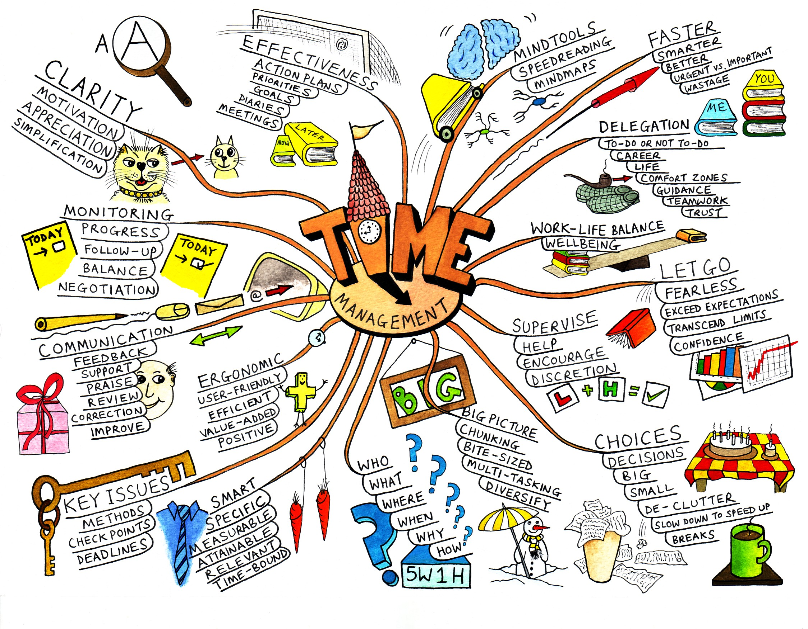

Slide 25
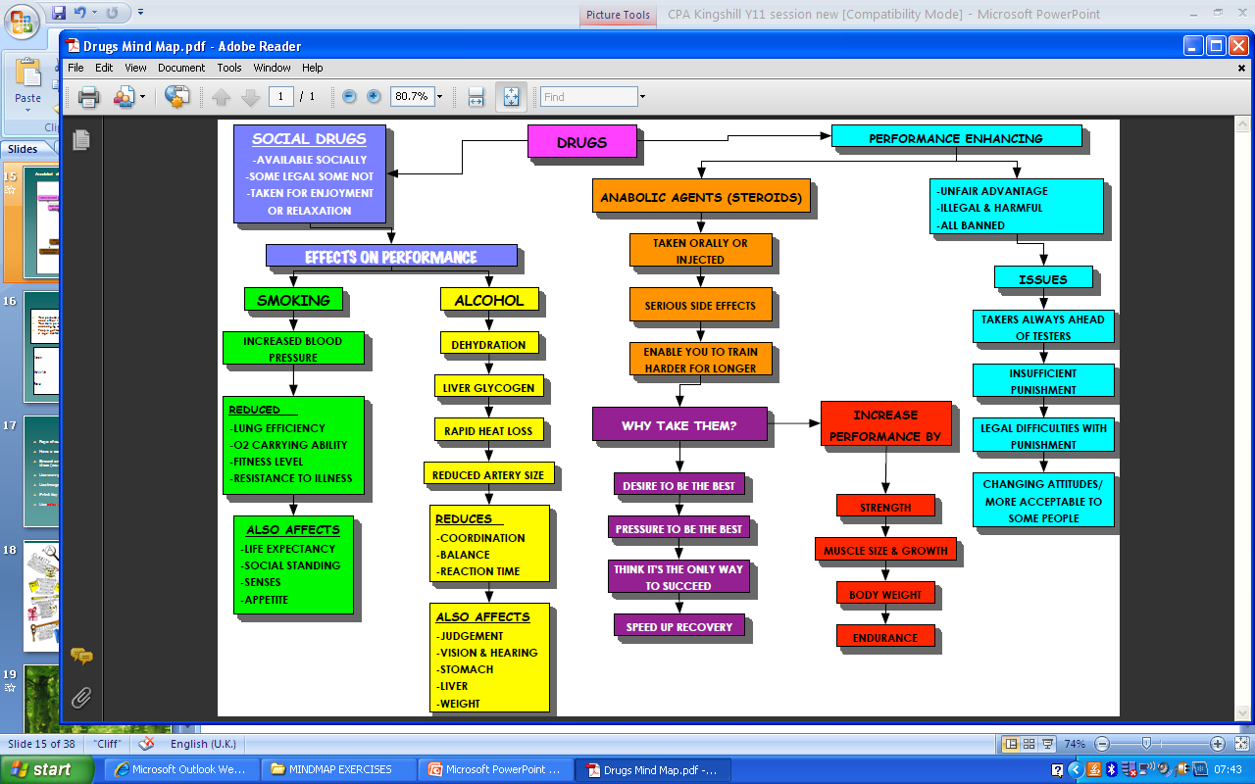
Annotated diagrams – useful for processes in many subject areas PE Process sheet e.g
soil
0.% of air
Roots, hairs, surface area
Palisade cells
Some for respiration
stoma
Xylem to leaves
LIGHT
Carbon dioxide + Water
Oxygen + Glucose
6CO₂ + 6H₂O
6O₂ + C₆H₁₂O₆
Phloem tubes
Chlorophyll in chloroplasts
Evaporate - transpiration
stoma
starch

Slide 26
Flash cards
Non-religious marriages
The purpose of a non-religious marriages could be for a man and woman to comfort and help each other, for a happy sex life and bring up children in a stable family.
The main points include public witnesses giving reasons why you can’t get married, exchanging vows promising you’ll live together until death and giving rings.
People get married because they publicly witness their love, makes children happier and have a legal contract.
Non-religious marriages
Purpose: comfort and help
happy sex life
stable family for children
Main points: witness (public) – no objections
exchange vows – live together forever
exchange rings
Reasons: vow of monogamy
declaring love
stable for children –so happier
legal contract so “stick at it” more

Slide 27
Choosing location for key words
Choose up to 10 locations per room.
Then go through words as you visually or kinaesthetically go around the room.
Go clockwise!

Slide 28
Use your own words / notes
Aoccdrnig to rscheearch at Cmabrigde Uinervtisy, it deosn't mttaer in waht oredr the ltteers in a wrod are, the olny iprmoetnt tihng is taht the frist and lsat ltteer be at the rghit pclae. The rset can be a toatl mses and you can sitll raed it wouthit a porbelm. Tihs is bcuseae the huamn mnid deos not raed ervey lteter by istlef, but the wrod as a wlohe.

Slide 29
Things that you know you know | Things that you know you don’t know
Things that you don’t know you don’t know | Things that you don’t know you know

Slide 30
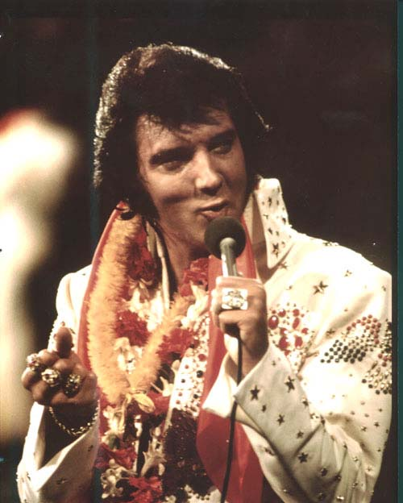
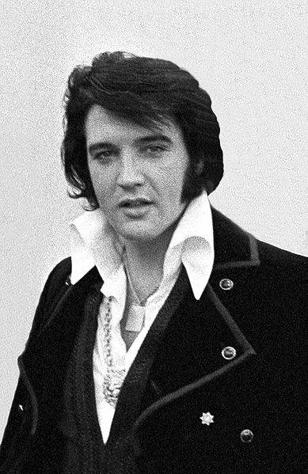
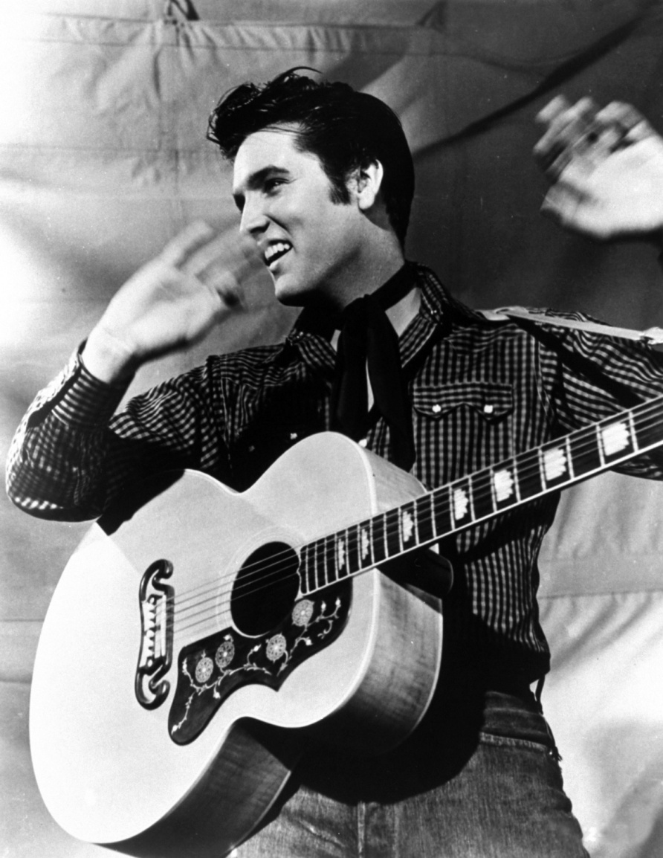
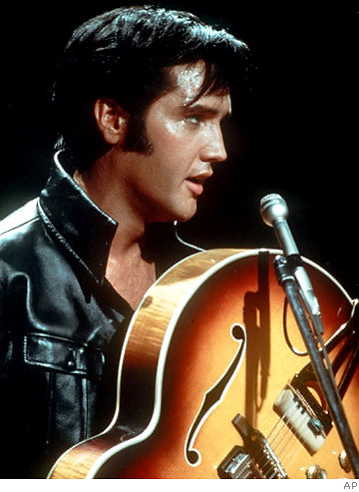
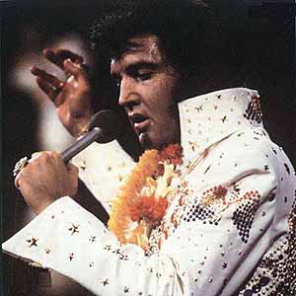

Slide 31
So, what did you learn?
Where was Elvis born?
What did the young Elvis look like?
Why was Vernon put in prison?
How old was Elvis when he moved?
Describe how music began to influence Elvis.

Slide 32
When was he offered his first ‘big break’?
What was the name of his first big hit?
How was he different to other white performers?
What was the name of his manager?
When did he make his first film?

Slide 33
How did you get on..?
Tupelo, Mississippi
Sandy haired, blue eyed
Forgery
3
Parents busy, music in church, hanging around local radio station, problems at school, worked with aspiring musicians including black artists – ‘crossed colour line’.

Slide 34
1954
That’s All Right (Mama)
Danced, ‘gyrated’
Colonel Tom Parker
1956, ‘Love Me Tender’

Slide 35
Preparing to revise: Proper Preparation Prevents Particularly Poor Performance

Slide 36
Prioritise – it’s up to you!
In terms of the next few months, place these activities in order from 1 (most important) to 10 (least important):
Socialising with friends
Earning some extra cash
Looking after my appearance
Keeping fit/playing sports
Planning my next summer holiday/prom
Finding/spending time with a/my partner
Contributing to local charitable projects
Spending time with my parents
Watching TV
Revising for my exams

Slide 37
Between now and the exams, plan every day. Note the times of other commitments you have (clubs, seeing friends etc.), then work out how many 45 minute revision sessions you can squeeze in.

Slide 38
Term Time revision (each block = 35-45 minutes) Include Task – (precise details!) And testing!
Mon | Tues | Wed | Thurs | Fri | Sat | Sun

Slide 39
Revision
Get organised – buy files – use them!
Organise yourself a revision timetable.
Have a start & finish time – stick to it.
Have clear goals for the revision.
Chunk it.
Take a break when you need it.
If you’re stuck, note it & move on.
Don’t listen to friends who tell you that they don’t revise – they probably do or they’ll fail!

Slide 40
Revision – It’s more than just hard work!
Students
Eat healthily.
Drink water
Take a day off
Build in rewards
Focus on successes
Parents
Talk to them
Provide supplies
Provide snacks
Be flexible
Be sensitive
Do ‘check-ins’
Keep perspective

Slide 41
Revision tips:
A useful website is getrevising.co.uk which allows you to design your revision timetable on line for free.
Make a start: the hardest bit is over then!
Forget social networks, mobile, TV, lyric music;
Vary how you revise;
Plan short, fun breaks;
Don’t avoid the subject that you find hardest / enjoy the least;
Vary when you study different subjects;
Avoid revising too late;
Be aware of your strengths and weaknesses and adjust your revision planning accordingly;
At the end of each session, file away your notes and clutter so that your work area is clear for the next session.

Slide 42
