Slide 1
Making a Repeat Pattern by Tracing

Slide 2
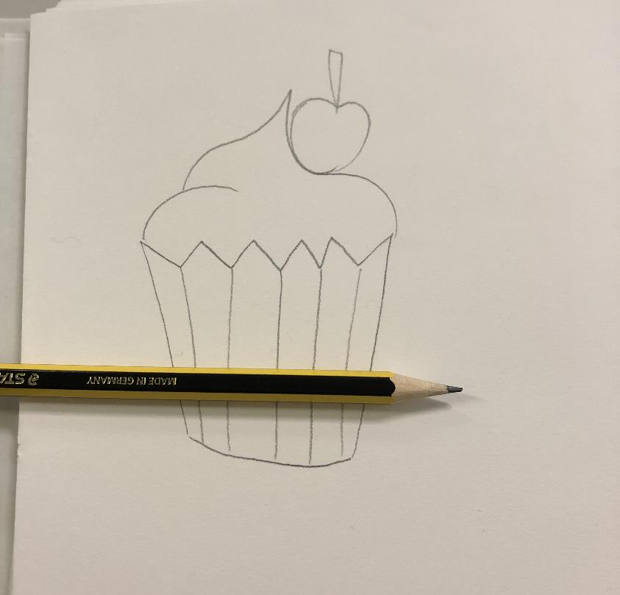
Step 1: Draw your design on paper

Slide 3
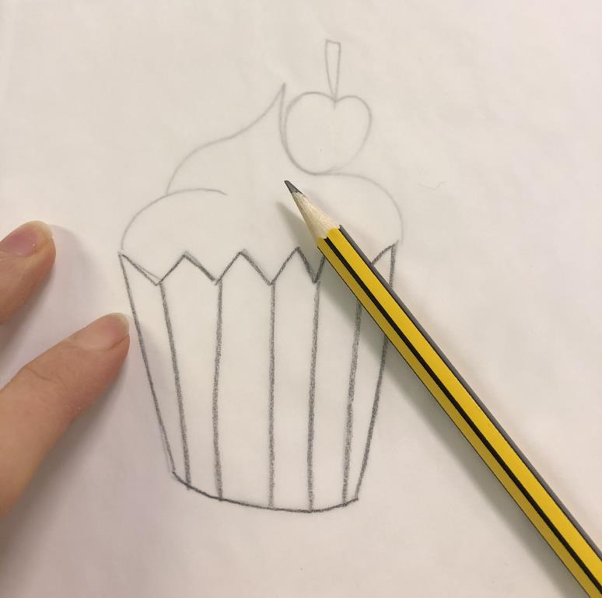
Step 2: Trace your design onto tracing paper (baking paper works just as well)

Slide 4
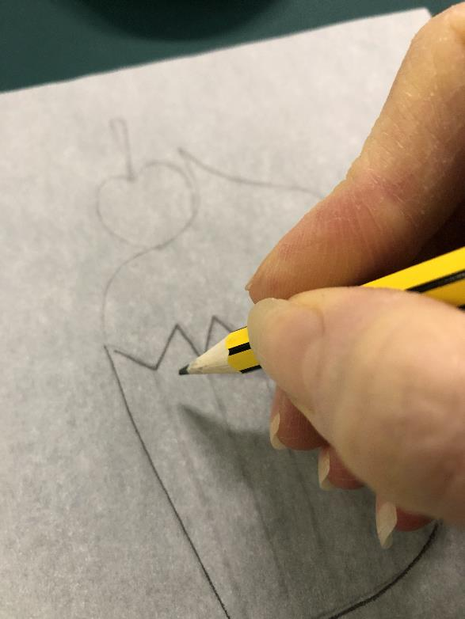
Step 3: Turn your tracing paper over and go over the design on the other side

Slide 5
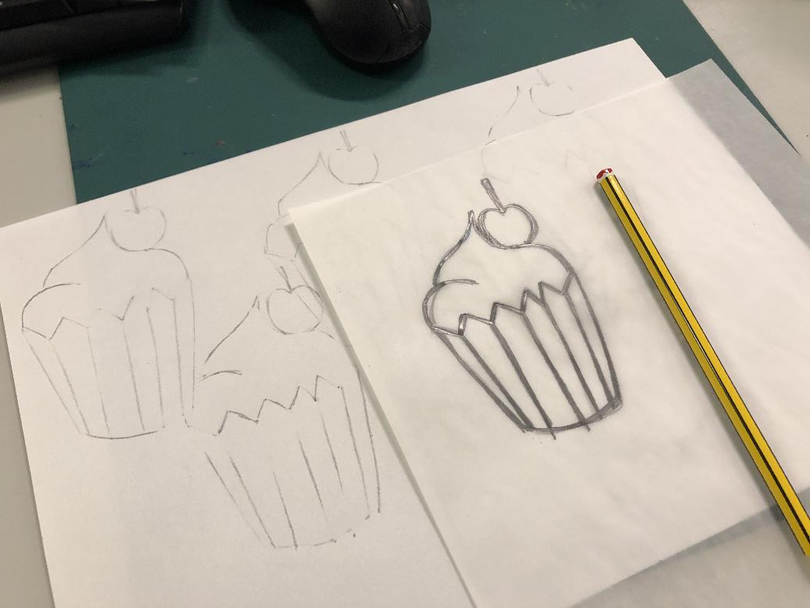
Step 4: Lay your tracing paper onto a new piece of paper. Transfer your image by going over the shapes with your pencil. You might need to turn the paper over now and then and add more pencil to the other side. Keep moving your sheet around until you build up a repeating design.

Slide 6
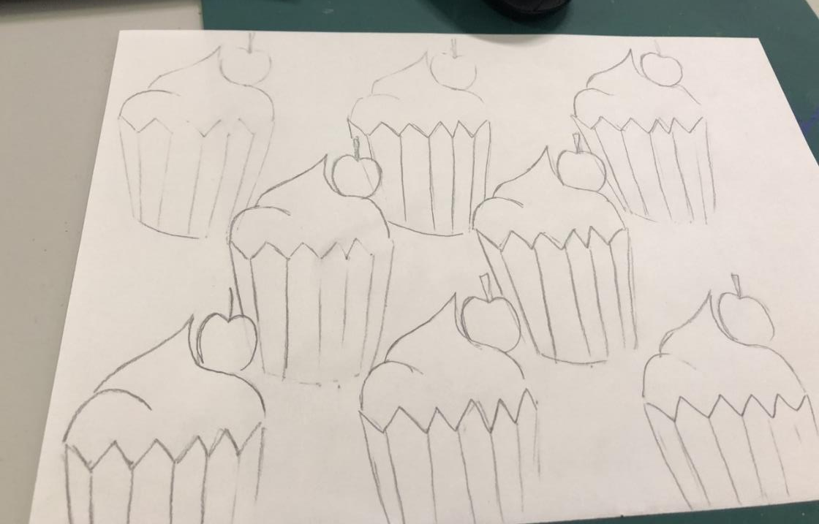
Step 5: Go over the lines of your design to make them stand out better. Now add colour to your design to finish it off.

Slide 7
No Tracing Paper?
Draw your design on paper as per step 1.
Instead of using tracing paper go over the image in a black felt tip pen you should then be able to lay a piece of paper over the top and still see your image underneath to be able to trace it.
Or place your piece of paper over a window this will enable you to trace your design.

