Slide 1
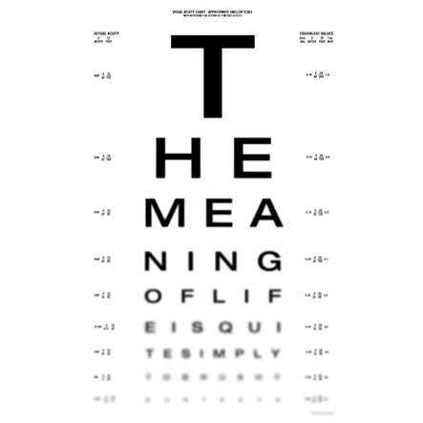
Life as a Journey
What does this sentence say?
What does it mean?
How would you finish it?

Slide 2
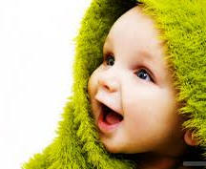
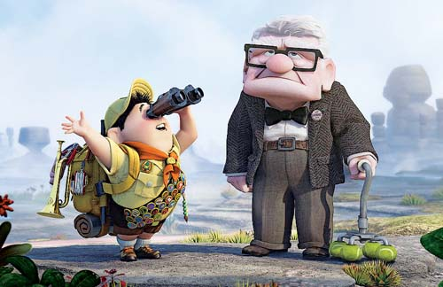
How do people mark their journey through life?
Key words:
Secular: things that are not to do with the belief in God or a religion
Religious: to do with the belief in God or religion
Draw a line across your page. At one end draw a baby- the other an old person
Notes:
Up hyperlink in old man!
John Lewis timeline hyperlink in baby

Slide 3
Mark the life-line of your person with important occasions that will happen throughout their life.
Two have been done for you.
0 years
80 years
5
17
driving test
first day of school
Notes:
You can get the students to do this across a double page

Slide 4
With one colour- underline the events that are SECULAR
With a different colour underline the events that are RELIGIOUS
80 years
0 years
0
5
17
25
30
65
80
50
first day
of school
driving
test
marriage
retirement
become
a parent
Christening
become a
grandparent
funeral

Slide 5
Your Life Line
Create a line showing the important events in your life up to the present day.
For each event on your line explain why it was important to you.
Are there any spiritual or religious events?

Slide 6
Important Moments
Write a paragraph about an important time in your life.
It should be a time that you felt had an impact on who you are as a person.
You should include why it was important and what happened.

Slide 7
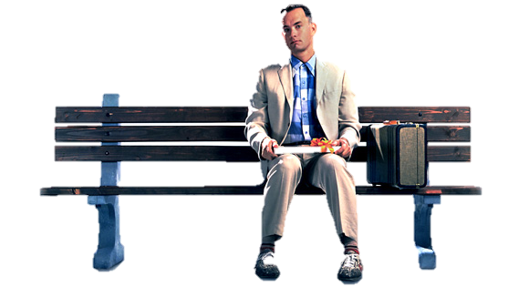
Now it’s your turn!
‘Life is like … ‘
Be creative with your language!
"Life is like a box of chocolates. You never know what you're going to get."
Forrest Gump

Slide 8
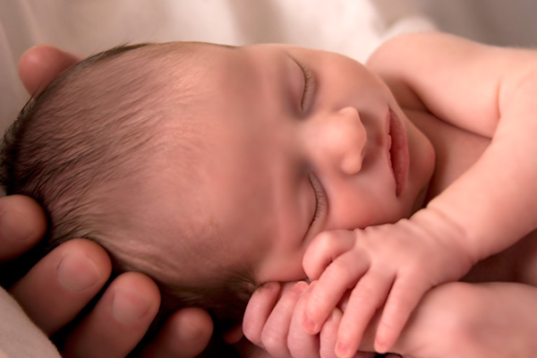
Birth
How do people celebrate the birth of a baby?
When you see this picture- write down the first 3 words that come into your head
Compare your answer with the person sat next to you- are they the same or different?

Slide 9
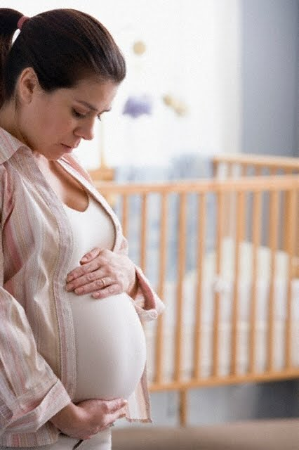
What are her worries?
What will the baby be like?
Draw a pregnant woman in the middle of your page. Write worries she may have about the baby.
Will I survive the birth?
Will I be able to look after the baby?
Is the world safe enough?
Will my husband still love me?
What will she look like?
What if the baby always cries?
Will it be a boy or a girl?

Slide 10
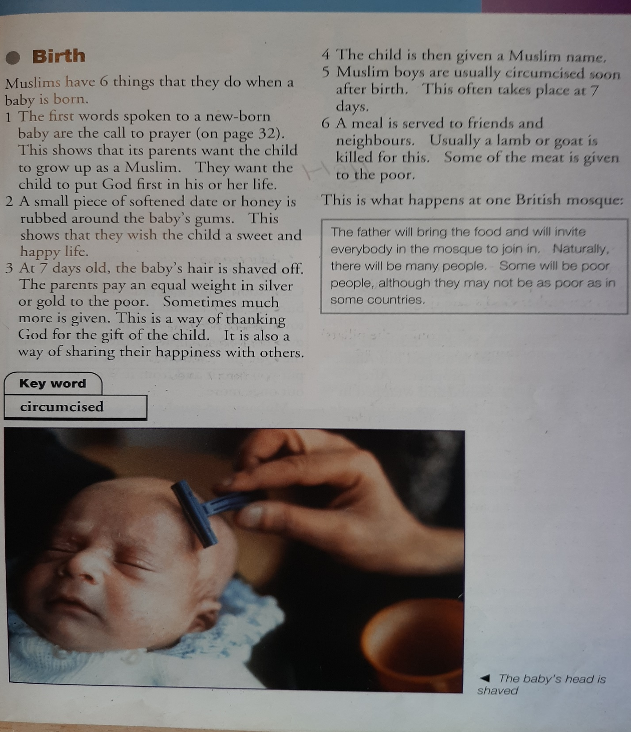

Slide 11
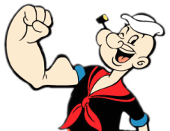
Push yourself!
In order to flex your RE muscles you need to explain the symbolism of the actions. How does it compare to other birth ceremonies?
Draw the following grid in your book. Write six things that happen in Islam to mark the birth of a baby. Draw a picture to show what happens
1 | 2 | 3
4 | 5 | 6
Use page 43 in The Muslim Experience textbook
Notes:
http://www.youtube.com/watch?v=1VQdY8n-Iqk- clip of prayer call and honey

Slide 12
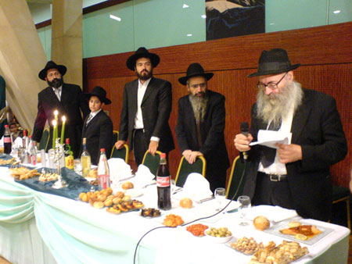
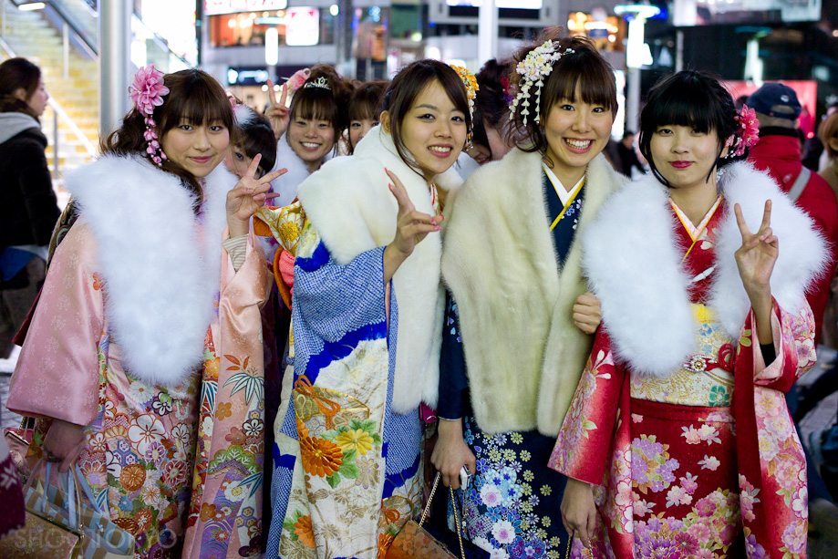
Coming of Age
What is the link here?
Can you think of any important events that you celebrate?
Which is the most important age to celebrate and why?

Slide 13
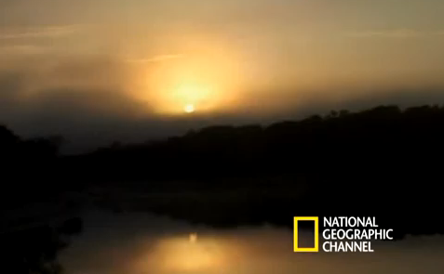
What do the tribe believe the ritual shows?
Do you agree with the chief? (explain your answer)
6 Strangest Coming of Age Rituals in the World - Neatorama

Slide 14
Research Work
Find out as many facts as you can about the Jewish Coming Of Age Ceremony.
Notes:
http://www.bbc.co.uk/learningzone/clips/bar-mitzvah/3667.html

Slide 15
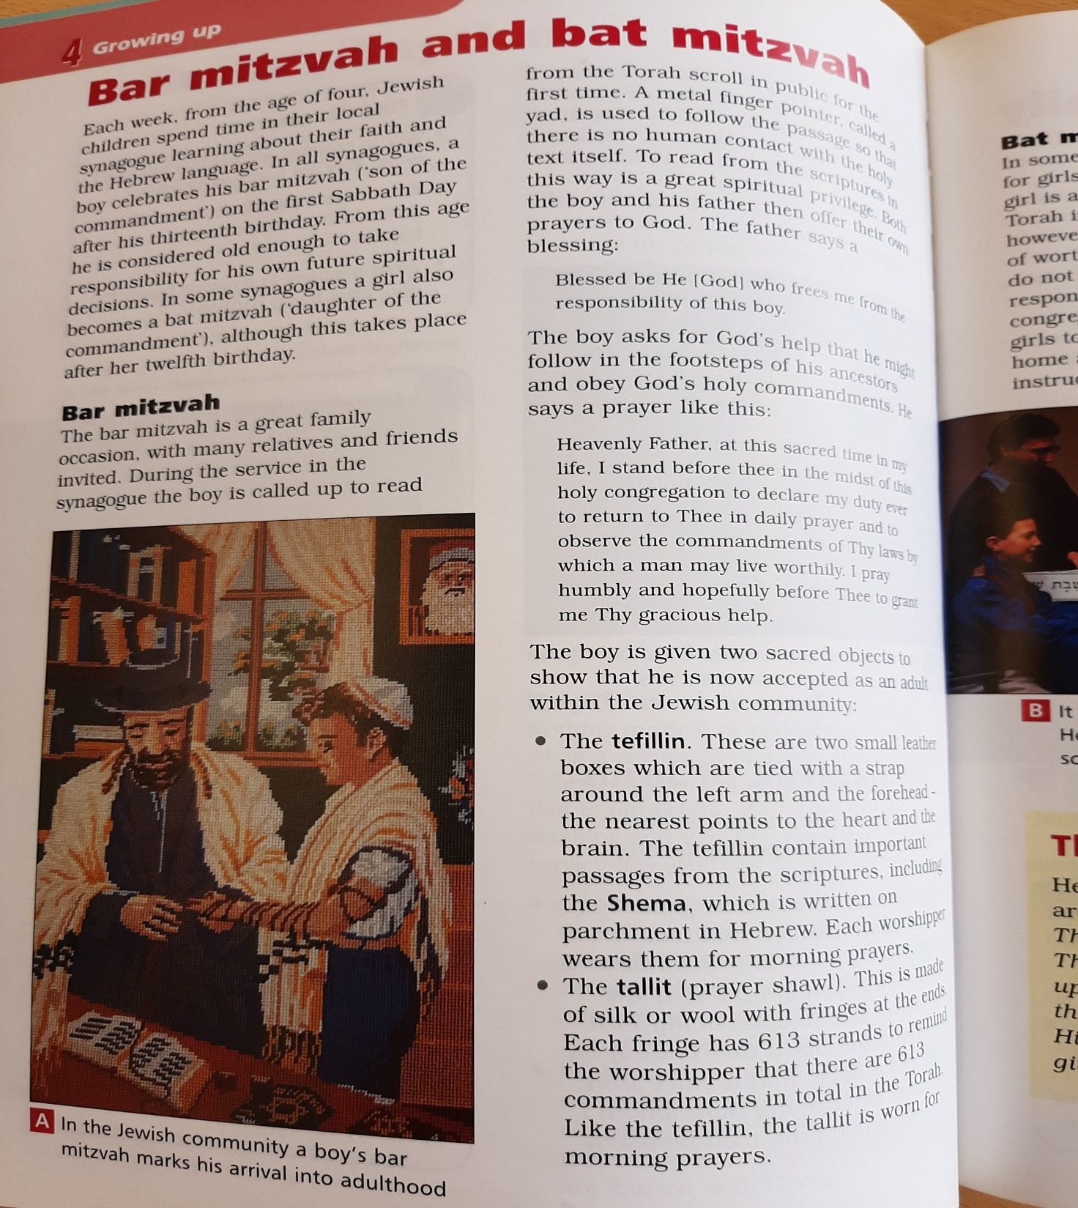

Slide 16
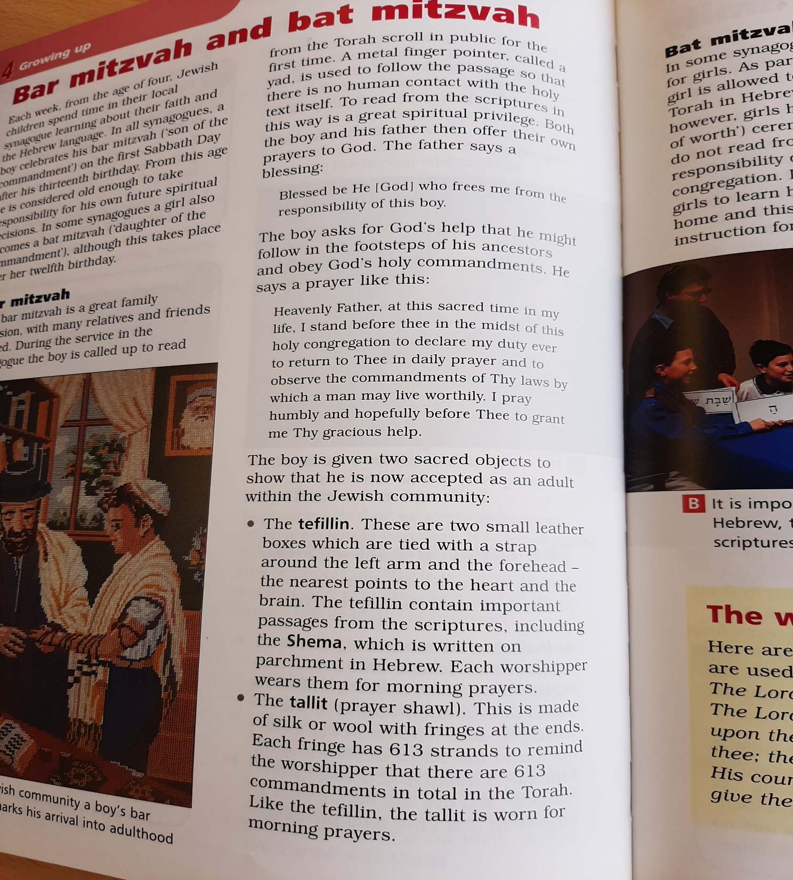

Slide 17
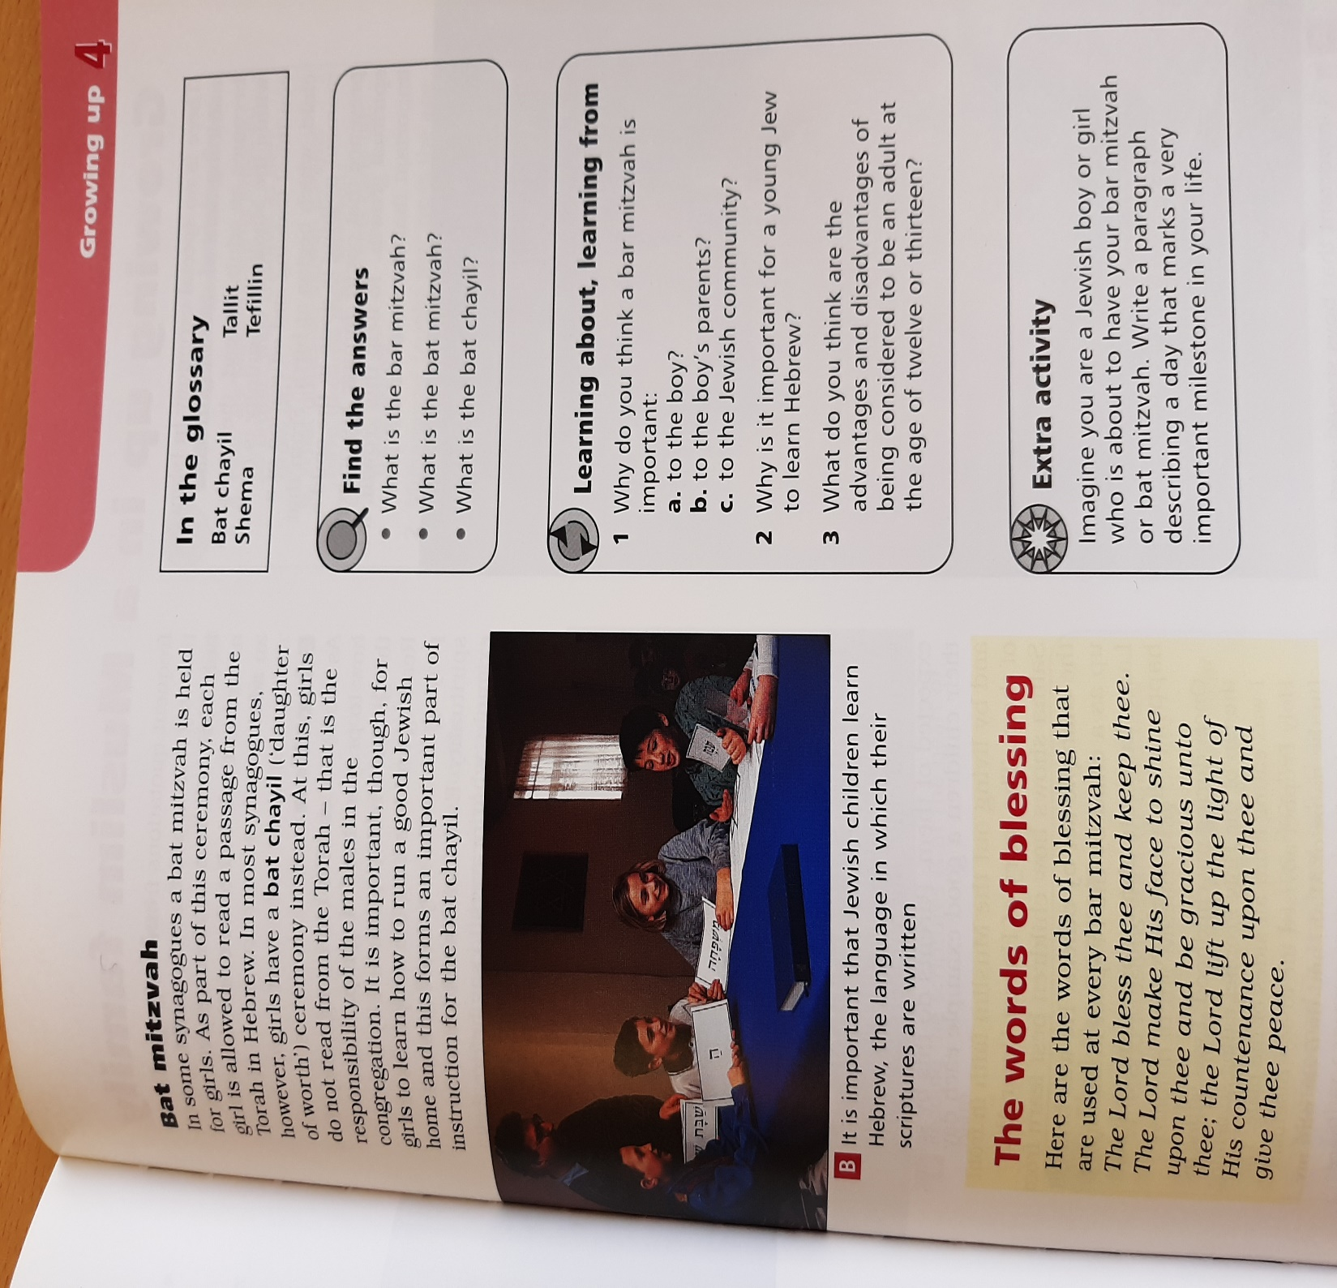

Slide 18
Discussion
Do you have any questions about what happens at the ceremony?
What symbolism can you see in this ceremony?
Can you explain why this is so important to Jews?

Slide 19
Sentence Starters
The Jewish coming of age ceremony is called...
I think...
Key Terms
Bat Mitzvah
Bar Mitzvah
How does the Jewish religion celebrate coming of age?
Answer the question above in full sentences.
You must include:
  A description of the ceremony
  Your opinion on the ceremony
  You could include:
    An explanation of why the ceremony is important to the Jewish religion.
    You could flex your RE muscles by exploring the symbolism in the ceremony. What does it say about the religion.
Notes:
http://www.bbc.co.uk/learningzone/clips/bar-mitzvah/3667.html BBC class clips ( explaining Bar Mitzvah)

Slide 20
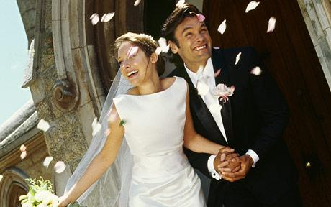
What is happening in this picture?

Slide 21
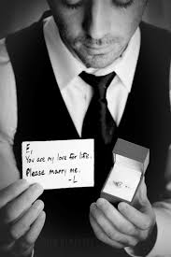
Marriage
Watch the clip.
What promises are being made?
          What commitments have you made in your life?
Isaac's Live Lip-Dub Proposal - YouTube

Slide 22
Vows: The couple then make their vows to one another.
To have and to hold
from this day forward;
for better,
for worse,
for richer,
for poorer,
in sickness and in health,
to love and to cherish,
till death do us part
Traditional Church of England wedding vows
Rings: The couple exchange rings and say:
With my body I honour you,
all that I am I give to you,
and all that I have I share with you,
within the love of God,
Father, Son and Holy Spirit.
Traditional words for the exchange of rings

Slide 23

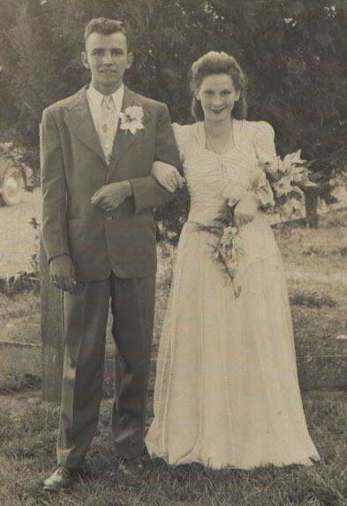
This is the story of Joyce and Samuel.
They met as 6 year olds on a Church outing to Western-Super-Mare. At first they disliked each other intently. Samuel had a bad habit of pulling Joyce’s hair.
It was at 16 years of age when things started to change. Samuel asked Joyce if she would like to attend a dance with him. Joyce had noticed that he had grown up a lot in the last few years and was now quite attractive!
That year they had a wonderful, carefree summer of courting.
The war on Germany was announced and Samuels signed up to fight for his country.
Before he left Samuel proposed to Joyce and said that on his next leave they would be wed.
They were married on the 9th May 1941.
What events would have happened just before this picture was taken?
Do you think the marriage will have made them stronger?
What do you think their hopes for the future were?
Do you think marriage has the same meaning today?
What are they wearing and why?

Slide 24
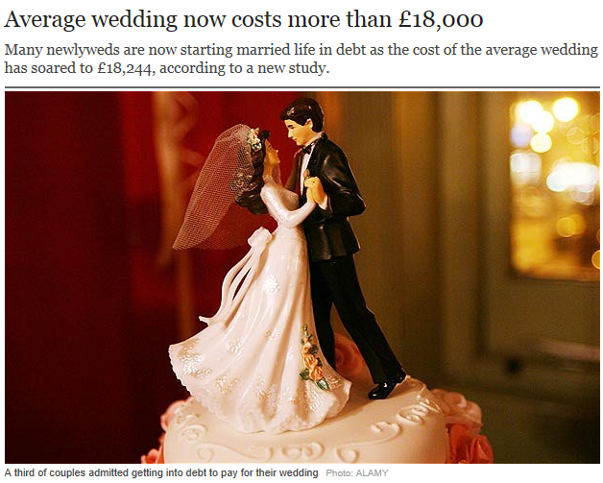
“Marriage is a waste of time and money”

Slide 25
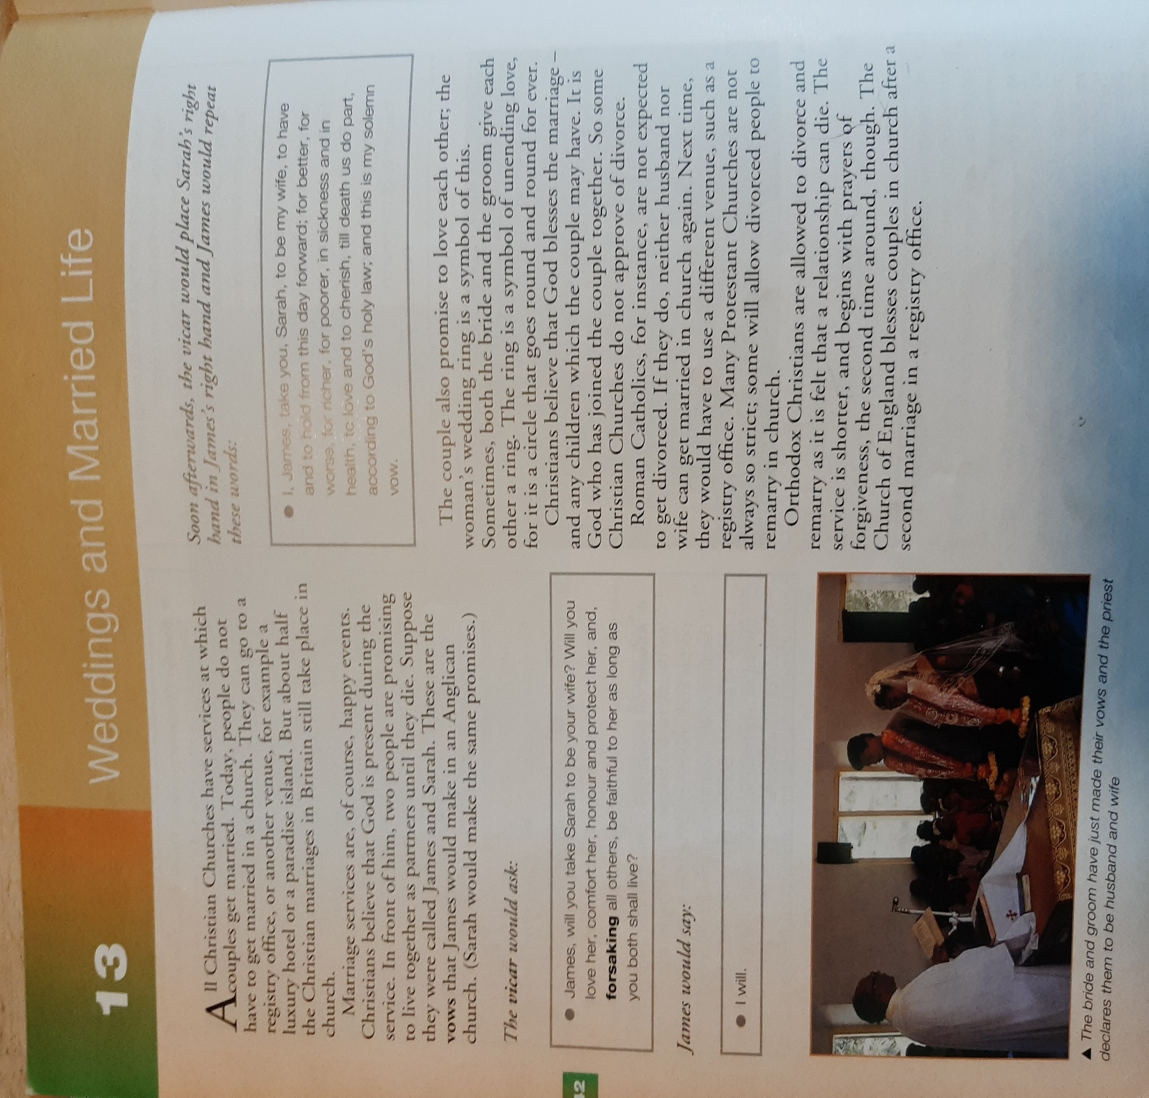

Slide 26
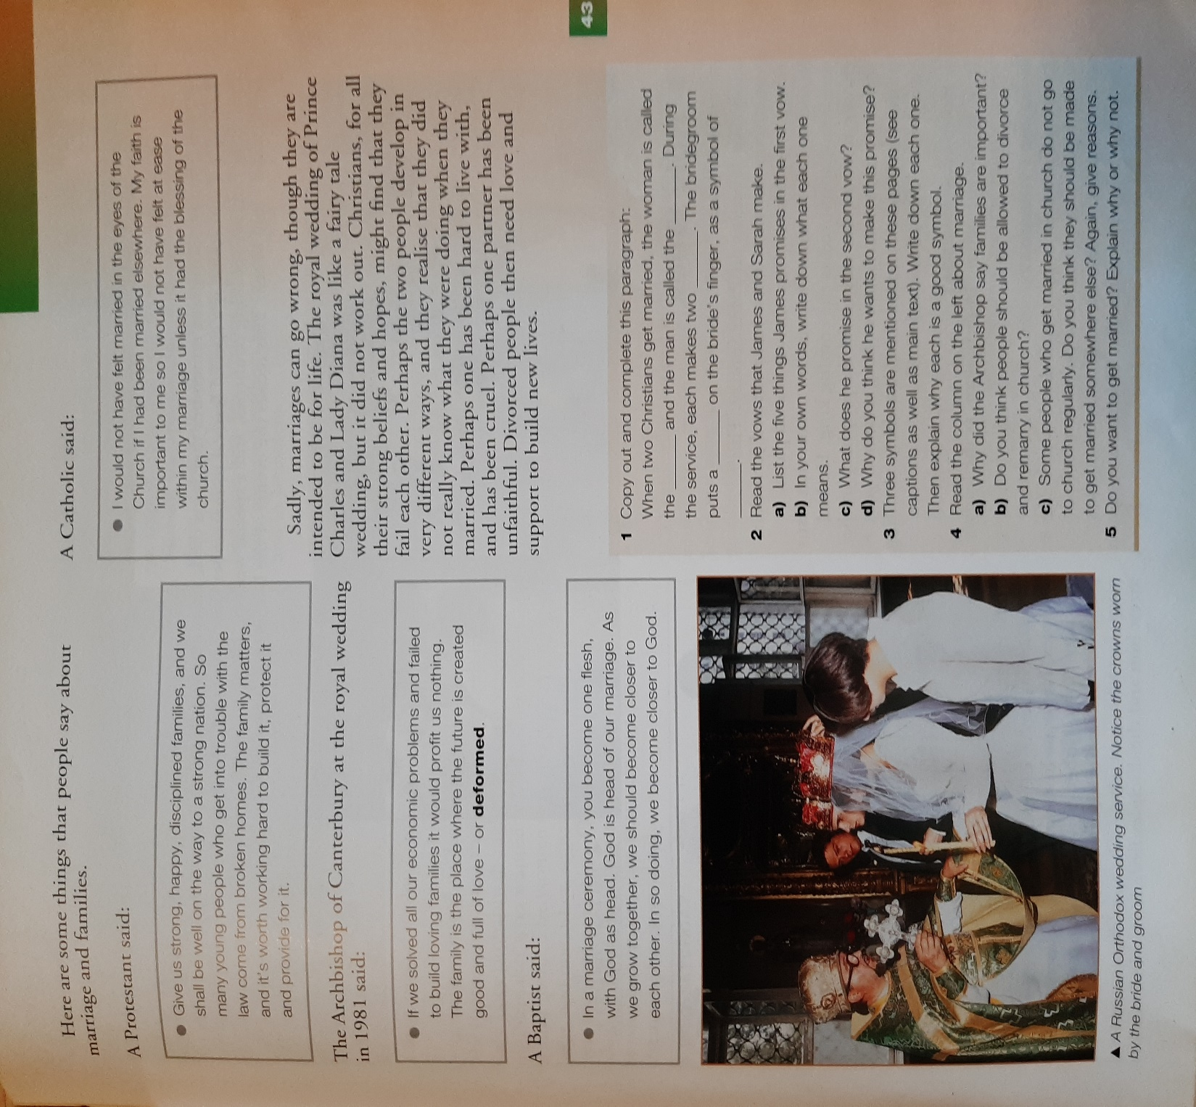

Slide 27
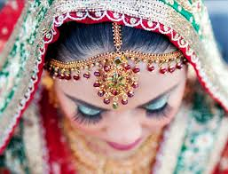

Slide 28
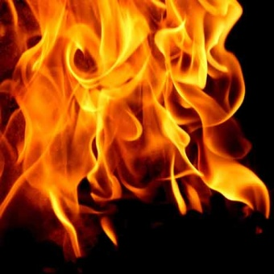
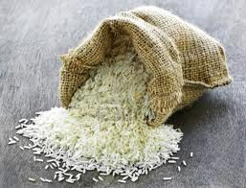
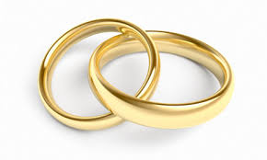
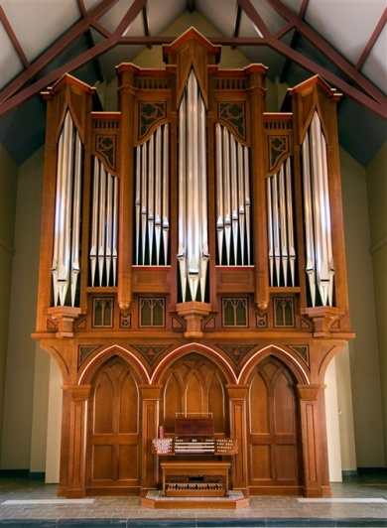
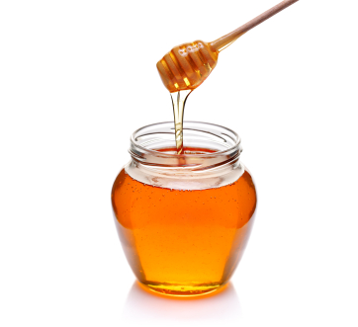
Which is the odd one out?

Slide 29
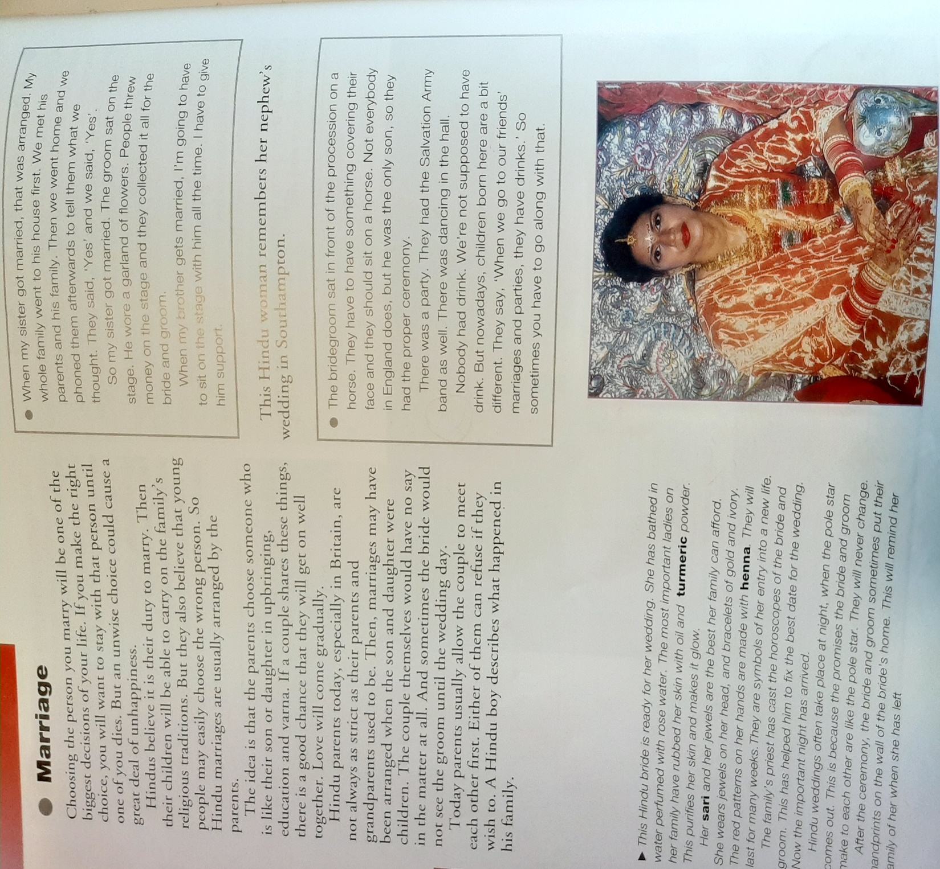

Slide 30
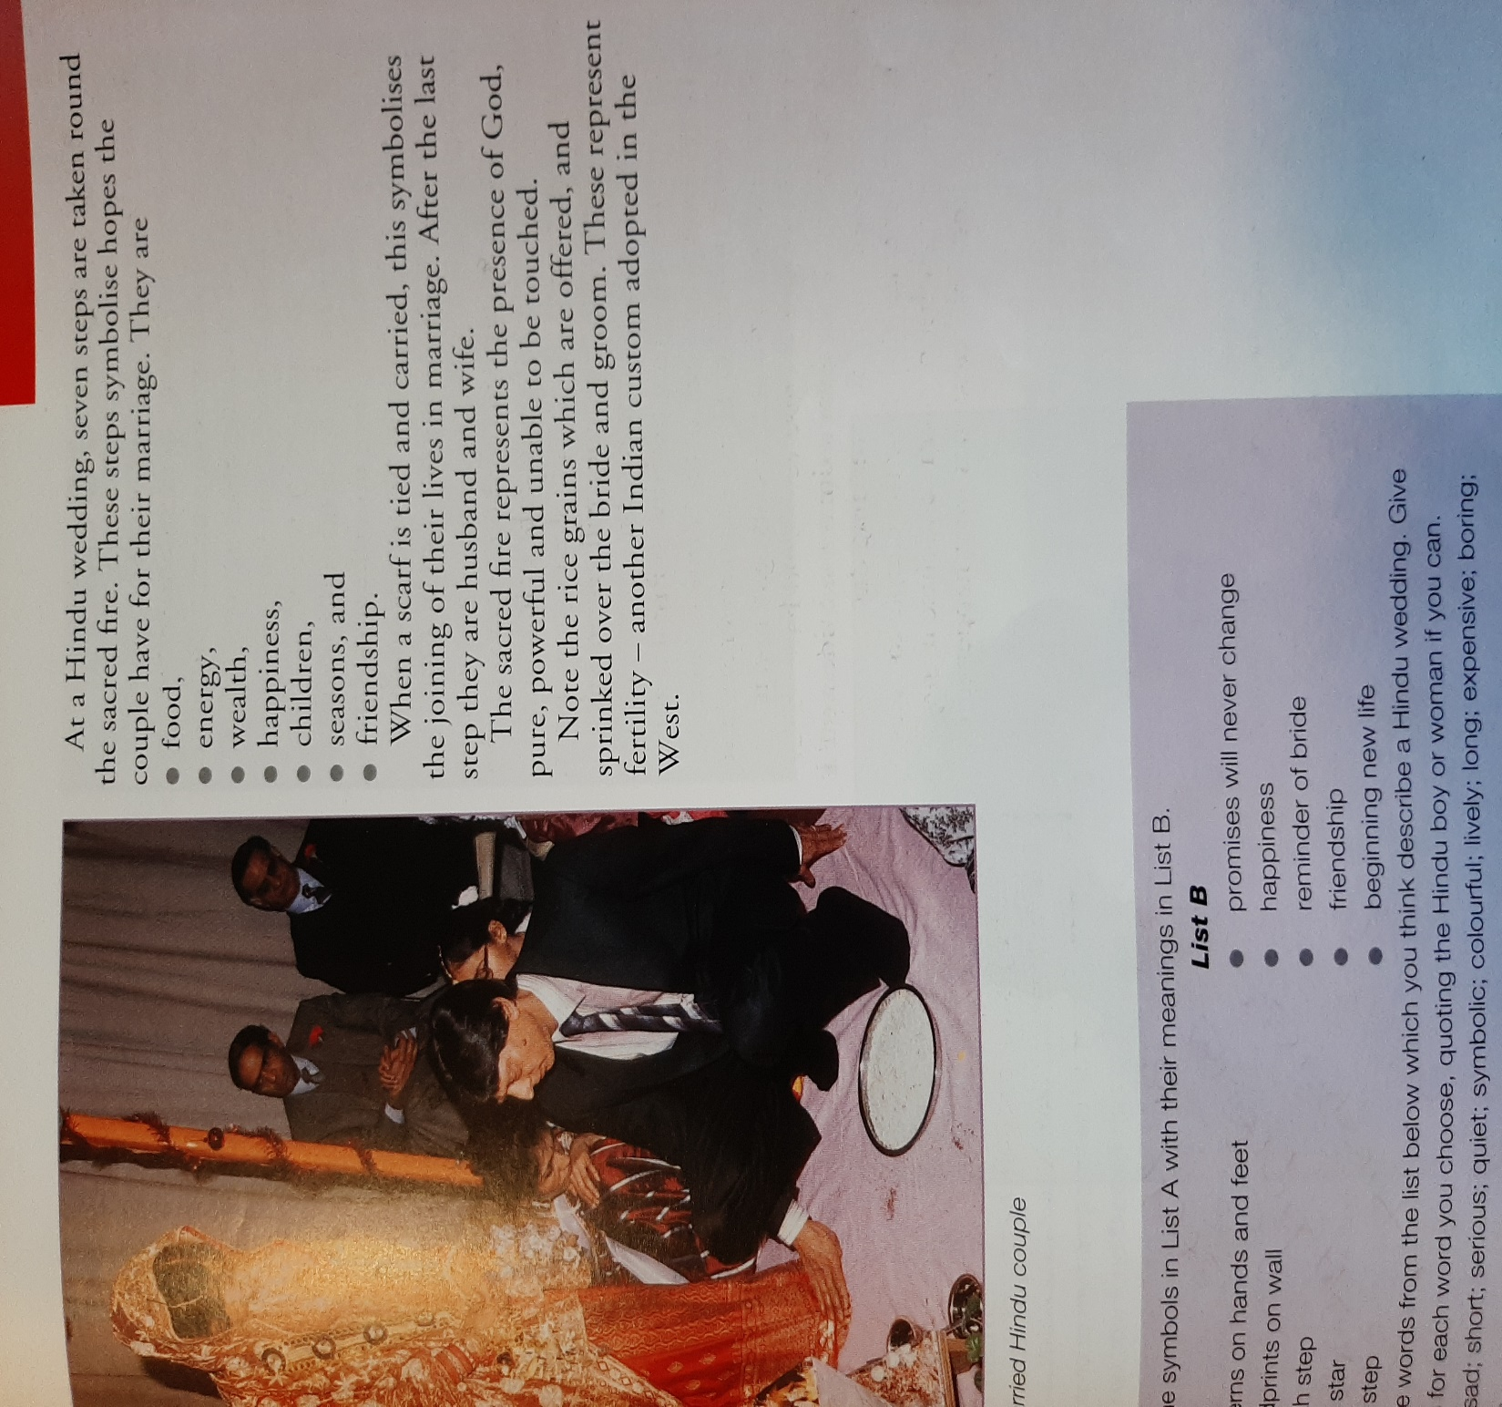

Slide 31
Individual Work
Explain the Hindu wedding ceremony in either:
10 bullet points.
or
A paragraph explaining the symbolism.

Slide 32
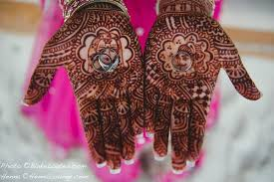

Slide 33
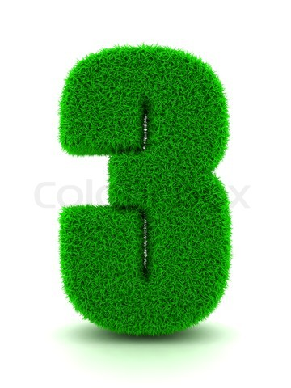
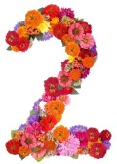

New key terms!
Events at a Hindu wedding
Example of symbolism at a Hindu wedding

Slide 34
MINI-PROJECT!
RESEARCH
Find out as much as you can about birth, coming-of-age and marriage ceremonies in religions that we have not covered in this module.
PRESENTATION
Create a presentation to show the results of your research. It can be a power-point presentation, a booklet, a series of posters or a speech.

