Slide 1
Lesson 1:
Attitudes to mental health

Slide 2
We are learning:
about attitudes to mental health and challenging misconceptions
We will be able to:
evaluate the links between mental health and physical health
identify common misconceptions about mental health
recognise and challenge prejudice and discriminatory language and behaviour, in relation to mental health
Notes:
Teacher Notes - Learning objectives and outcomes
Introduce the learning objectives and outcomes, explain that today’s lesson is about mental health and how to recognise and challenge myths and misconceptions.

Slide 3
Explain to an alien
Why might some people find it hard to talk about mental health concerns?
What is mental health?
How can people look after their mental health?
What support could be given to someone with mental health concerns?
Notes:
Teacher Notes (10 MIN) Explain to an alien
Ask students to imagine an alien has come to earth and wants to know about mental health. Using Resource 1: Explain to an alien, students should try to answer each of the alien’s questions, with as much detail as they can. As this is a baseline assessment for the scheme of work, they should work individually and without prompting from the teacher, in order to get an accurate representation of their current understanding. Ask students to put the sheets aside as they will be revisited at the end of the lesson.

Slide 4
Defining mental health
“A complete state of physical, mental and emotional wellbeing not merely the absence of disease.”
World Health Organisation’s definition of health
How can we define mental health?
What is the link between physical and mental health?
Notes:
Emphasise at this point that mental and physical health are closely linked, for example by promoting their physical health (through exercise, healthy food choice and quality sleep) a person is also promoting their mental health.

Slide 5
True or false quiz
Notes:
Teacher Notes (10 MIN) True or false quiz
In pairs, ask students to complete Resource 2a: True or false quiz. For a more active version of this activity, students could move to different sides of the room to represent ‘true’ or ‘false’ as each statement is read out.
Take feedback, ensuring that myths and misconceptions are challenged. Resource 2c includes additional teacher information to develop discussion. Students should annotate the ‘true’ information next to any statements marked ‘false’.
Support: Resource 2b is provided which is a simplified version of Resource 2. Questions posed are simplified versions of questions 2, 3, 5, 7, 8 & 9 from Resource 2.
Challenge: Encourage students to consider why they think these misconceptions might have occurred in the past. What could be done to prevent future misconceptions about mental health?

Slide 6
Exploring language
How might these statements make someone feel?
What could some more positive alternatives be?
Notes:
Teacher Notes (15 MIN) Exploring language
Explain to students that sometimes people find it difficult to talk about mental health, or might have little understanding of it and can therefore say things that might be unhelpful or offensive to others, often without meaning to.
Organise students into four groups and give each group a different sheet from Resource 3: Exploring language. Each group should spend 5 minutes adding ideas to the top and bottom half of the sheet, responding to the questions:
How might these statements make someone feel?
What could some more positive alternatives be?
After 5 minutes, have all students stick their sheet to the wall / desk, and ask the groups to move around the room look at each different group’s examples and ideas. They should add any additional ideas as they visit each sheet.
Take feedback, identifying key themes from each sheet:
Black = these statements demonstrate the flippant way people can use mental health language in everyday discussion. This is a subtle way in which mental health stigma is reinforced.
Blue = these statements are common of the types of responses people with a mental health issue sometimes get from friends or family. The statements diminish the issue and try to minimise the impact of experiencing a mental health issue.
Orange = these statements focus around unhelpful behaviours in relation to mental health, primarily excluding or deliberately trying to upset someone known to have mental health issues.
Green = these statements include unhelpful advice that people sometimes receive when discussing a mental health concern.
You can refer to Resource 4: Helpful language to provide examples of more positive alternatives.
Support: Students could be provided with Resource 4: Helpful language prompts or some appropriate responses could be modelled before starting the activity.
Challenge: Ask students to suggest reasons why this sort of language is used.

Slide 7
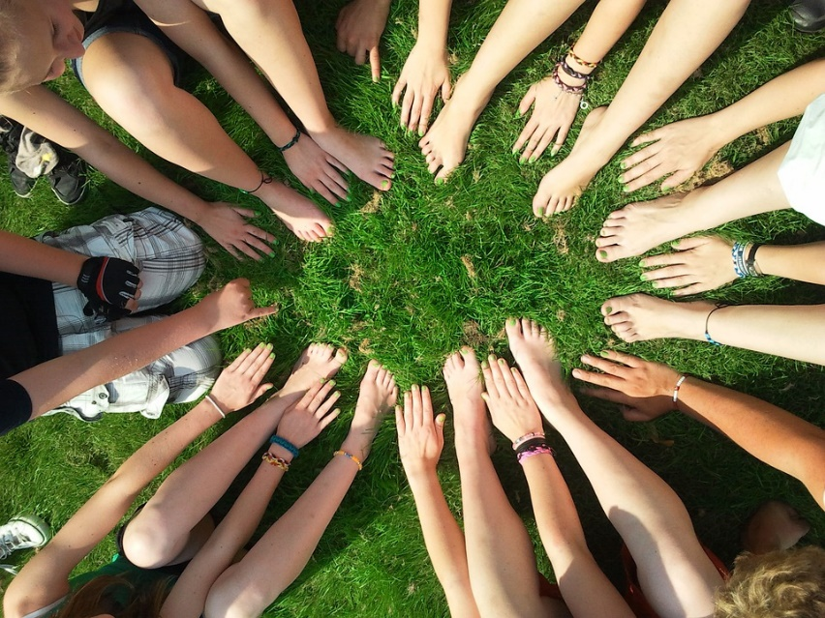
Challenging discrimination
What could be done by individuals/friends to challenge discrimination?
What could be done in schools to challenge discrimination?
What could be done in wider society to challenge discrimination?
Notes:
https://pixabay.com/photos/team-motivation-teamwork-together-386673/
Teacher Notes (10 MIN) Challenging discrimination
Ask students to work in pairs to suggest ideas about how mental health stigma and discrimination could be challenged using the questions on the slide. If time allows, share ideas as a class, either using post-it notes stuck at the front of the room, a class mind map, or students with the longest list read out their ideas.
Students might suggest ideas such as:
Individuals: avoid using language that might be offensive or upsetting, challenge this language when it is used, encourage people to be understanding and supportive around mental health, avoid trivialising or making fun of mental health issues;
Schools: teach more about mental health, promote school counsellors and other sources of support to normalise help-seeking behaviours, have ‘positive mental health’ events, make all people feel included, use displays to promote mental health;
Society: Mental health campaigns, more funding for mental health charities or services, stronger laws about discrimination of people with mental health, mental health support services in workplaces to both support and destigmatise those with mental health concerns, encourage open-ness around mental health issues, etc.

Slide 8
Revisit your alien
Why might some people find it hard to talk about mental health concerns?
What is mental health?
How can people look after their mental health?
What support could be given to someone with mental health concerns?
Notes:
Teacher Notes (5 MIN) Endpoint assessment
Revisit the baseline activity, using Resource 1: explain to an alien. Ask students to make any additions or edits to their original responses with a different coloured pen to demonstrate what they have learnt. This can be kept as assessment evidence and used to inform future teaching.

Slide 9
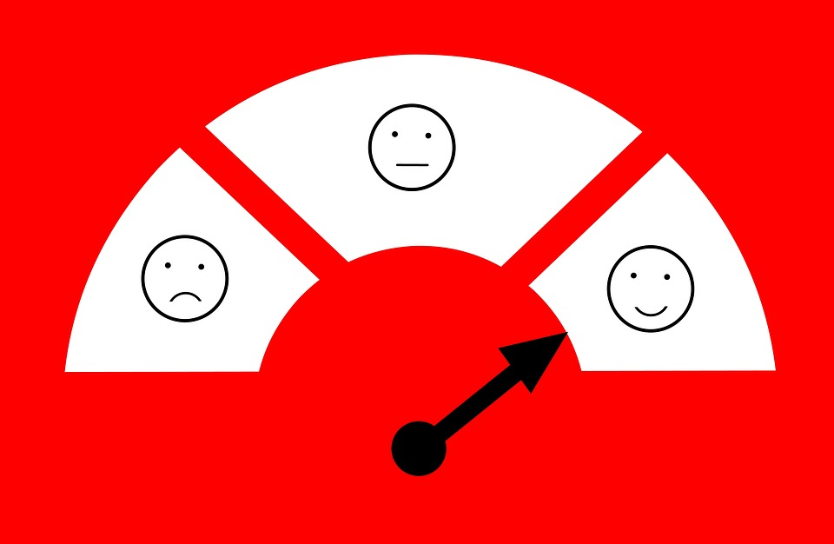
Lesson 2:
Promoting emotional wellbeing
Notes:
https://pixabay.com/illustrations/feedback-satisfaction-customer-3239758/

Slide 10
We are learning:
ways to promote emotional wellbeing
to build resilience and how to reframe disappointments and setbacks
We will be able to:
explain the factors that affect emotional wellbeing
identify ways to promote emotional wellbeing and build resilience
reframe and learn from disappointments and setbacks
Notes:
Teacher Notes - Learning objectives and outcomes
Introduce the learning objectives and outcomes, explain that today’s lesson focuses on managing thoughts, feelings and emotions during day-to-day events.

Slide 11
A-Z of factors that can affect mental health and emotional wellbeing
Notes:
Teacher Notes (5 MIN) Baseline assessment
Working in teams, students write the alphabet down a margin in their books. They then work against the clock to create an A-Z list of factors that can affect mental health and emotional wellbeing. Teams should try to have a suggestion for as many letters as they can. Put 5 minutes on the timer, or adapt for your lesson length.
Circulate around the class as they are working (without making any comments), looking for ideas that arise frequently and for any gaps. You may wish to award a prize for the team with an idea for the most letters. Use this activity to adapt the lesson content appropriately and to lead a suitable introductory discussion into factors affecting mental health and emotional wellbeing (MHEW).

Slide 12
Daily wellbeing
8am | 9am | 10am | 11am | 12pm | 1pm | 2pm | 3pm | 4pm | 5pm | 6pm | 7pm | 8pm | 9pm | 10pm
High wellbeing Low wellbeing
What might have improved Kaz’s wellbeing?
What might Kaz be doing or thinking now?
What might cause this gradual decline in Kaz’s wellbeing?
What might have caused Kaz’s wellbeing to change?
What strategies might Kaz have used to feel better?
Notes:
Hand students Resource 1: Daily wellbeing, and ask them to reflect on Kaz’s day, and to suggest ideas about what experiences or strategies might be having an effect on Kaz’s wellbeing.
Take some brief feedback, ensuring that students understand that it is typical and expected for emotional wellbeing to fluctuate throughout the day or over several days. A key element of having positive emotional wellbeing is knowing how to bounce back from setbacks, or lift mood again when things are difficult. Concerns arise for emotional wellbeing when someone’s mood continues to drop over a long period of time, or several challenging events occur close together, making it harder for someone to overcome them.
Support: Resource 1a provides ideas for students to place across the chart.
Challenge: Ask students to reflect on how typical they think Kaz’s day is, compared to most young people. What sort of events might cause more dramatic peaks and troughs in Kaz’s wellbeing?

Slide 13
Michael Jordan on failure
Notes:
Teacher Notes (5 MIN) Developing resilience
Show the 30-second video: Michael Jordan on failure. Explain that Michael Jordan is a famous USA basketball player who many consider to have been the greatest basketball player of all time. Ask students why he says ‘I’ve failed over and over again in my life – this is why I succeed’ - what does he mean by this? Explore the meaning of the word ‘failure’ and check that students understand the concept of reframing failure, i.e. looking at failure in a different way in order to use the failure to help us succeed in the future or in different ways.

Slide 14
Meaning of resilience
What is the meaning of ‘resilience’?
Resilience is a skill that helps people to recover quickly from difficulties, change or misfortune; to adapt to and overcome risk and adversity; to persevere and ‘bounce back’.
Notes:
Teacher Notes (5 MIN) Developing resilience
Ask students to work in pairs to define what they think is meant by ‘resilience’. Take feedback and agree on and write up a definition for the class that everyone is happy with.

Slide 15
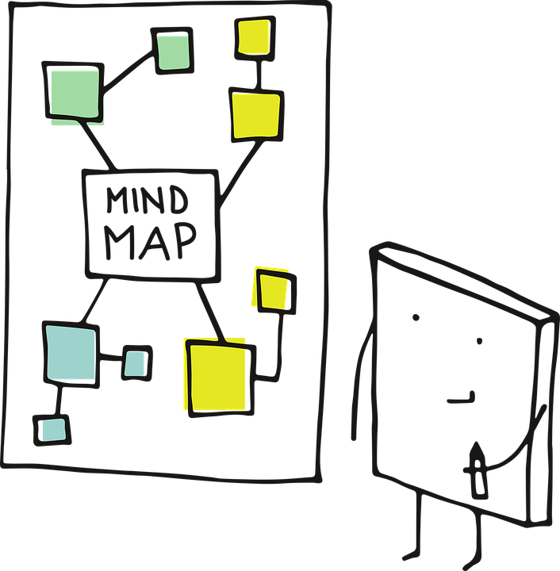
Developing resilience
How can we promote resilience in our daily lives?
Notes:
Teacher Notes (5 MIN) Developing resilience
Ask the class to create a mind-map of the ways people can promote their own resilience in their daily lives. Share ideas as a class to include:
Make meaningful connections
Develop a sense of purpose by supporting your community and/or moving towards goals
Embrace change as a normal part of living
Avoid seeing disappointments and setbacks as failures or problems which cannot be overcome
Develop a positive sense of self by focusing on their strengths and accomplishments
Gain self-confidence by embracing new challenges
Keep things in perspective
Maintain a positive outlook
Take care of themselves emotionally and physically - additional techniques like journaling or meditation can support emotions while healthy sleep, exercise and diet help both physical and emotional wellbeing
Support: Give students some categories to add ideas to their mind-map, e.g. things about character, things to do at school, things to do in the community, etc.
Challenge: Ask students to circle those techniques which they think are easiest for a person to use if they wanted to become more resilient.

Slide 16
Managing disappointments and setbacks
Sort the cards into:
Unhelpful strategies
Strategies to prevent disappointments and setbacks
Strategies to manage disappointments and setbacks
What day-to-day situations might cause disappointment or be seen as a setback?
Notes:
Teacher Notes (10 MIN) Managing disappointments and setbacks
Using think, pair, share, ask students to suggest situations which might cause someone disappointment, or be a setback, in their day to day life (e.g. not getting the grade they wanted on a test, being let down by a friend, seeing a negative comment on social media, struggling to master a new skill such as learning an instrument or sporting technique, not being allowed to go to a party at the weekend, getting a detention for something they didn’t think was their fault, etc.)
Ask students to work in pairs to separate the strategy cards (Resource 2: Managing disappointments and setbacks card sort) into the displayed categories.
Support: Ask students to separate cards into 2 piles - helpful and unhelpful strategies.
Challenge: Separate cards into unhelpful strategies, strategies to prevent disappointments, strategies which help to manage thoughts on disappointments and strategies which resolve a situation. Ask students to reflect on why using a range of strategies is so important.

Slide 17
Managing disappointments and setbacks
Which are unhelpful coping strategies and why?
What can people put in place to reduce the impact of setbacks and disappointments in everyday life?
How can a person manage difficult situations effectively?
Notes:
Teacher Notes (15 MIN) Managing disappointments and setbacks
Feedback by asking students to share their responses in pairs. Reflect on the following elements:
Which are unhelpful coping strategies and why?
Ensure students are clear that using drugs including alcohol to manage feelings is an unhealthy coping strategy. Shouting at, ganging up on and manipulating others are aggressive strategies which are likely to have unintended serious consequences. Ignoring issues is a passive response which can lead to difficult situations continuing unnecessarily.
What can people put in place to reduce the impact of setbacks and disappointments in everyday life?
Techniques such as journaling, listing positive qualities/experiences, and/or practicing gratitude can be regular habits which support a positive mindset. Asking questions such as ‘how will this event be affecting my life in a week/month/year’s time?’ can help keep things in perspective.
How can a person manage difficult situations effectively?
The key elements to discuss include reframing disappointments and setbacks to create a more positive take on an event, and being proactive in resolving issues which are upsetting them.

Slide 18
A-Z of factors that can affect mental health and emotional wellbeing
✓Things which can have a positive impact on mental health
Fill in gaps and reframe negatives where possible
Notes:
Teacher Notes (5 MIN) Assessing progress and reflection
Revisit the baseline A-Z activity. Ask students to ‘tick’ any which are things which can have a positive impact on mental health then for any gaps or things which might have a negative impact, ask teams to add a new idea which would have a potentially positive impact, especially ways to promote resilience.
They should make any additions with a different coloured pen. This can be kept as assessment evidence and used to inform future teaching.

Slide 19
More activities
Storylines
List characters or storylines from well-known programmes, films or recent news items that illustrate the following concepts:
keeping going when things are tough
having the confidence to do what they think is right
bouncing back from setbacks
seeing mistakes as opportunities to learn
adapting if a person does not succeed first time
Decision tree
Create a decision tree to illustrate consequences of acting in different ways.
Tara is upset she was not invited to go skating
Tara shouts at her friends for leaving her out and ignores them for a week
Tara asks her friends to message her if they go skating again
Tara’s friends are upset and don’t invite her to the cinema
Tara has a great weekend skating and at the cinema
Notes:
Teacher Notes
These activities can be used to extend the learning, either in lessons or as home learning.

Slide 20
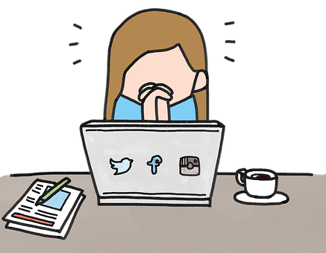
Lesson 3:
Digital resilience

Slide 21
We are learning:
about the impact of social media on mental health and emotional wellbeing
strategies to develop digital resilience
We will be able to:
evaluate the positive and negative impact of social media on emotional wellbeing
analyse the reasons people post and look at online images and the impact this can have on self-esteem and body image
describe strategies to develop digital resilience
Notes:
Teacher Notes - Learning objectives and outcomes
Introduce the learning objectives and outcomes, explain that today’s lesson is about healthy sleep habits and will explore both the importance of, and habits to help achieve, healthy sleep, particularly during teenage years.

Slide 22
Plus, minus, interesting
3mins: List as many benefits to young people’s emotional wellbeing from being online and using social media
3mins: List any challenges to young people’s emotional wellbeing from being online and using social media
Do you know any interesting facts about using social media and its impact on emotional wellbeing?
Do you have any questions about today’s topic?
Notes:
Teacher Notes - Baseline activity (15 mins)
This activity should be completed individually to help you gauge students’ current understanding. Take feedback, which might include:
Benefits: meeting people around the world, sharing interests, it’s fun, it’s an easy / quick / cheap way to communicate, can express yourself creatively, give you confidence to be who you want to be, access to support groups, time to think about what to type/say, availability of wellbeing support (e.g. meditation apps).
Challenges: peer pressure, cyber-bullying, expected to always be available, might feel excluded from certain groups (e.g. don’t have the app), people behave differently online than they would face-to-face, can see upsetting content accidentally, fear of missing out (FOMO), jealousy caused by looking at others’ social media accounts, pressure to look a certain way, sleep deprivation
Support: Create cards from the suggested answers above and ask students to sort them into positive and negative categories.
Optional development activity: If time allows, ask students to also consider: Are there any particular apps or sites which are better or worse for emotional wellbeing? Why? To support this discussion, you may wish to show the following video from the Royal Society for Public Health: www.rsph.org.uk/our-work/campaigns/status-of-mind.html

Slide 23
Diamond 9
Most common reason
Why do people take and post selfies?
Sort the cards into a diamond 9 showing the most common reasons why people post take selfies.
Put the most common reason at the top, then the next two most common, down to the least common.
Least common reason
Notes:
Teacher Notes (10 MIN) Diamond 9
Hand out Resource 1: Diamond 9 card sort to small groups of 2 or 3, and ask students to prioritise the cards focusing on which reasons they think are the most common to the least common. Remind students that there is no right or wrong order for the cards, but that they should try to reach a consensus as a group during their discussion.
Support: It may be useful to play the following clip of primary school children talking about why they post selfies before participating in the task: www.bbc.co.uk/newsround/38841467. Alternatively, students could organise a Diamond with just 5 cards to sort.
Challenge: Use a set of blank cards and ask students to create and prioritise their own reasons. During feedback, compare the ideas they have suggested with the existing cards; how similar or different are they?

Slide 24
A day in the life of Taylor
As we read through Taylor’s day, note how Taylor’s experience of social media affects their emotional wellbeing.
Thinking back to your ‘Diamond 9’, which reasons might Taylor have given for posting on social media?
Overall, is Taylor enjoying using social media or not? Why do you think this?
What evidence is there that Taylor’s behaviour is being impacted upon by social media?
What gender do you think Taylor is? What makes you think this?
To what extent do young people of different genders experience different pressures on social media?
What could Taylor, or Taylor’s friends, have done differently to make the experience of using social media more positive?
Notes:
Teacher Notes (15 MIN) A day in the life of Taylor
As a class, read Resource 2: A digital day in the life of Taylor. Students should identify how Taylor’s emotional wellbeing changes throughout the day based on their experience of social media; when were they having good experiences? When did they have challenging or negative experiences?
Use the questions on the slide to further develop the learning from this story, by asking students to discuss (or write) their responses.
Support: Students could highlight the positive and negative experiences for Taylor using two different colours. Resource 2 could be adapted into a comic strip to help students access the story.
Challenge: Ask students to reflect on what other challenging experiences young people have online, that weren’t included in Taylor’s story. How could these be managed?

Slide 25
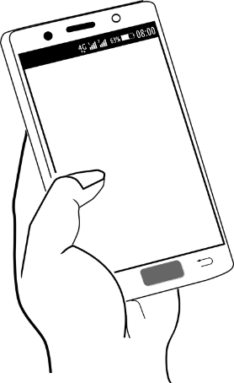
Improving Taylor’s day
Try to rewrite any ‘low’ parts of Taylor’s day, demonstrating how the day might have been improved.
Try to consider:
Is it social media that might need to change, or Taylor’s attitude towards it?
How has Taylor been influenced by others throughout the day? Was this mostly positive or negative?
What could everyone do to make the experience of social media more positive for everyone?
Notes:
Teacher Notes (10 MIN) Improving Taylor’s day
Ask students to work in pairs to rewrite any ‘low’ parts of Taylor’s day demonstrating how the day might have been improved. They could consider:
Is it social media that might need to change, or Taylor’s attitude towards it?
How has Taylor been influenced by others throughout the day? Was this mostly positive or negative?
What could everyone do to make the experience of social media more positive for everyone?
Support: Chose just one part of Taylor’s day to rewrite.
Challenge: Ask students to imagine that they were Taylor’s friend and they were starting to get worried about Taylor’s use of social media, particularly Taylor’s feelings about their body. What would they recommend that Taylor should do? Whom could Taylor go to for help?

Slide 26
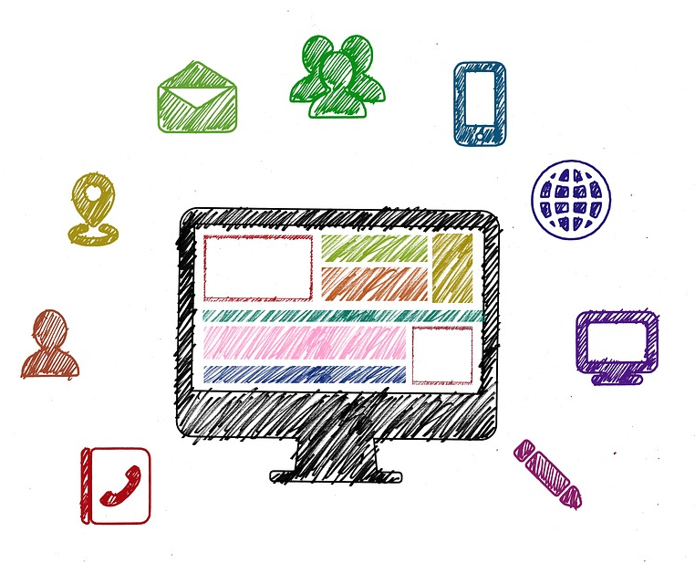
What advice would you give?
Think of one great idea for managing mental health, emotional wellbeing and self-esteem when online.
Add your idea to your post-it note and bring to the front
Notes:
Teacher Notes (10 MIN) Endpoint assessment
To encourage a range of responses, ask half of the class to focus on “Things a young person can/should do” and the other half of the class to focus on “Things a young person should avoid” in order to promote emotional wellbeing.
When students have added ideas to the front of the class, summarise key themes and common ideas.

Slide 27
More activities
Advice for social media
Reflect on advice you would give to social media companies to help them promote young people’s emotional wellbeing.
What could be done to improve young people’s experience of social media in general?
How can social media be used to celebrate people’s individuality and self-expression?
Notes:
Teacher Notes
These activities can be used to extend the learning, either in lessons or as home learning.

Slide 28
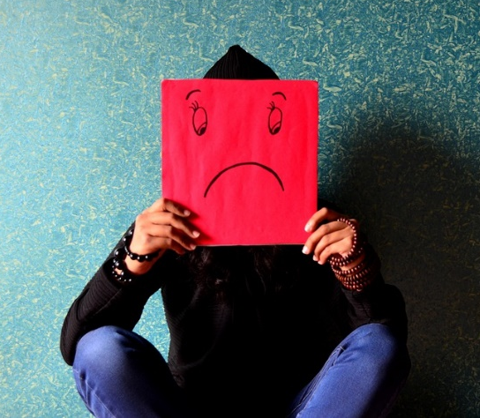
Lesson 4:
Unhealthy coping strategies

Slide 29
We are learning:
about unhealthy coping strategies, including self-harm and eating disorders
why, when and how to access support for ourselves or others
We will be able to:
explain why self-harm and eating disorders are unhealthy coping strategies
recognise misconceptions about unhealthy coping strategies
recognise warning signs of emotional difficulties
identify suitable sources of support and explain why, when and how to seek help for ourselves or others
Notes:
Teacher Notes - Learning objectives and outcomes
Share the learning objectives and intended outcomes for the lesson. Explain that self-harm and eating disorders are topics which are not widely talked about but they will be our focus today. It is OK to ask questions and explore the subject in a frank and honest way in the lesson but the discussion should stay in the room. If a question is not appropriate to answer with the whole class, then you will explain why or address it individually after the lesson. Highlight whom students can speak to outside of the lesson if they are worried about themselves or a friend, and outline the limits on confidentiality.
Make it clear at this point that you won’t be talking about specific methods of self-harm or disordered eating and ask them not to either, as this can be unhelpful or counterproductive for people more vulnerable to unhealthy behaviours.

Slide 30
Questions please!
Notes:
Give each student a slip of paper and invite them to write down any questions or comments they have about self-harm or eating disorders and put these in the anonymous question box or envelope. To make sure students do not feel self-conscious about asking a question, encourage everyone to write something: either a question or ‘no question’.
Explain that as many as possible of these questions will be addressed during the lesson but we may need to return to some later. Address them at appropriate points throughout the lesson and return to any that remain outstanding at a later point.

Slide 31
Meaning of unhealthy coping strategies
Unhealthy coping strategies are behaviours people use to deal with difficult emotions which have long-term negative consequences
Self-harm describes a wide range of ways in which a person might hurt themselves, put themselves at risk or neglect to take care of themselves in order to manage difficult thoughts, feelings or experiences.
An eating disorder is a serious mental health condition involving extreme, unhealthy eating behaviours and can take various forms, such as anorexia, bulimia and binge eating disorder.

Slide 32
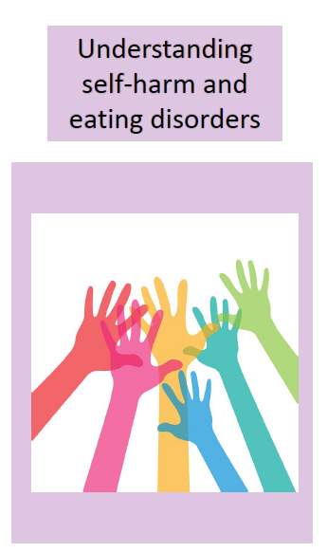
Responding to opinions
“I heard that only teenage girls suffer from eating disorders.”
“I’ve always thought people who self-harm are just attention seeking.”
“Eating disorders are a result of vanity and are caused by the media.”
“People who self-harm are suicidal.”
“People don’t ever recover from an eating disorder or self-harm.”
Notes:
Teacher Notes (10 MIN) Five opinions
Place around the classroom A3 copies of Resource 1: Five opinions. Ask students to move around the room rating their response to each opinion from 1 (strongly agree) to 5 (strongly disagree). Encourage students to add words or phrases that explain the reason for their view or that respond directly to the statement.
Circulate during the baseline assessment activity to get an idea of student responses. When everyone has had a chance to add ideas to all five sheets, bring the class back together and highlight any insightful responses.
At this point, emphasise that these opinions are all misconceptions about self-harm and eating disorders and that in today’s lesson you will be exploring the realities.
Hand out Resource 2: Understanding self-harm and eating disorders leaflet at this stage and read through the ‘myth-busting’ sections as a class. Allow students to keep the leaflets on their desks to reference throughout the lesson. It is advised they are also made available for students to take away after the lesson.

Slide 33
Helping Pete
What is Pete experiencing right now?
What warning signs might make someone concerned about their friends?
What could Yasmin do next?
Notes:
https://pixabay.com/illustrations/mental-health-brain-thinking-2313430/
Teacher Notes (10 MIN) Case study part 1
As a class, read Resource 3: Case study (part 1). Ask students to discuss in pairs and feedback responses to the following questions:
What is Pete experiencing right now?
What warning signs might make someone concerned about their friend?
What could Yasmin do next?
Ensure that responses include:
It is not clear what is happening for Pete at the moment, although it is possible he is suffering from depression or anxiety. There are signs that he has developed unhealthy coping strategies, possibly self-harm or an eating disorder. Even though we don’t know for sure what Pete is going through, it is clear his behaviour has changed and he needs some support.
Pete has become disconnected from his friends, is avoiding socialising, has changed the clothes he is wearing, he is tired and easily distracted, he becomes defensive and loses his temper quickly, his mood is getting worse. Additional warning signs might include lack of decision making, tearfulness, worrying posts on social media, signs of physical harm such as harm or injury, significant changes in body weight or appetite, changes in habits and acting out of character, including drug-taking. It is important to point out that while each of the warning signs in Pete’s scenario, considered on their own as a one off, may not be worrying, but noticing several changes, or continued issues over time might increase concern.
Yasmin could try to talk to Pete again, or could talk to another trusted adult (e.g. a parent or teacher).
Support: Remind students to refer to Resource 2 to support their answers, and could use highlighters to identify warning signs in part 1.

Slide 34
Helping Pete
Place them in order on the decision tree.
Dimitri thinks it is none of their business and they can’t do anything.
Optional: add extra consequences for each card.
Pete is likely to continue using unhealthy coping strategies, and may increase using them as his current state of mind means he’s unlikely to be able to think clearly enough to get help for himself.
Sort the cards into 2 piles:
Likely consequences of Yasmin’s suggestion to seek help.
Likely consequences of Dimitri’s suggestion not to interfere.
Increased risk to Pete’s health.
Notes:
Teacher Notes (10 MIN) Case study part 2
Ask pairs or small groups to continue reading Resource 3: Case study (part 2). In this section, Yasmin goes to speak to a mutual friend to discuss her concerns about Pete.
Ask students to work in groups to complete Resource 4: Decision tree using the card sort provided (Resource 5). Students should begin by organising the cards into two piles; consequences that are likely for Yasmin’s course of action (seeking help) and Dimitri’s course of action (ignoring it). They can then place the cards onto the decision tree in a sequence showing a timeline of potential consequences. Optional development: To further develop this activity, ask students to add their own additional branches showing the likely consequences of each card. For example, reflecting on how Pete or his friends might feel, the impact on Pete’s mental health, school work, relationships with others, etc. Remind students to keep this activity safe by being sensitive with their suggestions.
Take feedback from this activity, using a copy of Resource 5. The cards are currently organised with consequences for Yasmin’s choice on the left column (chronologically from top to bottom) and on the right hand side for Dimitri’s choice. During this discussion, it is essential to emphasise that if anyone has concerns about their friend, they are doing the right thing by seeking help for them.
Support: Students could just organise the cards into two piles; consequences of Yasmin’s choice and consequences of Dimitri’s choice.
Challenge: Following the decision tree activity, students could continue the scripted conversation, showing how Yasmin successfully convinces Dimitri that they should get further support for Pete.

Slide 35
Helping Pete
Was Yasmin right to talk to her dad about Pete’s problems?
How might Yasmin have started the conversation with her dad?
What advice might Yasmin’s dad have given her?
How might Yasmin have started the conversation with Pete?
Pete asks Yasmin not to tell anyone else. What should Yasmin do next?
Notes:
Teacher Notes (10 MIN) Case study part 3
As a class, read Resource 3: Case study (part 3). In this section, Yasmin seeks further advice and uses this support to speak to Pete about her concerns. Organise students in to five small groups and ask them to discuss and prepare feedback for one of the questions shown.
Take feedback as a class to ensure all students gain learning on each point. Ensure responses include:
Was Yasmin right to talk to her dad about Pete’s problems?
Students may have varying opinions. It is important that if Yasmin is worried, she has someone she can trust to talk to. However, there might be concerns that Yasmin’s dad might not give appropriate advice, might not understand, or might want to call Pete’s parents and talk to them about it. Emphasise that Yasmin probably chose her dad to speak to because she felt she could trust him to appropriately respond. Helplines and school staff can all be useful ways to get support in this situation.
How might Yasmin have started the conversation with her dad?
It is helpful to point out that when starting a difficult conversation, it is important to choose the right time and place when the conversation can be had privately and not rushed. Yasmin could use phrases such as “Dad, I have something really important/serious to talk to you about…” “Can I ask your advice about my friend? I’m worried about him…”
What advice might Yasmin’s dad have given her?
Yasmin’s dad is likely to have advised her to try to talk to Pete again, finding an appropriate time and place. He might have helped her do some research about how to support a friend in need, e.g. showing her sections of the Childline or Young minds websites. They might have thought together about how Yasmin could start the conversation with Pete, and what to do if Pete still didn’t want to talk about his problems, including options such as any anonymous reporting methods the school might have.
How might Yasmin have started the conversation with Pete?
Yasmin could try some of the following phrases “Pete, please can we talk, I’m worried about you” “I’ve noticed you seem different recently, I want to help” “When you’re ready, I’m here to talk with you about anything that’s worrying you” “You remember when I tried to talk to you before? Can we try again now?”.
Pete asks Yasmin not to tell anyone else. What should Yasmin do next?
Yasmin’s in a difficult situation – Pete’s asked her not to tell anyone but he does need further help and is unlikely to get this without someone else being told (e.g. a parent, a doctor, a teacher). The risks to Pete if Yasmin says nothing are potentially quite serious, so Yasmin would be a better friend in this situation to say something, even if it might (at least at the beginning) affect their friendship.

Slide 36
Questions!
Notes:
Ensure you allow time to respond to students’ anonymous questions. Many questions may have been answered through the lesson content, but those that have not should be responded to.
If questions were submitted at the start of this lesson – rather than the previous one – you may prefer to wait until the start of next lesson to answer them. This will allow time to research and ensure the accuracy and appropriate level of detail in the answers.

Slide 37
There are lots of places to get advice about emotional wellbeing, social media or to discuss feelings.
ChildLine:
www.childline.org.uk Phone: 0800 1111
Young Minds:
www.youngminds.org.uk
Samaritans:
www.samaritans.org Phone: 116 123
BEAT (for support with eating disorders): www.beateatingdisorders.org.uk
Phone: 0808 8010711
In a crisis, text ‘Shout’ to 85258
Further support
If you have questions or concerns about your experience of social media, you can always speak to your parent or carer, or a teacher in school for more advice and support.
What service might be best for Pete to access and why?
Notes:
Refer back to Resource 2: Understanding self-harm and eating disorders leaflet, and allow students time to read through on their own. To encourage students to engage with the leaflet, you could use some prompt questions to direct them to particular sections.
Students could be encouraged to take copies of the leaflet away with them. You may also choose to make the leaflet available in other locations in the school, if appropriate, for example in pastoral offices, the library or school nurse / counsellor’s office.

Slide 38
Responding to opinions
“I heard that only teenage girls suffer from eating disorders.”
Have any of your responses changed?
Can you add more to any of your original responses based on today’s lesson?
“I’ve always thought people who self-harm are just attention seeking.”
“Eating disorders are a result of vanity and are caused by the media.”
“People who self-harm are suicidal.”
“People don’t ever recover from an eating disorder or self-harm.”
Notes:
Teacher Notes (5 MIN) Endpoint assessment
Revisit the baseline myths and misconceptions, by asking students to reflect on whether their responses have changed, or whether they could add more detail to their responses based on today’s learning.
This could be written in student books, or on a postcard to be handed in at the end of the lesson. This can be kept as assessment evidence and used to inform future teaching.

Slide 39
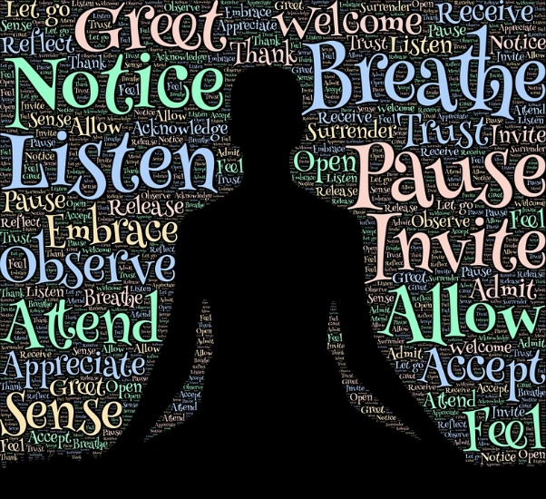
Lesson 5:
Healthy coping strategies

Slide 40
We are learning:
healthy ways to manage difficult feelings or challenging circumstances
We will be able to:
recognise circumstances leading to intense emotions that may be difficult to manage
explain a range of positive strategies for managing difficult emotions
assess whom, how and why to ask for support when it’s needed
Notes:
Teacher Notes - Learning objectives and outcomes
Share the learning objectives and intended outcomes for the lesson. Explain that today’s lesson is about developing healthy coping strategies for managing intense feelings. Remind students of the learning from the lesson on unhealthy coping strategies, explaining that these strategies can be used as healthier alternatives, recognising this selection is not always a rational decision-making process.

Slide 41
Managing intense feelings
Add words people can use to express different degrees of feeling.
Suggest strategies to manage these kinds of feelings.
Most intense
panicked
What strategies could be used to manage the more intense emotions?
Is it problematic to be feeling these kinds of intense emotions now and again?
When do they become problematic?
WORRY
Breathing techniques
Stepping away from trigger to go for a walk
Least intense
Notes:
Baseline assessment (10 MIN)
In pairs, hand each pair two (or one if time is short) of the four cards from Resource 1: Intense feelings. Ask students to add different words to express the degree of these feelings along the scale, from least to most intense. e.g. for ‘anger’ students might add irritated, annoyed, incensed, furious, livid as they progress up the scale. They should also suggest any strategies they think might help manage the more intense feelings effectively.
Take some brief feedback and ask the pairs to put these aside to return to at the end of the lesson.
To develop discussion further, ask if feeling intense emotions every now and again is a problem. Explore when it does become a problem. Draw out that feeling furious, for example, every now and again for a good reason, is not necessarily a problem. If they have written words such as ‘suicidal’ discuss that some extreme feelings are more problematic. If someone is experiencing an overwhelming number of negative feelings, does not have healthy ways of coping, is at risk of using unhealthy coping strategies, or is experiencing these feelings for no apparent reason, then this indicates they need further support.

Slide 42
A day in the life: Logan
…and Celia
As you read through Logan’s day, note down or highlight everything that happens, or that Logan does, that could have either a positive or negative effect on his emotional wellbeing.
Use your traffic light cards to show if what is happening to Celia:
promotes her emotional wellbeing
is not so good for her emotional wellbeing
is really worrying
Notes:
Teacher Notes (10 MIN) A day in the life
In small groups, students read Resource 2a: A day in the life of Logan and highlight everything that could have either a positive or negative effect on his emotional wellbeing. Consider the following when taking feedback:
Logan’s phone use
His diet and eating habits
His sleep pattern
Logan’s interest in football
His friendship with Matt
Logan’s homework habits
Give each student a set of traffic light cards and read out another ‘day in the life …’ diary entry about Celia, who goes to the same school as Logan and is in the same year group. If something occurs that promotes her emotional wellbeing, students should hold up their green card; if something happens or Celia does something that is not so good for her emotional wellbeing, they should hold up an amber card; if they feel very worried about something happening to Celia, they should hold up a red card.

Slide 45
A day in the life - Celia
Celia is upset when she sees her reflection. Why might she feel this way?
What could she do to help manage these feelings?
How does Celia’s parents’ arguing make her feel? Do they know this?
How will Celia’s focus on her studies affect her wellbeing?
Why has Celia not eaten?
What might others think/say if they noticed?
Why does Celia fake a smile before taking a selfie?
If Celia’s friends comment on her weight loss, how might this make Celia feel?
How important is Celia’s relationship with Casey?
Celia cries herself to sleep – what could she do to help her to feel better at the end of the day?
Notes:
Use these questions to lead discussion. Discuss what the triggers were in the diary that caused students to display different cards, or to be concerned for Celia.

Slide 46
Help conversation starters
What could Celia’s friends do and where could they go for help?
How could each different person start a conversation about this?
Celia
Celia’s mum
A teacher
Someone else
Notes:
Teacher Notes (10 MIN) Help conversation starters
Explain that Celia’s friends are worried about her: she seems down, she’s wrapped up in her schoolwork and doesn’t really talk to them much or go out with them outside school any more. Ask the class what Celia’s friends should do and where they could go for help. Feedback’s likely to include:
-do nothing
-talk to a teacher
-talk to Celia’s parents
-talk to Celia
-do something else? – if so, what?
Explore the possible consequences of each option using a think, pair, share discussion.
Give each group a large sheet of paper and a different coloured pen. Allocate each group one of the following people and ask them to write their person’s name at the top – Celia, Celia’s Mum, a teacher, someone else they have identified. Ask the groups to brainstorm all the ways that Celia’s friends could open up a conversation, about their concerns for Celia, with the person on the flipchart (e.g with Celia herself, with Celia’s mum, with a teacher).
Once finished, ask each group to stick their sheet on the wall in different areas of the room. Students should go as a group to look at the other groups’ work and add their own ideas in their colour pen.

Slide 47
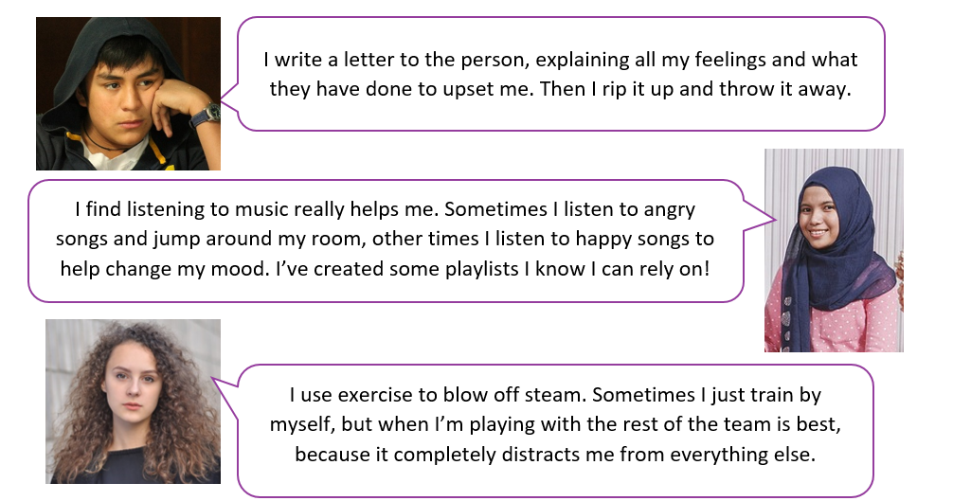
Healthy coping strategies
Which strategies would be most appropriate for Logan?
Which strategies would be most appropriate for Celia?
Rank your top 3 strategies for each character.
Notes:
Teacher Notes (10 MIN) Healthy coping strategies
As a class, read Resource 3: Talking heads which suggests a range of healthy coping strategies. Ask students to discuss these ideas and decide which strategies might be most appropriate for Logan to use to manage his wellbeing, and which might be most helpful for Celia. Students could be asked to select and rank their top 3 strategies for each character.
Take feedback, ensuring that a range of techniques are discussed. If not brought up in discussion, it should be emphasised that different techniques will appeal to different people, so trying a range of strategies can help people find the strategies that work best for them.

Slide 48
Managing intense feelings
Most intense
panicked
What strategies could be used to manage the more intense emotions?
Add additional ideas based on your learning today
Breathing techniques
Stepping away from trigger to go for a walk
WORRY
Least intense
Notes:
Endpoint assessment (5 MIN)
Ask students to revisit their baseline assessment using Resource 1: Intense feelings. They should add anything that they would change as a result of the learning, or add any new strategies they have learnt about to manage intense feelings.

Slide 49
More activities
Reflective journal
Keep a reflective journal for a week.
Note down any difficult feelings encountered and any strategies used to manage them.
This is a private reflection activity and will not be shared as a class.
Notes:
Teacher Notes
This activity can be used to extend the learning.
https://pixabay.com/photos/desk-smartphone-iphone-notebook-3076954/

Slide 50
Mood lifter
Teacher
slide
It may be helpful to lift the mood after this lesson using a technique of your choosing.
Notes:
It may be necessary to lift the mood after this learning - ensure the lesson ends on a positive note, using a strategy of your choice.
https://pixabay.com/illustrations/feedback-survey-questionnaire-3239454/

Slide 51
Further support
There are lots of places to get advice about emotional wellbeing, social media or to discuss feelings.
ChildLine:
www.childline.org.uk Phone: 0800 1111
Young Minds:
www.youngminds.org.uk
Samaritans:
www.samaritans.org Phone: 116 123
If you have questions or concerns about your experience of social media, you can always speak to your parent or carer, or a teacher in school for more advice and support.

