Slide 1

Lesson 1:
Attitudes to mental health

Slide 2



We are learning:
about attitudes to mental health and challenging misconceptions
We will be able to:
evaluate the links between mental health and physical health
identify common misconceptions about mental health
recognise and challenge prejudice and discriminatory language and behaviour, in relation to mental health
Notes:
Teacher Notes - Learning objectives and outcomes
Introduce the learning objectives and outcomes, explain that today’s lesson is about mental health and how to recognise and challenge myths and misconceptions.

Slide 3

Explain to an alien
Why might some people find it hard to talk about mental health concerns?
What is mental health?
How can people look after their mental health?
What support could be given to someone with mental health concerns?
Notes:
Teacher Notes (10 MIN) Explain to an alien
Ask students to imagine an alien has come to earth and wants to know about mental health. Using Resource 1: Explain to an alien, students should try to answer each of the alien’s questions, with as much detail as they can. As this is a baseline assessment for the scheme of work, they should work individually and without prompting from the teacher, in order to get an accurate representation of their current understanding. Ask students to put the sheets aside as they will be revisited at the end of the lesson.

Slide 4

Defining mental health
“A complete state of physical, mental and emotional wellbeing not merely the absence of disease.”
World Health Organisation’s definition of health
How can we define mental health?
What is the link between physical and mental health?
Notes:
Emphasise at this point that mental and physical health are closely linked, for example by promoting their physical health (through exercise, healthy food choice and quality sleep) a person is also promoting their mental health.

Slide 5



True or false quiz
Notes:
Teacher Notes (10 MIN) True or false quiz
In pairs, ask students to complete Resource 2a: True or false quiz. For a more active version of this activity, students could move to different sides of the room to represent ‘true’ or ‘false’ as each statement is read out.
Take feedback, ensuring that myths and misconceptions are challenged. Resource 2c includes additional teacher information to develop discussion. Students should annotate the ‘true’ information next to any statements marked ‘false’.
Support: Resource 2b is provided which is a simplified version of Resource 2. Questions posed are simplified versions of questions 2, 3, 5, 7, 8 & 9 from Resource 2.
Challenge: Encourage students to consider why they think these misconceptions might have occurred in the past. What could be done to prevent future misconceptions about mental health?

Slide 6

Exploring language
How might these statements make someone feel?
What could some more positive alternatives be?
Notes:
Teacher Notes (15 MIN) Exploring language
Explain to students that sometimes people find it difficult to talk about mental health, or might have little understanding of it and can therefore say things that might be unhelpful or offensive to others, often without meaning to.
Organise students into four groups and give each group a different sheet from Resource 3: Exploring language. Each group should spend 5 minutes adding ideas to the top and bottom half of the sheet, responding to the questions:
How might these statements make someone feel?
What could some more positive alternatives be?
After 5 minutes, have all students stick their sheet to the wall / desk, and ask the groups to move around the room look at each different group’s examples and ideas. They should add any additional ideas as they visit each sheet.
Take feedback, identifying key themes from each sheet:
Black = these statements demonstrate the flippant way people can use mental health language in everyday discussion. This is a subtle way in which mental health stigma is reinforced.
Blue = these statements are common of the types of responses people with a mental health issue sometimes get from friends or family. The statements diminish the issue and try to minimise the impact of experiencing a mental health issue.
Orange = these statements focus around unhelpful behaviours in relation to mental health, primarily excluding or deliberately trying to upset someone known to have mental health issues.
Green = these statements include unhelpful advice that people sometimes receive when discussing a mental health concern.
You can refer to Resource 4: Helpful language to provide examples of more positive alternatives.
Support: Students could be provided with Resource 4: Helpful language prompts or some appropriate responses could be modelled before starting the activity.
Challenge: Ask students to suggest reasons why this sort of language is used.

Slide 7

Challenging discrimination
What could be done by individuals/friends to challenge discrimination?
What could be done in schools to challenge discrimination?
What could be done in wider society to challenge discrimination?
Notes:
https://pixabay.com/photos/team-motivation-teamwork-together-386673/
Teacher Notes (10 MIN) Challenging discrimination
Ask students to work in pairs to suggest ideas about how mental health stigma and discrimination could be challenged using the questions on the slide. If time allows, share ideas as a class, either using post-it notes stuck at the front of the room, a class mind map, or students with the longest list read out their ideas.
Students might suggest ideas such as:
Individuals: avoid using language that might be offensive or upsetting, challenge this language when it is used, encourage people to be understanding and supportive around mental health, avoid trivialising or making fun of mental health issues;
Schools: teach more about mental health, promote school counsellors and other sources of support to normalise help-seeking behaviours, have ‘positive mental health’ events, make all people feel included, use displays to promote mental health;
Society: Mental health campaigns, more funding for mental health charities or services, stronger laws about discrimination of people with mental health, mental health support services in workplaces to both support and destigmatise those with mental health concerns, encourage open-ness around mental health issues, etc.

Slide 8
Revisit your alien
Why might some people find it hard to talk about mental health concerns?
What is mental health?
How can people look after their mental health?
What support could be given to someone with mental health concerns?
Notes:
Teacher Notes (5 MIN) Endpoint assessment
Revisit the baseline activity, using Resource 1: explain to an alien. Ask students to make any additions or edits to their original responses with a different coloured pen to demonstrate what they have learnt. This can be kept as assessment evidence and used to inform future teaching.

Slide 9

Further support
There are lots of places to get advice about emotional wellbeing, social media or to discuss feelings.
ChildLine:
www.childline.org.uk Phone: 0800 1111
Young Minds:
www.youngminds.org.uk
Samaritans:
www.samaritans.org Phone: 116 123
If you have questions or concerns about your experience of social media, you can always speak to your parent or carer, or a teacher in school for more advice and support.

Slide 10
Inclusion
TARGETS:
I will know what “inclusion” means.
I will think about times when I have felt included and excluded.
I will know some of the reasons why we might exclude people, even if we don’t mean to.

Slide 11
INCLUSION
Action the or of state including of or included being a group within structure or

Slide 12
INCLUSION
The action or state of including or of being included within a structure or group.

Slide 13
What is inclusion meant to do? Why?

Slide 14
Individual Work
Think about a time when you really felt a part of something – really included.
Think of five words to describe how you felt at the time. Write them down.

Slide 15
Individual Work
Then think about a time when you felt left out or excluded.
Think of five words to describe how you felt then. Write them down.

Slide 16
Think
Think back to the task at the start of the lesson, was it inclusive?

Slide 17
Plenary
Choose either the word inclusion or exclusion and create an acrostic poem.
Extension: have a go at the other

Slide 18
Disability
I will know what disability means.
I will know what a stereotype is.
I will think about different attitudes about disability.

Slide 19
Disability is when people are in a wheelchair
Disability is when people dis others for having no ability
Disability is an illness, injury, or condition that makes it difficult for someone to do the things that other people do

Slide 20
Starter task
Which definition do you think is correct?
Write this down in your book and explain.
Who is correct

Slide 21
Stereotyping
Look at the images and write down one word to describe them.

Slide 22

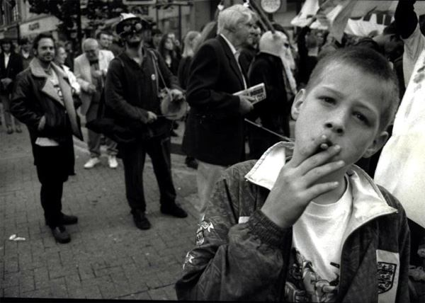
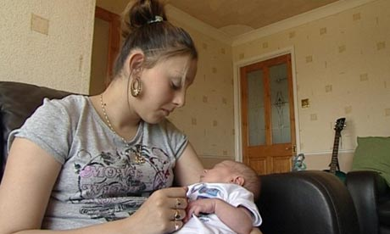


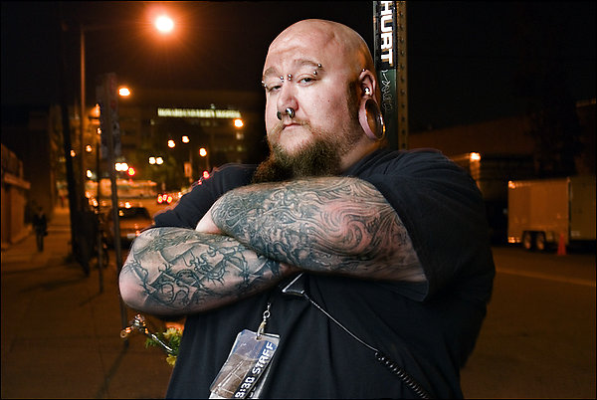

Slide 23
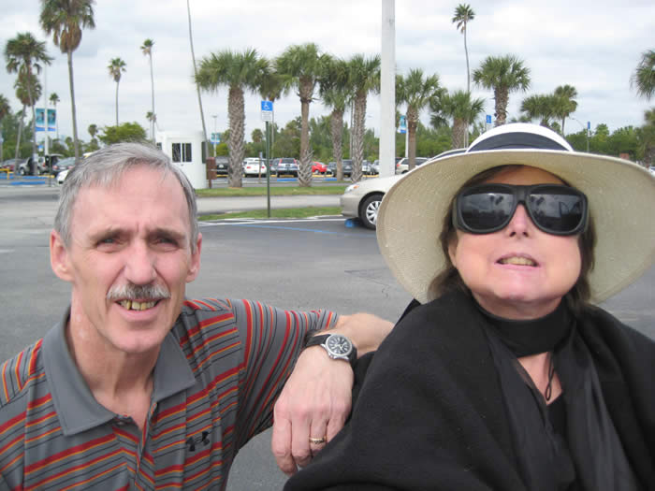
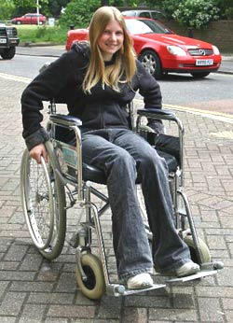
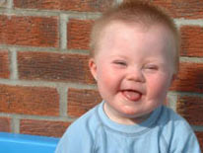
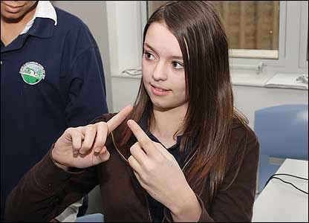


Slide 24
What are the dangers of stereotyping?
Answer the question above in your books in full sentences
Sentence Starter:
The dangers of stereotyping are...
You must use:
Because I think

Slide 25
What are the dangers of stereotyping?
In groups, come up with ideas about the question above.

Slide 26
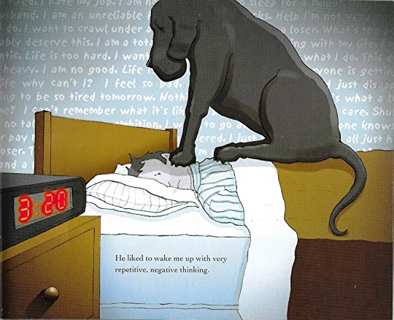

Slide 27
The Black Dog
I will know what is meant by the term depression
I will discuss the ways depression can affect different people
I will know where to go for help if I am worried about depression

Slide 28


Slide 29
Feeling Low
Feeling grumpy or irritable all the time
Have thoughts about suicide or self-harming
Big changes in weight
Feeling sadness that lasts a long time
Tiredness or exhaustion
Have trouble concentrating
Eat less than usual or over eat
Feeling empty or numb
Talking about feeling guilty and worthless
Have trouble sleeping
Seem unable to relax or be more lethargic than usual
Actually self-harming
Interact less with family and friends
Not have much confidence
Being indecisive

Slide 30
Complete the quiz

Slide 31
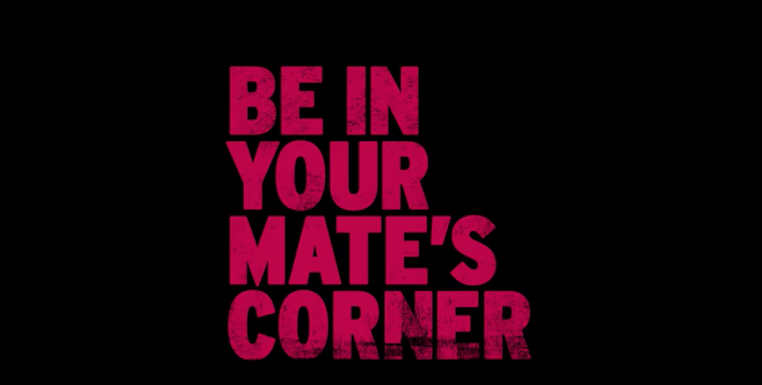
Time to Talk
In 2017 Time to Talk have launched a 5 year campaign aimed at talking about mental health in young people.
They have called it ‘BE IN YOUR MATE’S CORNER’.

Slide 32
Where to go for help
Speak to a friend
Speak to a family member (It doesn’t have to be your parents at first)
Speak to your tutor/ teacher/ Head of Year
Young minds website https://youngminds.org.uk/
Gloucestershire Health little red book- around school
Call ChildLine
Speak to the School Nurse
Speak to your doctor

Slide 33
Your Campaign
In your groups you must create your own campaign about mental health.
This is a very serious topic and the best work from each group will be given to Mrs Christopher to be displayed around school.
Your campaign must include:
A Poster (on A3 paper)
A leaflet
A short campaign advert (with a script)

