Slide 1
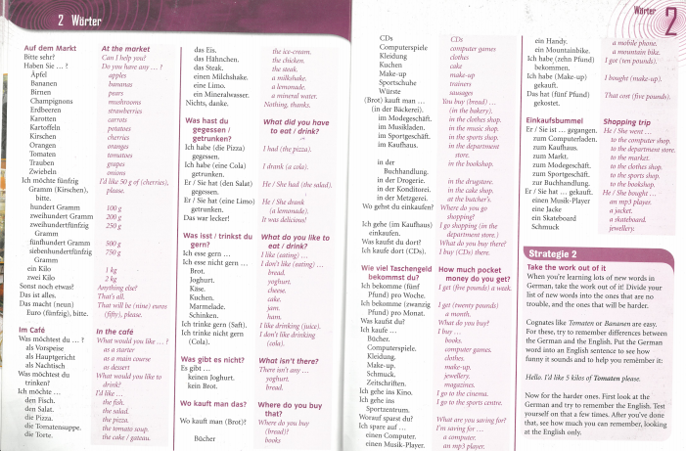
German yr8. This week is assessment week so spend time revising the vocabulary we have learned this term. You have a vocab sheet stuck in your books and it looks like the picture below. You can make flashcards or a spider diagram to help you revise
Contact your MFL teacher for the assessment papers if you know you will be away for the lesson when the tests are taking place.

Slide 2
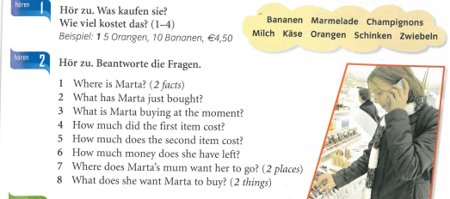
Revision tasks –
Task 1 - what is she buying and how much does it cost?
Task 2 - Answer the questions

