Slide 1
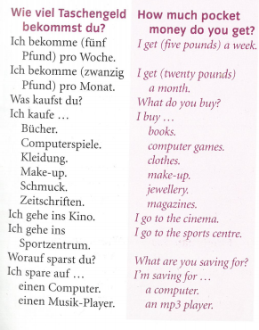
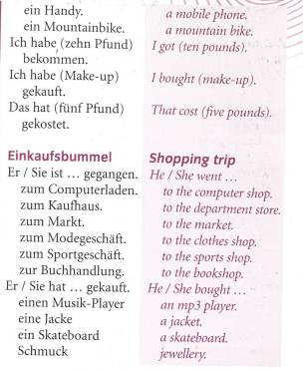
German yr8. Work through as many of the activities as you can.
Task 1 -Read through this week’s vocab. Try and learn it

Slide 2
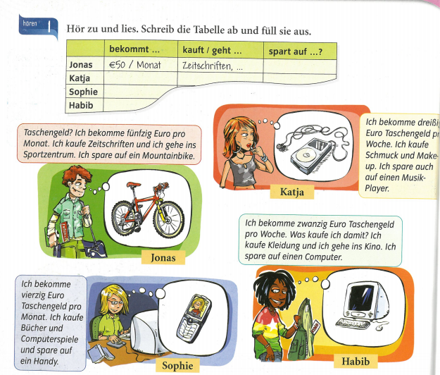
Task 2. Draw the table. Read the information and listen to it by playing the track. Fill in the table. How much do they get and how often? What do they buy or where do they go/ What are they saving for?

Slide 3
TASK 3 – Listen to a different conversation now. Draw the table and fill it in. How much do they get and how often? What do they buy or where do they go/ What are they saving for? the conversation and read along. Then say if the 6 statements are richtig (true) or falsch (false)

Slide 4
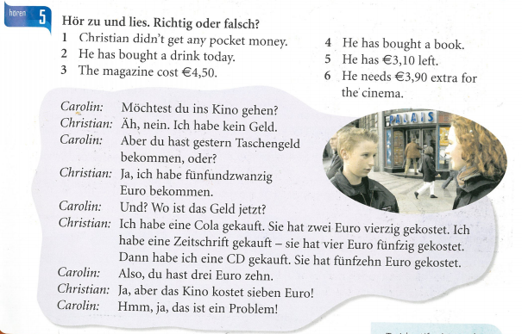
TASK 4 – Listen to the conversation and read along. Then say if the 6 statements are richtig (true) or falsch (false)

Slide 5
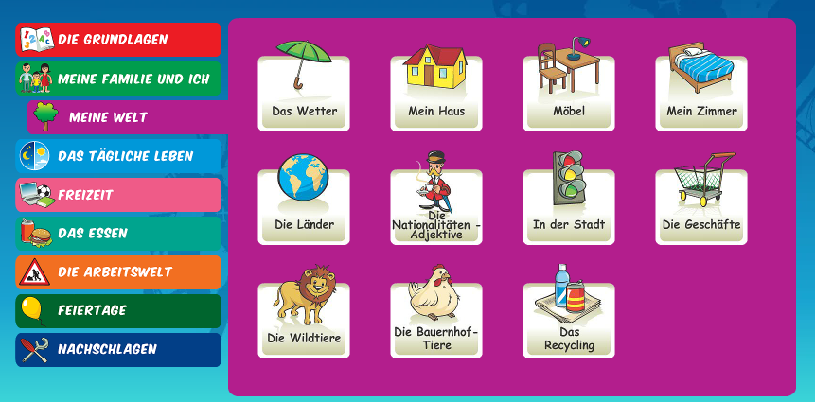
Log in to Linguascope. Username is Kingshill Password is bonjour123
Look at the ‘die Geschäfte’ (shops) section. Make a list of any new vocab. Play some games to help you learn the words

