Slide 1
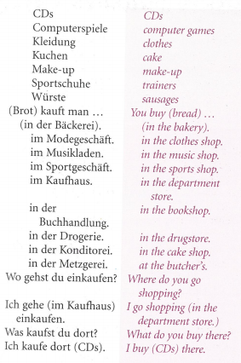
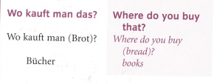
German yr8. Work through as many of the activities as you can.
Task 1 -Read through this week’s vocab. Try and learn it

Slide 2
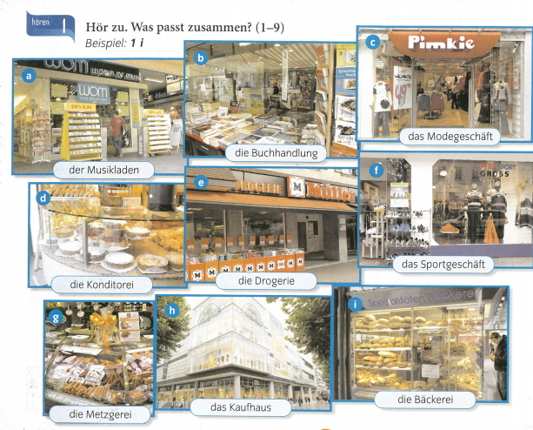
Task 2. Listen to the track. Which shop is mentioned? Example, 1i

Slide 3
TASK 3 – Listen to the track. Which shop is mentioned and what item is mentioned?

Slide 4
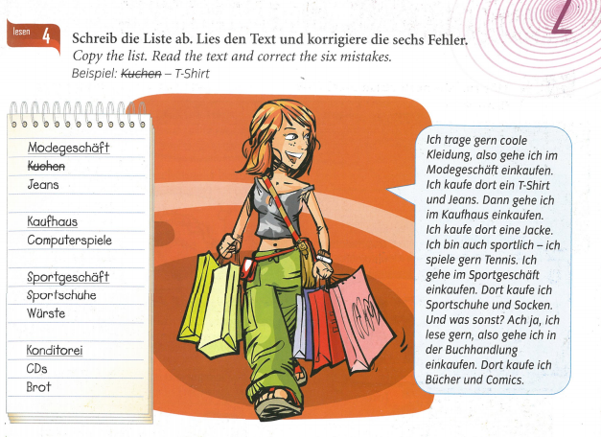
TASK 4- Copy the shopping list. Then read the text. Correct the 6 mistakes on the list.

Slide 5
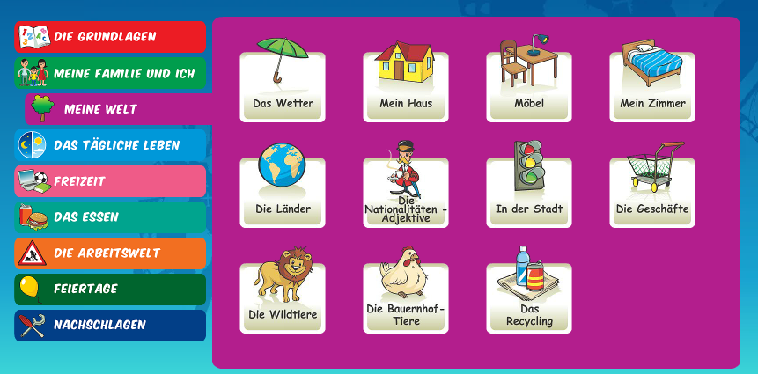
Log in to Linguascope. Username is Kingshill Password is bonjour123
Look at the ‘die Geschäfte’ (shops) section. Make a list of any new vocab. Play some games to help you learn the words

