Slide 1
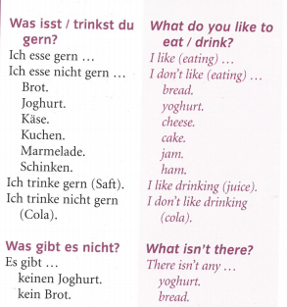
German yr8. Work through as many of the activities as you can.
Task 1 -Read through this week’s vocab. Try and learn it
Task 2 – Make a poster of the key words

Slide 2
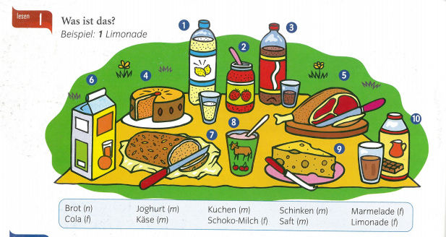
Task 3. Match the pictures with the words below

Slide 3
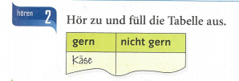
Task 4. Listen to the track and copy the table. What do they like to eat and not like to eat?

Slide 4
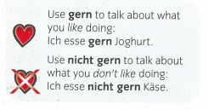
TASK 5 – Write a few sentences in German about what you like to eat and what you don’t like to eat

Slide 5
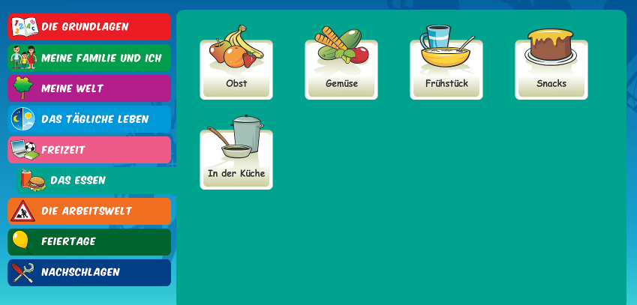
Log in to Linguascope. Username is Kingshill Password is bonjour123
Look at the Frühstück (breakfast) and Snacks sections. Make a list of any new vocab. Play some games to help you learn the words

