Slide 1
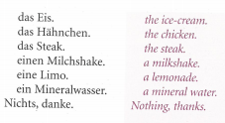
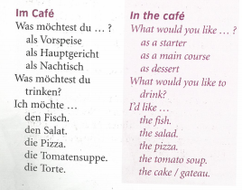
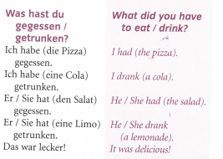
German yr8. Work through as many of the activities as you can.
Task 1 -Read through this week’s vocab. Try and learn it

Slide 2
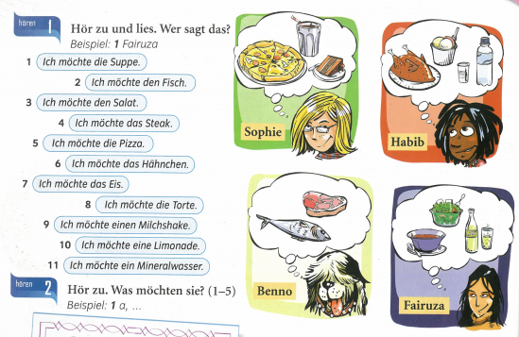
Task 2. Listen to what they order and look at the pictures. For each statement say which person said it. .

Slide 3
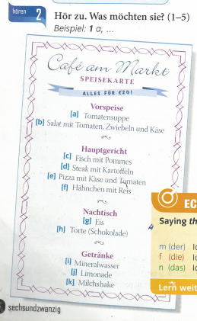
TASK 3 – Listen to the people talk. What do they order? Example 1 a,…

Slide 4
TASK 4. Read the text and write down what they had to eat

Slide 5
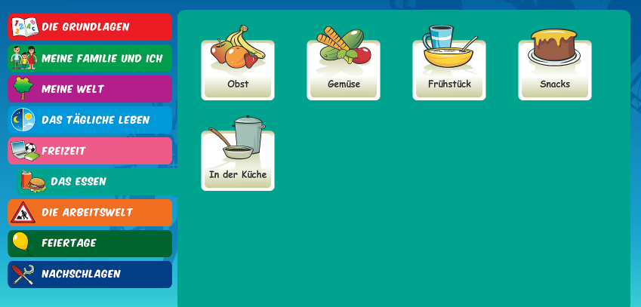
Log in to Linguascope. Username is Kingshill Password is bonjour123
Practise the fruit and veg in the beginner section. Make a note of any new words
You can also look at any of the other topics in this section.

