Slide 1
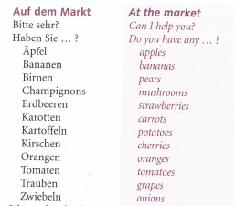
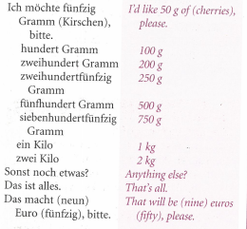
German yr8. Work through as many of the activities as you can.
Task 1 -Read through this week’s vocab. Try and learn it

Slide 2
Task 2. Make a poster of the fruit and veg vocab in your book

Slide 3
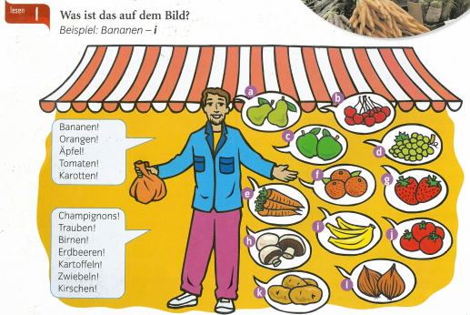
TASK 3 –
Label the items a-l in German

Slide 4
TASK 4 – Listen to the track. What do they buy and how much do they cost?

Slide 5
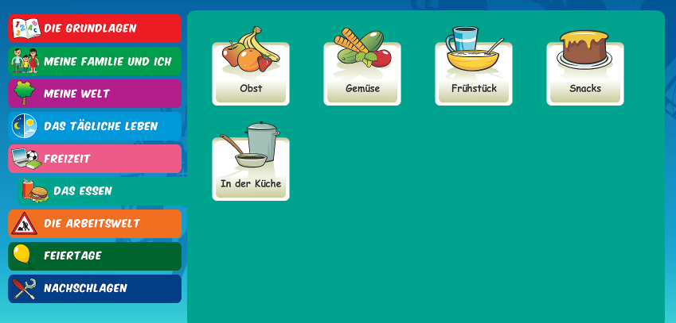
Log in to Linguascope. Username is Kingshill Password is bonjour123
Practise the fruit and veg in the beginner section. Make a note of any new words

