Slide 1
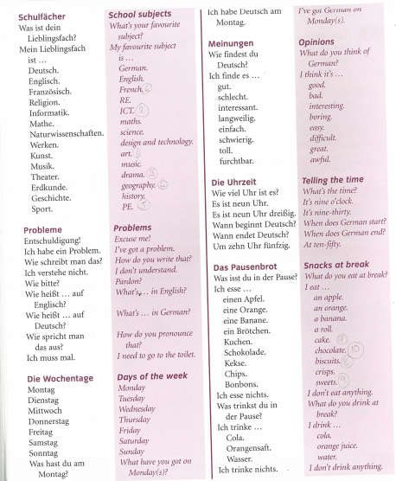
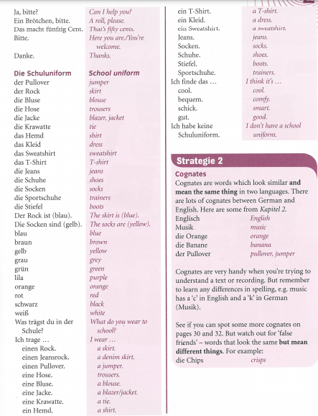
German yr7. This week is assessment week so spend time revising the vocabulary we have learned this term.
The vocabulary should be stuck in your orange book. Please go through it. It looks like the picture below.
Contact your MFL teacher for the assessment papers if you know you will be away for the lesson when the tests are taking place.

