Slide 1
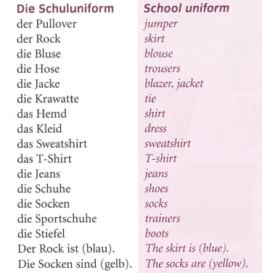
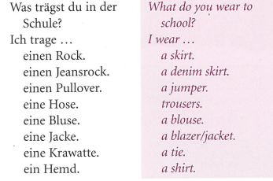
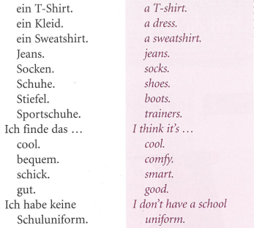
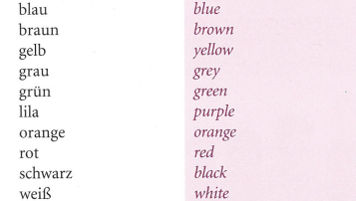
German yr7. Work through as many of the activities as you can.
Task 1 –Read through the vocab for this week. Try and learn it.

Slide 2
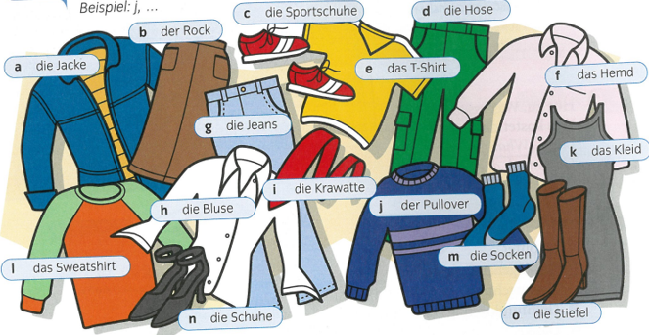
Task 2. Make a poster in your book of the clothes items below:

Slide 3
Task 2. Make a poster in your book of the colours vocabulary

Slide 4
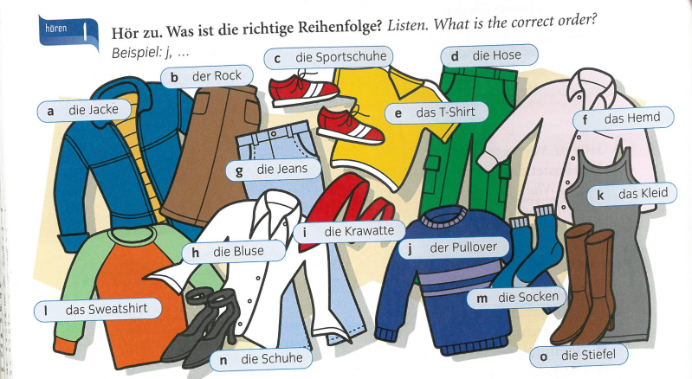
Task 3. Listen to the track. What order are the clothes mentioned? Example, j..

Slide 5
TASK 4 – Look at the pictures again and then read the statements below. Are they true or false?

Slide 6
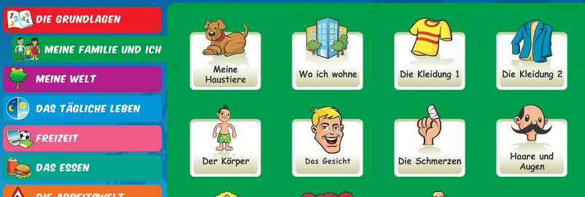
Log in to Linguascope. Username is Kingshill Password is bonjour123
Practise the vocab for colours and clothes in the beginner section. Write down any new words

