Slide 1
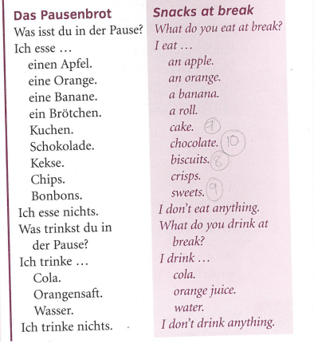
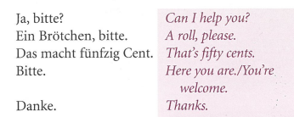
German yr7. Work through as many of the activities as you can.
Task 1 -Read through this week’s vocab. Try and learn it

Slide 2
Task 2. Write down 1-12. Listen to the track. Which food and drink item do you hear? Example 1l

Slide 3
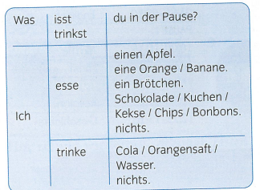
TASK 3 – Listen to the track. What do they eat and drink at break?

Slide 4
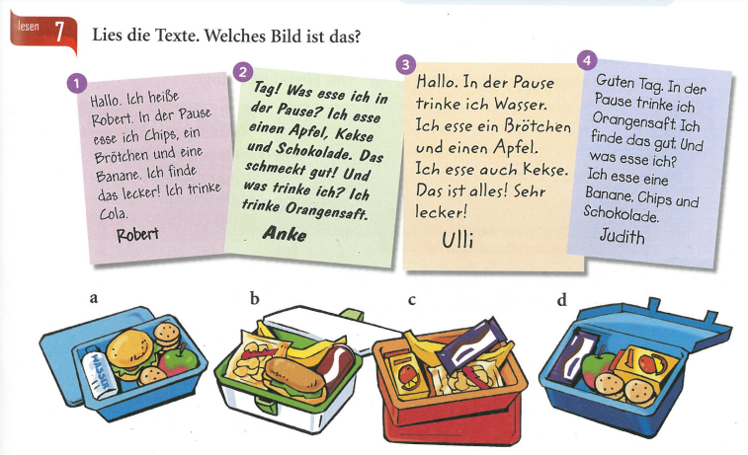
TASK 4. Match up the descriptions of what they eat and drink with the lunchboxes

Slide 5
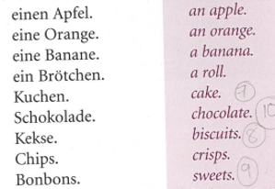
TASK 5 – Make a poster in your books of the food and drink items below

Slide 6
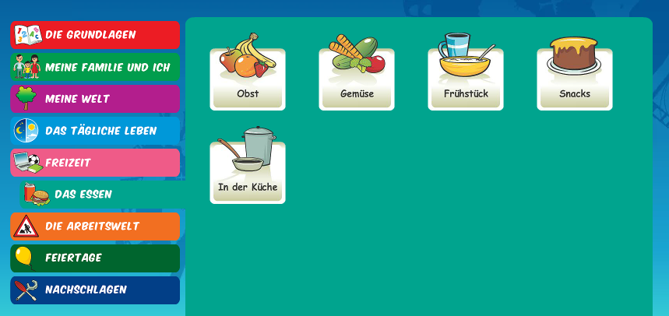
Log in to Linguascope. Username is Kingshill Password is bonjour123
Practise the vocab for snacks in the beginner section. Write down any new words

