Slide 1
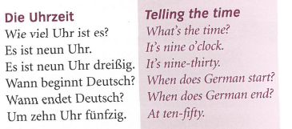
German yr7. Work through as many of the activities as you can.
Task 1 -Read through this week’s vocab. Try and learn it. Also remind yourself of the German numbers which are on the next slide

Slide 2
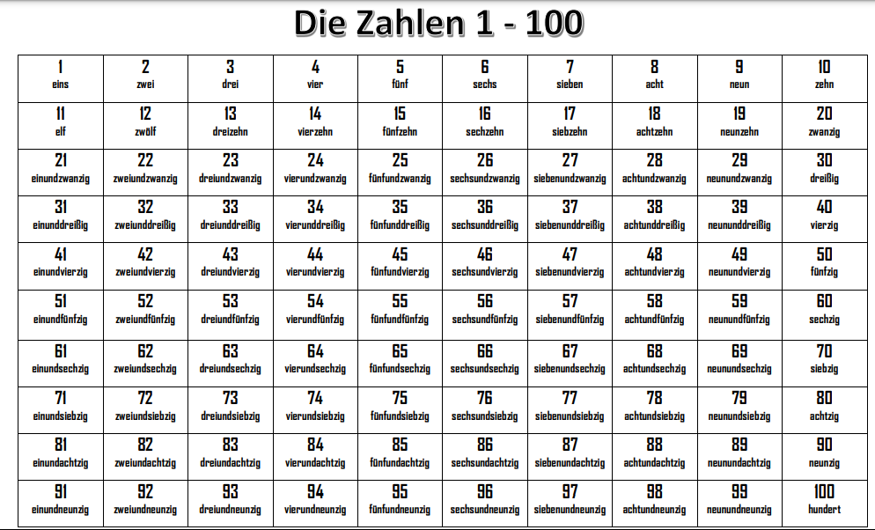

Slide 3
Task 2. Match up the clock faces with the times. Example 1e

Slide 4
Task 3. Listen to the track. Write down 1-10. what time is it?

Slide 5
Task 4. Write down what time it is

Slide 6
TASK 5 – Read Julia’s timetable and answer the questions about what time her lessons begin and end

Slide 7
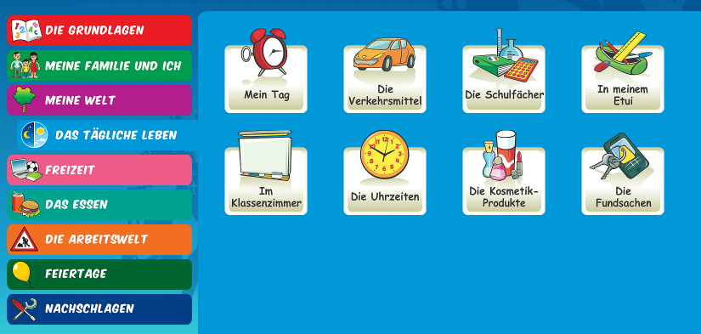
Log in to Linguascope. Username is Kingshill Password is bonjour123
Practise the vocab for the school subjects in the beginner section.

