Slide 1
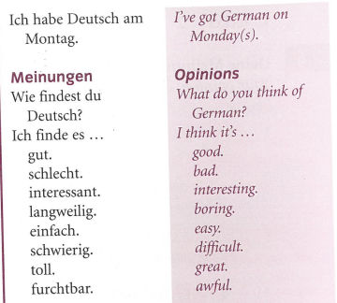
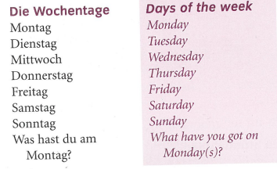
German yr7. Work through as many of the activities as you can.
Task 1 -Read through this week’s vocab. Try and learn it

Slide 2
Task 2. Write down 1-7 in the back of your book. Listen to the track. Which day do they say? Example 1e

Slide 3
TASK 3 – Write down 1-5. Look at the pictures and listen to the track. Which day is it?

Slide 4
TASK 4. Write down 1-8 in the back of your book. Listen to the track. What does Julia think of her subjects? Example, 1a

Slide 5
TASK 5 – Look at the information below. Write some sentences in German giving your opinions about school subjects. Refer back to the first slide if you need to check the vocab.

Slide 6
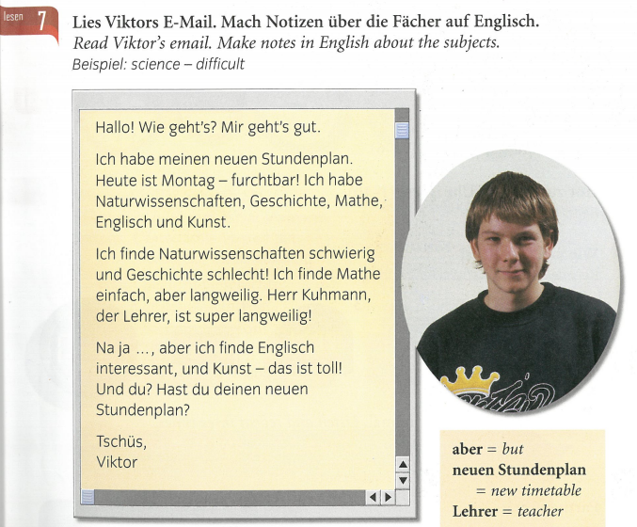

Slide 7
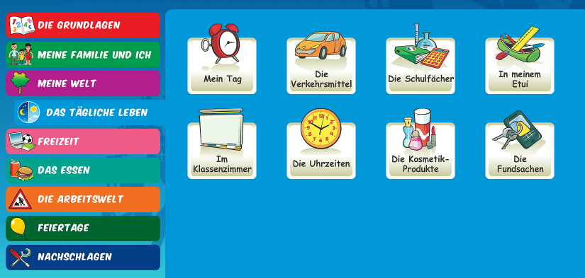
Log in to Linguascope. Username is Kingshill Password is bonjour123
Practise the vocab for the school subjects in the beginner section.

