Slide 1
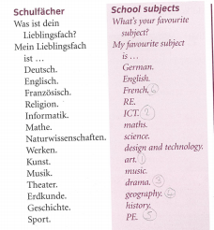
German yr7. Work through as many of the activities as you can.
Task 1 -Read through this week’s vocab. Try and learn the school subjects

Slide 2
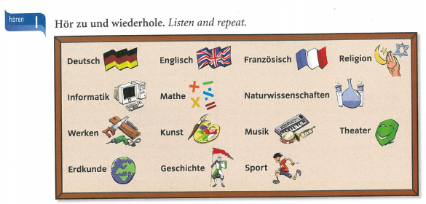
Task 2. Listen to the subjects. Repeat them.
Task 3. Write down 1-12 in the back of your book. Which subject do you hear?

Slide 3
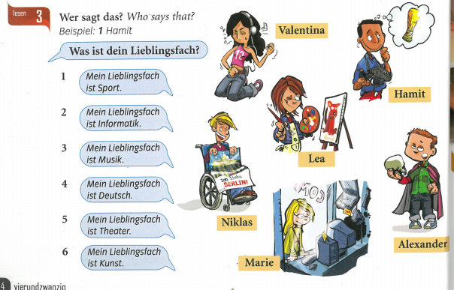
TASK 4 –
Match up the people with what they say

Slide 4
TASK 5. Write sentences saying what your favourite subjects are using the pictures below.

Slide 5
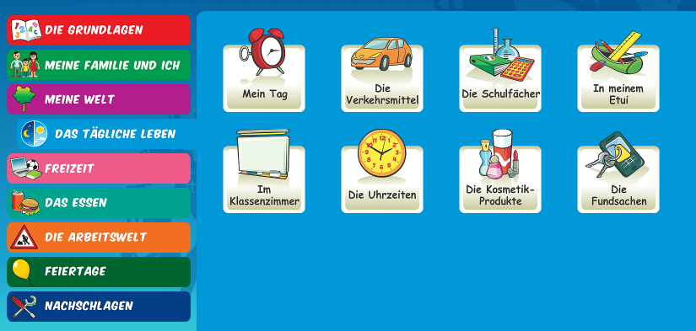
Log in to Linguascope. Username is Kingshill Password is bonjour123
Practise the vocab for the school subjects in the beginner section.

