Slide 1
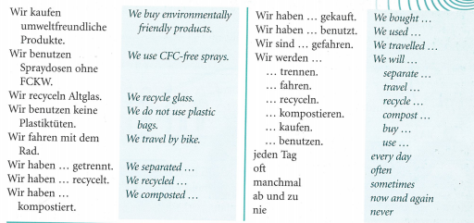
Year 9 German term 6 week 3
Spend some time learning the vocab for this week.

Slide 2
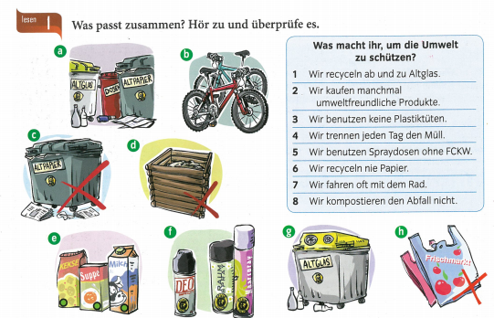
Match up the 8 sentences with the pictures.

Slide 3
Listen to the track. What do they do to protect the environment? Example 1 d, b

Slide 4
Write 5 environmentally friendly sentences and 5 environmentally unfriendly sentences

